Slide 1
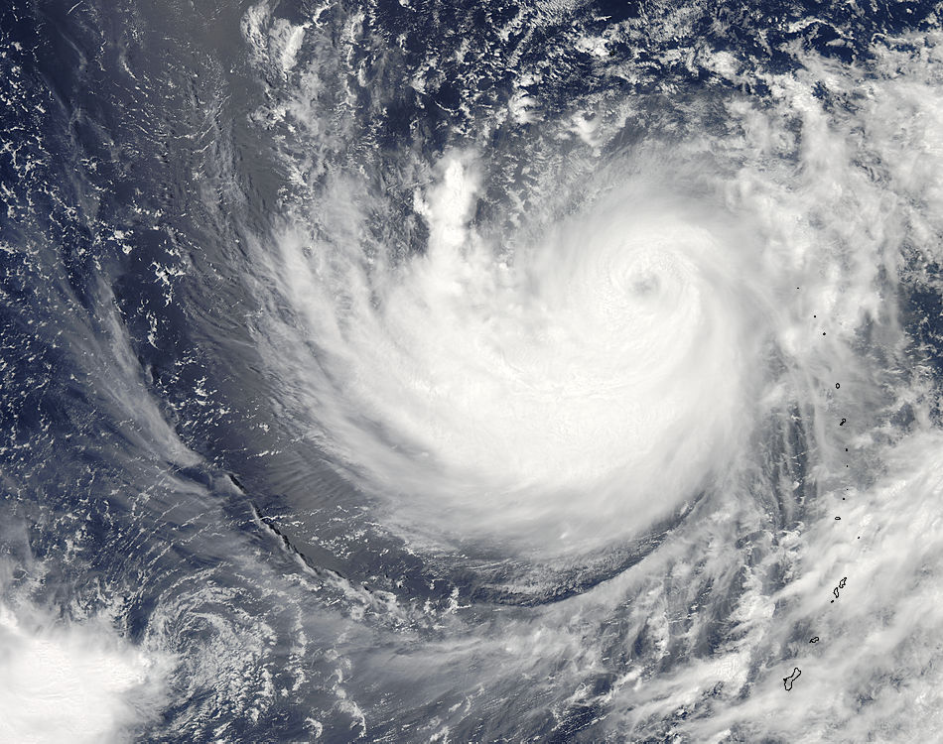
Antonio Garcia-Mendez
Meteorological Operations Section
a.garcia@ecmwf.int

Slide 2
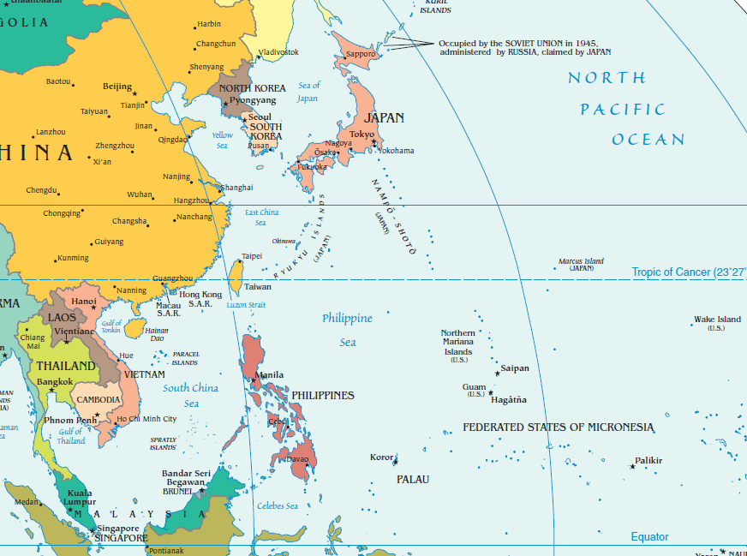

Slide 3
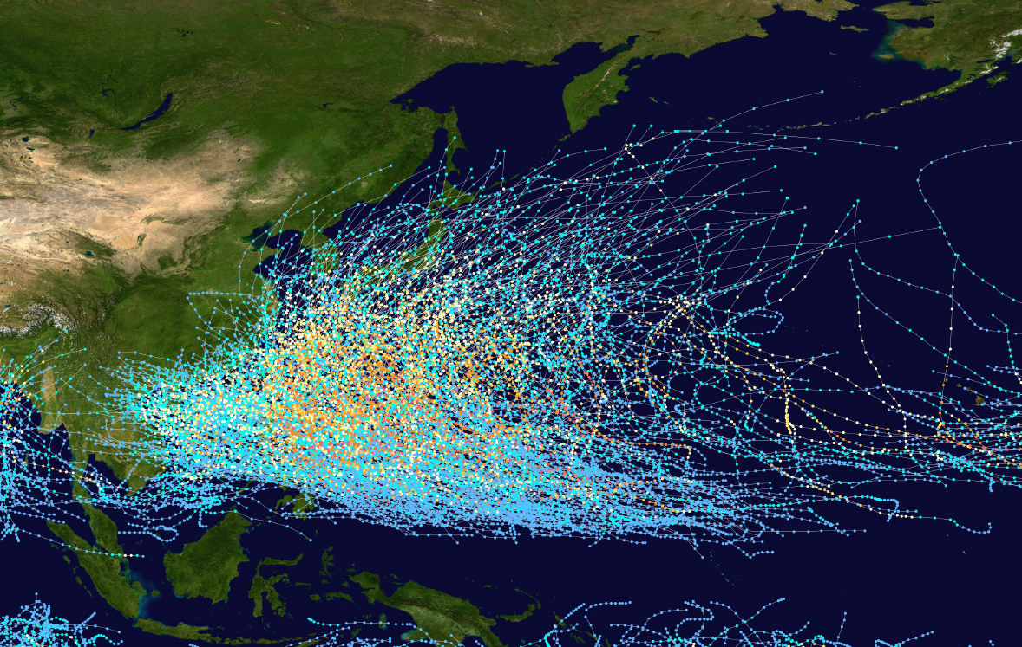
Typhoon tracks 1985-2005

Slide 4
Forecast in the Northwestern tropical Pacific
Seasonal forecast
Monthly forecast
EPS
  EPSgrams
  EFI
  Probabilities
Deterministic forecast

Slide 5
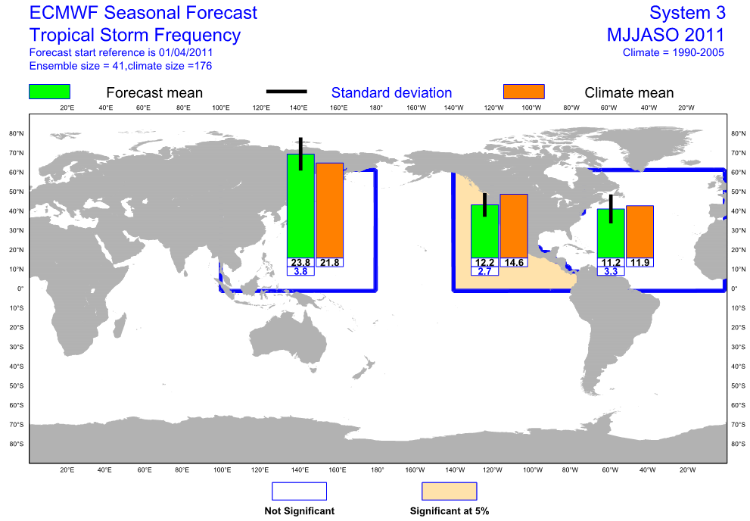

Slide 6
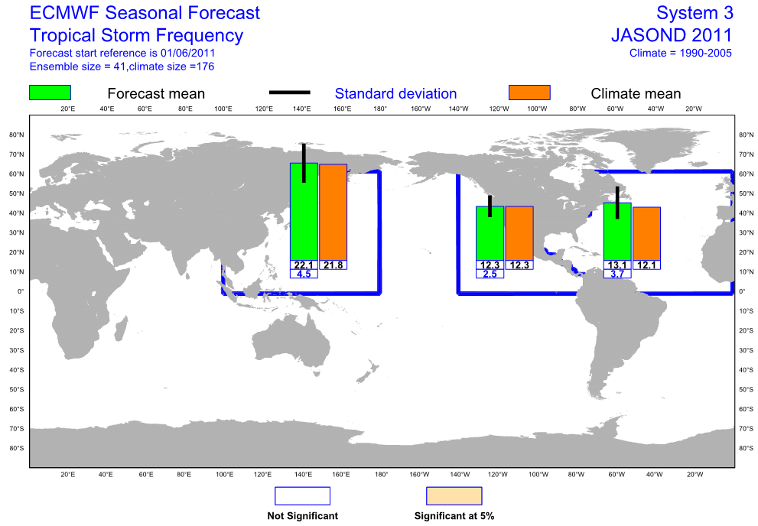

Slide 7
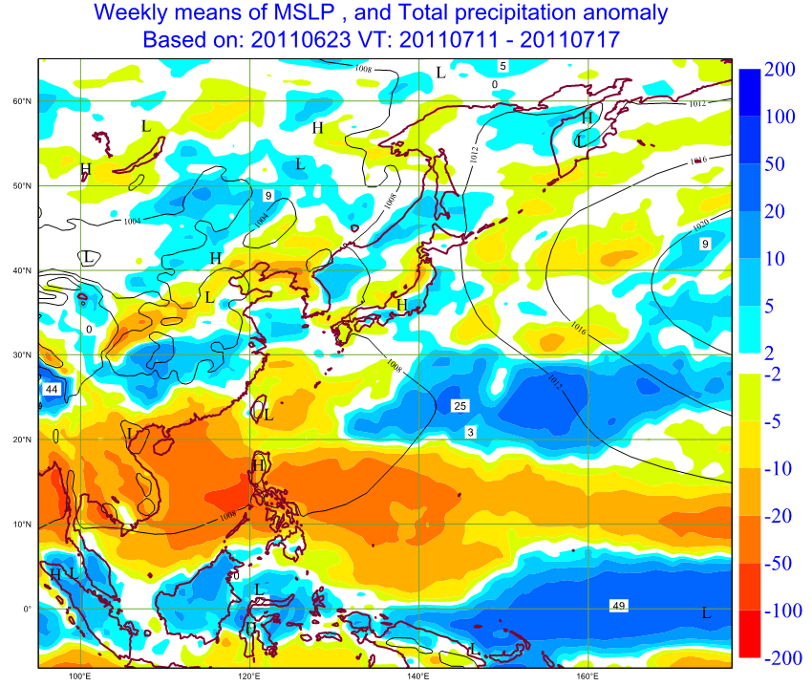

Slide 8
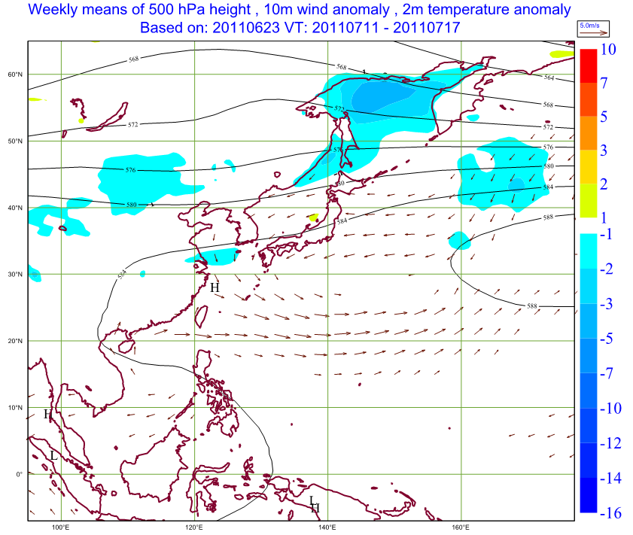

Slide 9
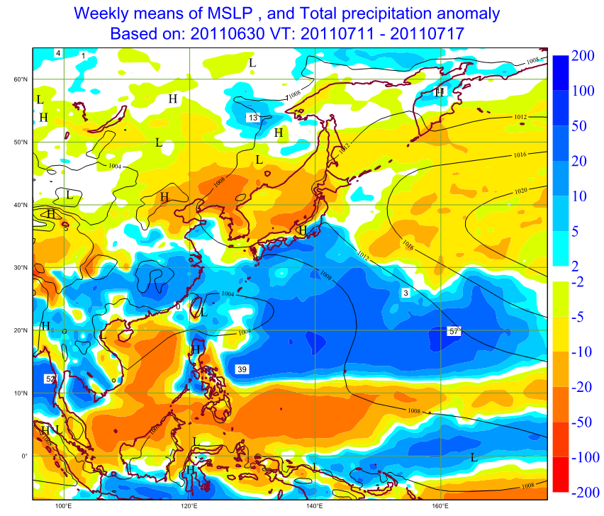

Slide 10
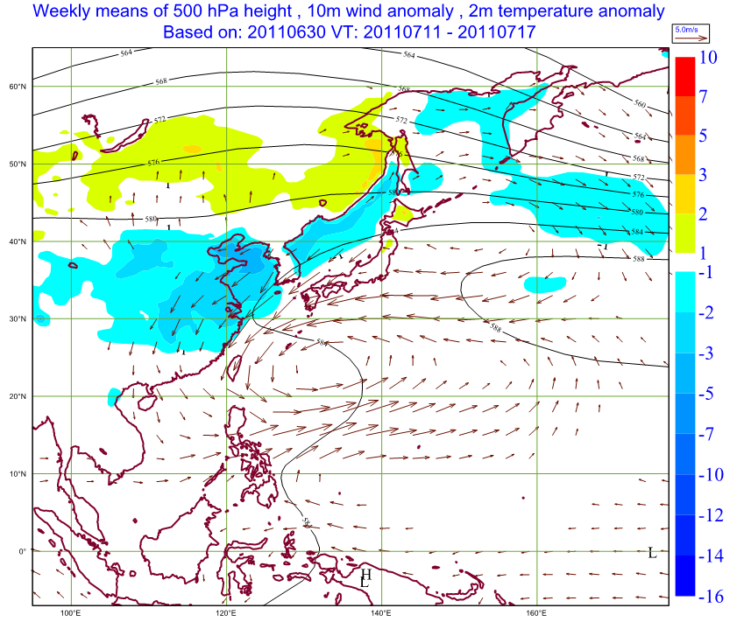

Slide 11
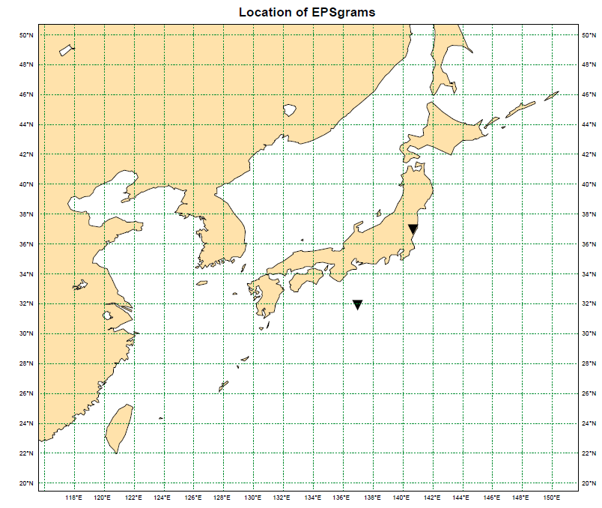
17 to 20 July 2011
9 to 17 July 2011

Slide 12
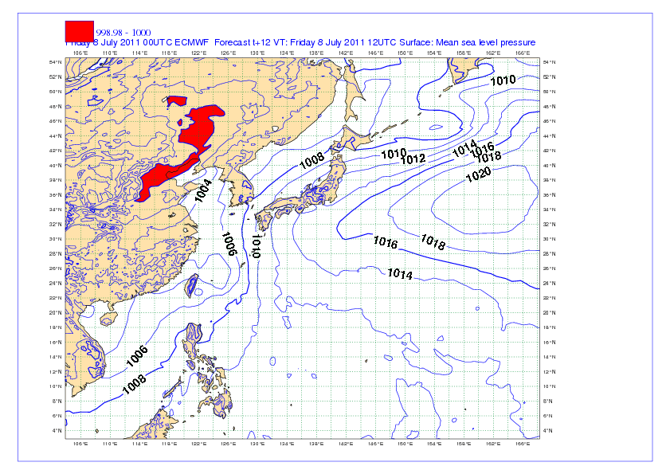
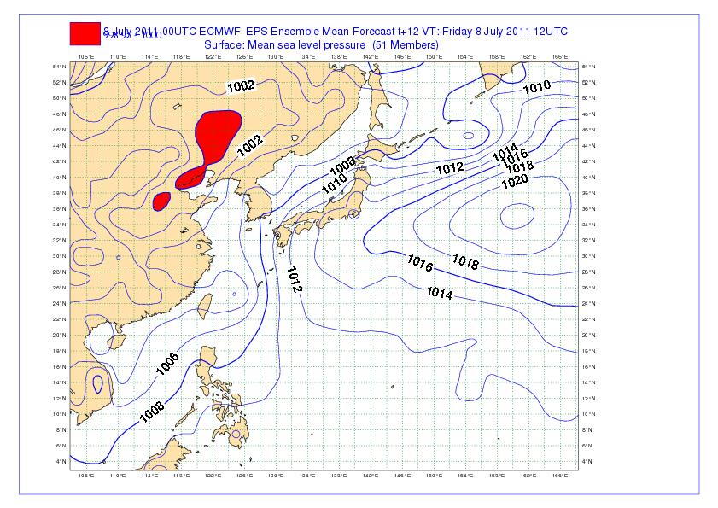
T1279
8/July/2011
00 UTC
EPS mean

Slide 13
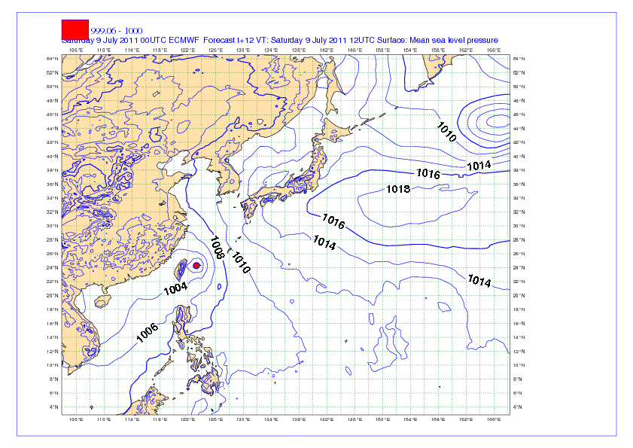
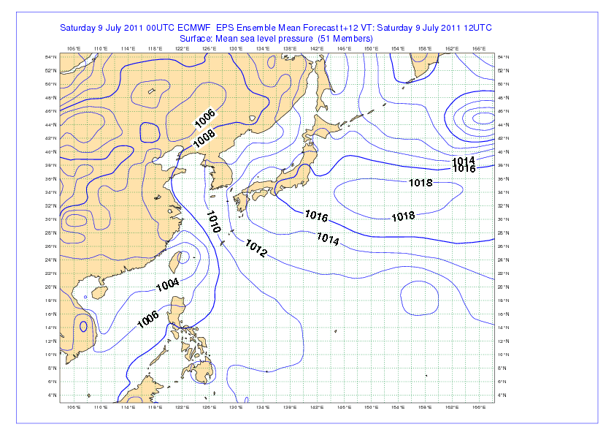
9/July/2011
00 UTC
T1279
EPS mean

Slide 14
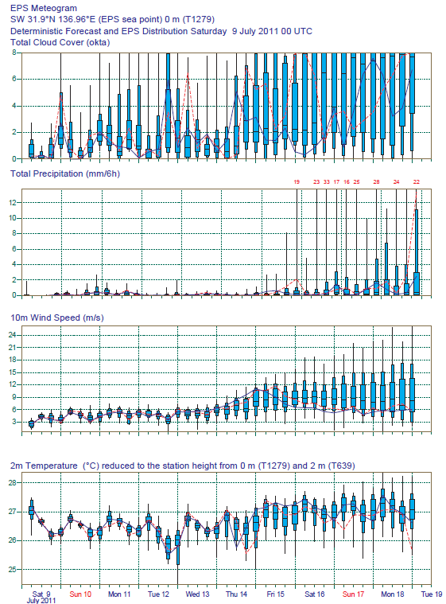
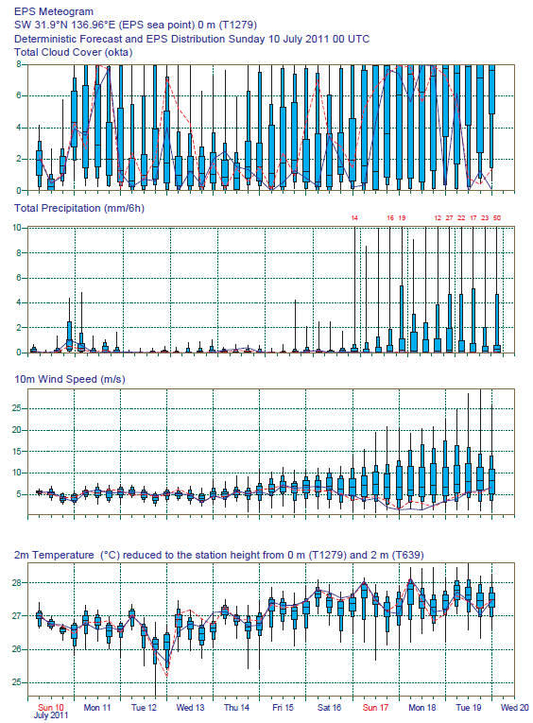

Slide 15
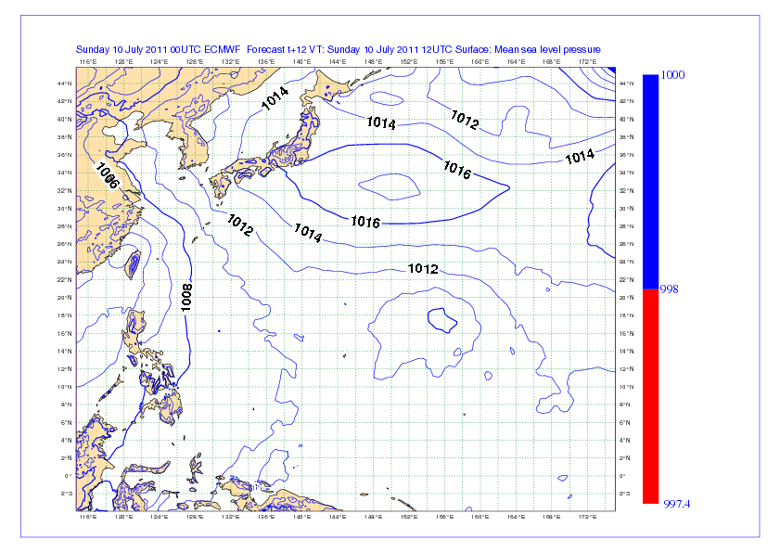
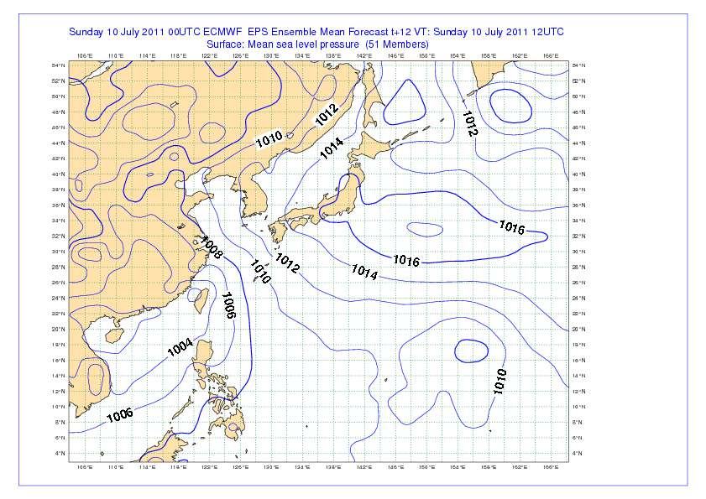
10/July/2011
00 UTC
T1279
EPS mean

Slide 16
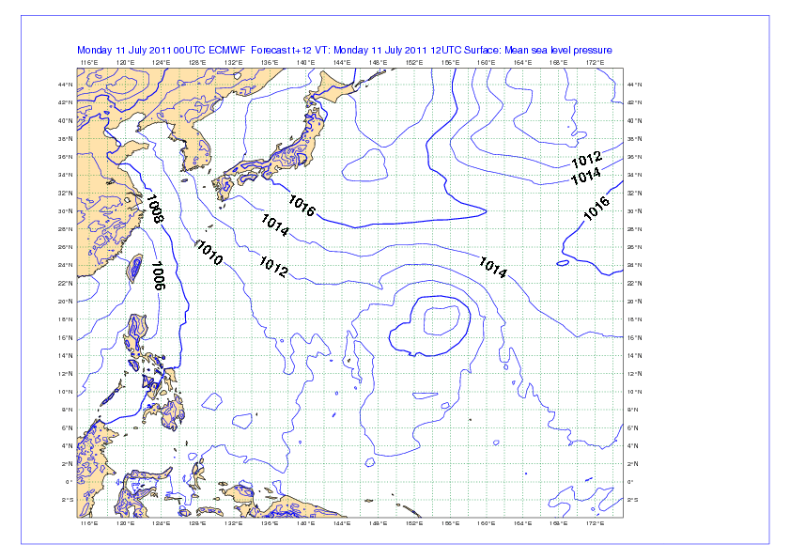
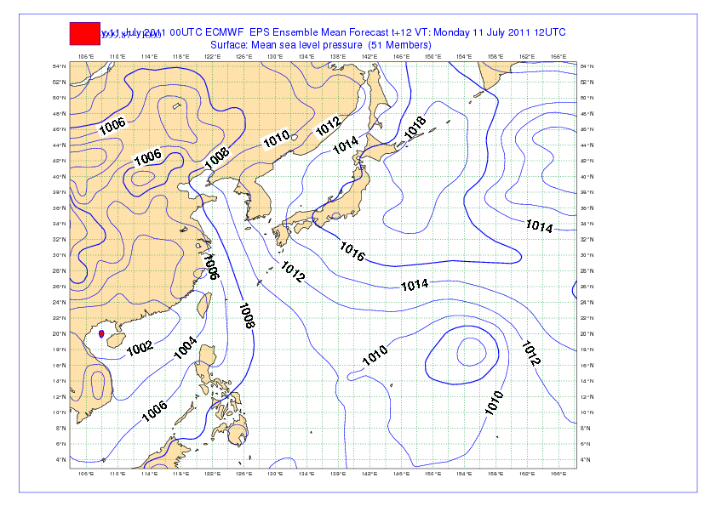
11/July/2011
00 UTC
T1279
EPS mean

Slide 17
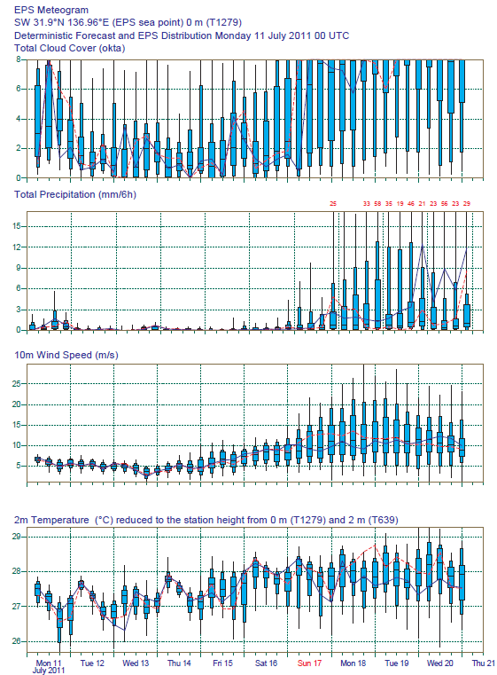
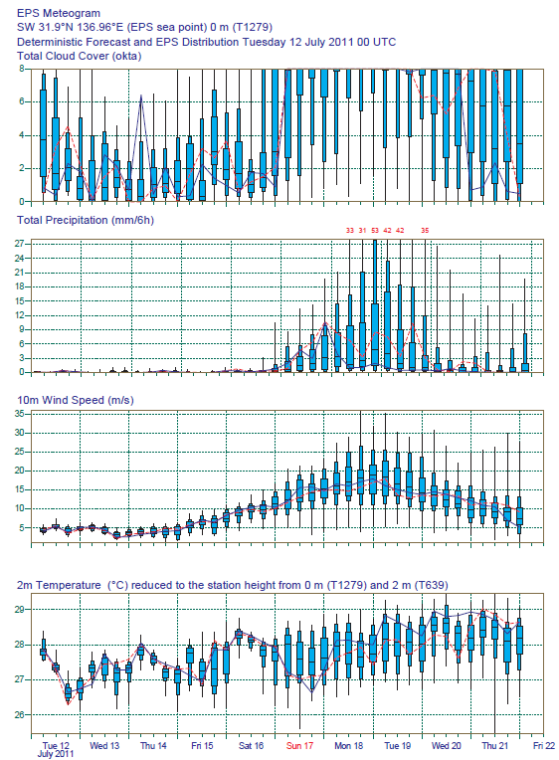

Slide 18
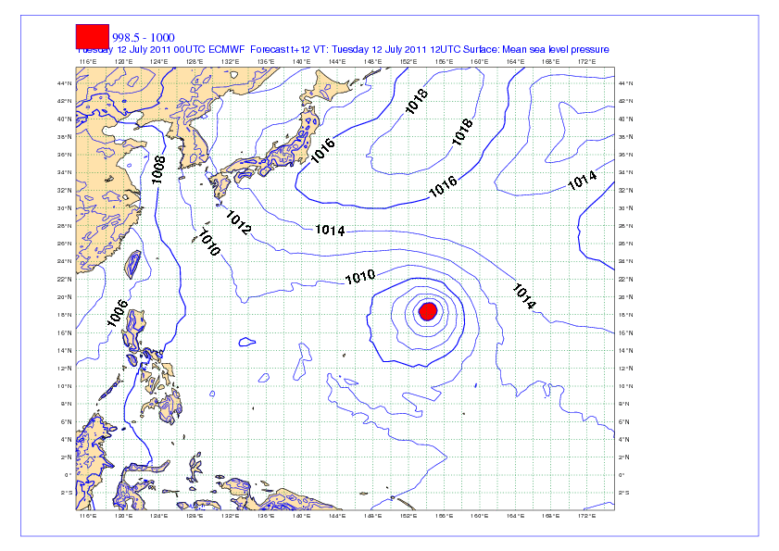
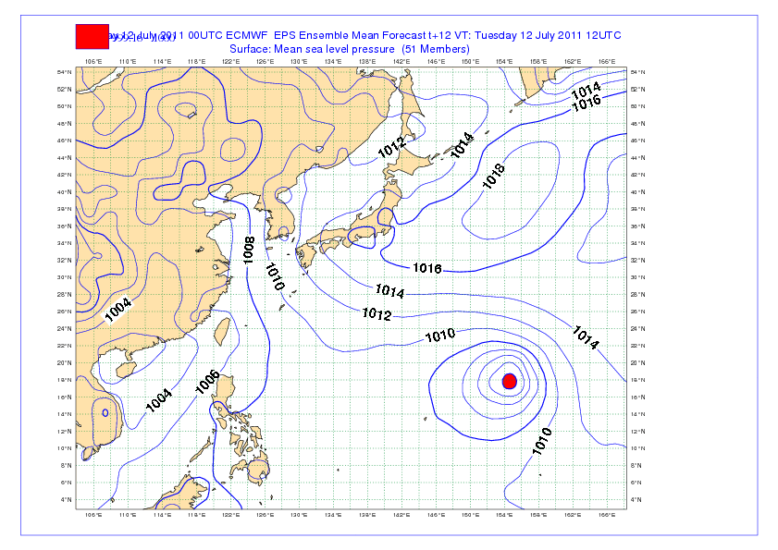
12/July/2011
00 UTC
T1279
EPS mean

Slide 21
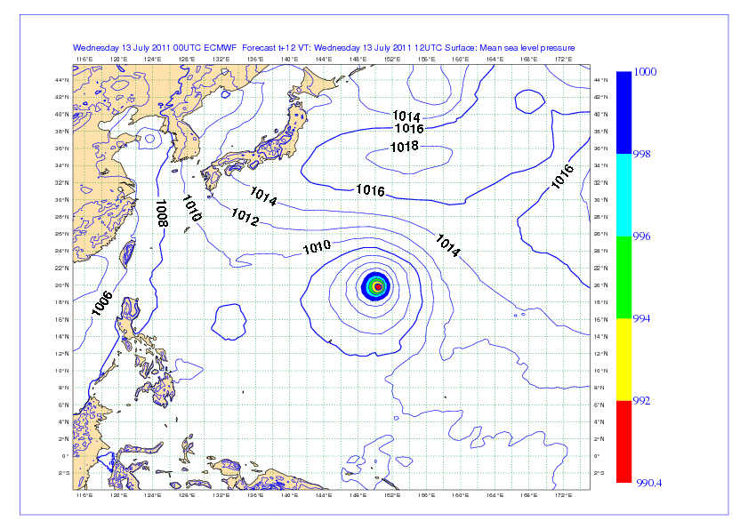
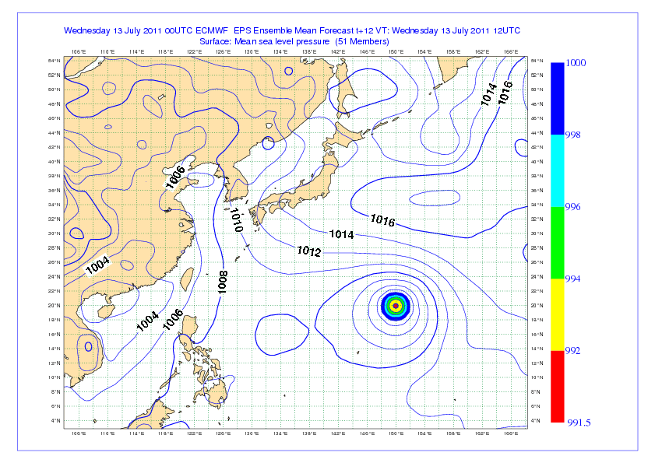
13/July/2011
00 UTC
T1279
EPS mean

Slide 23
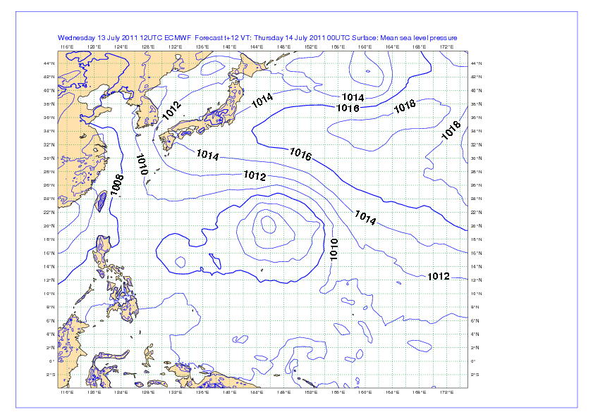
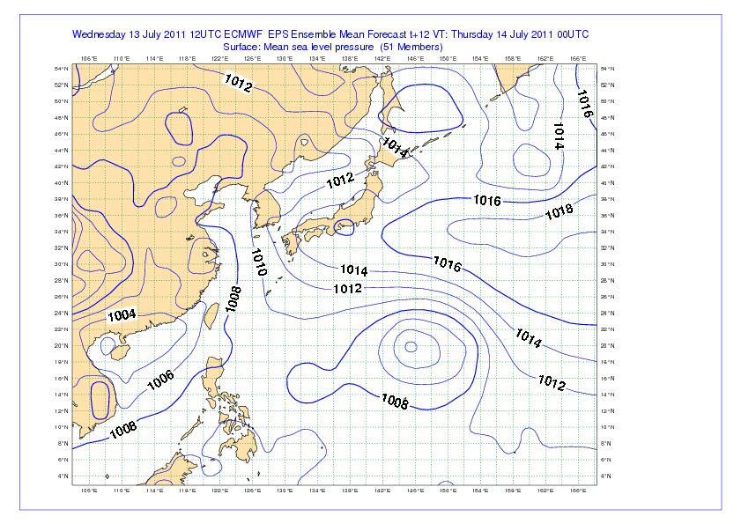
13/July/2011
12 UTC
T1279
EPS mean

Slide 25
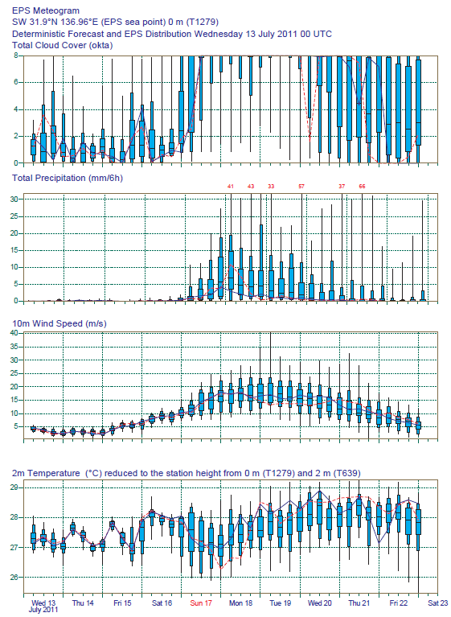
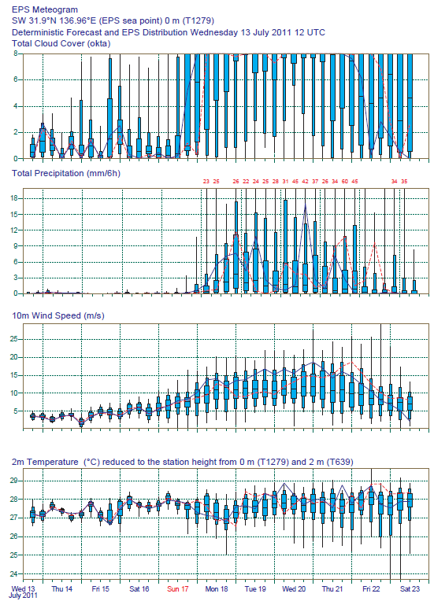

Slide 26
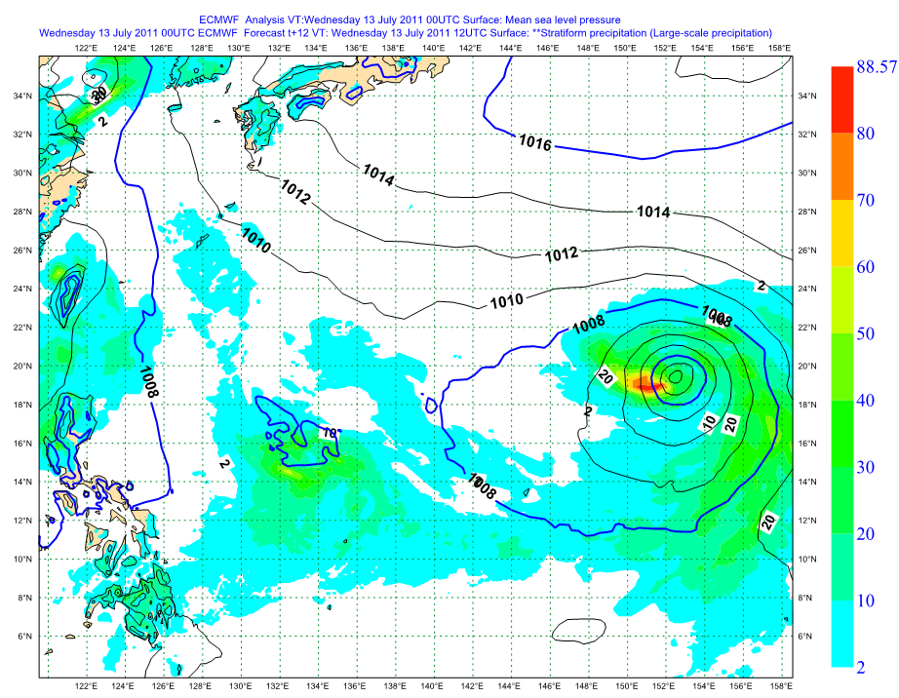
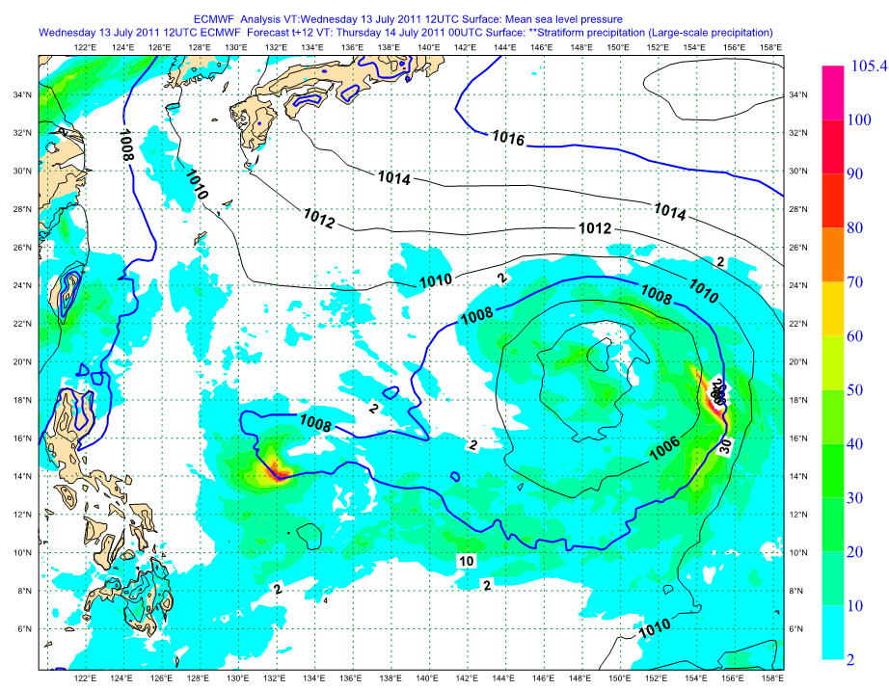
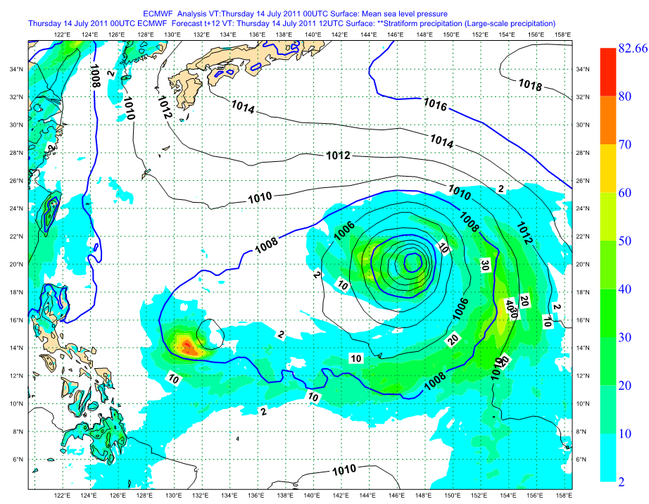
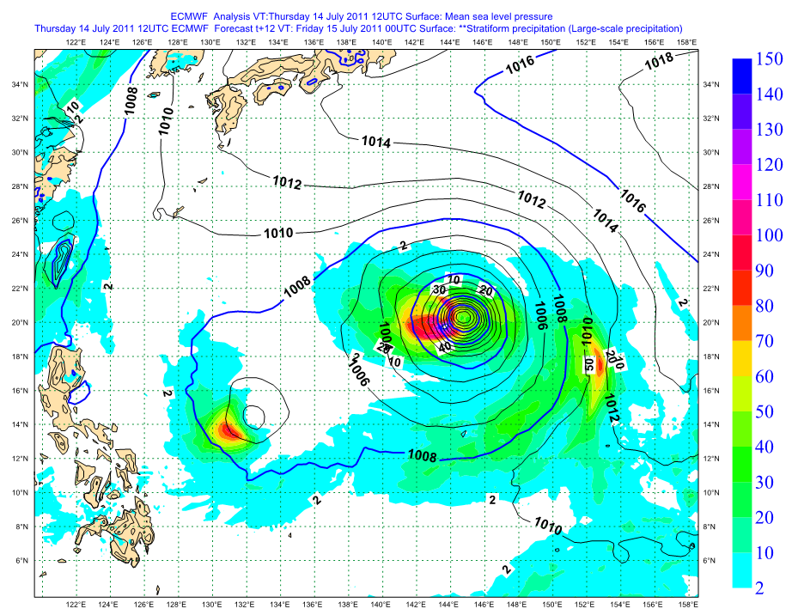
13/Jul/2011; 00 UTC
T1279 AN
H+12 prec
13/Jul/2011; 12 UTC
14/Jul/2011; 00 UTC
14/Jul/2011; 12 UTC

Slide 27
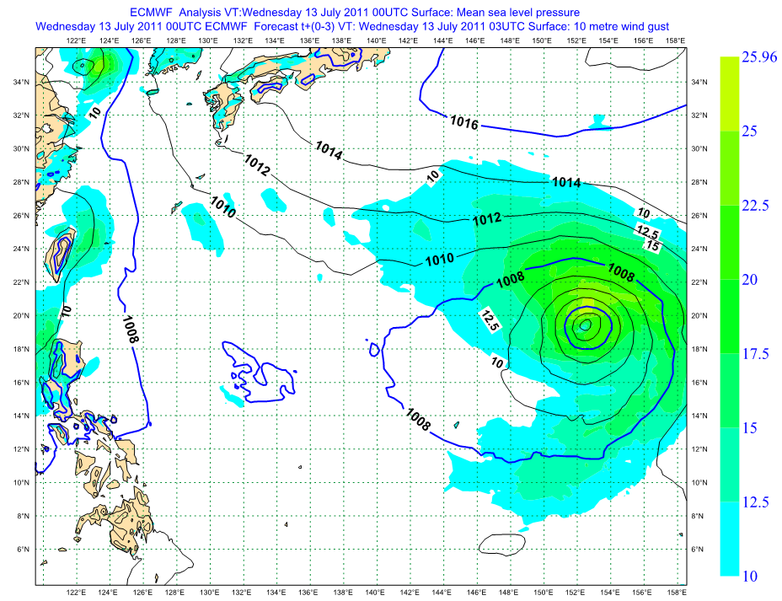
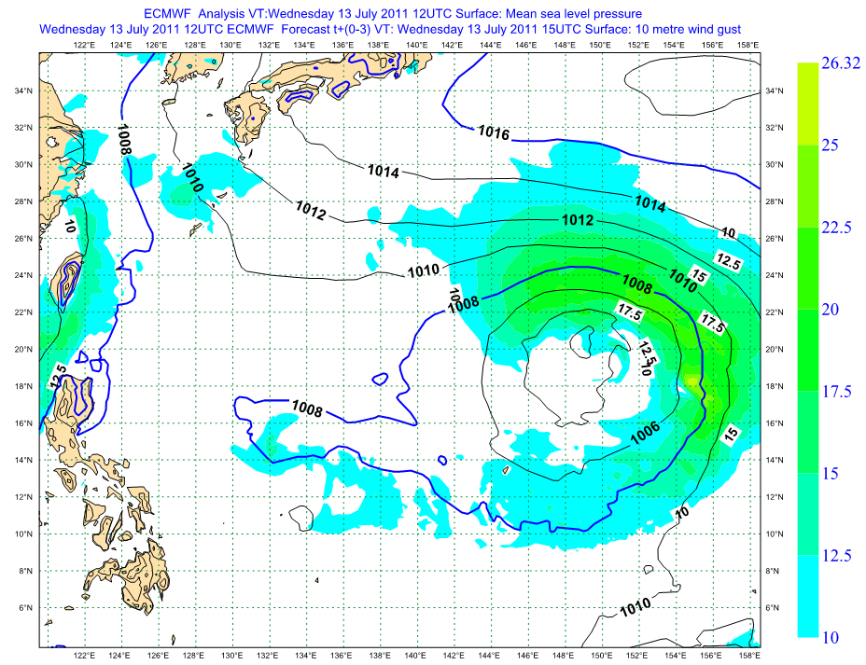
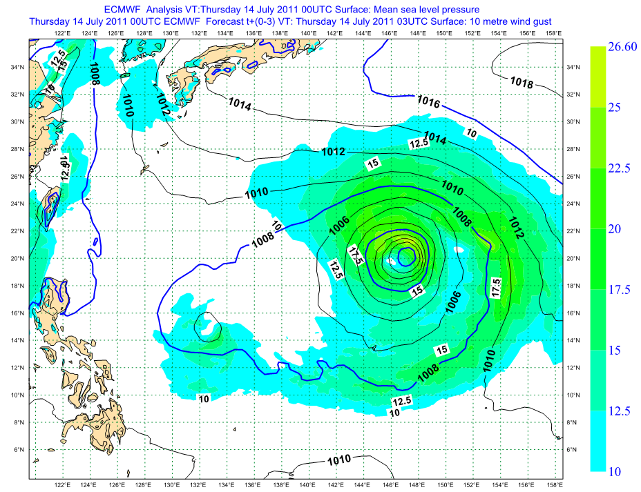
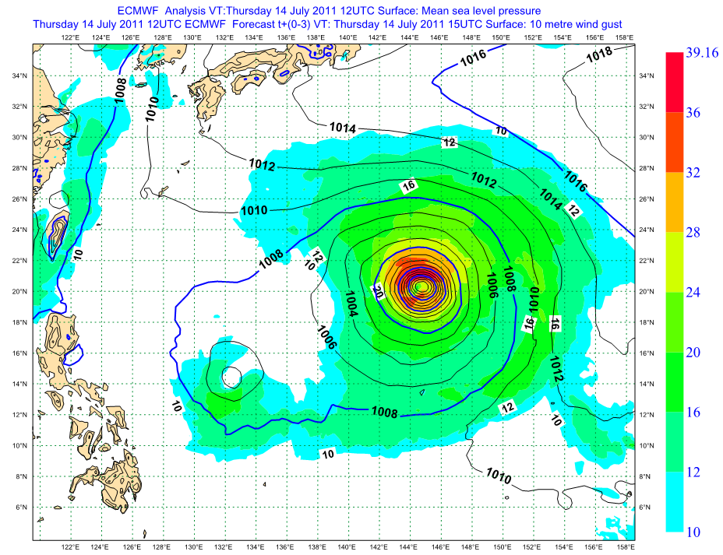
T1279 AN
H+3 windgusts

Slide 28
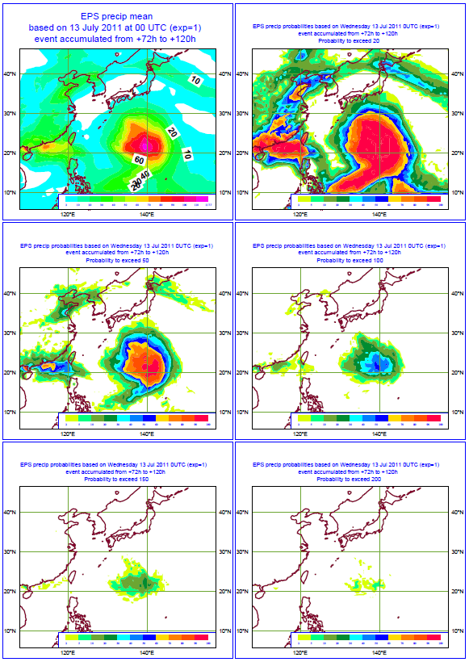
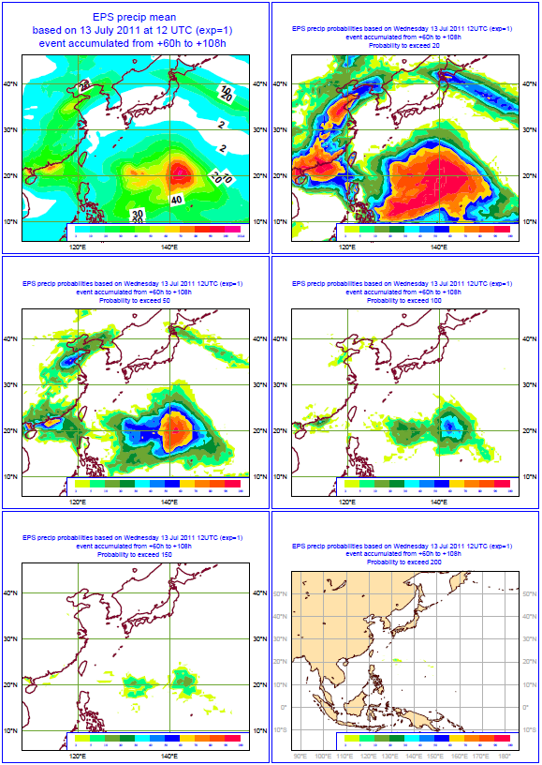
13/Aug/2011; 00 UTC
13/Aug/2011; 12 UTC
rr>20
rr>50
rr>100
rr>150
rr>200

Slide 29
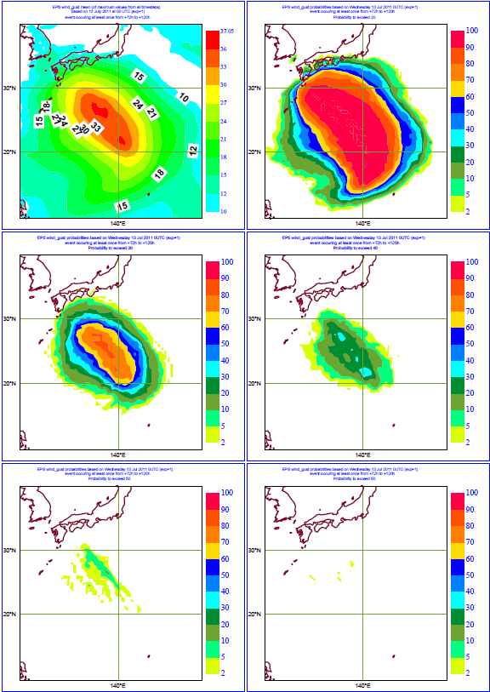



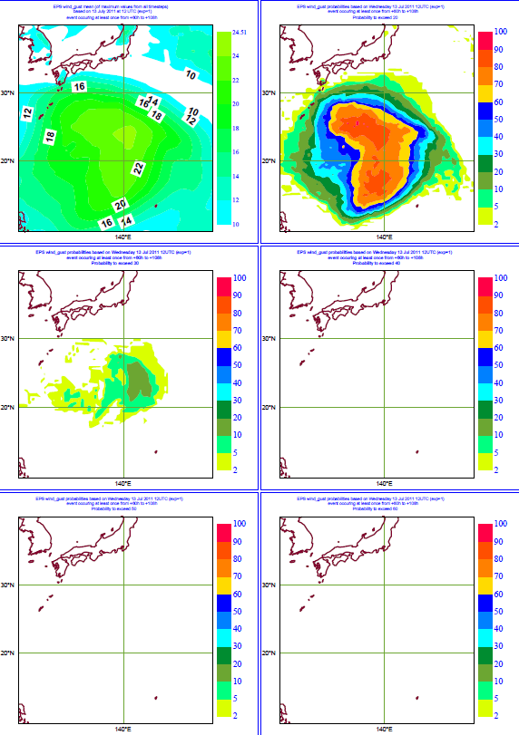









Gust>20 m/s
Gust > 30 m/s
Gust > 40 m/s
Gust > 50 m/s
13/Aug/2011; 00 UTC
13/Aug/2011; 00 UTC
Gust > 60 m/s

Slide 30
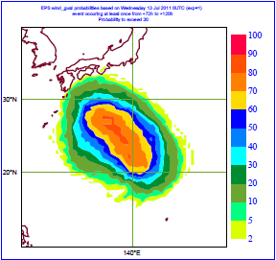
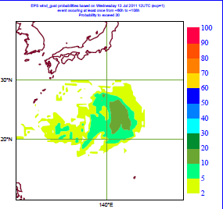

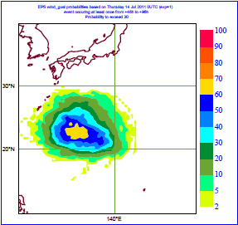
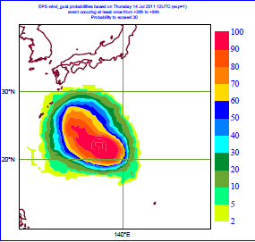

Probabilities of wind gusts exceeding 30 m/s
16 to 18 July 2011
13/Jul/2011; 00 UTC
13/Jul/2011; 12 UTC
14/Jul/2011; 00 UTC
14/Jul/2011; 12 UTC

Slide 31

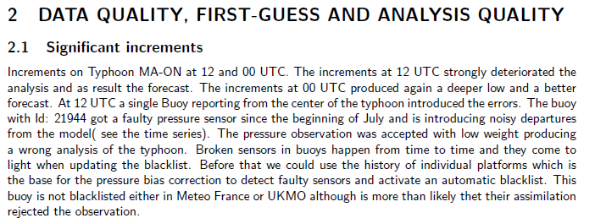

Slide 32
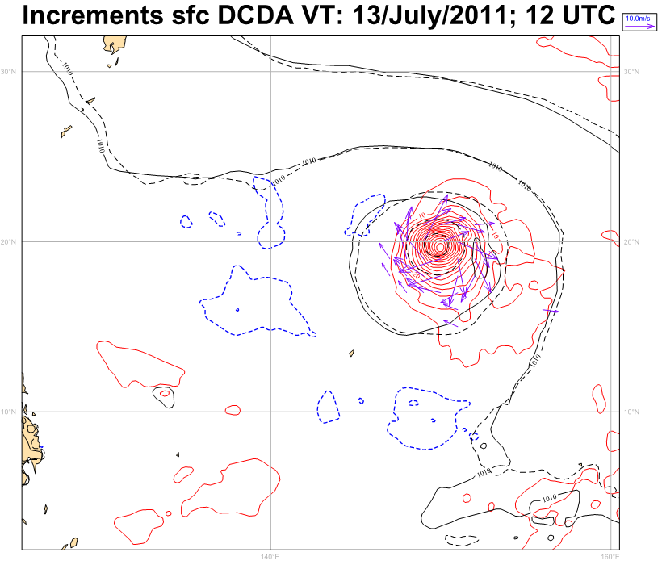

Slide 33
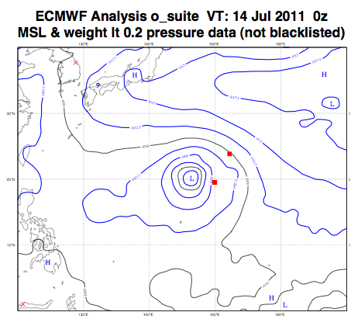
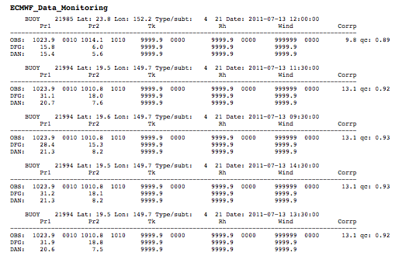


Slide 34

Stuck pressure sensor

Slide 35


Normalizacion de Huber
18 months of conventional data
  Feb 2006 – Sep 2007
Normalised fit of PDF to data
if |x| <= k,
if |x| > k,
Gaussian
Huber
Gaussian + flat

Slide 36
Fitting the Huber norm parameters to observed probability density function (pdf) of obs-bg
18 months of conventional data used for computing statistics
Normalised fit of pdf to data
  Best Gaussian fit
  Best Huber norm fit => smaller σ_{o}
Huber norm used for
  SYNOP, METAR, DRIBU: surface pressure, 10m wind
  TEMP, AIREP: temperature, wind
  PILOT: wind
Very relaxation of the fg-check
  Obs accepted as long as |obs-bg| < 20 σ_{o}
(obs-bg)/σ_{o}
Notes:
It is a fact that the distribution of obs-fg is not gaussian. By fitting gaussian curves we do a relatively bad job and we mis-represent the observation errors

Slide 37

expver=fk2m
Buoy removed

Slide 38


13/July/2011; 12 UTC
T1279 expver=fk2m
T1279 oper

Slide 39




EFI
based on 13/July/2011; 00 UTC
VT: 14-15 July 2011
VT: 15-16 July 2011
VT: 16-17 July 2011
VT: 17-18 July 2011

Slide 40


14/July/2011
00 UTC
T1279
EPS mean

Slide 42




EFI
based on 14/July/2011; 00 UTC
VT: 15-16 July 2011
VT: 16-17 July 2011
VT: 17-18 July 2011
VT: 18-19 July 2011

Slide 43



Slide 44




Probabilities
VT: 16-18 July 2011

Slide 45


14/Jul/2011; 00 UTC
VT: 16-18 Jul/2011
14/Jul/2011; 12 UTC
Gusts>20
Gusts>30
Gusts>40
Gusts>50
Gusts>60

Slide 47


Slide 48


Slide 49


Slide 50

EPS probabilities of wind gusts exceeding 20/30/40 m/s
Based on:
14/July/2011; 00 UTC
D+2 to D+7

Slide 51


15/July/2011
00 UTC
T1279
EPS mean

Slide 52




EFI
Based on 15/July/2011; 00 UTC
VT: 16-17 July 2011
VT: 17-18 July 2011
VT: 18-19 July 2011
VT: 19-20 July 2011

Slide 53

EPS probabilities of wind gusts exceeding 30/40/55/55 m/s
Based on:
15/July/2011; 00 UTC
D+1 to D+6

Slide 54

EPS probabilities of accumulated precip exceeding60, 70, 100 and 200 mm
Based on:
15/July/2011; 00 UTC
D+1 to D+6

Slide 55


Slide 56




EFI
Based on 16/July/2011; 00 UTC
VT: 17-18 July 2011
VT: 18-19 July 2011
VT:19-20 July 2011
VT: 20-21 July 2011

Slide 57















Slide 58


Slide 59


Near Fukushima

Slide 60















Slide 61




EFI
Based on 17/July/2011; 00 UTC
VT: 18-19 July 2011
VT: 19-20 July 2011
VT: 20-21 July 2011
VT: 21-22 July 2011

Slide 62


Slide 63



Slide 64



Slide 65



Slide 66



Slide 67



Slide 68



Slide 69



Slide 70
Tracks and features verification

Slide 71


Slide 72

Synop pressure observations Japan

Slide 73


Slide 74


Slide 75


Slide 76


Slide 77


Slide 78


Slide 79


Slide 80


Slide 81


Slide 82


Slide 83


Slide 84


Slide 85


Slide 86


