Slide 1
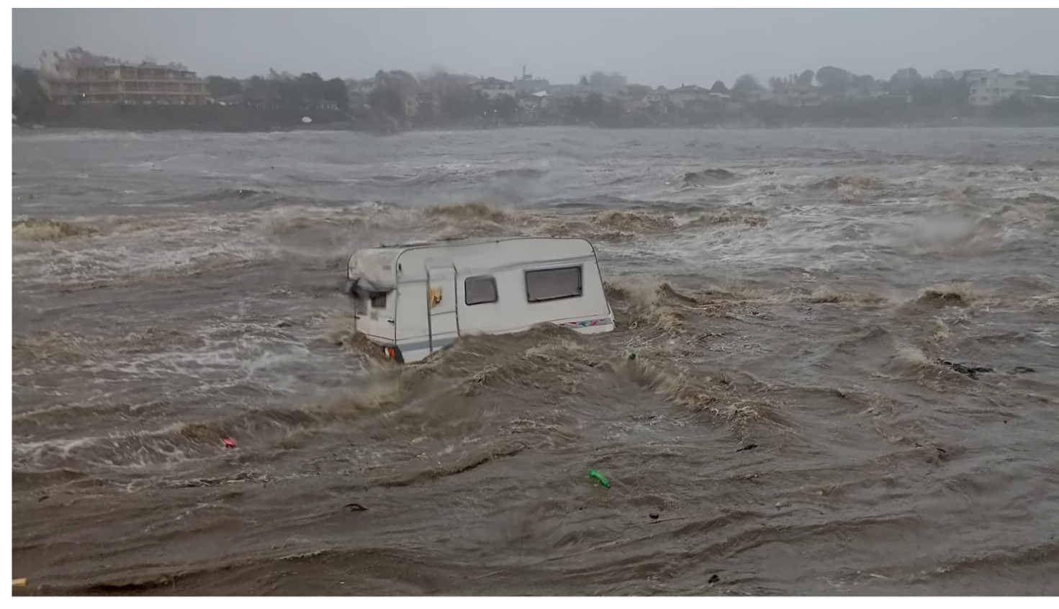
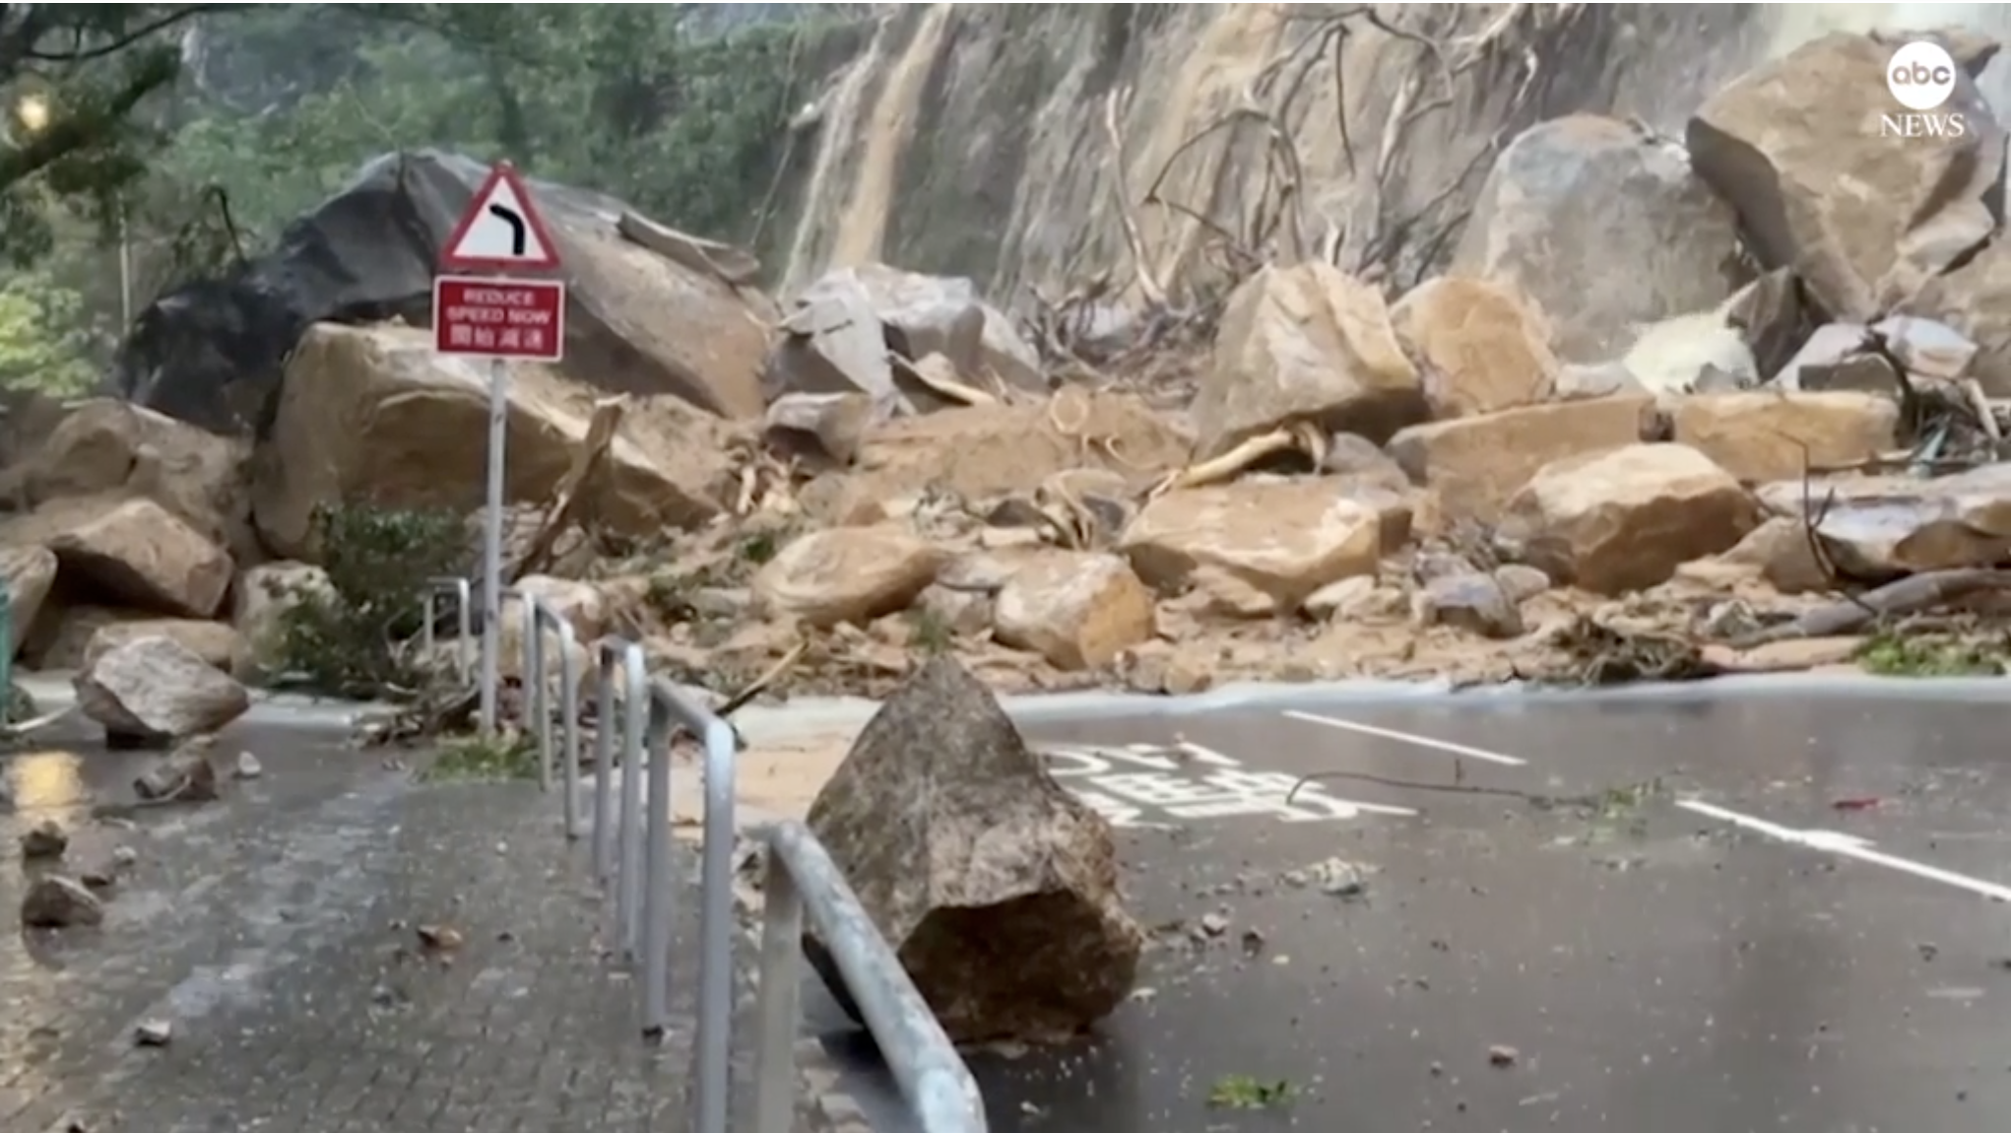
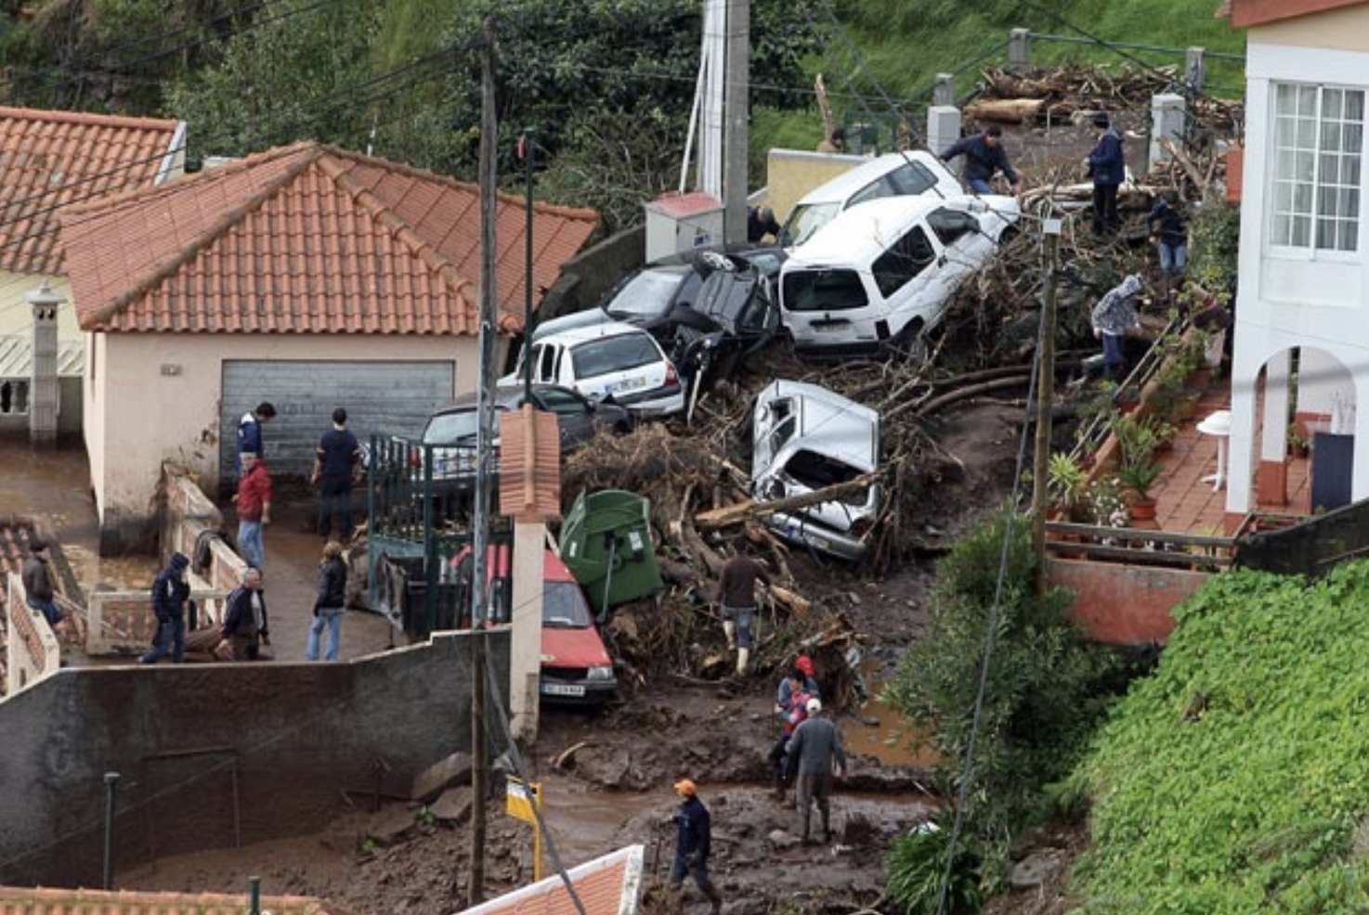
1. Extreme Rainfall / flooding events in JJA(S) 2023
Besides heatwaves and wildfires, flooding events have featured prominently in the media this summer
  Continuing on into early September (cyclone/medicane Daniel)
ECMWF has run re-forecasts at 3 resolutions in the last year: 9 + 18 + 36km
So a good opportunity to examine model ability to capture extreme localised rainfall
  At different resolutions
  And to contextualise the rainfall/flooding events and forecasts thereof

Slide 2
What might be the 100-year return period gridbox rainfall for models with different resolutions?
100mm
Assume a convective situation
Assume “raingauge truth” = 100mm
Assume no systematic gridscale biases
Conceptual picture shown
50mm
Large-scale rainfall situation
0mm
20,000
2,000
200
20
2
0.2
Gridbox dimensions (km)

Slide 3
Reforecast Analysis of extreme 24h gridscale rainfall
Focus on medium range (24h) rainfall maxima – lots of data
  Use D1, D2, …D7
  Use 2 dates per week, for 4-5 weeks per month, for 11 ENS members, for 20 years, for JJAS
  Gives 7*2*4.5*11*20*4 ≈ 56,000 cases !
  Extract 100th percentile in this dataset, for the 4-month period – so the wettest event for each gridbox
  Implies ~ 1 in 500-year return period for this 4-month period
Some plots show data conservatively interpolated to TCo79 (~144km) – sampling noise reduced
    OK for extremes unrelated to topographic enhancement; not so good for topographically-forced
For 18km resolution we use reforecasts from 47r3 from JJAS 2022
For 9km resolution we use reforecasts from 48r1 from JJAS 2023 (expver 78 where necessary)
  (last few days of Sep not available at the time)
Intention had been to include 36km resolution, but data management for that is complex
  24h model-climate statistics not stored & 7-day totals are difficult to compare for technical reasons
  Huge MARS download needed was not tractable

Slide 4
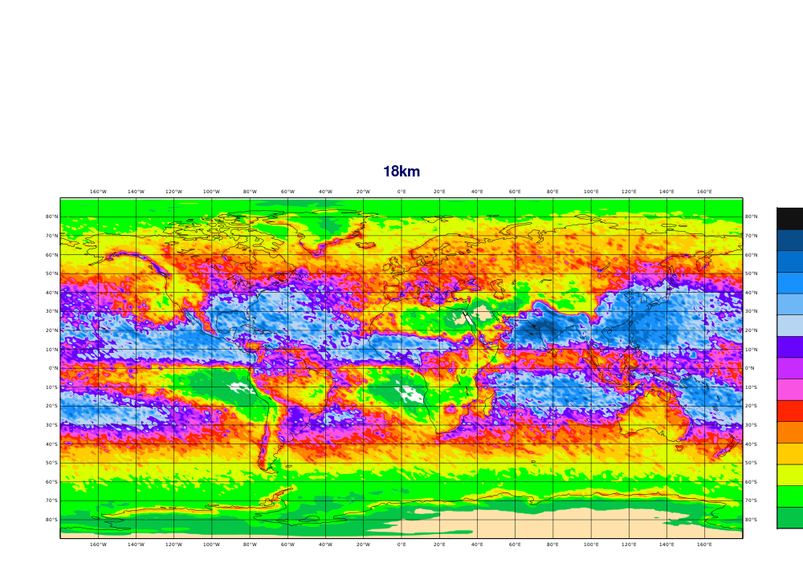
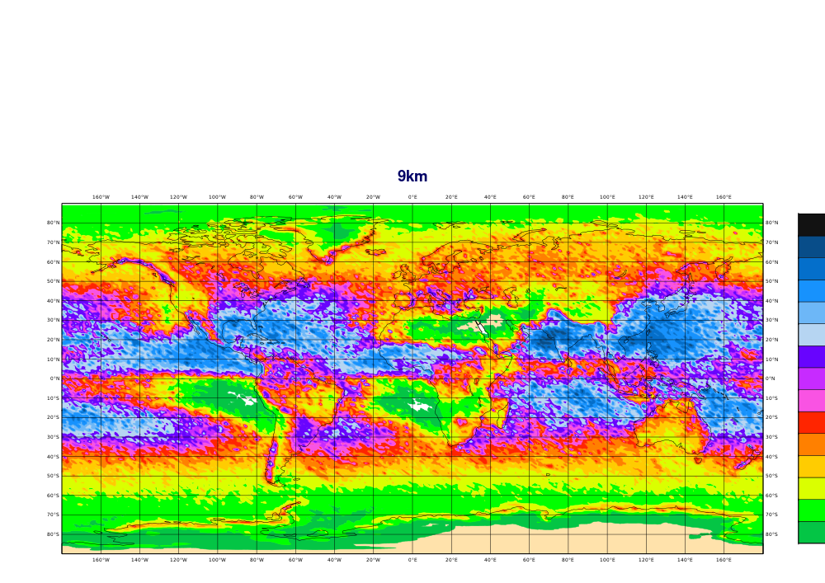
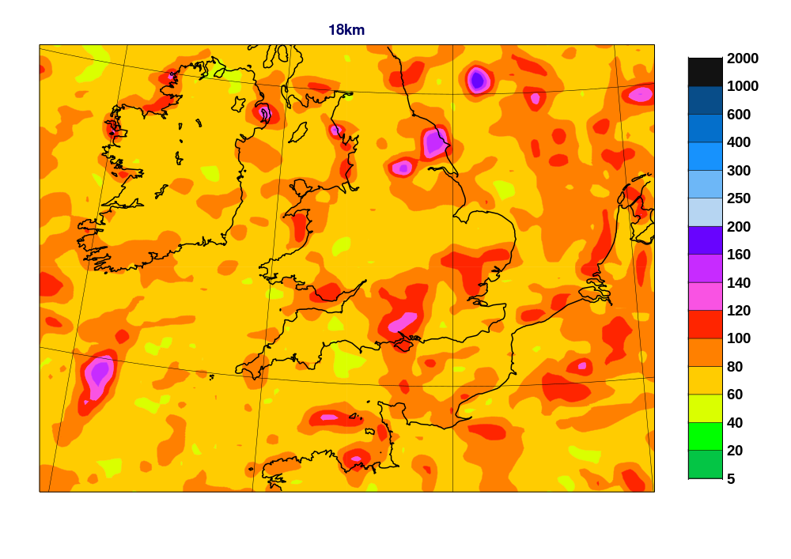
9km versus 18km extremes – 500y return period – 24h rainfall

Slide 5


9km versus 18km extremes – 500y return period – 24h rainfall
At 9km resolution:
- Slight increase
- Orographic rainfall increase clear (e.g. Andes)
- Some sampling issues
- N’ward shift of peaks in Indian ocean (?)

Slide 6
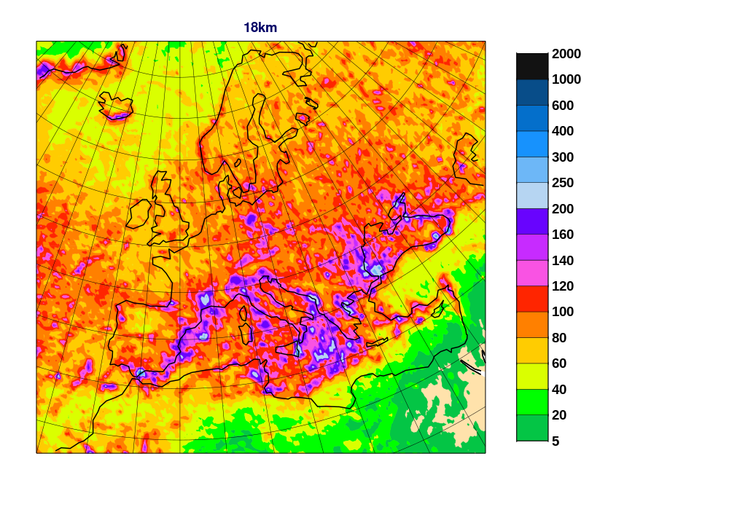
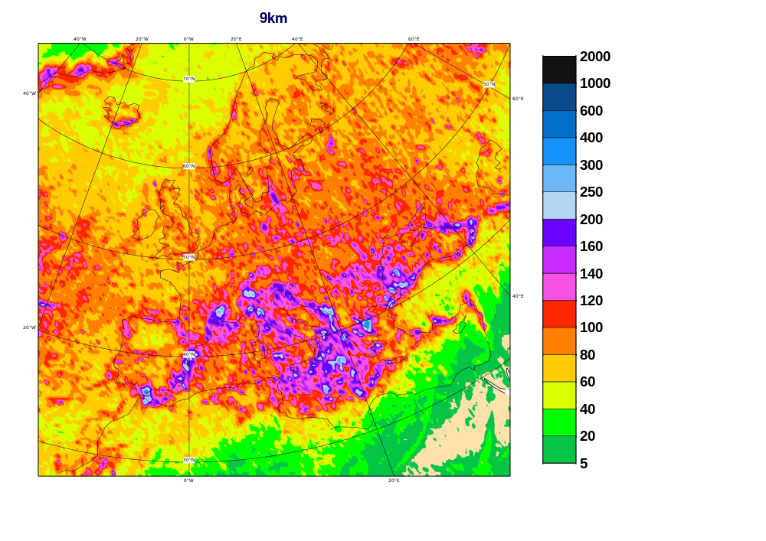
9km versus 18km extremes – 500y return period – 24h rainfall

Slide 7
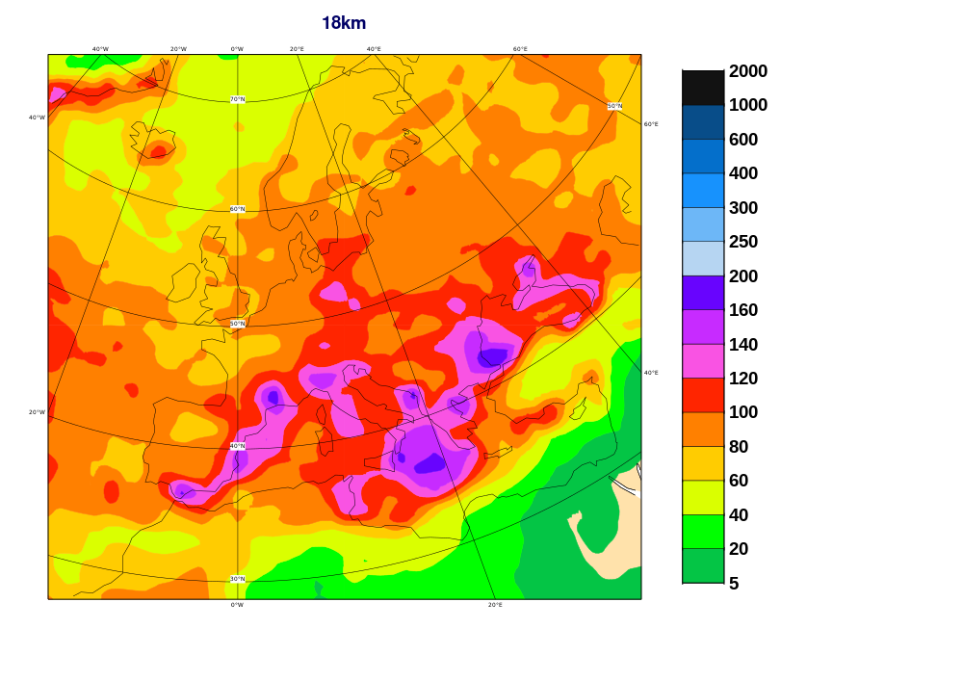
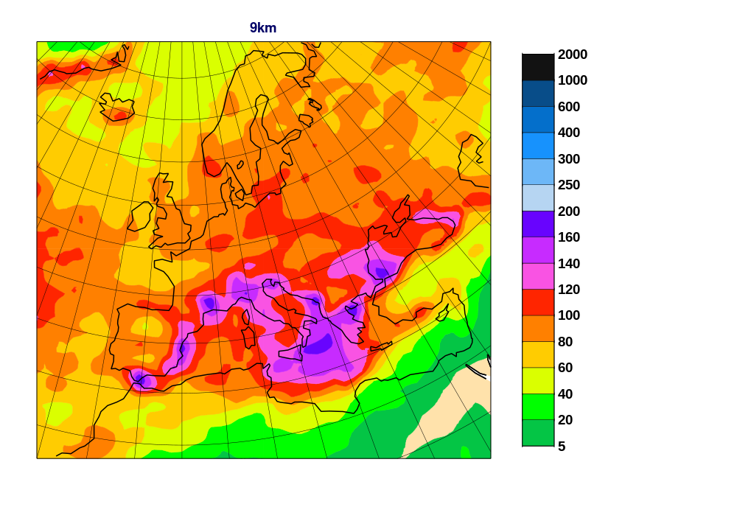
9km versus 18km extremes – 500y return period – 24h rainfall
Extreme Rain “Hotspots”
- SE Bulgaria
- E Greece
- Herault in France
- Gibraltar / Valencia
- …

Slide 8
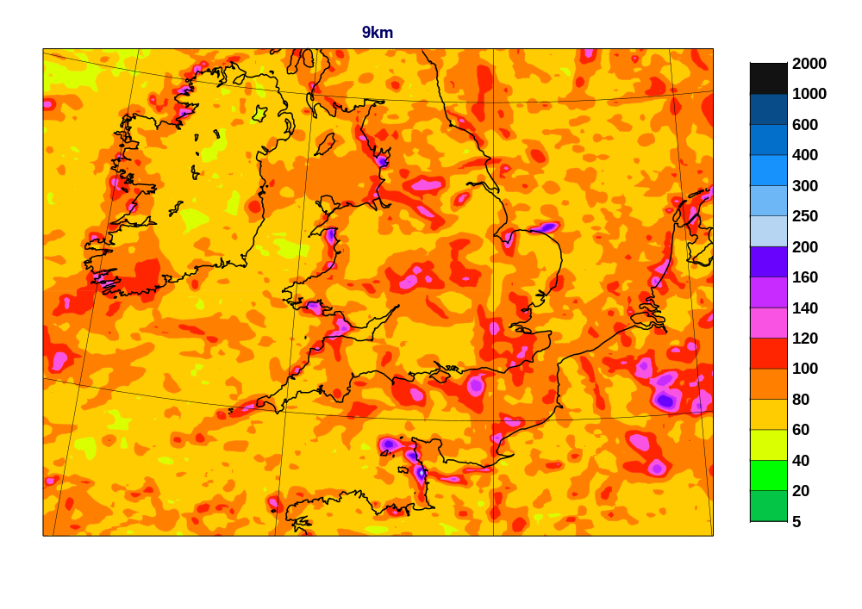
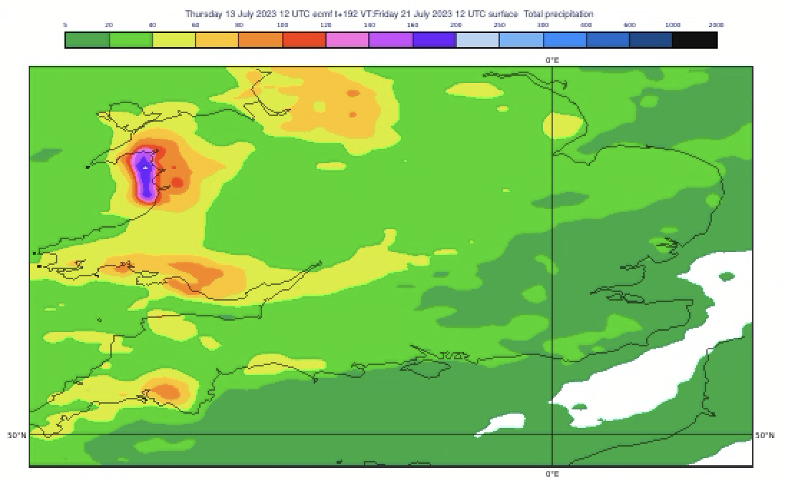
9km versus 18km extremes – 500y return period – 24h rainfall
“Coastal rainbombs”
Reported by Met Office last year (in HRES)
Discussed in daily reports
High coastal SST max in sheltered bays:
  Local enhancement of CAPE release + no cell drift
Not just UK waters
Some evidence at 18km also

Slide 9
Event Search
Searched Daily Reports for “flood”, for JJAS 2023
Looked for reasonably reliable point (gauge) observations of 24h rainfall for any events found
  Used maximum value found within an affected area
  Values still likely to be an underestimate of the true local maximum – due to sparseness of gauge networks
A somewhat ad-hoc dataset, admittedly, but most flood datasets are !
15 extreme 24h rainfall observations – related to flooding – were logged
  Range: 54mm to 754mm (in 24h)
  2 TC-related
  2 Medicane-related
  11 seem convection-related (organized or otherwise), with differing degrees of topographic forcing
More events could be added, with more work
  Sorry if ‘yours’ is not in the list !

Slide 10
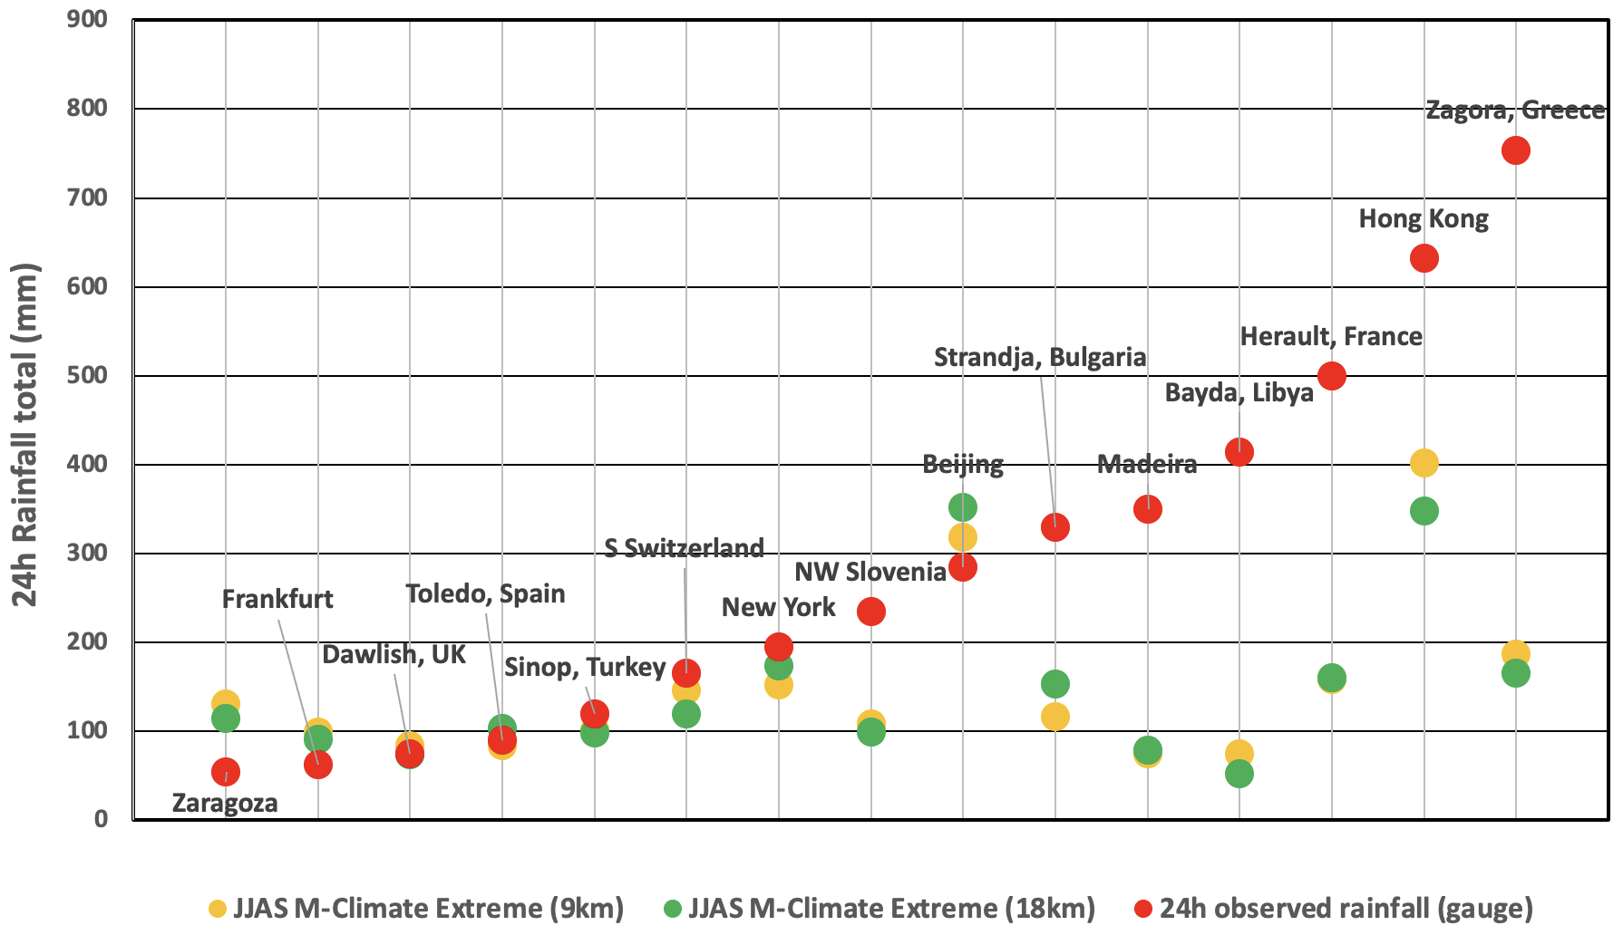
How do observations compare with the 1-in-500 year M-Climate-derived values ?
Ranked Events
TC
TC
(TCo79 used)

Slide 11
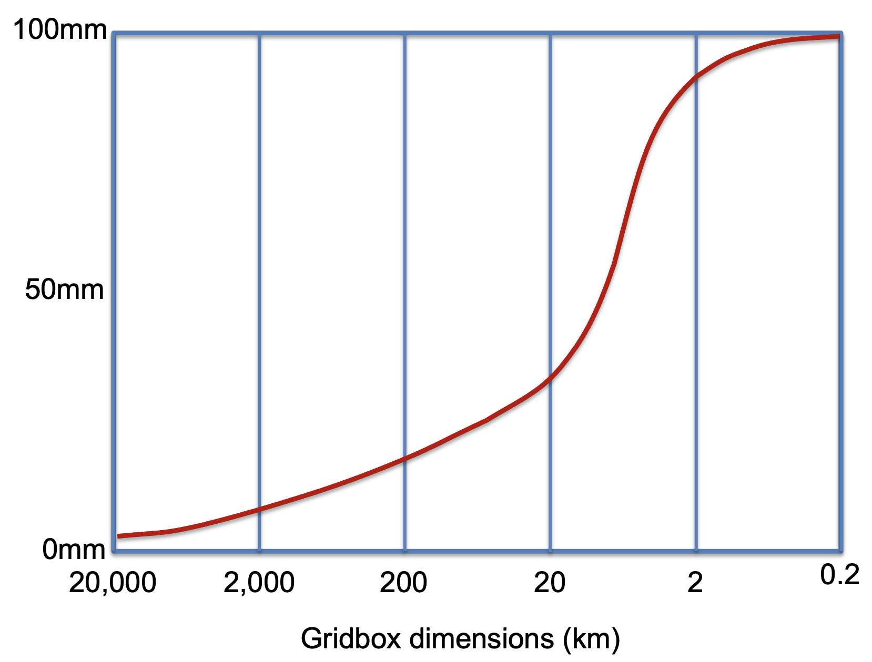
Results
For the wettest events at least the model climate looks unrepresentative
  Potential to multiply by up to ~4 (!)
The biggest discrepancy (as a ratio) is for the Libya event
  Partly illustrates how truly exceptional this event was
  Furthermore, observation density worse than for all other cases
For 9km resolution I was expecting a clearcut step upwards for the extremes
  This is not seen, the increase is rather marginal
  Curious! Perhaps relates to 48r1 being somewhat drier overall ??
TC cases seem less “problematic” – sampling inevitably a big issue
  Sampling may also be a factor for the Libya Medicane case ?
Topographic impacts complex – likely important for Madeira case
  And likely much more prominent in winter (but no 9km re-forecasts yet!)
?

Slide 12
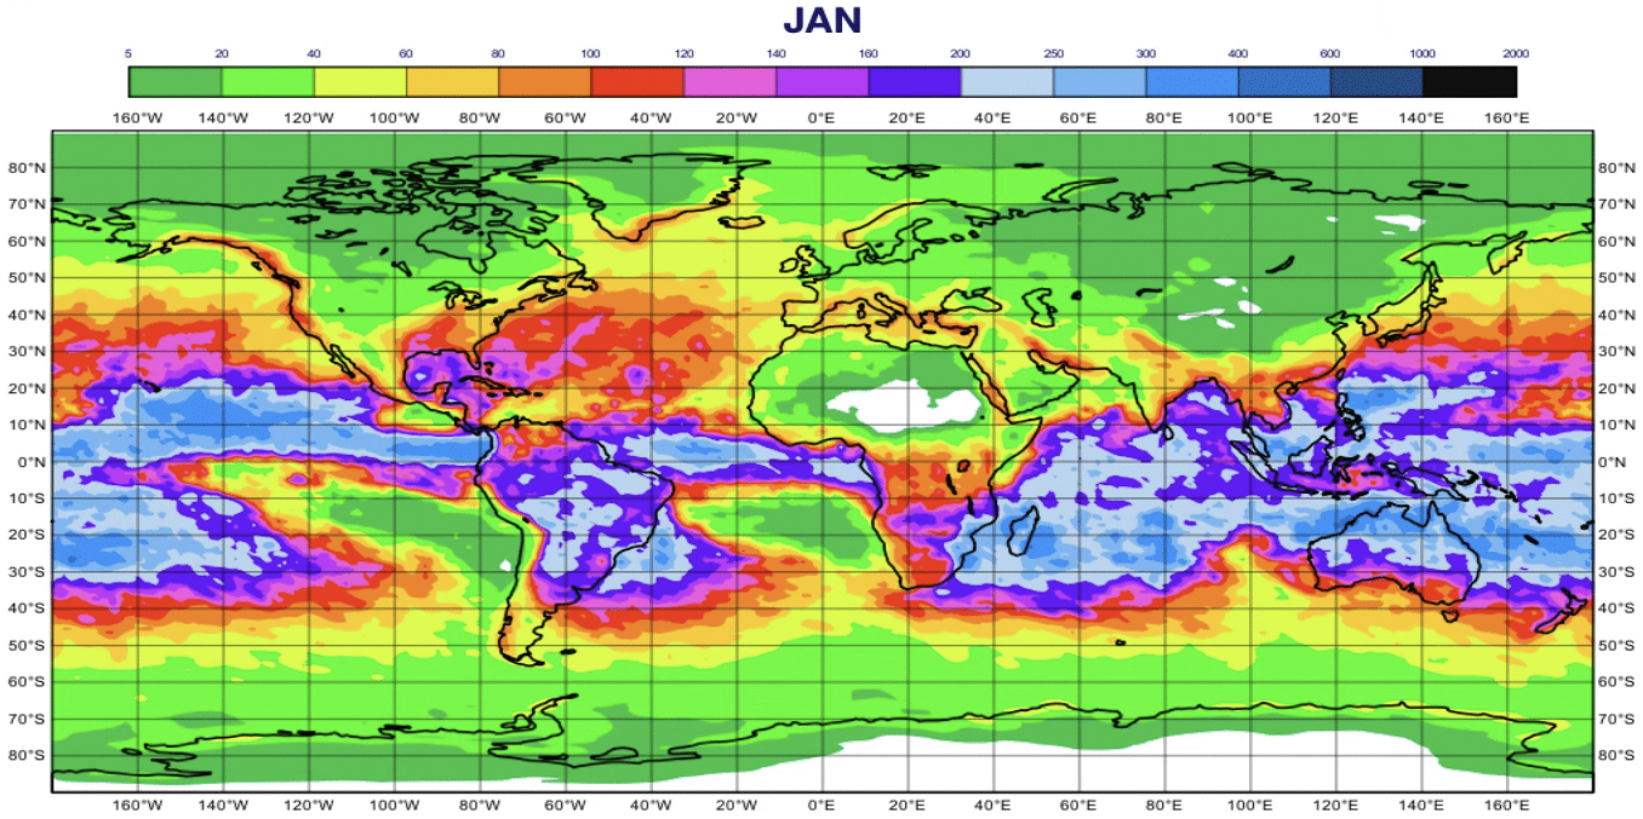
1 in 500 year return period 24h gridscale rainfall events (by month, 18km)
mm

