Slide 1
International Symposium on Data Assimilation
2 December 2022, Online
Recent activities on snow data assimilation
for NWP and reanalysis at ECMWF
Kenta Ochi, Patricia de Rosnay, David Fairbairn
Notes:
1

Slide 2
Outline
Why land surface matters?
Current land data assimilation system at ECMWF
Recent activities on snow data assimilation
Summary and future plans
2

Slide 3
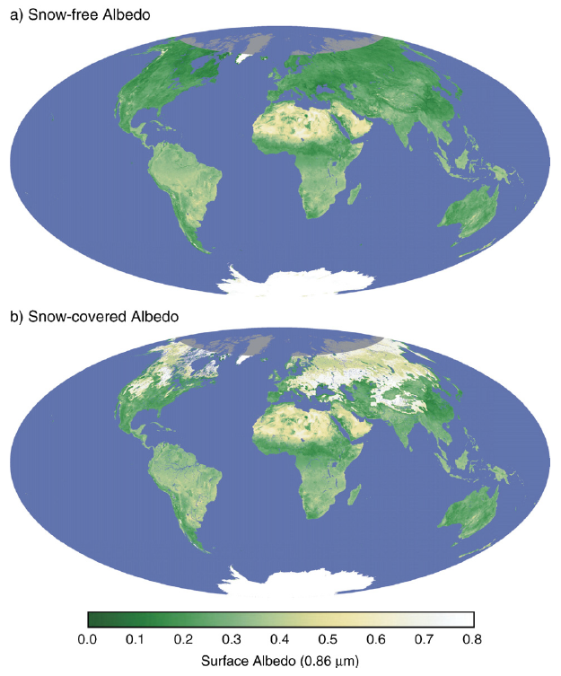
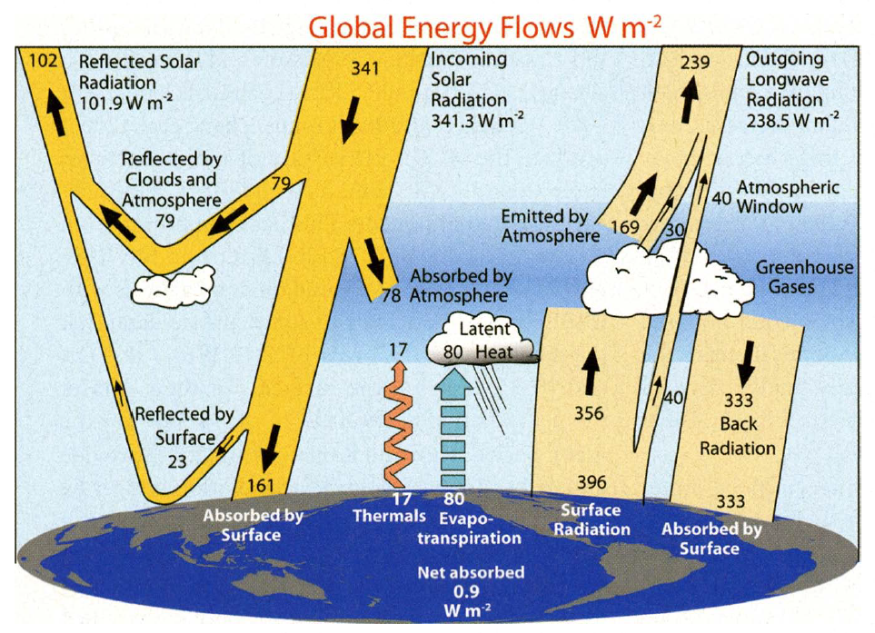
Why land surface matters?
Trenberth et al. (2009)
Moody et al. (2007)
Land and atmosphere interact with each other through radiation, sensible and latent heat flux
  Widely different depending on the land surface status (e.g., albedo on snow)
Land DA makes it possible to represent land surface status more appropriately
3

Slide 4
Current land data assimilation system (LDAS) at ECMWF
18 00 06 12 18 00
Coupled forecast
IC
LDAS includes:
  2D-OI for screen-level T and RH
  2D-OI for snow depth
  SEKF for soil moisture
  1D-OI for soil and snow temperature
outer loop cycling
12-hour window 4D-Var
LDAS
first-guess + increments from each analysis
IC
Coupled forecast
Coupled forecasts for first-guess but separated land DA and atmospheric DA
  Weakly coupled data assimilation between land and atmosphere
  Coupled DA approaches enable to propagate the impact to the other earth system components
(de Rosnay et al., QJRMS 2022)
4

Slide 5
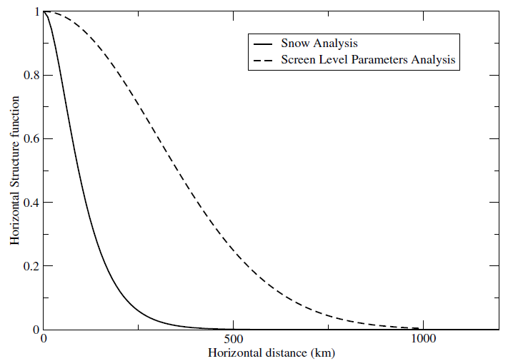
Snow depth analysis in the LDAS
Snow Model: Component of the ECMWF land surface model H-TESSEL
  Single layer snowpack
  Snow water equivalent SWE (m)
  Snow Density ρ_{s}
Observations:
  Conventional snow depth data: SYNOP and National networks
  Snow cover extent: NOAA NESDIS/IMS daily product (4km)
    Available daily at 23 UTC, assimilated in the next analysis at 00UTC
Data Assimilation:
  Optimal Interpolation (OI): optimally combine first-guess, in situ snow depth and IMS snow cover
    Based on horizontal structure function in Brasnett (1999), increments spread isotropically
  The result of the data assimilation is used to initialize NWP
Dutra et al. (2010), Balsamo et al. (2009)
Prognostic variables
de Rosnay et al. (2015)
5

Slide 6
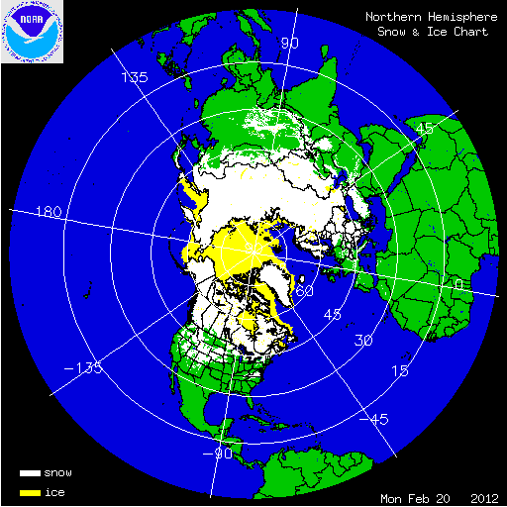
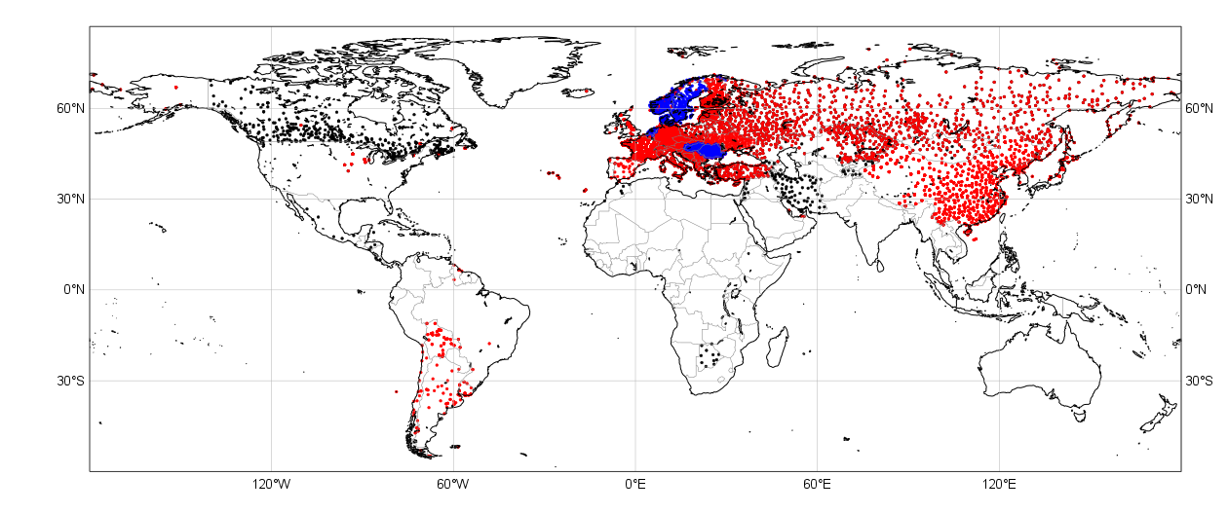
An example of in situ snow depth and IMS
Snow depth availability on the Global Telecommunication System (GTS)
*SYNOP TAC *SYNOP BUFR *National BUFR data
15 Jan 2021
Available snow depth reports are increasing in recent years (including zero snow depth reports)
  Promoted by WMO Global Cryosphere Watch (GCW) and Snow Watch Team
Still sparse in some regions: depend on IMS snow cover in the NH
6

Slide 7
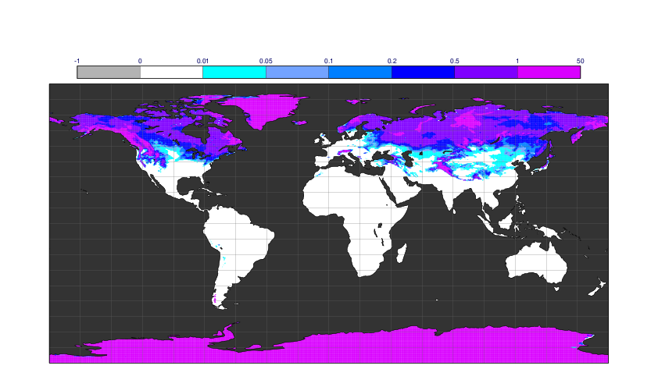

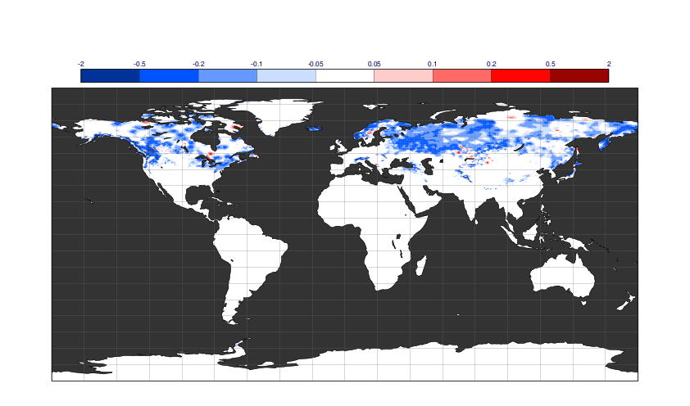
Impact on snow depth by assimilating observations
Analysis without observations
Analysis with observations
28 Feb 2021
Latest observations can be reflected in the analysis
In addition, they reduce systematic snow depth biases
  Due to excessive snowfall by the model
  The increments are accumulated during snow season
Improve forecasts in the lower atmosphere
w/ obs – w/o obs
7

Slide 8
Outline
Why land surface matters?
Current land data assimilation system at ECMWF
Recent activities on snow data assimilation
Summary and future plans
8

Slide 9
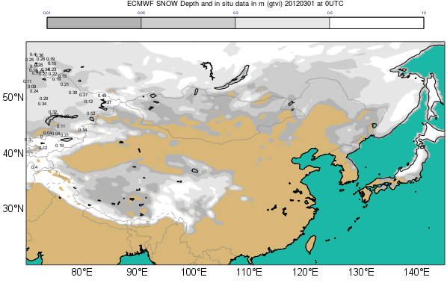
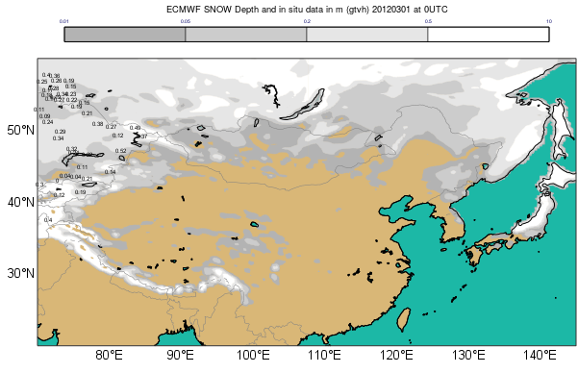
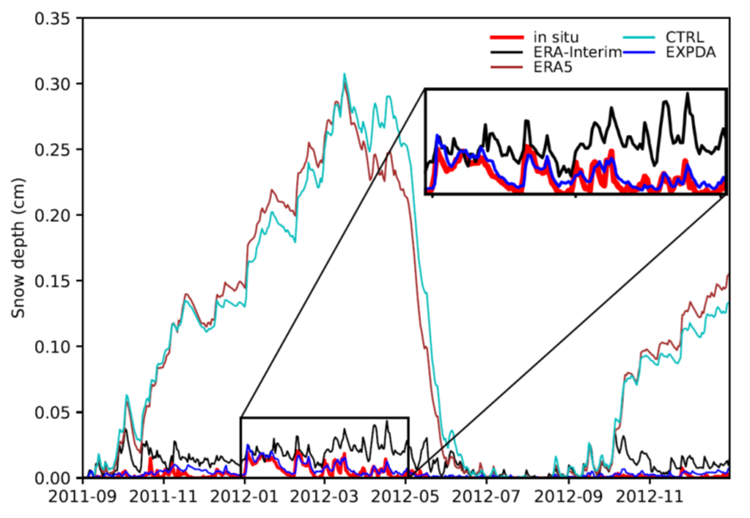
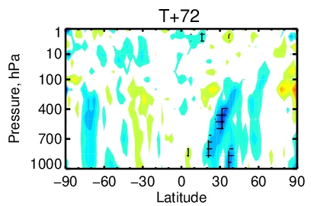
IMS snow cover coupled data assimilation impact over the Tibetan Plateau
IMS snow cover assimilation removes snow and improves snow depth
CTRL (no IMS DA)
Overestimate snow
Test (IMS DA)
More realistic snow
Reduce RMS errors for wind
(Dec 2020 - Feb 2021)
Orsolini et al., The Cryosphere 2019
Wei Li et al., The Cryosphere Discussion 2022
de Rosnay et al., in prep
☺
9

Slide 10
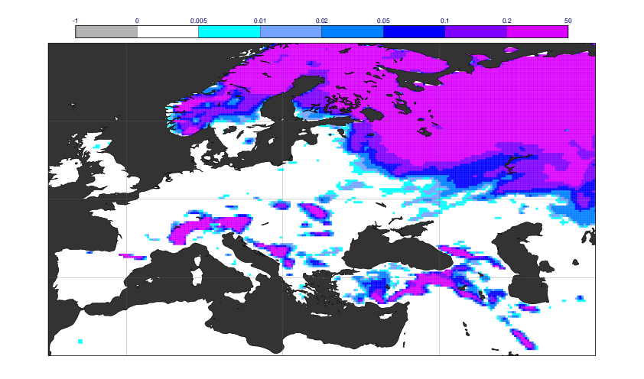
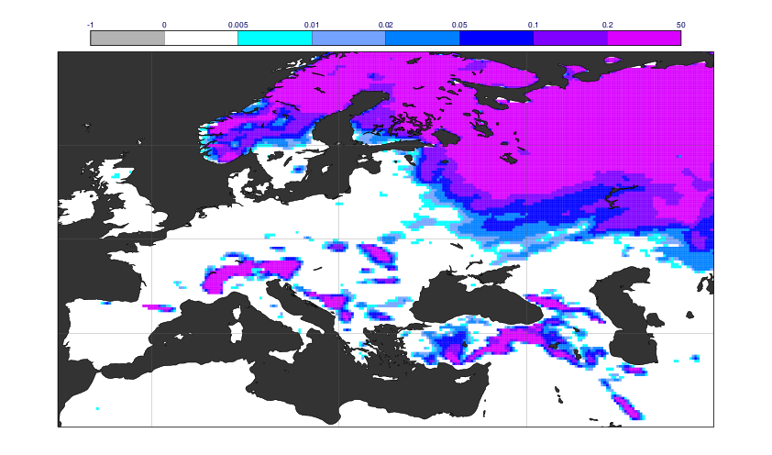
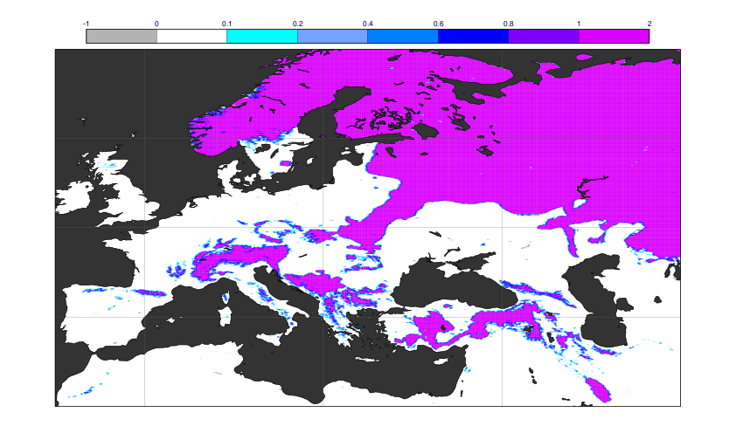
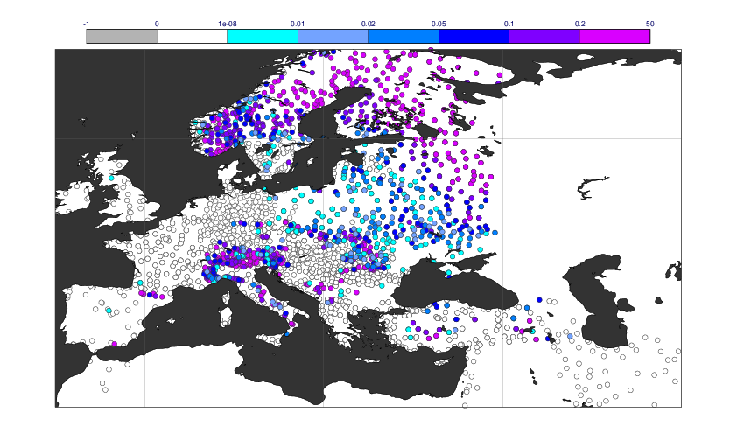
QC modification for IMS
Current
New
IMS
SYNOP
20 Dec 2021
Fresh snow is sometimes removed by assimilating IMS due to its time lag
Improved by rejecting IMS if much fresh snow exists in first-guess
10

Slide 11
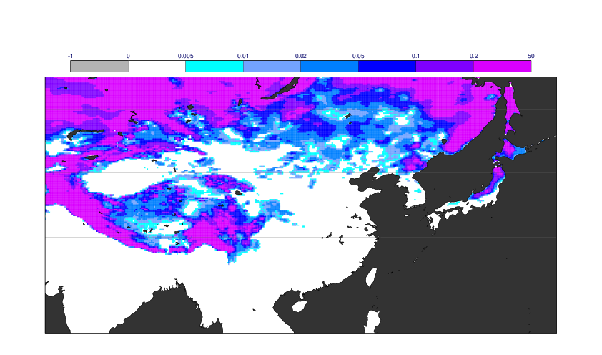
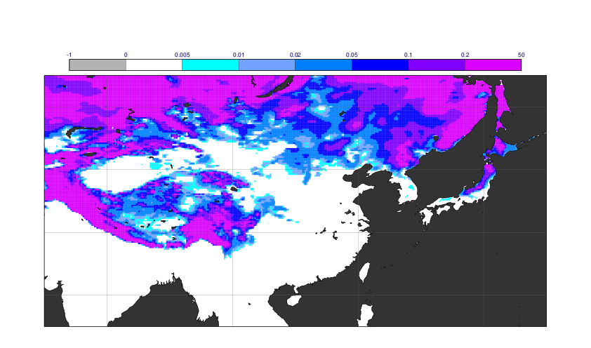
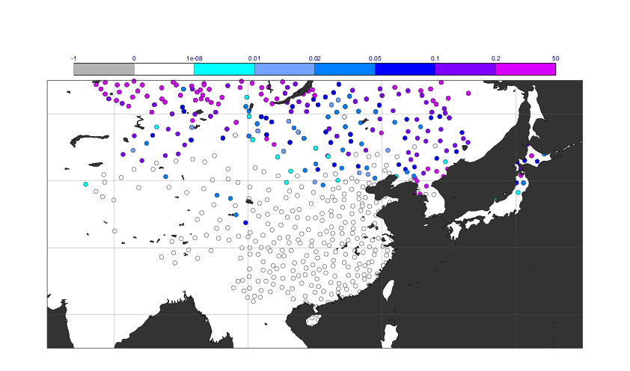
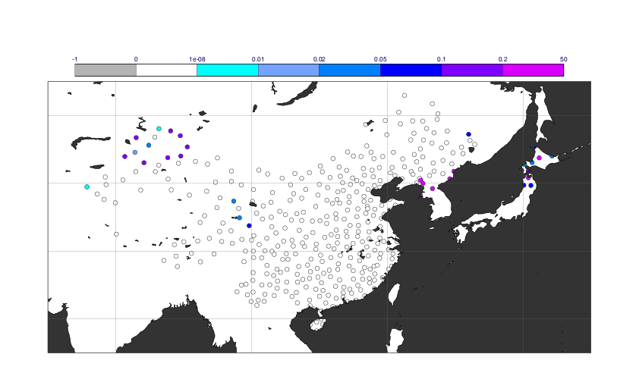
QC modification for SYNOP
Current
New
SYNOP 0UTC
SYNOP 12UTC
1 Jan 2020
Suspicious 0cm reports have been assimilated in China except 0 UTC since 2019
Improved by rejecting part of 0cm reports in China Improve forecasts in the lower atmosphere
11

Slide 12
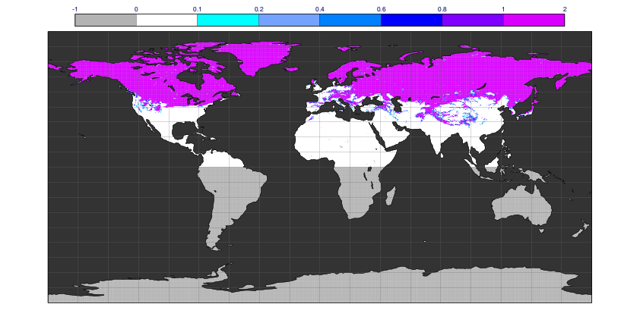
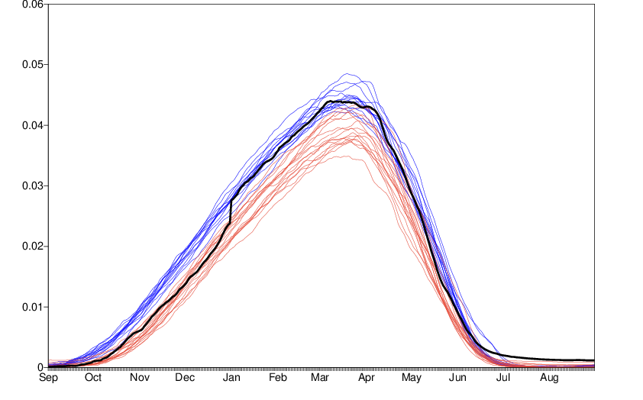
Snow reanalysis at ECMWF
IMS has been assimilated since 2004 in ERA5
Some issues with ERA5 snow
  Inconsistency around 2004 (with or without IMS)
  Discontinuity in 2014/15
  Excessive snow on the Tibetan Plateau
  Snow depth is capped by 1.4m
Necessary to be consistent for longer periods
IMS (15 Feb 2018)
SWE averaged in the NH (ERA5)
1991-2004
2004-2021
2014/15
12

Slide 13
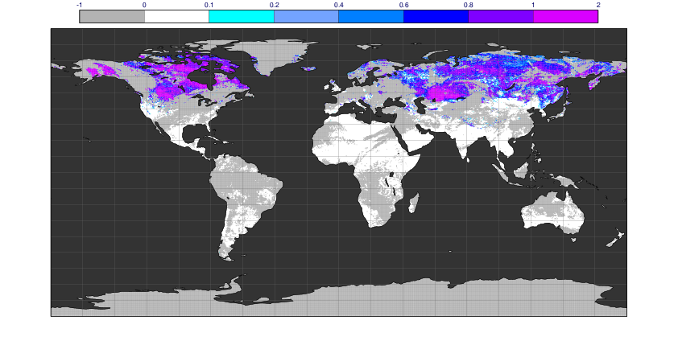
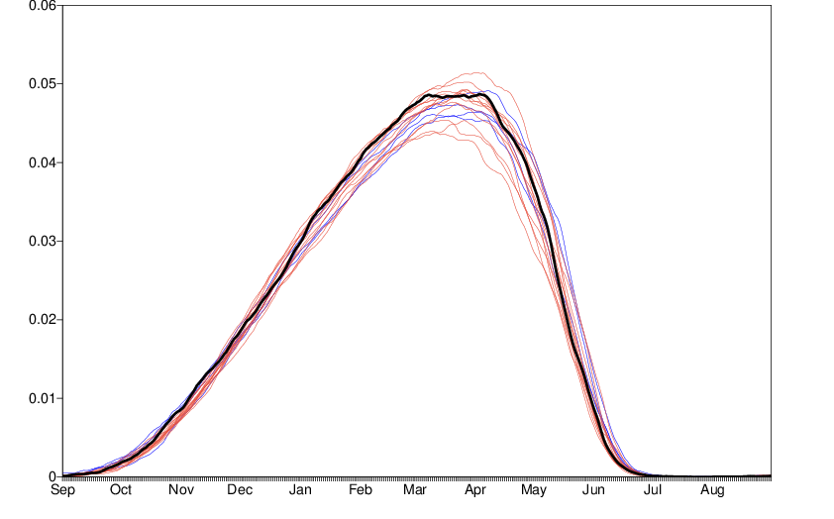
ESA CCI Snow assimilation for next reanalysis
ESA CCI Snow covering longer periods
  1982 - 2018 (AVHRR snow cover product)
As a first step, tested by offline LDAS
More consistent around 2004
  To be tested by coupled LDAS
ESA CCI Snow (15 Feb 2018)
SWE averaged in the NH (Offline LDAS)
2000-2004
2004-2018
2014/15
13

Slide 14
Summary
The current ECMWF LDAS relies on weakly coupled DA approaches
  Coupled forecasts for first-guess but separated land DA and atmospheric DA
Snow data assimilation plays an important role in the IFS
  Reduce systematic snow depth biases and improve forecast skill
Several ongoing activities
  IMS assimilation over the TP: significant impacts on analyses and forecasts
  QC modifications: importance of real-time monitoring for operational system
  ESA CCI Snow assimilation: enhance consistency of reanalysis for longer periods
14

Slide 15
Future plans
(More details in de Rosnay et al., QJRMS 2022)
Towards unified multivariate ensemble-based LDAS
  Start with extension of the SEKF (including all of land analyses)
  Use EDA information to estimate background error
Stronger land-atmosphere coupled assimilation with outer-loop
Coupling between land-atmosphere through the observation operator
  Relevance of the future Copernicus Expansion multi-frequency mission CIMR
  RTTOV simulation using CMEM* emissivity on snow-covered areas (Hirahara et al, 2020)
*CMEM: Community Microwave Emissivity Model (de Rosnay et al., 2020)
https://confluence.ecmwf.int/display/LDAS/CMEM
15

