Slide 1
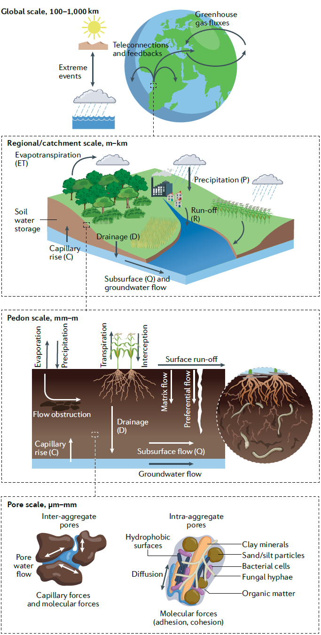





Towards a high-fidelity Integrated Forecasting System via ground-breaking and ambitious data-assimilation of the dynamic soil-vegetation hydraulic continuum
Team
Anne Verhoef (PI), Emily Black
Patricia de Rosnay plus Coupled Assimilation team; Gianpaolo Balsamo, Souhail Boussetta (ECMWF)
Dr Yijian Zeng (University of Twente, NL)
International collaborators

Slide 2
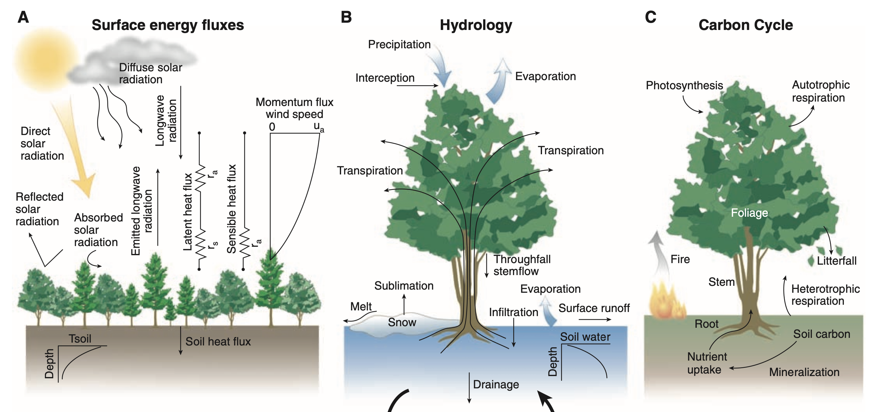

Problem-statement & importance of L-A feedbacks
Still considerable and persistent biases in land surface and near-surface state variables in ECMWF’s IFS forecasts
Modelled L-A feedbacks and related memories play a strong role....
Bonan, 2008, Science

Slide 3
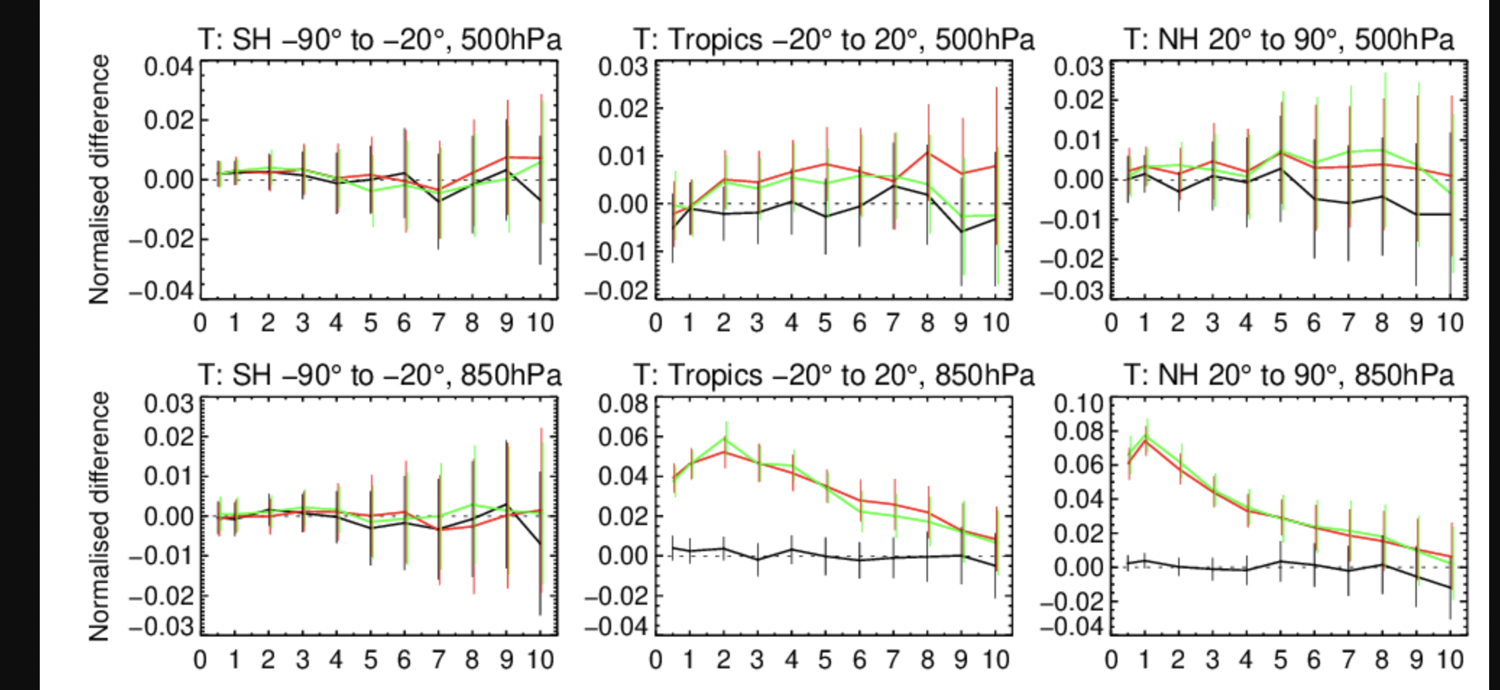
Soil analysis for NWP: impact of DA on the atmospheric forecast
Without soil moisture DA
Without soil moisture DA
With soil moisture DA
Temperature RMSE; JJA 2020; IFS cycle 48r1
☺
☺
FC lead time (days)
FC lead time (days)
FC lead time (days)
Significant positive impact of land DA on low level atmospheric temperature forecasts!

Slide 4
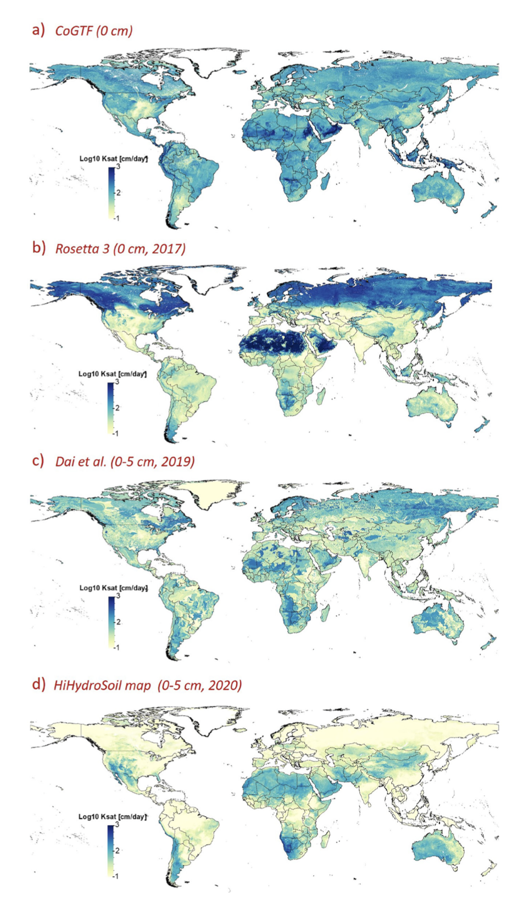
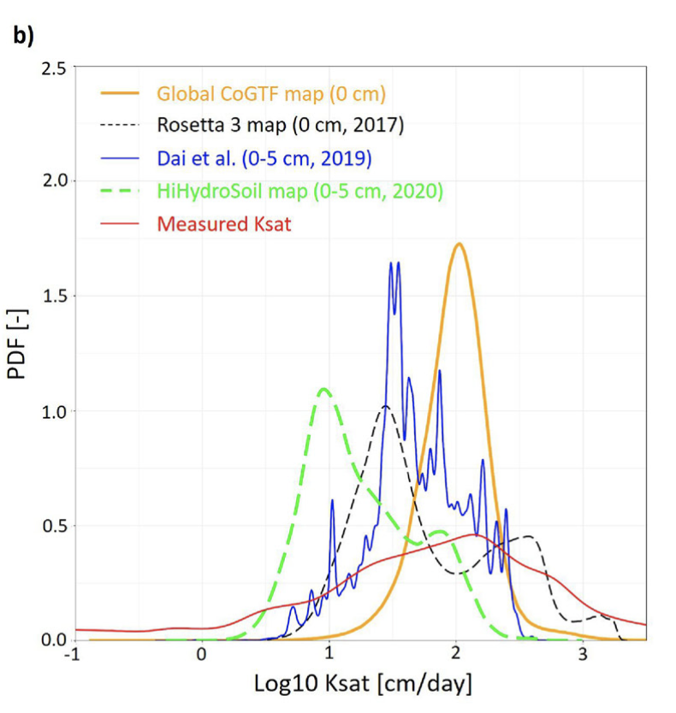
Issues with soil maps and Pedotransfer functions..
Gupta et al. (2021). Global prediction of soil saturated hydraulic conductivity using random forest in a Covariate-based GeoTransfer Function (CoGTF) framework. Journal of Advances in Modeling Earth Systems, 13

Slide 5
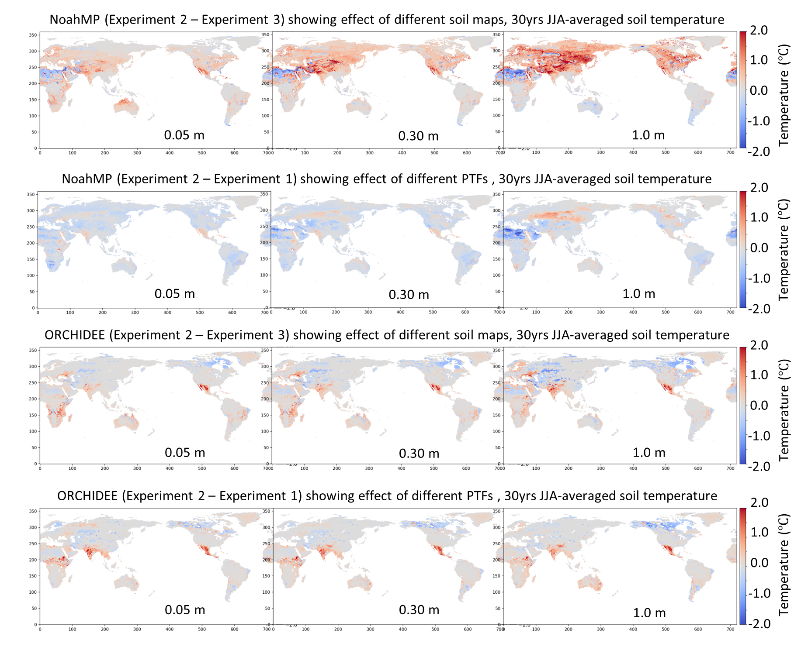
Implications: Soil Parameter-MIP
Different soil maps
NOAH-MP
Different PTFs
Different soil maps
ORCHIDEE
Different PTFs

Slide 6
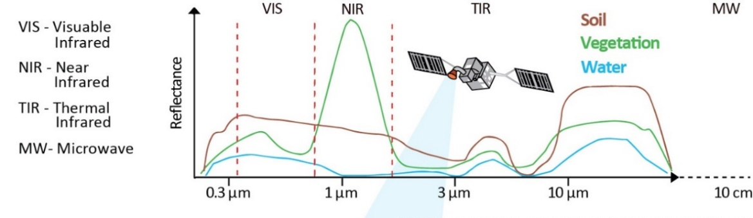
Aims
A significant reduction of surface and near-surface biases, at a range of spatial and temporal scales
Tackle issues with improved L-A coupling and related memories:
(i) Increase the realism in the representation of soil and vegetation in ECLand (leveraging interaction between soil structure & parameters)
(ii) Advance Earth Observation-driven model development of the coupled IFS Land Data Assimilation (DA) system (LDAS) and ECLand
(iii) Use a novel ‘vegetation as a root-zone soil sensor’ (VaaSS) approach via exploitation of the soil-vegetation-hydraulic-continuum:
  Satellite observables across near (NIR), thermal (TIR) and shortwave (SWIR) infrared, and microwave domains (MW), including the vegetation-soil variables: vegetation optical depth (VOD), Solar-Induced Fluorescence (SIF), leaf area index (LAI), soil moisture (SM) and land surface
  temperature (LST).
CMEM
CMEM: Community Microwave Emission Modelling Platform

Slide 7
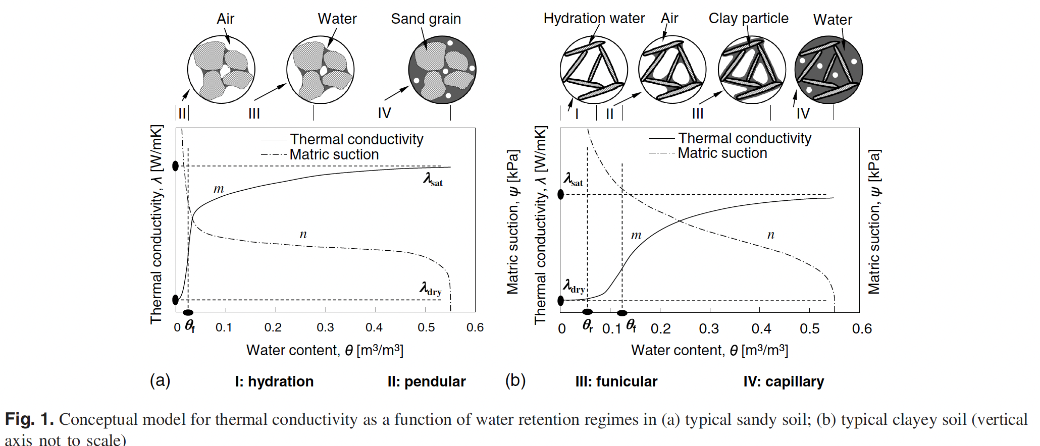
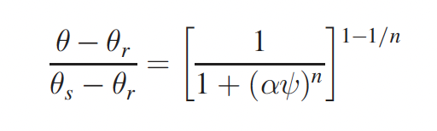
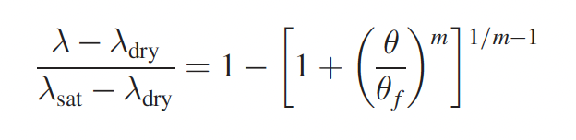
Implementing unifying soil hydro-thermal framework
Lu & Dong (2015)
Hydraulic and thermal theories are unified

Slide 8
Models, tools and datasets
Models:
  STEMMUS-SCOPE model (2021), IFS system (= LDAS and ECLand)
Datasets:
  Site-scale data: e.g. PLUMBER2 (170 sites) & ESM-SnowMIP
  Observing networks (e.g. SYNOP, the International Soil Moisture Network)
  Aerial and satellite EO-data (VOD, VWC, SIF, and LAI)
Tools:
  Multiscale parameter regionalization system (MPR) for testing and calibration, and re-tuning/optimization of parameters.
  Externalisation package for easy compilation and running of the standalone ECLand versions for PLUMBER2 and ESM-SnowMIP sites.
  Includes 2D regional and global offline simulation configurations
  LS analysis metrics and data from GEWEX-GLASS efforts (PALS: Protocol for the Analysis of Land Surface models; LoCo: Local Land-Atmosphere Coupling Working Group; ILAMB: The International Land Model Benchmarking project )

Slide 9
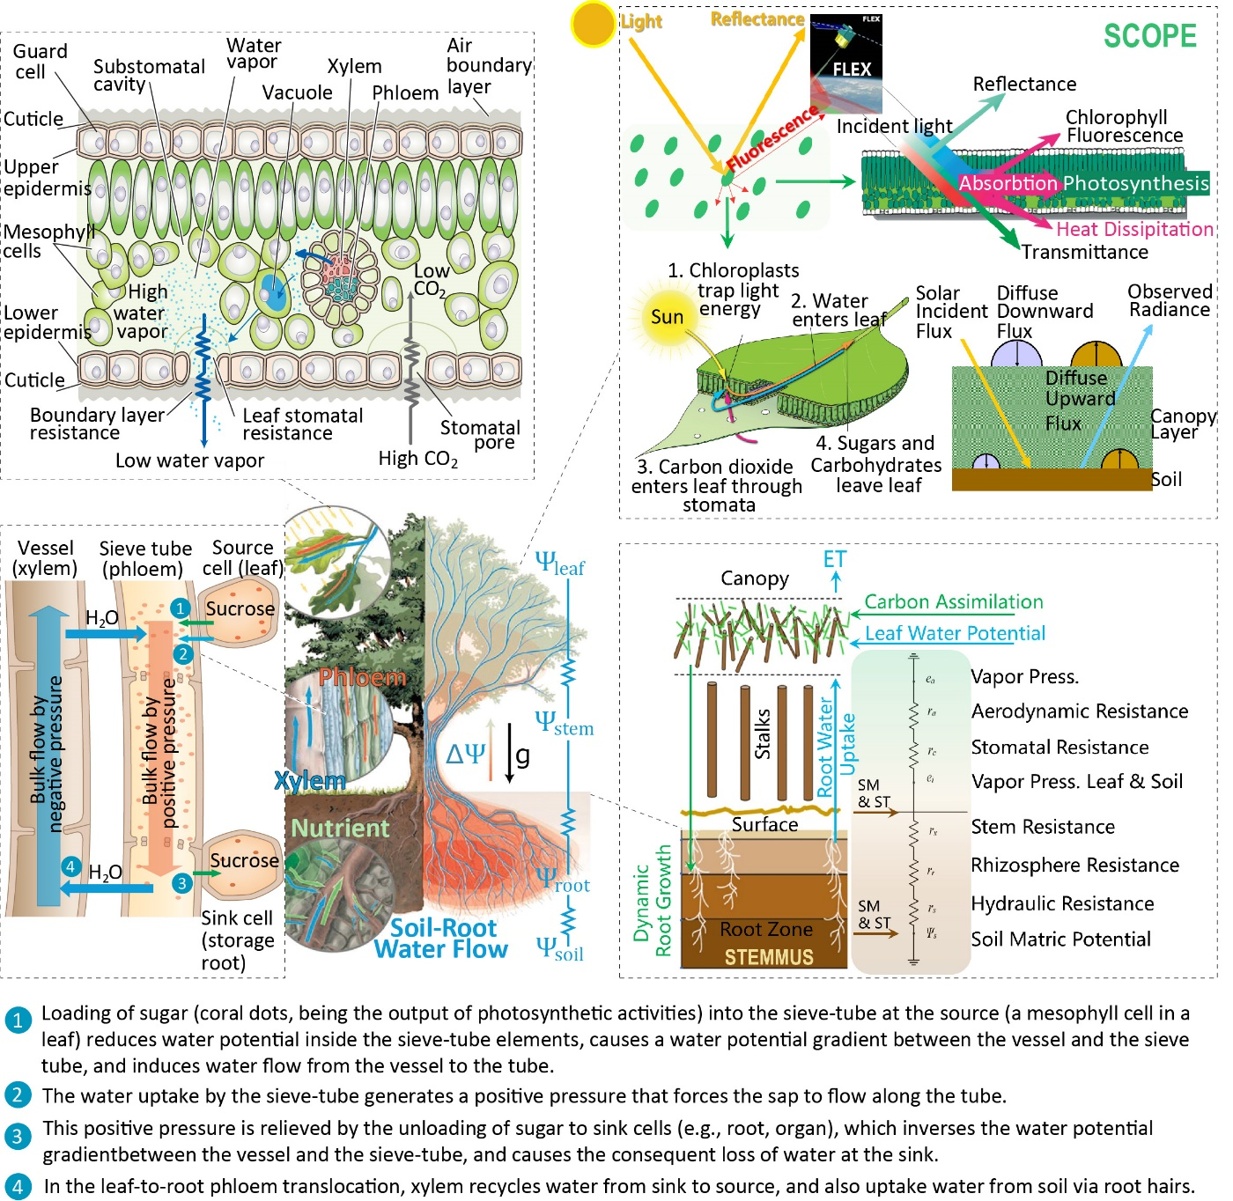
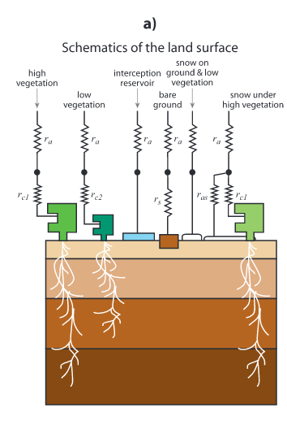
Project workflow: STEMMUS-SCOPE & IFS
SCOPE
WP1: Implementation, testing and verification of the ‘Vegetation as a root-zone Soil-Sensor’ (VaaSS) approach using the STEMMUS-SCOPE model + OpenDA
WP2: Extension of the ECMWF ECLand ensemble DA system to achieve novel dynamic soil-vegetation hydraulic parameter estimation
‘IFS’
STEMMUS
SCOPE: Van der Tol, C...Verhoef, A, Su, Z (2009). An integrated model of soil-canopy spectral radiances, photosynthesis, fluorescence, temperature and energy balance, doi: 10.5194/bg-6-3109-2009;
STEMMUS: Zeng, Y & Su, Z (2013) STEMMUS: Simultaneous Transfer of Energy, Mass and Momentum in Unsaturated Soil. (ITC-WRS Report). University of Twente (ITC), Enschede, The Netherlands, pp. 64; based on 2011 PhD thesis by Zeng

Slide 10
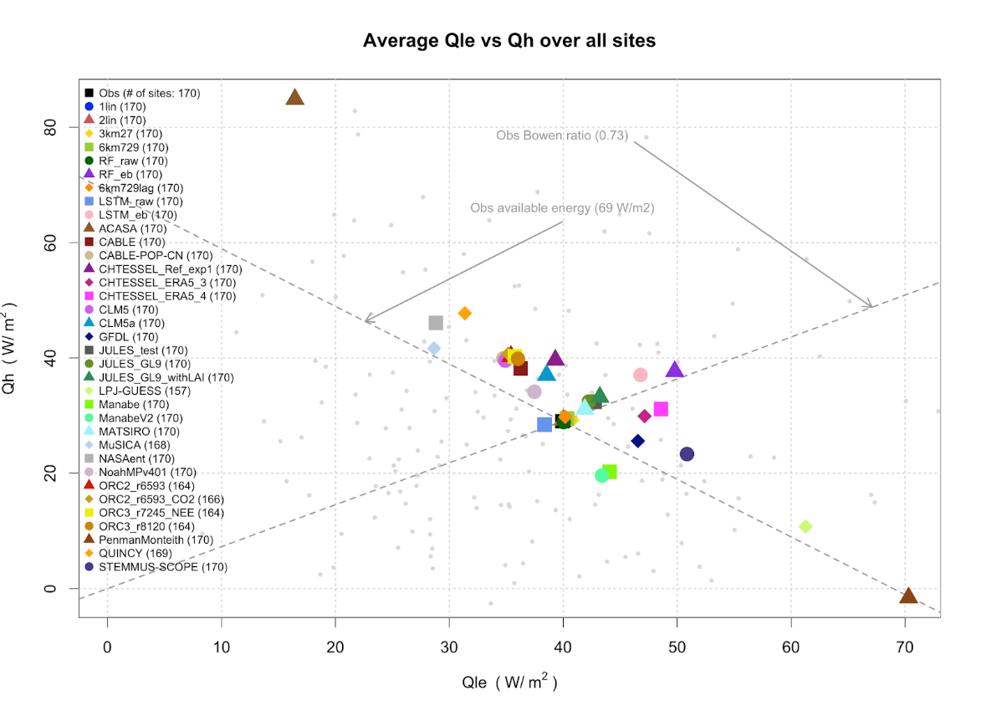
STEMMUS-SCOPE and ECLand validation via GEWEX-PLUMBER2
Latent heat flux versus sensible heat flux averaged over all 170 sites, for STEMMUS-SCOPE and ECLand (note: CHTESSEL model is equivalent to ECLand)
Bench-marks
Latent heat flux (W m⁻²)
ECLand
ECLand
Empirical
Bench-marks
STEMMUS-SCOPE
Sensible heat flux (W m⁻²)
PLUMBER2: Protocol for the Analysis of Land Surface models (PALS) Land Surface Model Benchmarking Evaluation Project, Phase 2

Slide 11
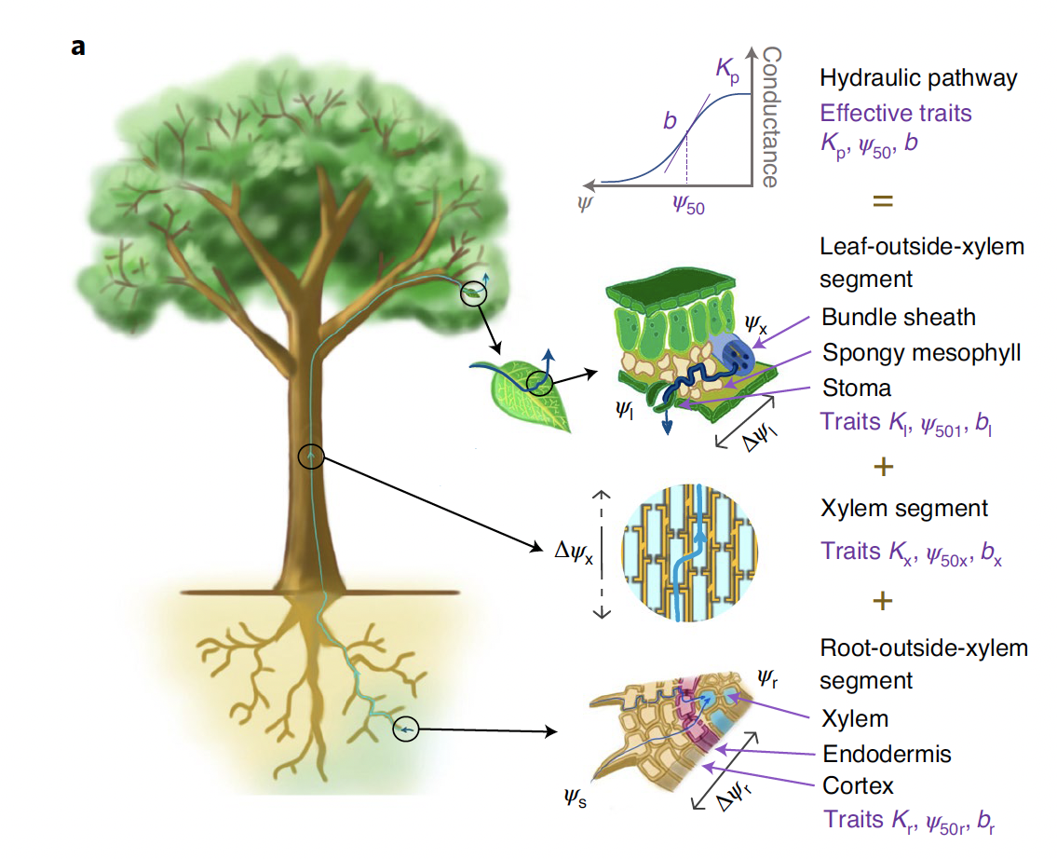
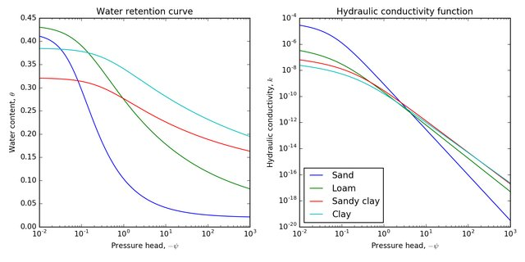
The soil-plant-hydraulic system and its properties
Joshi et al., (2022)
Plant part
Soil part
Ψ_{leaf}
Hydraulic conductivity, K
Ψ_{stem}
Affected by soil pore-size distribution !
Ψ_{soil}
Ψ_{root}
Both used in Richard’s equation
Ψ_{soil}
Soil water cotntent, θ
Drought stress: risk of ‘hydraulic failure’ increases when root water availability declines, or when vapour pressure deficit increases at the leaf surfaces.
Ψ_{soil}
Notes:
As a thermodynamic property of the water itself (i.e., its free energy), the
Ψ can be averaged at any scale and across media,

Slide 12
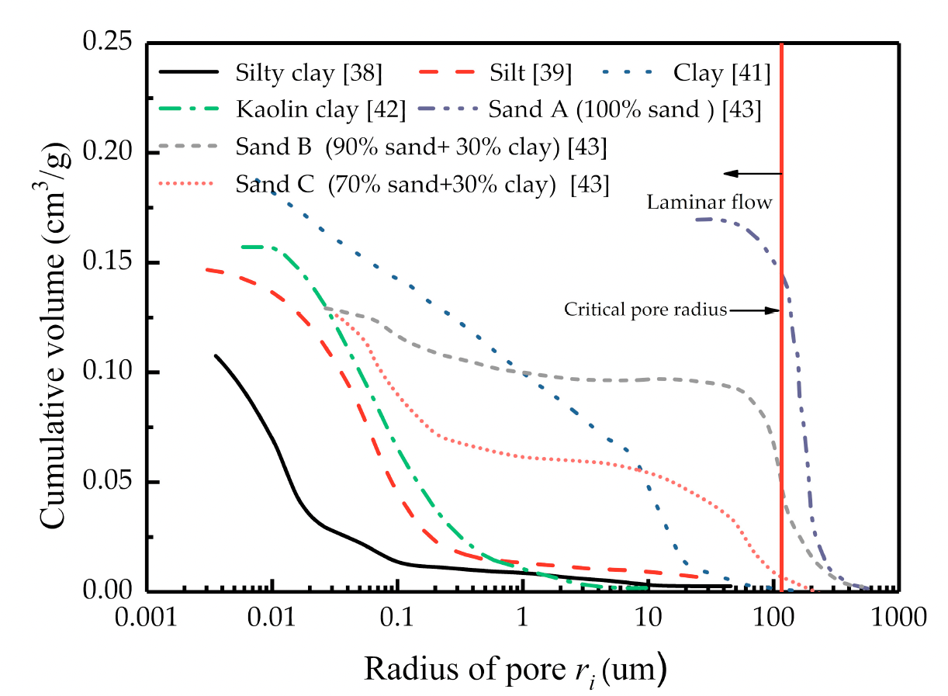
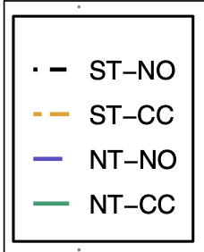

Use Ψ_{soil} to derive PSD and dynamic soil hydraulic curves
Central to this is a set of hydraulic equations in which pore-size distribution (PSD) directly affects the hydraulic functions: Kosugi model
Soil Texture
Land management effects
Chen et al., 2019
Local variability
Bulk densities
Araya et al., 2022
ST: standard till; NT: no-till; CC: cover cropping; NO: no cover-cropping
Schlüter &
Vogel, 2016

Slide 13
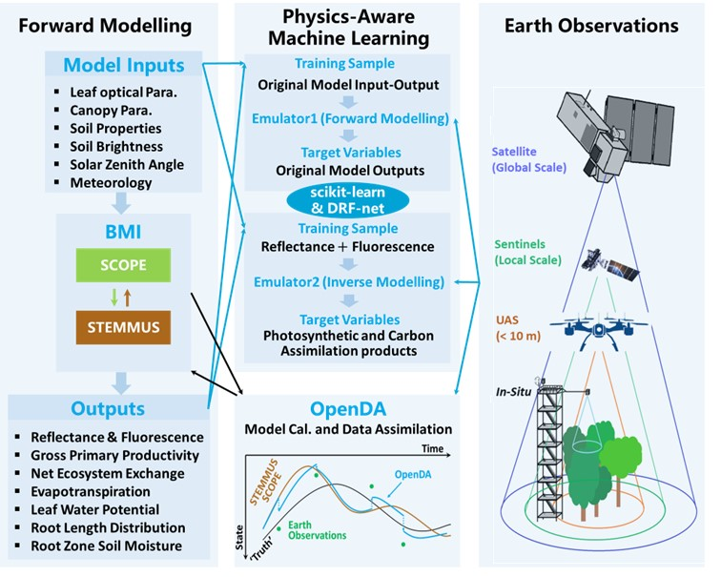
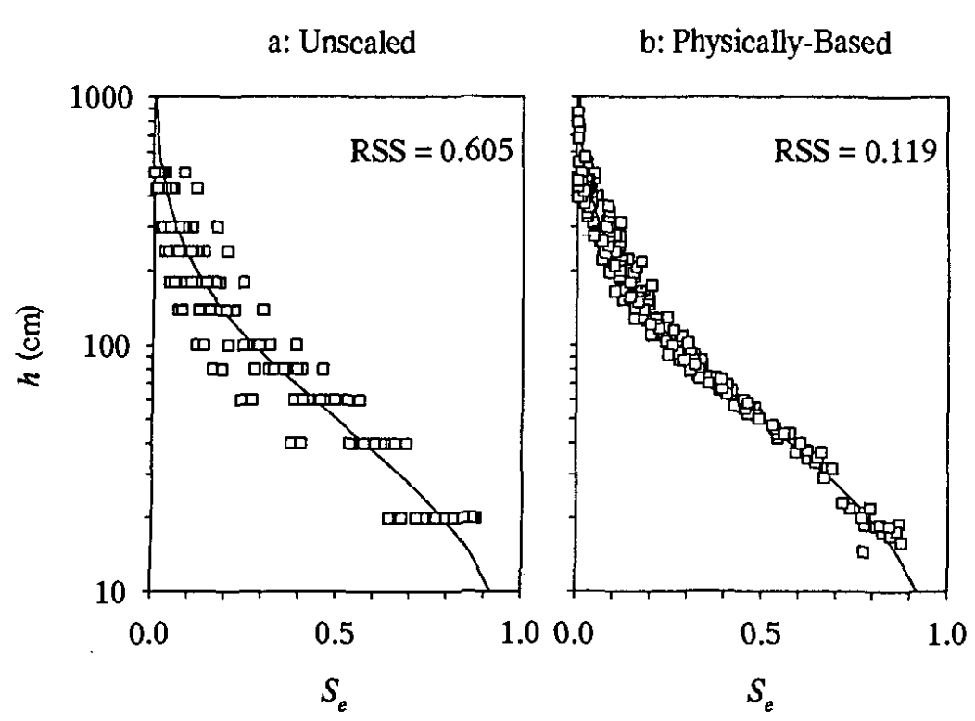
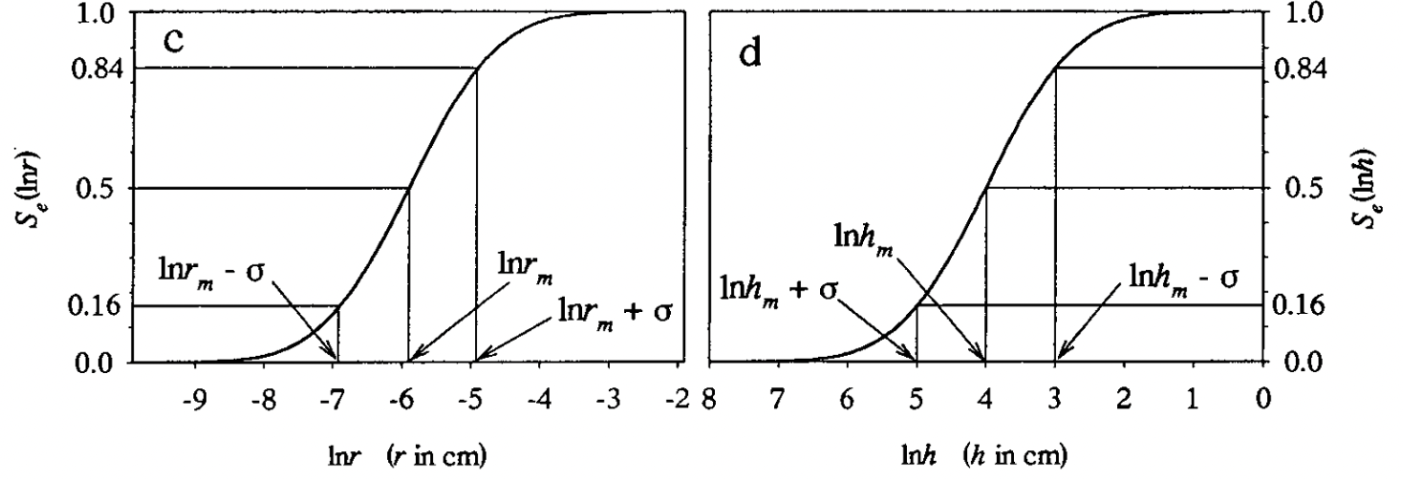
Seamless moving across spatiotemporal scales..
Earth observations at nested scales
→ area-representative soil parameters at a range of scales
Kosugi hydraulic functions (Zhang et al., 2018) also provide excellent scaling opportunities (Kosugi & Hopmans, 1998)
Hydraulic parameter sets will be accompanied with physically meaningful scaling parameters
information on sub-grid scaling variance is given for dynamical up-and downscaling, or to perturb hydraulic parameters for model ensemble output generation
h_{m} (median capillary pressure head = median Ψ_{s}), and standard deviation, σ, as Kosugi parameters
Un-scaled
Scaled
Relative SWC
Relative SWC
Relative SWC

Slide 14
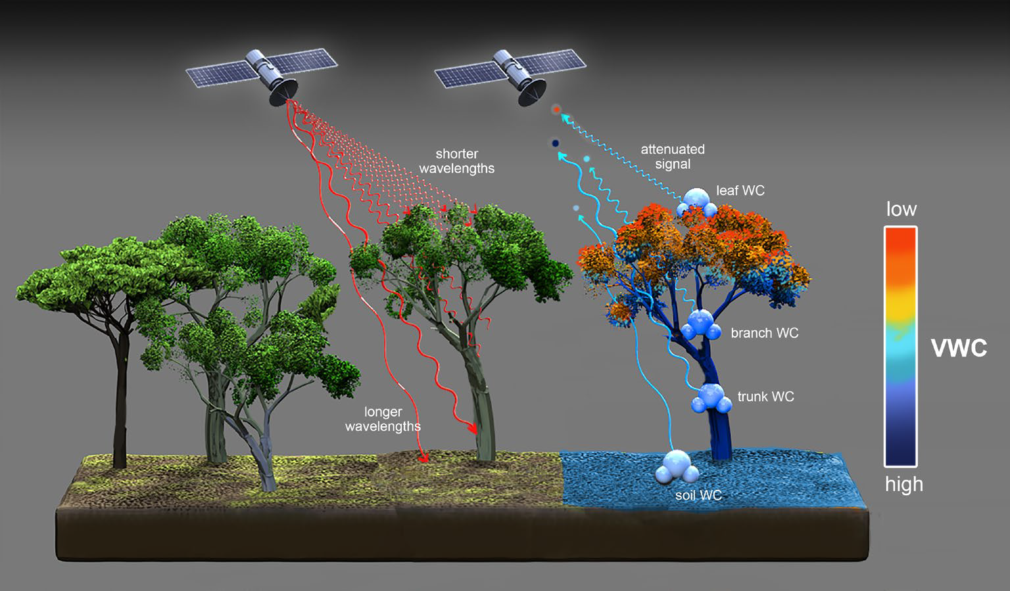
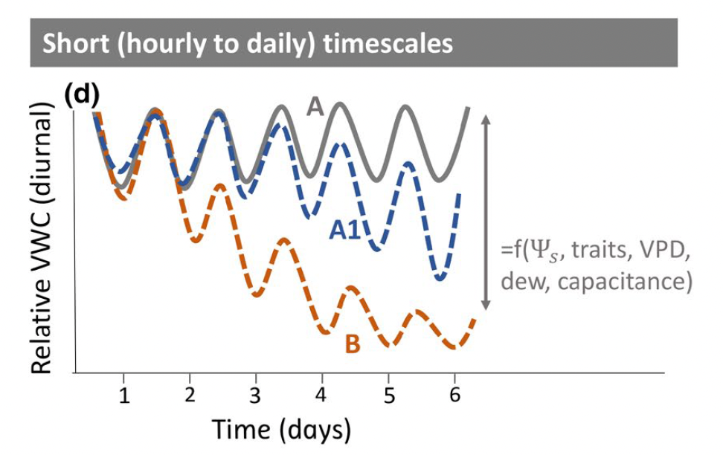
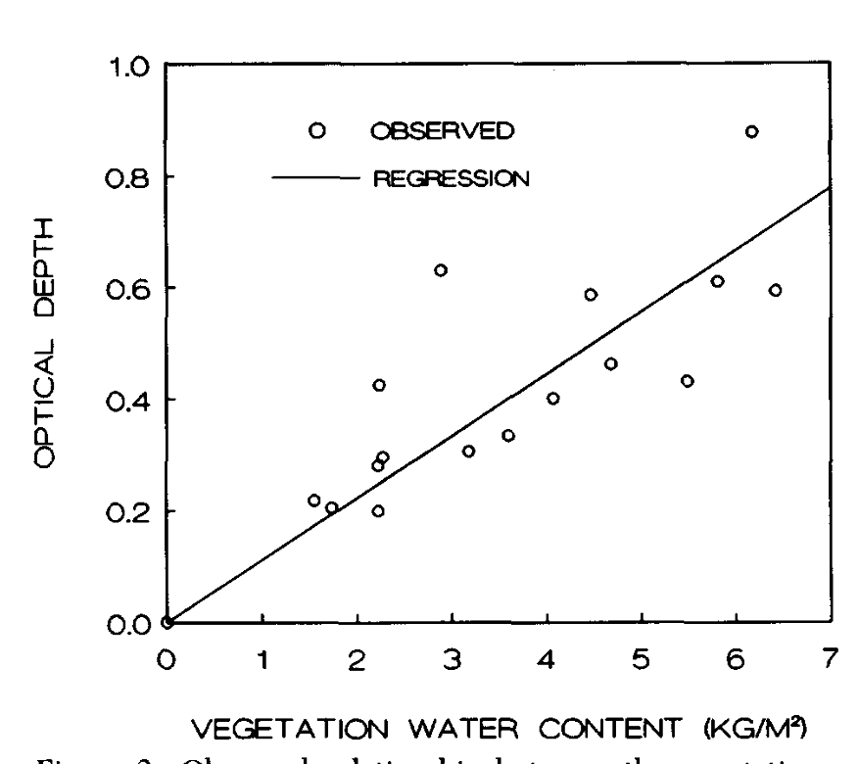
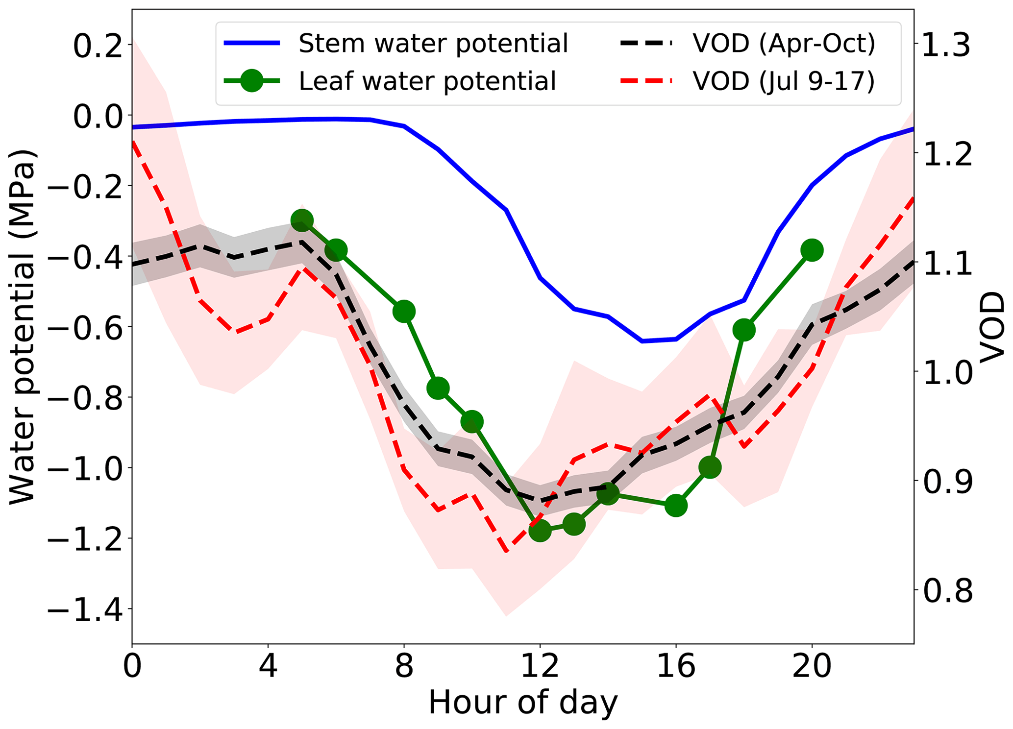
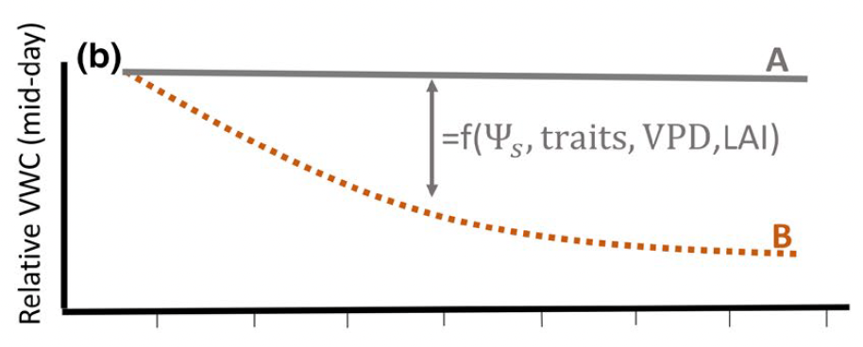
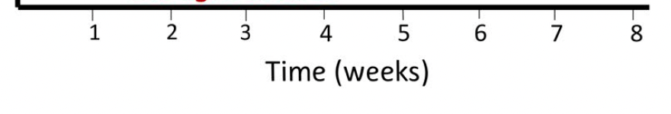
Spatio-temporal scales and RS observations
STEMMUS-SCOPE will simulate Ψ_{leaf} , and water content in roots, stem and leaves (i.e. VWC) as model state variables (‘background’)
Ψ_{soil} is found from jointly considering ‘Richards equation’ and root water uptake/transpiration estimates (via ‘Ohm’s law’)
S-S is also a forward observation simulator of reflectance and fluorescence spectra
VIS-NIR-TIR-MW data + DA → Updated ‘analysis’ of Ψ_{leaf} (via VIS-NIR-TIR), VWC (via VOD) & Ψ_{soil} estimates
Konings et al., 2021
Konings et al., 2021
Ecosystem drought responses
Holtzmann et al., 2021
Jackson & Schmugge, 1991

Slide 15
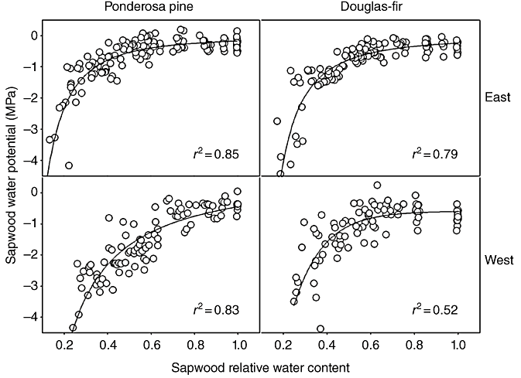
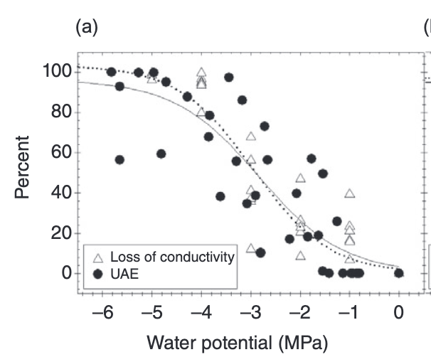
Hydraulic functions for vegetation
Derive the relationship between Ψ_{veg} and VWC (VOD) at the ecosystem scale (Pressure-Volume: P-V curve or moisture release curve)
Analogous to soil water retention/moisture release curves
Using nested combined visible and MW domain EO measurements, we will construct a family of Ψ_{veg} -VWC_{R} curves, that go hand-in-hand with the soil hydraulic modelling & scaling
Water potential, Ψ (MPa)
% loss of xylem conductivity
Water potential, Ψ (MPa)
Relative VWC
Notes:
As a thermodynamic property of the water itself (i.e., its free energy), the
Ψ can be averaged at any scale and across media, enabling the consideration
of an instantaneous Ψ for a cell, a leaf, a shoot, a branch,
or a tree (Pallardy et al., 1991; Scholander et al., 1964), or potentially,
the whole ecosystem. Given the spatial scale of remote sensing observations,
estimating Ψ from orbit would require ecosystem-scale
Ψ-WC curves (eco Ψ-WC;
pronounced, ecopsych). Such curves can
be conceived as large-scale
analogs of tissue-scale
P-V curves:graphical plots of the relationship between relative or absolute
water content and Ψ, commonly constructed by dehydrating leaves
or stems (Richter, 1978; Scholander et al., 1964; Tyree & Hammel,
1972). They are also analogous to soil water retention curves (Hillel
2013).
Notably, even for one ecosystem at any moment in time, the
eco Ψ-WC would consist of a family of curves, each dependent on
the spatial scale being used to average Ψ and VWC.
Furthermore, there is potential to extract parameters from eco Ψ-WC
curves, analogous to those extracted from leaf P-V
curves, to enable the consideration of how whole ecosystem drought resilience and its determinants shift
over the course of the day and seasonally, and how ecosystem-level
drought responses vary across ecosystems of different diversity, climate,
or soil type

Slide 16
Developing Emulators with Physics-Informed Machine Learning
Conceptual framework of EcoExtreML Project: PI Dr Yijian Zeng
EcoExtreML consists of three pillars: i) the forward modelling of STEMMUS-SCOPE; ii) the Physics-aware machine learning for building emulators of STEMMUS-SCOPE; iii) Earth Observation data that will be assimilated via deploying OpenDA. (Zeng et al. 2023, Unpublished)
Emulators are required for computing efficiency
To allow for ensemble parameter perturbation experiments

Slide 17
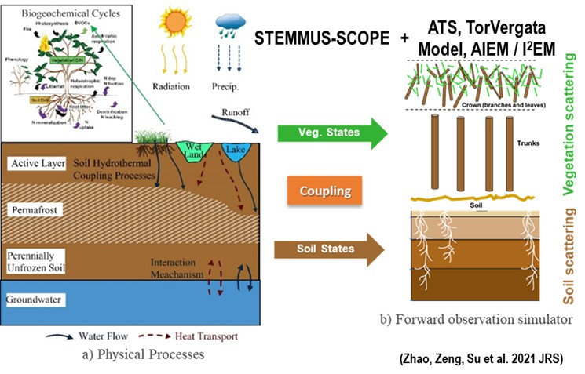
CMEM-STEMMUS-SCOPE emulator
CMEM*
*Community Microwave Emission Modelling Platform (de Rosnay et al, 2020)
Notes:
CMEM is composed of four modules to compute the contributions from the soil, vegetation, snow and atmosphere to the TOA TB. It includes a choice of different parameterizations for each component of the modules

Slide 18
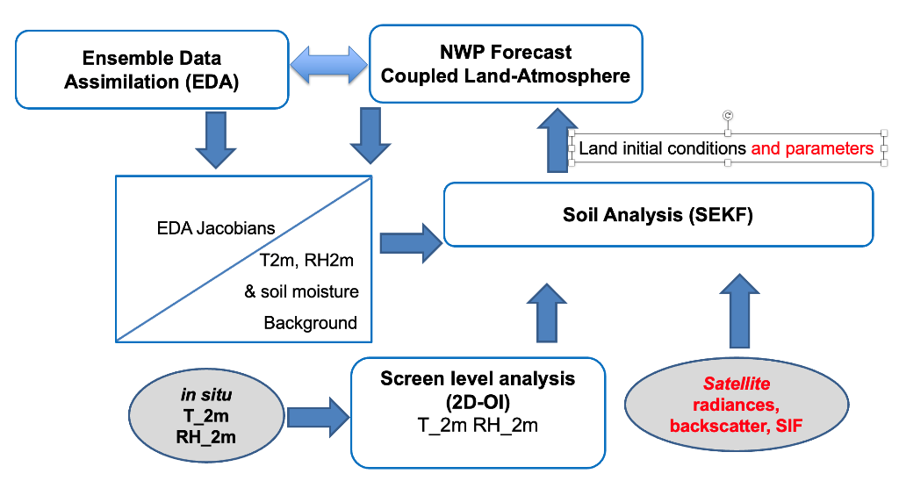
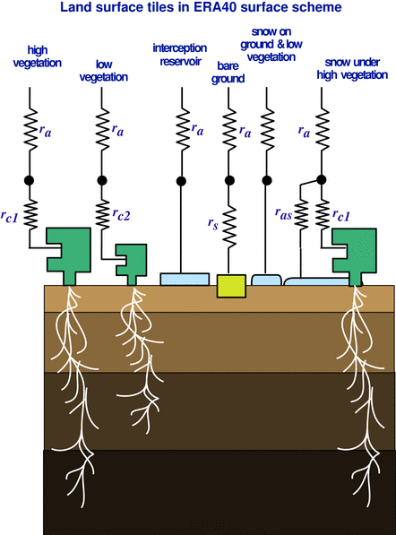
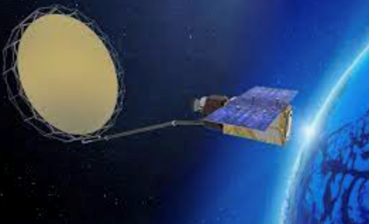
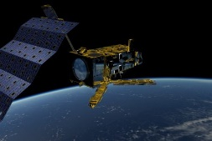
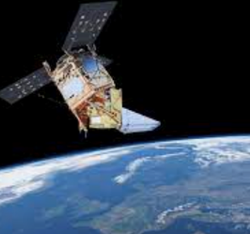
Vegetation as a root-zone Soil Sensor: operational
Extending and updating the ECMWF ECLand LDAS
Spatio- temporal derivation of veg. & subsurface properties, WP2
SM_{L1}(t)
SM_{L2}(t)
SM_{L3}(t)
SM_{L1}(t)
SM_{L2}(t)
SM_{L3}(t)
Soil Param
LAI
Phenology
α_{veg}
h_{veg}
WP1
x_{b}(t) =
WP2
Scalable, dynamic
Veg. & soil
parameters
Updated ECLand
& LDAS
Copernicus Imaging Microwave Radiometer:
CIMR
Notes:
SEKF: simplified extended Kalman filter
- The x(b) vector is the state vector.
- SM L1-L2 refers to the model soil moisture layers 1, 2 and 3 (down to 1m depth).
- I have added in red 'and parameter' because indeed we currently only do initial conditions
- I didn't include snow DA as part of the schematic because our snow DA relies a different system (not part of the SEKF yet). Since the proposal focuses on soil analysis this schematic is appropriate. But if there is a question on this, we are actually working on including snow in the SEKF. So, in the long term we will have snow in the SEKF.
- I have added new satellites such as CIMR and products such as SIF. We are currently working on developments in other projects to use these new data (e.g. in CERISE and CORSO), but we will not address soil parameter. So, the VaaS approach is very complementary: it will rely on developments we do in the sense that we have the data in our system (or we are working on it), and it will extend the usage of these satellite data to constrain the soil parameters.

Slide 19
Work-packages, WP1
WP1: Implementation, testing and verification of the ‘Vegetation as a root-zone Soil-Sensor’ (VaaSS) approach using the STEMMUS-SCOPE model
Deliverables
D1.1 PIML*-based CMEM**-STEMMUS-SCOPE emulator.
D1.2. Literature study on state-of-the-art soil hydro-thermal theory and VaaSS approaches.
D1.3 Expert elicitation workshops (e.g. via ISMC working groups, GEWEX GLASS SoilWat activity, and EO-DA forums).
D1.4 Updated CMEM-STEMMUS-SCOPE model/emulator (with theory derived from D1.2-1.3) and testing for ROIs
D1.5 Optimal set of model parameter distributions for the ROIs, and climatologies
D1.6 Multi-year parameter sets for initial tests with IFS (see WP2), drawing from parameter distributions provided by D1.5
D1.7 Papers to summarise the findings and recommendations from WP1.
*PIML: Physics-informed Machine Learning
** Community Microwave Emission Modelling Platform

Slide 20
Work-packages, WP2
WP2: Extension of the ECMWF ECLand ensemble DA system to achieve novel dynamic soil-vegetation parameter estimation
Deliverables
D2.1 New version of ECLand with updated soil-plant hydraulic system theory and offline DA updates based on WP1.
D2.2 Production and evaluation of offline ECLand ensemble land DA experiments with updated soil & vegetation parameters.
D2.3 Production of medium-range coupled NWP experiments on selected case studies and assessment of updated parameters’ impact. D2.4 Papers presenting findings of D2.1-D2.3; communications to scientists and end-users.
D.2.5 Internal ECMWF report detailing the findings and recommendations.

Slide 21
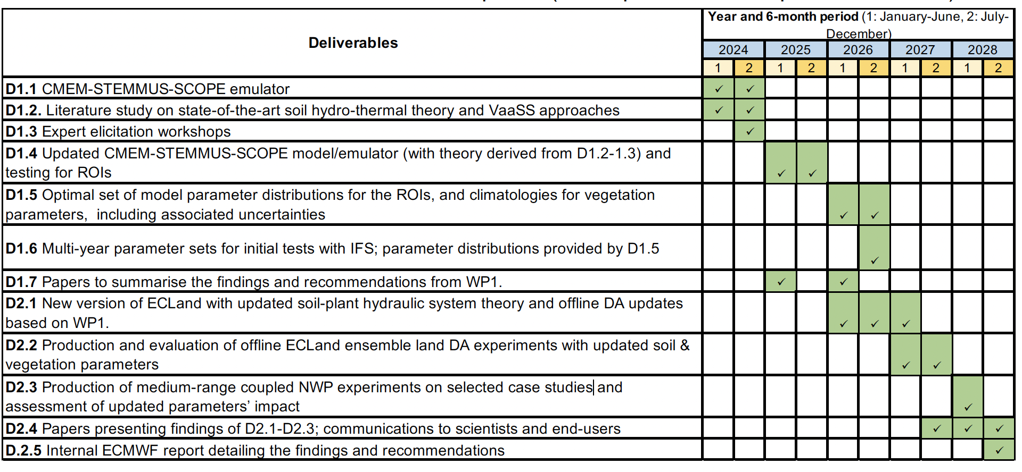
Project Management & Workplan

Slide 22
SOME EXTRA/STANDBY SLIDES

Slide 23
.. what sort of temporal or spatial resolution the STEMMUS-SCOPE or ECLand models will be run at?
For system development, STEMMUS-SCOPE and off-line ECLand model will be run at the point scale at a 30 mins timestep to fit with the in-situ observations from e.g. PLUMBER2 (FLUXNET)
ECLand will also be tested and evaluated at global scale at Tco399 (25 km spatial resolution) for all seasons
Further experiments at Tco1279 (9km) will be conducted with ECLand to assess the capability of VaaSS to capture surface properties at different spatial scales.
The impact of VaaSS in ECLand on subsequent NWP will be evaluated at these two resolutions with a particular focus on the impact of VaaSS on NSASV forecast skills.
The land data assimilation is every 6 hours (at 0,6,12,and 18 UTC). The model time step much shorter ~ 10min
ECMWF OSMA package also includes 2D regional and global offline simulation configurations (as developed within the EartH2Observe project) for catchment evaluations at the spatial resolutions of 0.25° x 0.25°, 0.1° x 0.1° and 0.05° x 0.05°.

Slide 24
...which observations would be used in the data assimilation, and how information about processes affecting soil structure (land management, environmental change etc) would be gathered, compiled and used at relevant scales for land surface modelling
For STEMMUS-SCOPE DA system, the following EO observables (of soil-plant system) would be assimilated: VOD - Vegetation Optical Depth (e.g., from SMOS and AMSR-2), LAI – Leaf Area Index (e.g., CONFESS or MODIS), SIF – Solar-induced Fluorescence (e.g., OCO-2, TROPOMI), Soil Moisture (e.g., ASCAT), and Land Surface Temperature (e.g., ESA CCI LST).
All these observations can help update the soil-plant states and parameters, including vegetation water content, leaf water potential, soil water potential, and soil hydro-thermal properties. We will derive parameterisations by using historical observation and driving data
Here, since the EO-based vegetation variables (i.e., VOD, LAI, and SIF) will be assimilated, the effect of land use change (e.g., linked to land management) is, therefore, automatically considered (via the effect of soil structure change).
We will translate these effects into soil hydraulic parameters (at any scale required) by using the Kosugi model that directly links soil structure (via changes in pore-size distribution) to soil potentials. This model also allows for easy scaling between spatial scales
There are also strong functional relationships between soil hydraulic properties (SHPs) and vegetation cover across different soil types and biomes that have been used to characterize soil structure effects on SHP parameters. (Bonetti et al. 2021)

Slide 25
It is unclear why developing a CMEM emulator is included in this project (WP1.1), or what the purpose of using a STEMMUS-SCOPE emulator would be..
The STEMMUS-SCOPE is already a forward observation simulator for the VNIR-SWIR-TIR domain, and can simulate top of canopy reflectance and fluorescence, but not the microwave domain. We will extend the STEMMUS-SCOPE model to MW domain (0.5-100 cm), via coupling STEMMUS-SCOPE to CMEM.
Running the above STEMMUS-SCOPE-CMEM model would be very computationally expensive
even more so for optimizing model parameters, which requires sometimes thousands of model realizations.
Therefore STEMMUS-SCOPE-CMEM emulator will approximate the original model by a surrogate machine learning model. Based on a limited number of STEMMUS-SCOPE runs, the input-output pairs (i.e., training samples) can be used to establish the emulator, which is then used to infer the model output given a yet-unseen input configuration.
The emulator of STEMMUS-SCOPE has been developed for a global sensitivity analysis of parameters and fast generation of synthetic TOC reflectance and SIF, accelerating the model in the orders of hundreds to thousands of times at plant scale.
For the same purpose, the CMEM MW emulator will be developed.

Slide 26
The project contains a large amount work, and it would be important to understand whether sufficient time has been allowed for, e.g., collation of datasets, methods for developing observation operators for the STEMMUS-SCOPE DA part of the project, model development, and dissemination and writing up of results....
As discussed above, the coupled STEMMUS-SCOPE model has been validated for 170 Fluxnet sites. These datasets, combined with historical EO observables for these sites will be used in the project
We agree that there is a large amount of work proposed in this project. Nevertheless, we are not starting from scratch.
For example, the STEMMUS-SCOPE Data Assimilation Framework will be developed in the existing project EcoExtreML, applying the open interface standard OpenDA.
In the same project, the STEMMUS-SCOPE emulator has been also developed, the approach of which can be conveniently applied to develop a CMEM emulator. As such, we are quite confident that we can build the STEMMUS-SCOPE-CMEM forward observation simulator, and to complete proposed WP tasks within the AFESP project duration of 5 years.

Slide 27
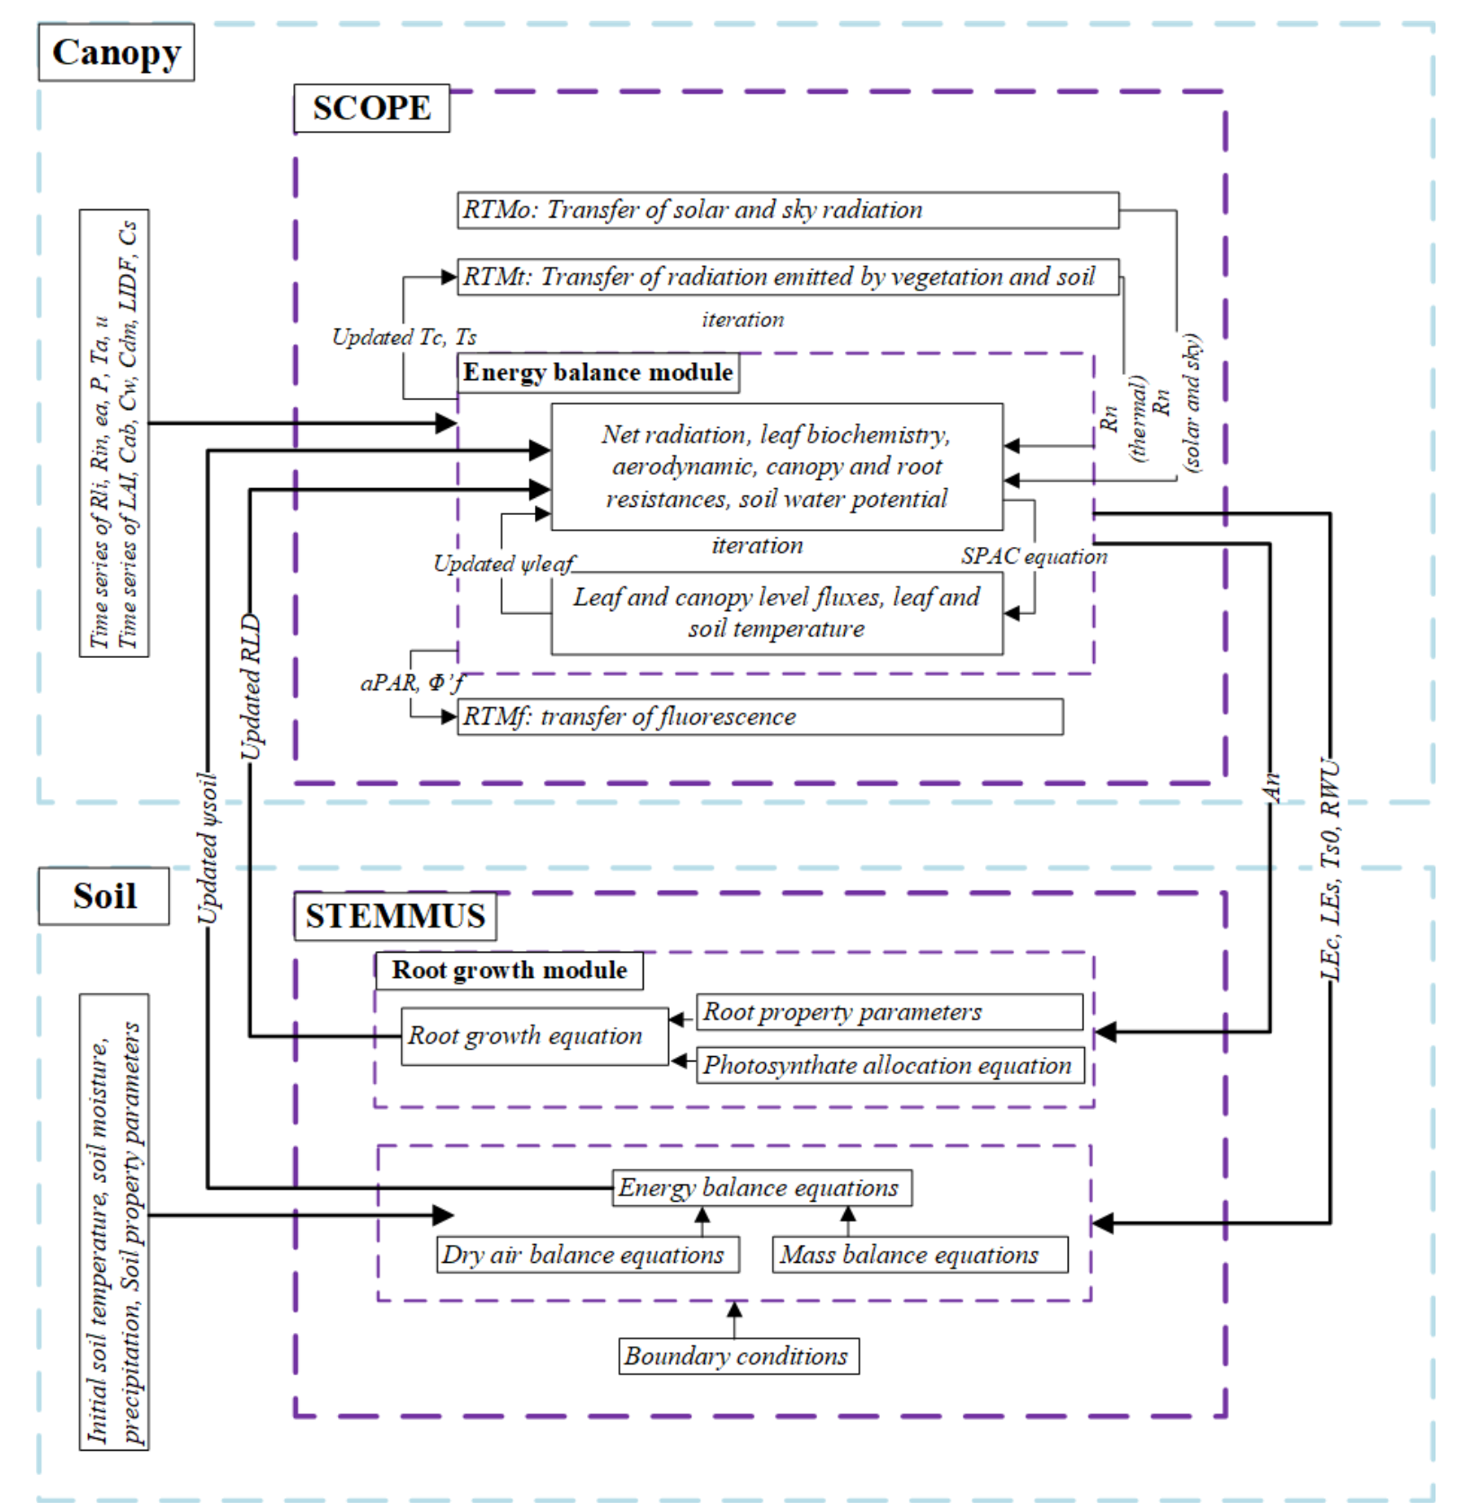

Slide 28
Examples of Regions of Interest (ROI)
Tibetan plateau to study the effects of freeze-thaw and soil-snow-atmosphere feedbacks on model biases;
Agricultural bread-baskets for scrutiny of land use and management effects on model biases;
Amazon for root-soil interactions and its implications for spatio-temporal variability of PSD, soil properties and related biases of LSSV and NSASV
Etc.

Slide 29
Current lack of realism in LMs?
Soil and vegetation parameters are prescribed and remain static
They are assumed independent of each other & environment
Soil parameters derived from globally distributed soil maps and empirical pedotransfer functions (PTFs)
Land use and management activities are not considered
  tillage and livestock trampling
  freeze-thaw effects
  vegetation growth
  fire
This causes major issues in the context of km-scale modelling!

Slide 30
Soil input parameters; current situation
Main parameters:
  soil hydraulic parameters (water retention curve and hydraulic conductivity curve)
  soil thermal properties (thermal conductivity and heat capacity)
  soil biogeochemical parameters
  vegetation-related (root depth)
  General: soil profile depth, soil layer thickness
Soil maps & related datasets : basic soil properties; semi-realistic vertical distribution
Classic soil PedoTransfer Functions (PTFs) or Covariate GeoTransfer Function (CoGTF) Frameworks
  PTFs: Choice of soil dataset, soil covariates
  CoGTF Choice of PTFs or CoGTF, and type and source of environmental covariates

Slide 31
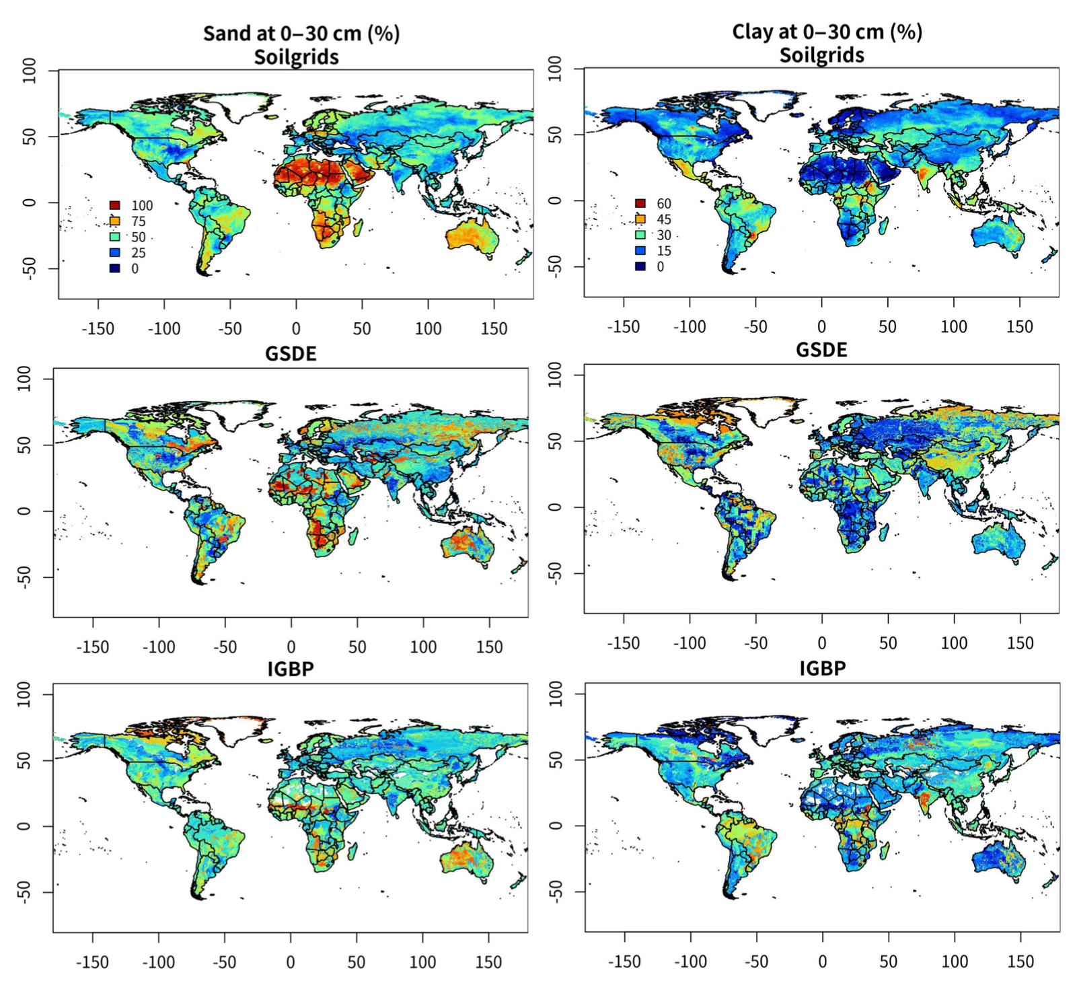
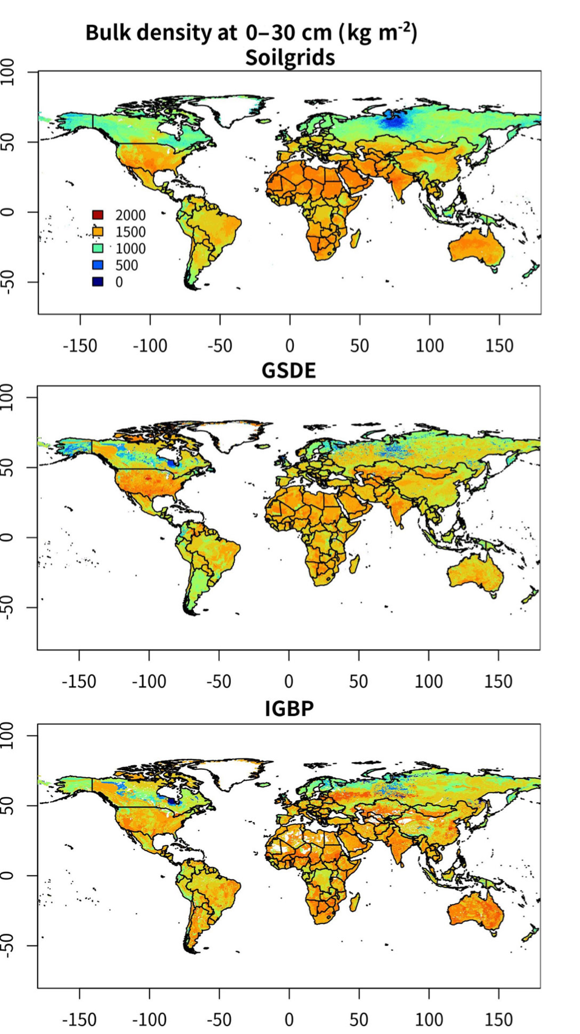
Global soil datasets
Dai et al., 2019.: A review of the global soil property maps for Earth system models, SOIL, 5, 137–158, https://doi.org/10.5194/soil-5-137-2019, 2019

Slide 32
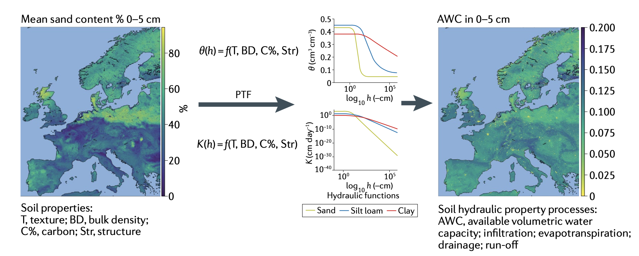
Classical pedotransfer function (PTF) approach
Vereecken, H., Amelung, W., Bauke, S.L. et al. Soil hydrology in the Earth system. Nat Rev Earth Environ 3, 573–587 (2022). https://doi.org/10.1038/s43017-022-00324-6

Slide 33
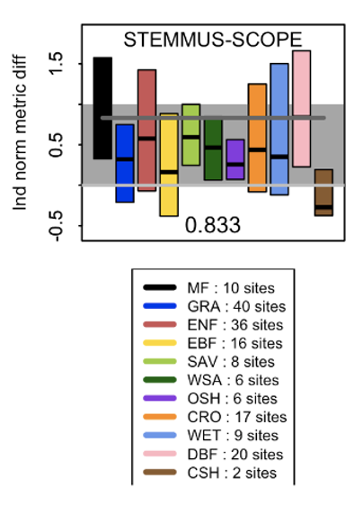
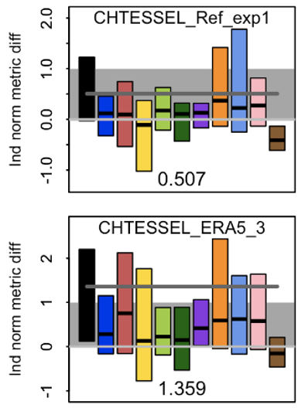
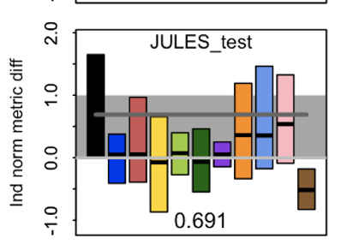
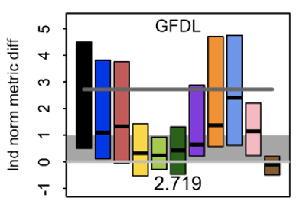
STEMMUS-SCOPE and ECLand validation via GEWEX-PLUMBER2
Normalised metric discrepancy between each mechanistic model and LSTM_raw for latent heat flux (Qle), with separate inter-quartile boxes for each vegetation type, using raw fluxes. Mean model discrepancy is shown by the dark grey line and text at the bottom of each panel, with reference empirical model range [0,1] shaded in grey.
Notes:
LSTM: A Long Short-Term Memory model, empirical benchmark, given as much information as the LMs

