Slide 1



Global hourly 9 km terrestrial water-energy-carbon fluxes with physics-informed machine learning
Tentative Agenda:
-Update UoR (20 min)
-Update from ECMWF (20 min)
-Update from U Twente (20 min)
-Discussion (30 min)
Qianqian Han¹, Yijian Zeng¹, Yunfei Wang¹, Fakhereh (Sarah) Alidoost², Francesco Nattino², Yang Liu², Bob Su¹
¹ ITC, University of Twente, the Netherlands
² Netherlands eScience Center, the Netherlands
11 June, 2024
Update on land surface observation operator developments at ECMWF and UTwente and link to VaaS (vegetation as a root-zone soil sensor) plans.

Slide 2
Workflow Outline
Data preparation
Emulator build
Feature importance
Preliminary testing result (testing_random, testing_time, testing_space)
Fluxes map

Slide 3
1 Data preparation
--Input and output variables
The input variables selected from STEMMUS-SCOPE include:
Rin (Incoming shortwave Radiation),
Rli (Incoming Longwave Radiation),
ea (Air Vapor Pressure),
Ta (Air Temperature),
p (Air Pressure),
u (Wind Speed),
Precip_msr (Precipitation),
CO2 (Carbon Dioxide Concentration),
SSM (Surface Soil Moisture),
LAI (Leaf Area Index),
hc (Canopy Height),
Vcmo (Maximum carboxylation rate),
IGBP (International Geosphere-Biosphere Programme land cover type).
The output variables are:
LE (Latent Heat Flux in W m⁻²),
H (Sensible Heat Flux in W m⁻²),
G (Soil Heat Flux in W m⁻²),
Rn (Net Radiation in W m⁻²),
GPP (Gross Primary Productivity in umol m⁻² s⁻¹),
SIF in 685 nm (Solar-Induced Fluorescence in W m⁻² um⁻¹ sr⁻¹),
SIF in 740 nm (Solar-Induced Fluorescence in W m⁻² um⁻¹ sr⁻¹).
Notes:
API, Bob thought I used it. 我记得我好像也用它试验过，后来怎么去掉了？但是我记得现在的RZSM是用了API的。
When Rasj said dependent, he means output variables, Bob thought it is time dependent.

Slide 4
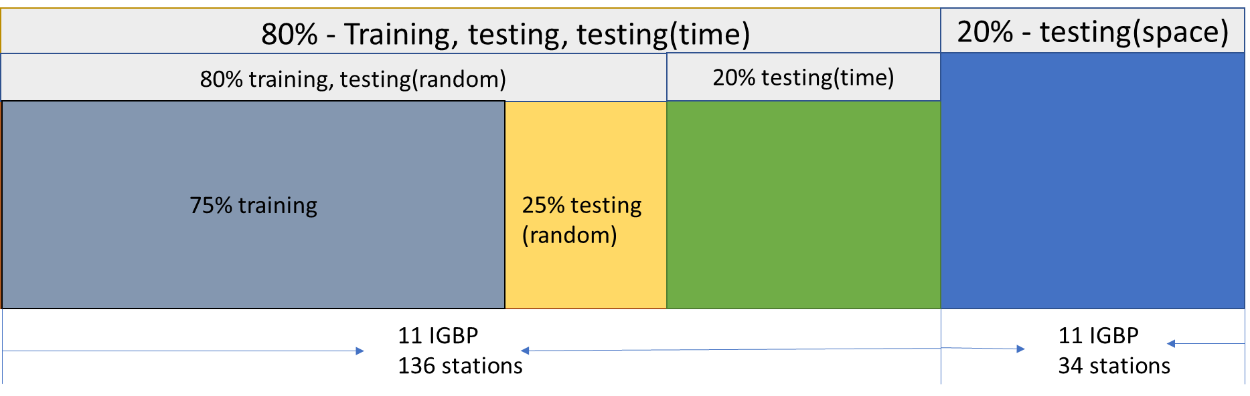
1 Data preparation
--Data split
Spatial training, testing. Every IGBP, select 80% as training and testing. The rest 20% as testing(space).
For the 80% in the first step, we select 80% along time as training and testing, and 20% as testing(time).

Slide 5
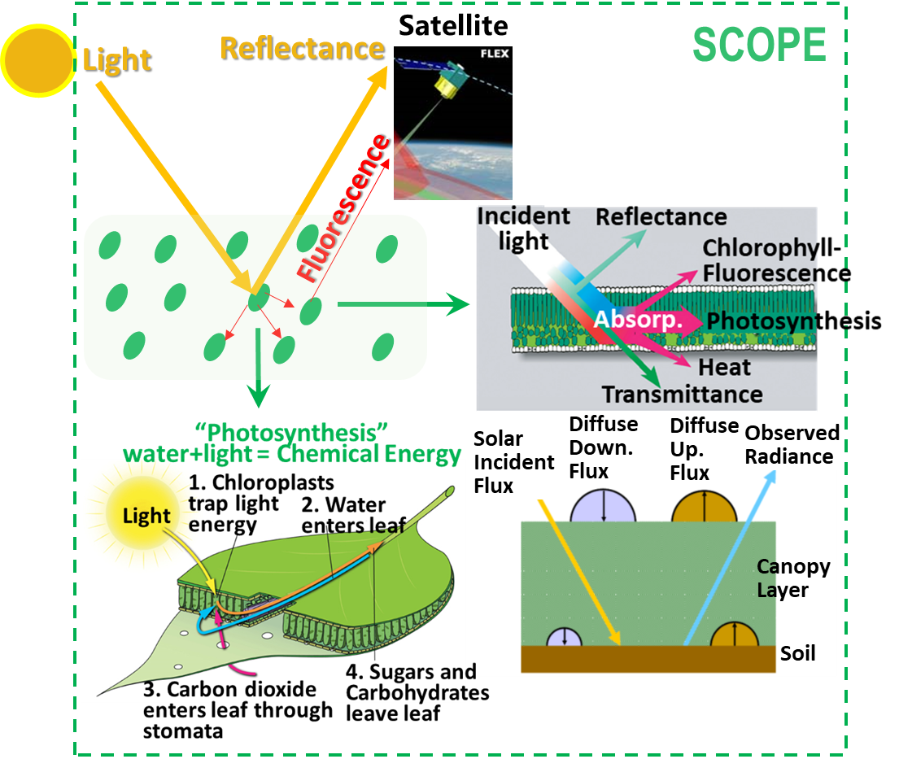
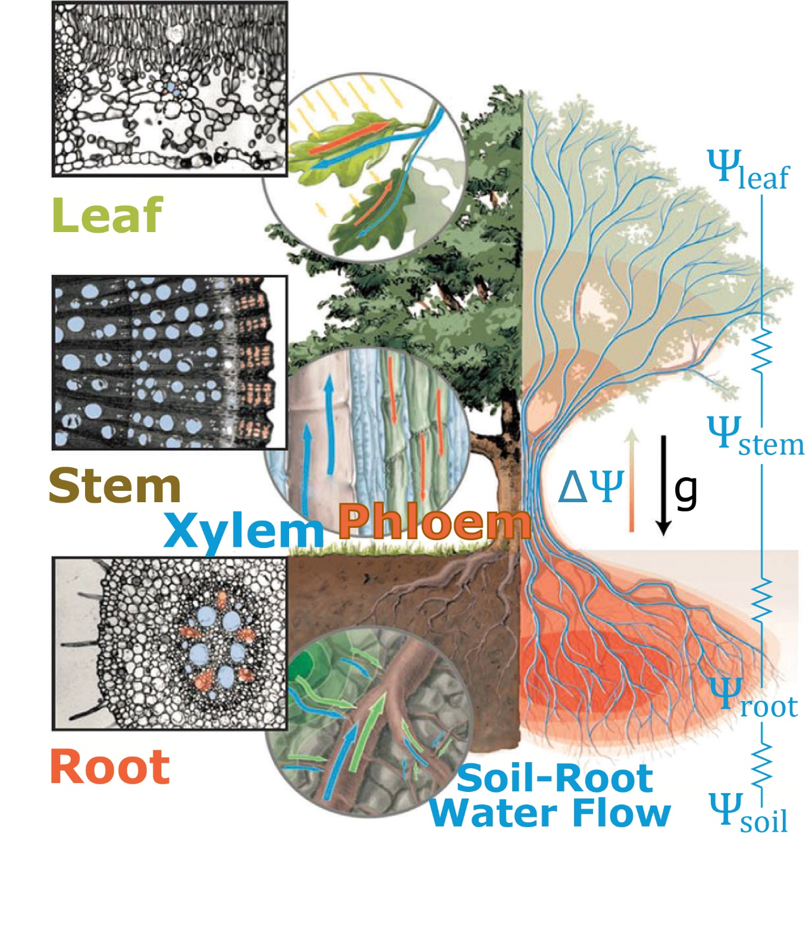
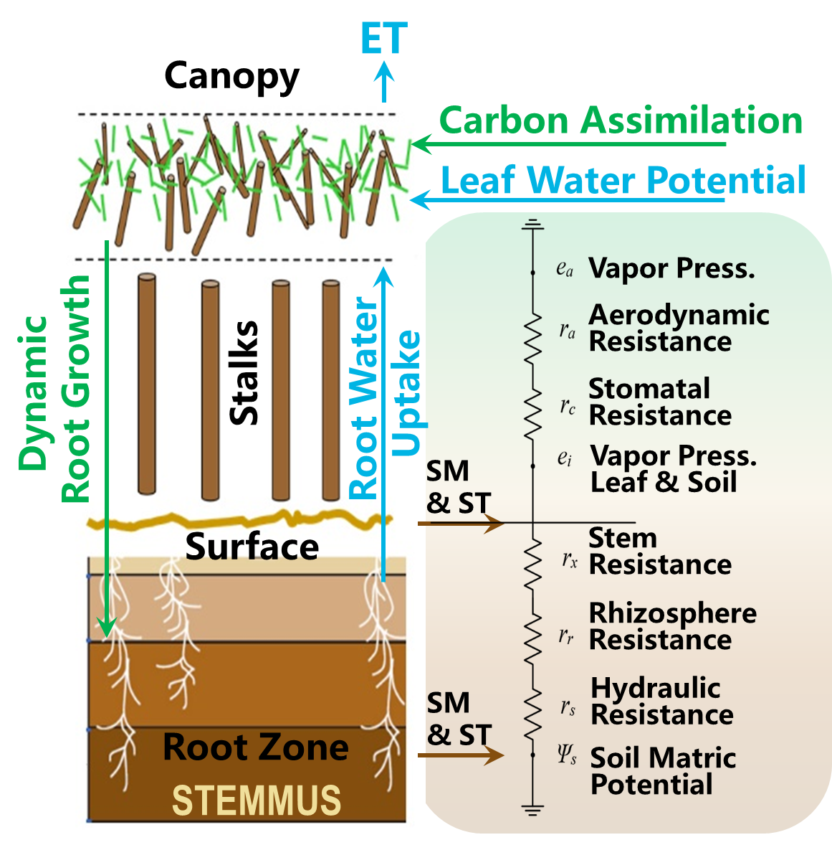
2 Emulator build
STEMMUS-SCOPE: Integrated modelling of canopy photosynthesis, fluorescence, and the transfer of energy, mass, and momentum in the Soil-plant-atmosphere continuum.

Slide 6
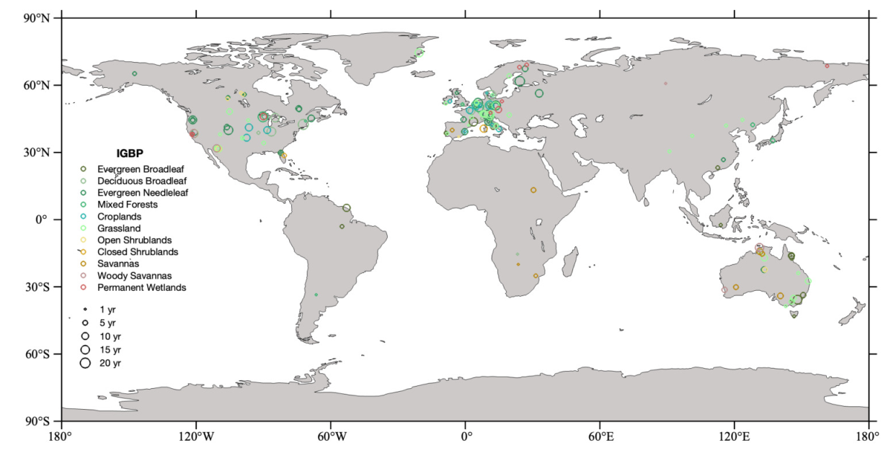
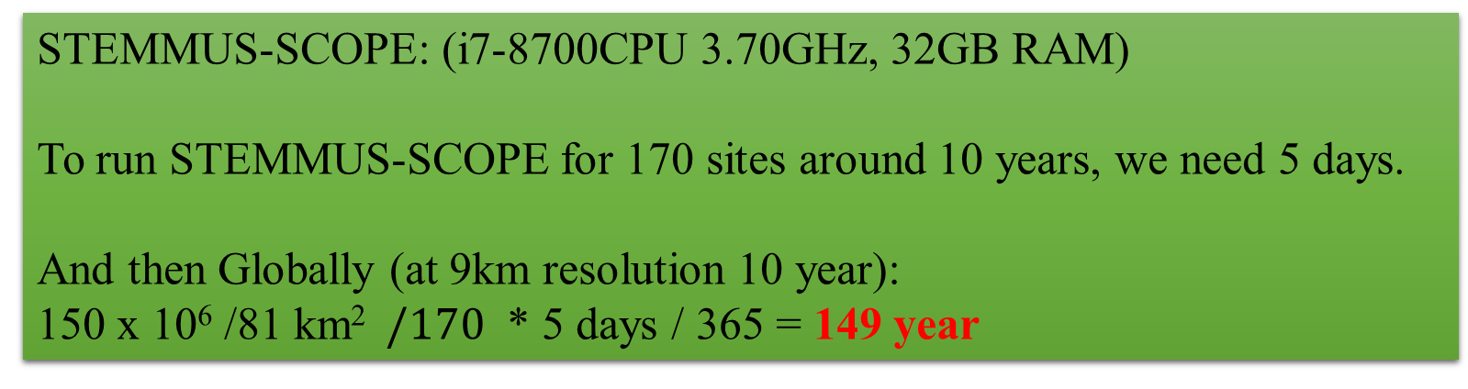
STEMMUS-SCOPE: (i7-8700CPU 3.70GHz, 32GB RAM)
To run STEMMUS-SCOPE for 170 sites around 10 years, we need 5 days.
And then Globally (at 9km resolution 10 year):
150 x 10⁶ /81 km² $/170$ * 5 days / 365 = 149 year

Slide 7
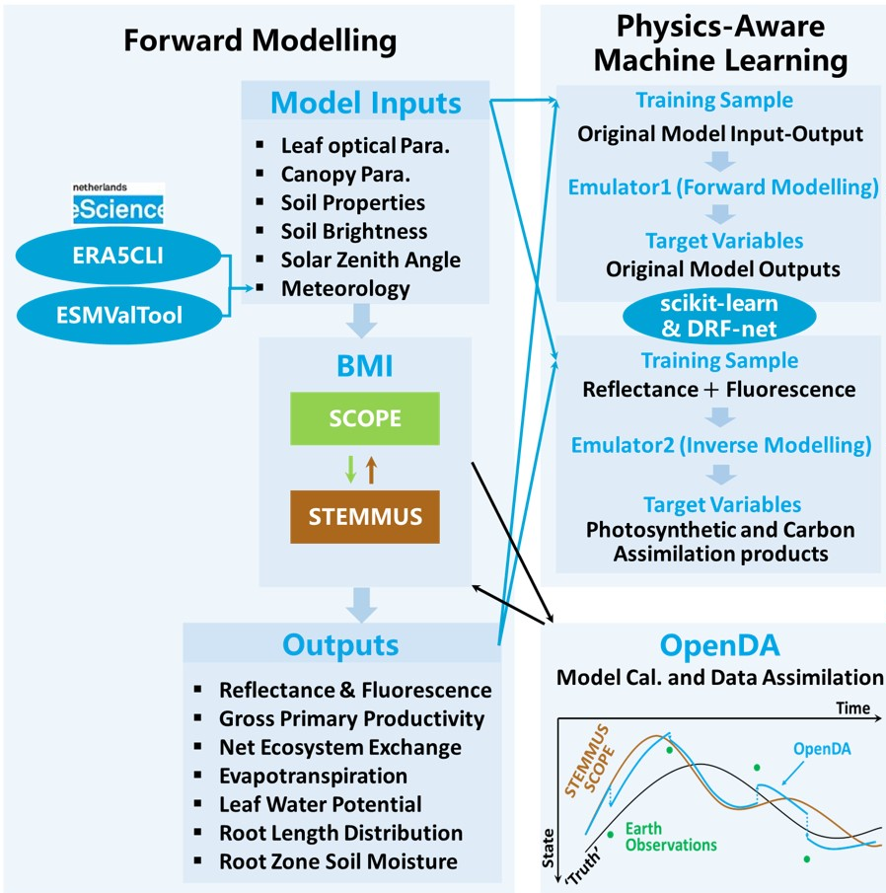

Slide 8
2 Emulator build
Random Forest was used to build the emulator with STEMMUS-SCOPE output, which is called RF_S-S.
At the same time, we also trained RF with in-situ fluxes, which is called RF_in-situ.

Slide 9
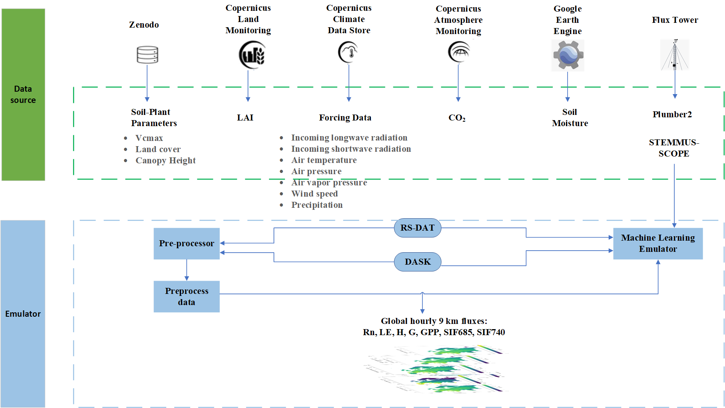


2 Emulator build
https://www.surf.nl/en/services/snellius-the-national-supercomputer
RS-DAT: Remote Sensing Deployable Analysis environmenT

Slide 10
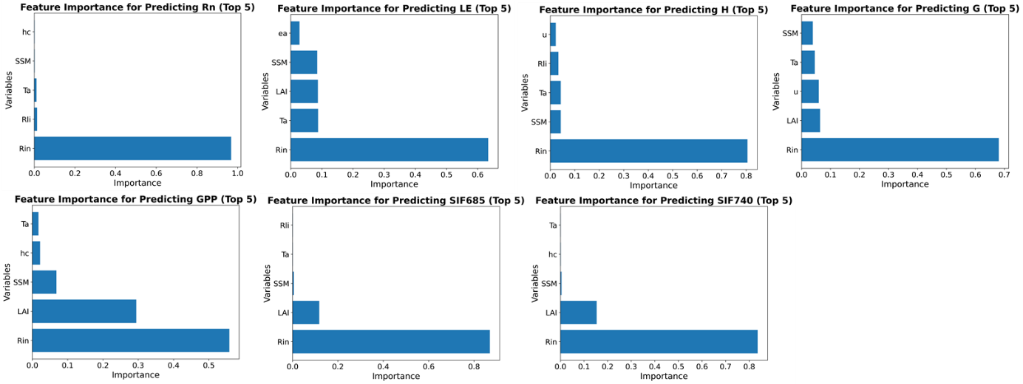
3 Feature importance
--RF_S-S
Notes:
Feature importance value physical meaning?

Slide 11
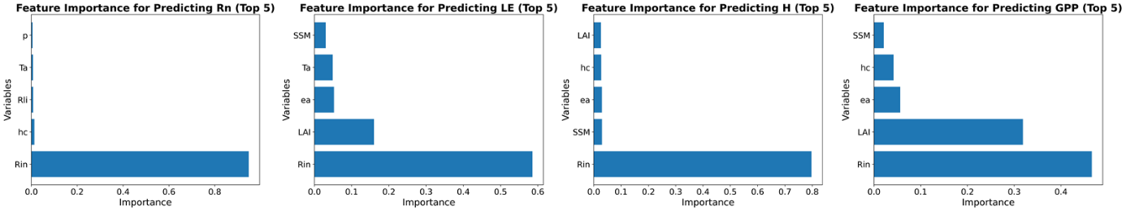
3 Feature importance
--RF_in-situ

Slide 12
4 Preliminary testing result testing_random, testing_time, testing_space
ID | Target variables | Testing_random |  | Testing_time |  | Testing_space
 |  | RMSE | r score | RMSE | r score | RMSE | r score
RF_S-S | Rn (W m⁻²) | 5.9207 | 0.9995 | 6.3796 /38.7934 | 0.9994 /0.9823 | 7.1306 /43.7466 | 0.9992 /0.9761
 | LE (W m⁻²) | 11.9970 | 0.9870 | 13.6575 /51.3204 | 0.9823 /0.7732 | 21.3858 /45.5028 | 0.9452 /0.7661
 | H (W m⁻²) | 17.6290 | 0.9877 | 19.0925 /62.3594 | 0.9860 /0.8375 | 25.0404 /59.7170 | 0.9739 /0.8372
 | G (W m⁻²) | 15.7445 | 0.9106 | 16.9778 | 0.8932 | 19.6624 | 0.8160
 | GPP (umol m⁻² s⁻¹) | 0.7274 | 0.9946 | 0.9759 /4.6136 | 0.9902 /0.7896 | 1.6454 /3.9754 | 0.9671 /0.8204
 | SIF685 (W m⁻² um⁻¹ sr⁻¹) | 0.0060 | 0.9985 | 0.0066 | 0.9982 | 0.0081 | 0.9971
 | SIF740 (W m⁻² um⁻¹ sr⁻¹) | 0.0219 | 0.9991 | 0.0260 | 0.9987 | 0.0345 | 0.9975
RF_in-situ | Rn_insitu (W m⁻²) | 25.3287 | 0.9916 | 26.9443 | 0.9910 | 39.7407 | 0.9787
 | LE_insitu (W m⁻²) | 28.0920 | 0.9260 | 35.1671 | 0.8880 | 37.8781 | 0.8146
 | H_insitu (W m⁻²) | 27.6739 | 0.9519 | 32.4634 | 0.9334 | 46.8580 | 0.8900
 | GPP_insitu (umol m⁻² s⁻¹) | 2.4184 | 0.9420 | 3.4192 | 0.8830 | 3.4583 | 0.8524
For Rn, LE, H, GPP in RF_S-S, we used both model output and insitu fluxes to test, that’s why there are two values in those cells.
In each cell who has two values, the first value is model output as true values, the second value is insitu as true values.
Notes:
Are the output dependent? Gaussian process regression.
GPR can make output dependent.

Slide 13
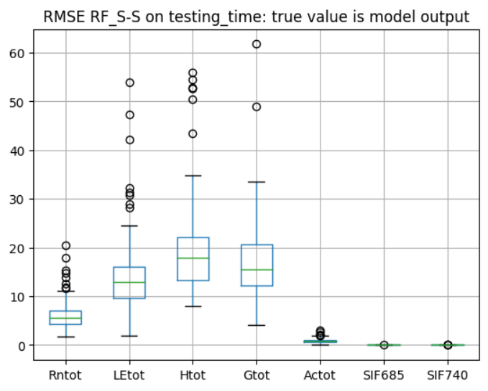
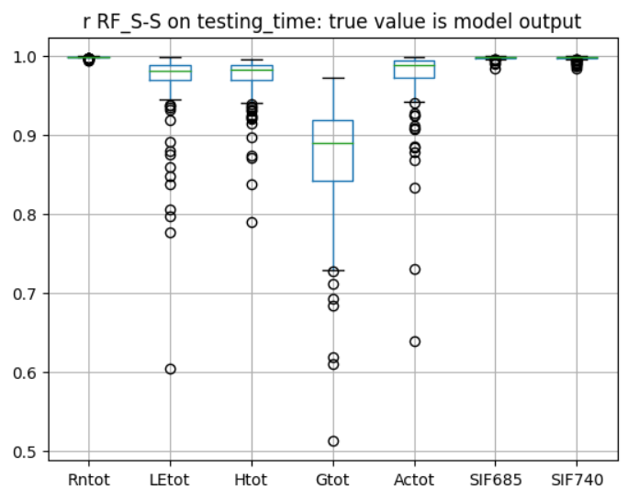
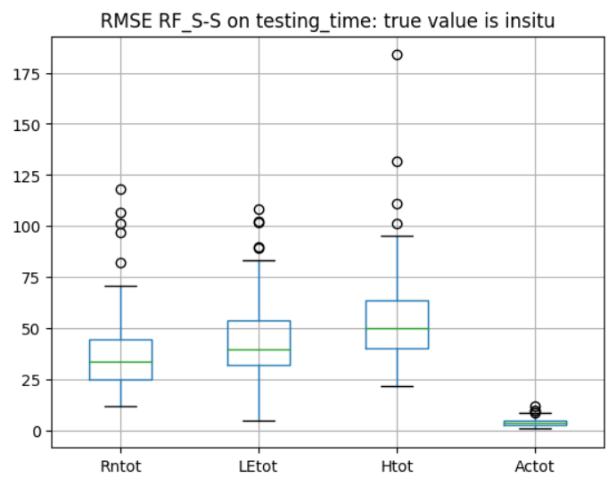
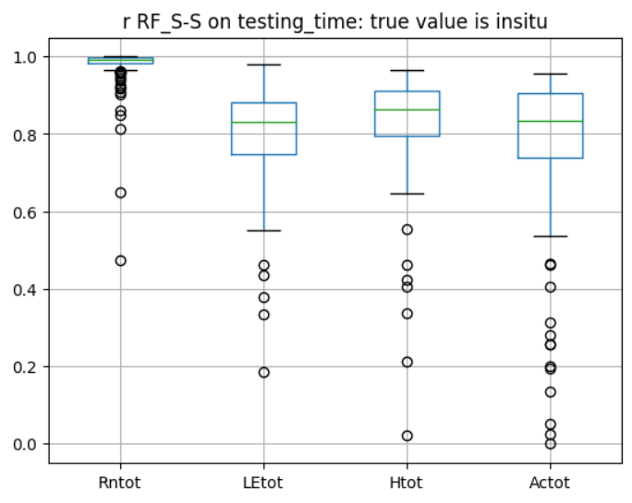
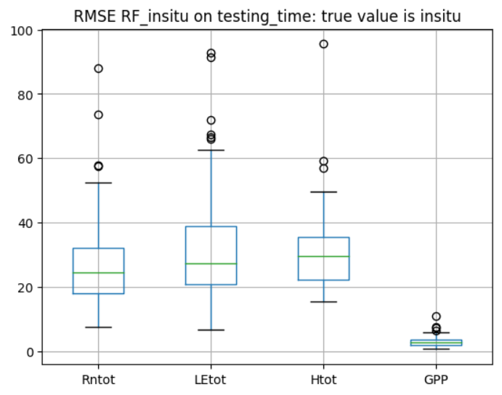
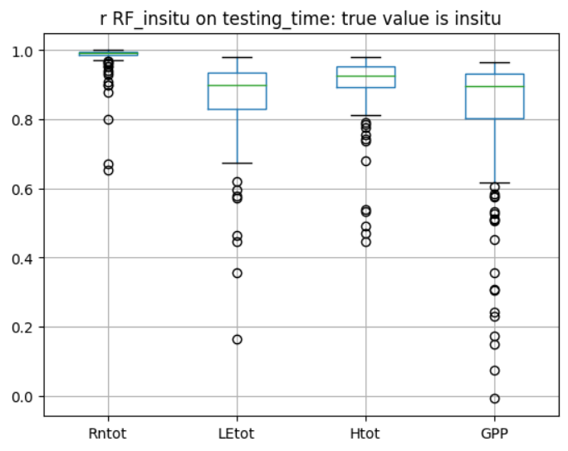
Testing time
RF_S-S
Testing: model output as true values
RF_S-S
Testing: insitu fluxes as true values
RF_insitu

Slide 14
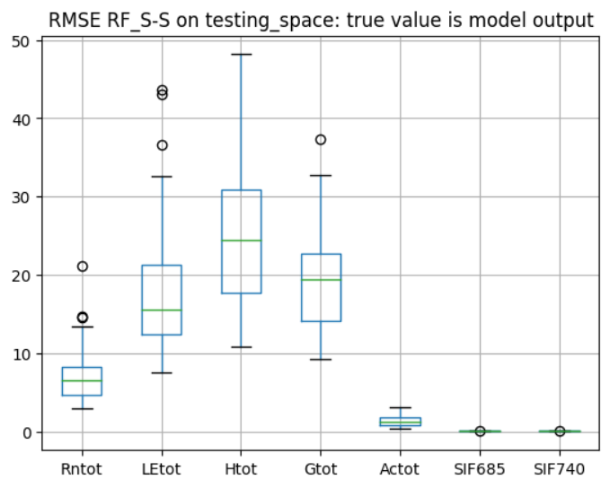
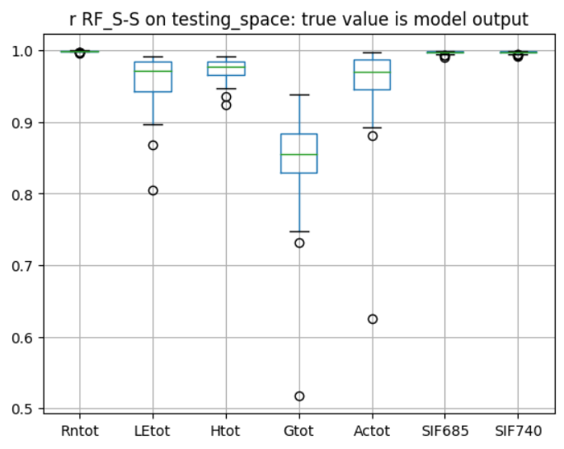
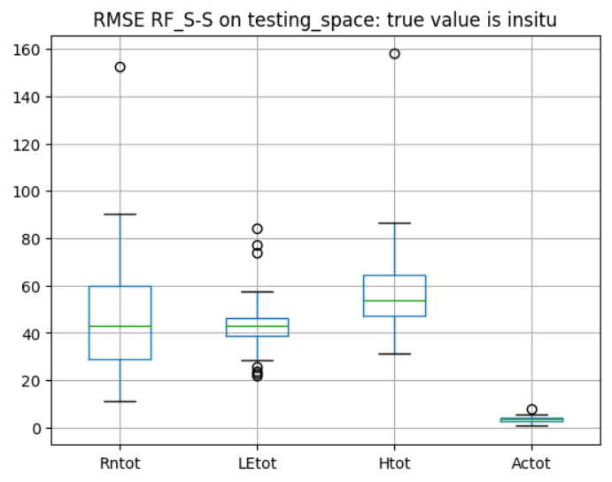
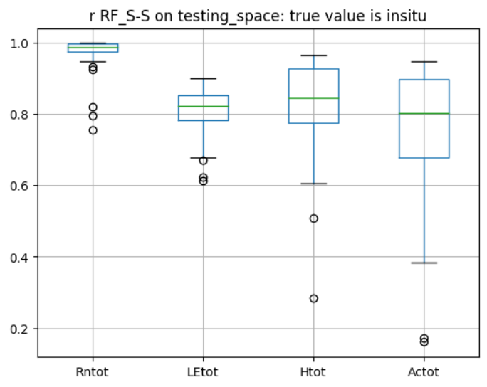
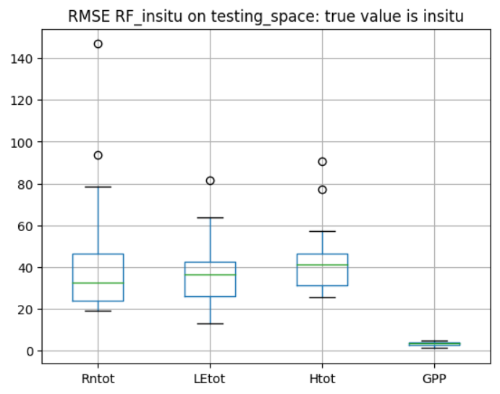
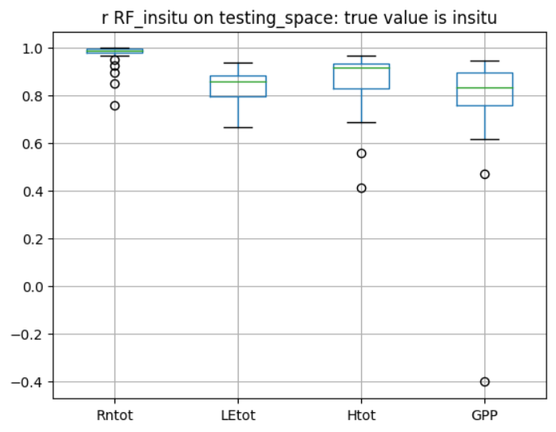
Testing space
RF_S-S
Testing: model output as true values
RF_S-S
Testing: insitu fluxes as true values
RF_insitu

Slide 15
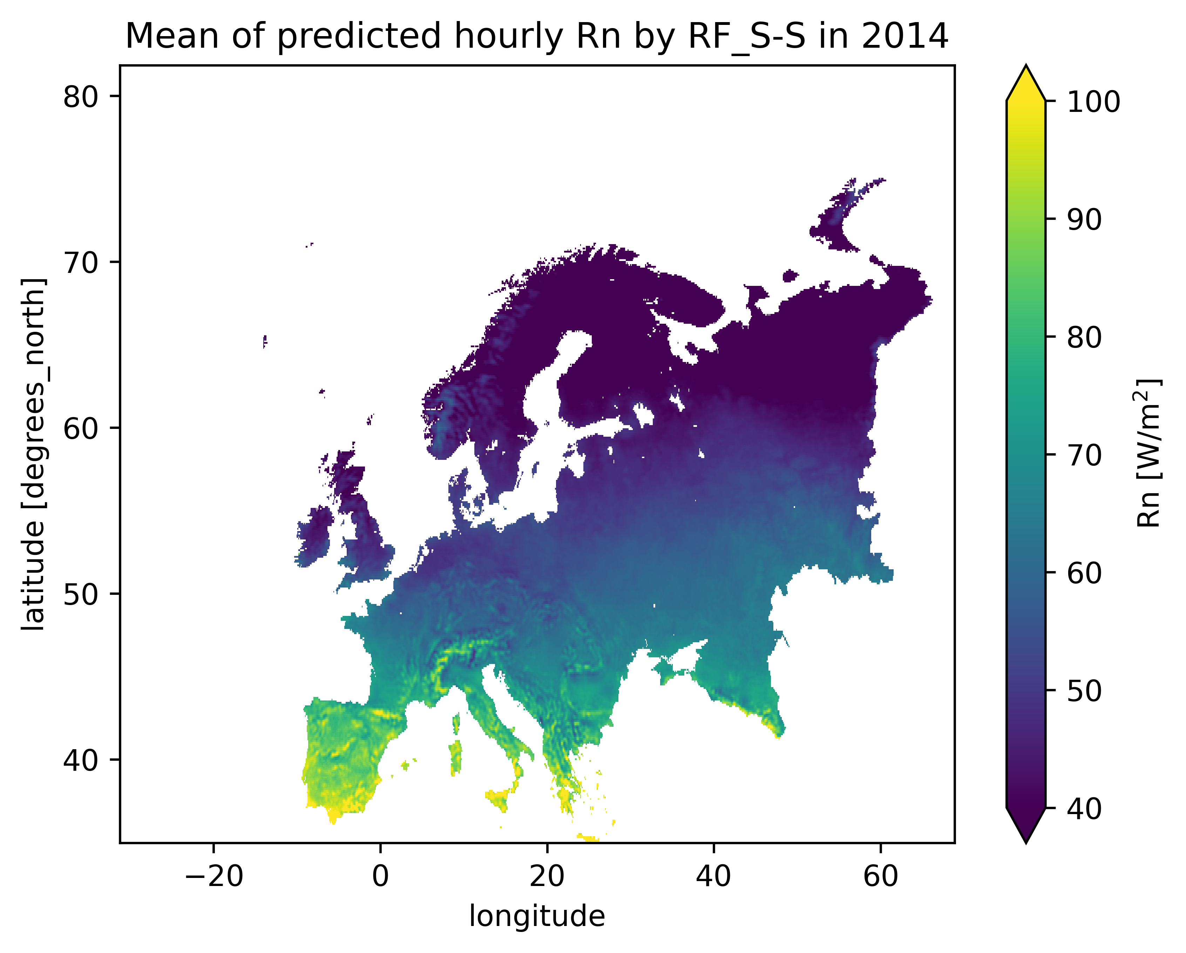
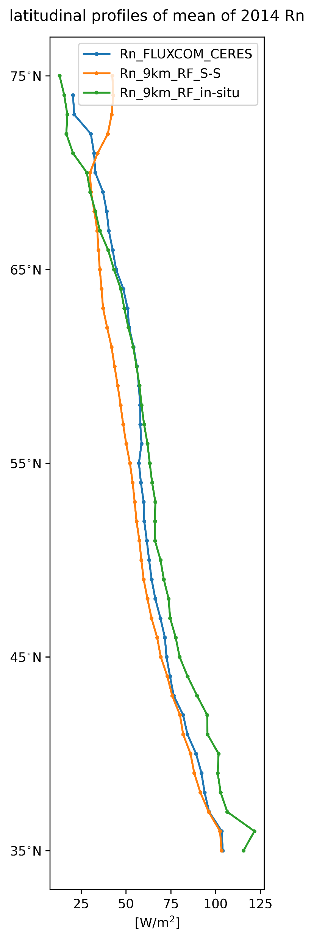
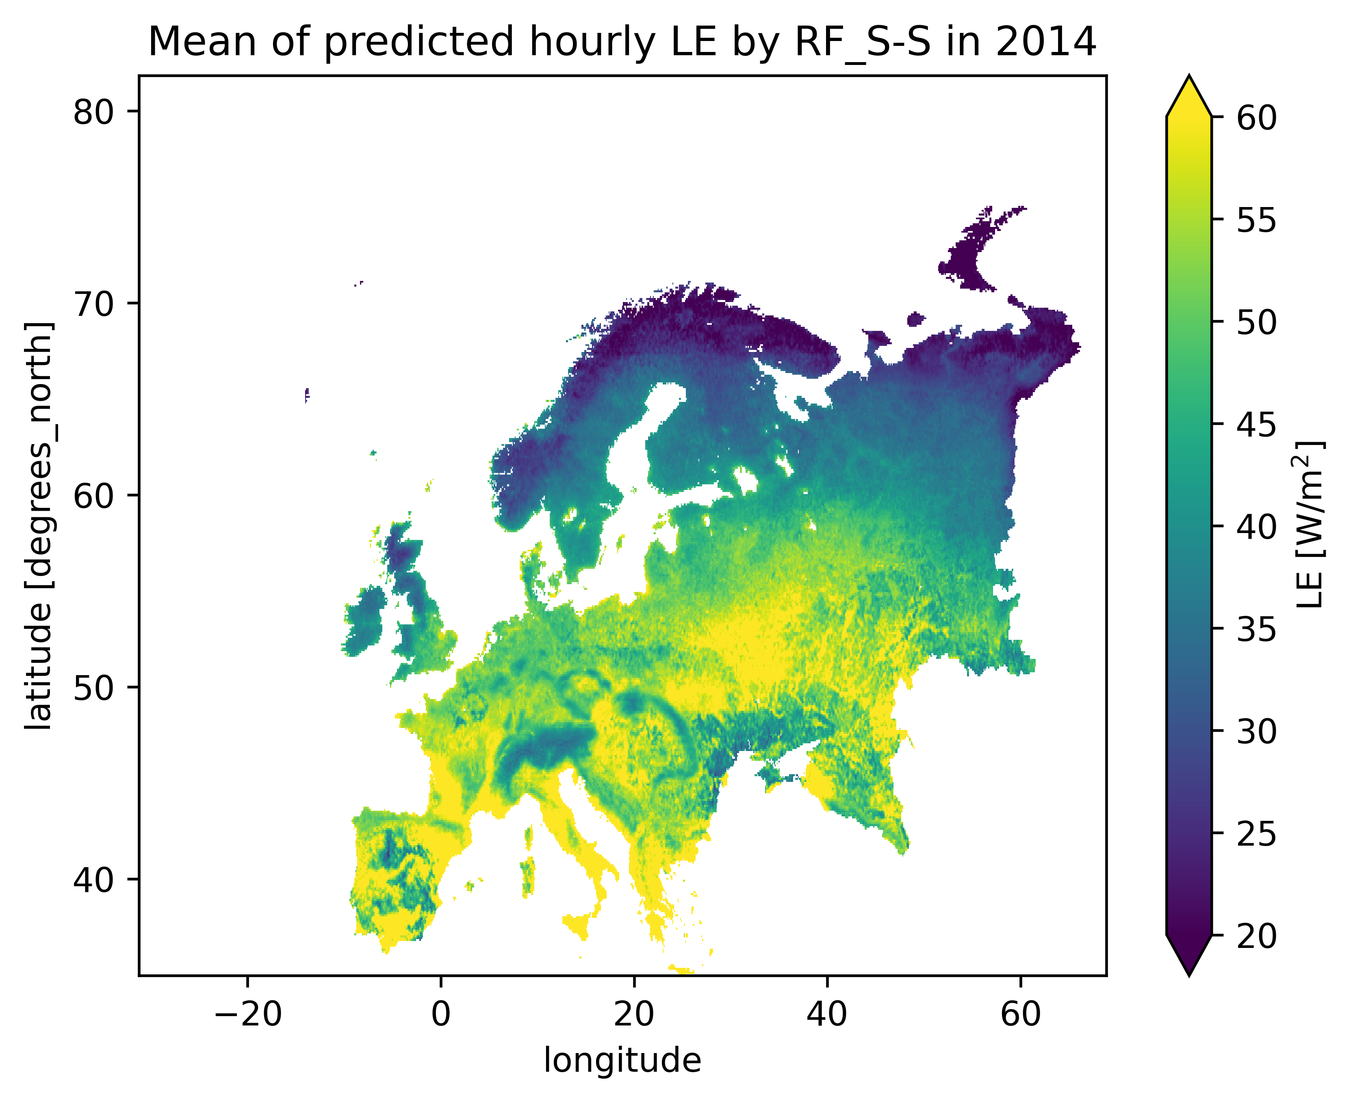
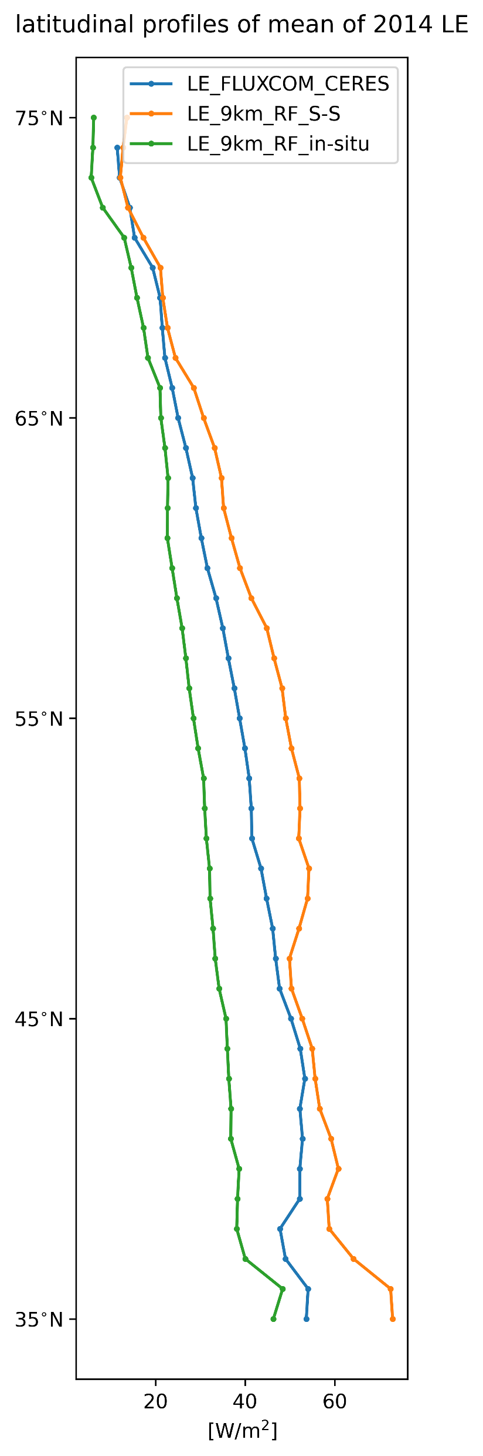
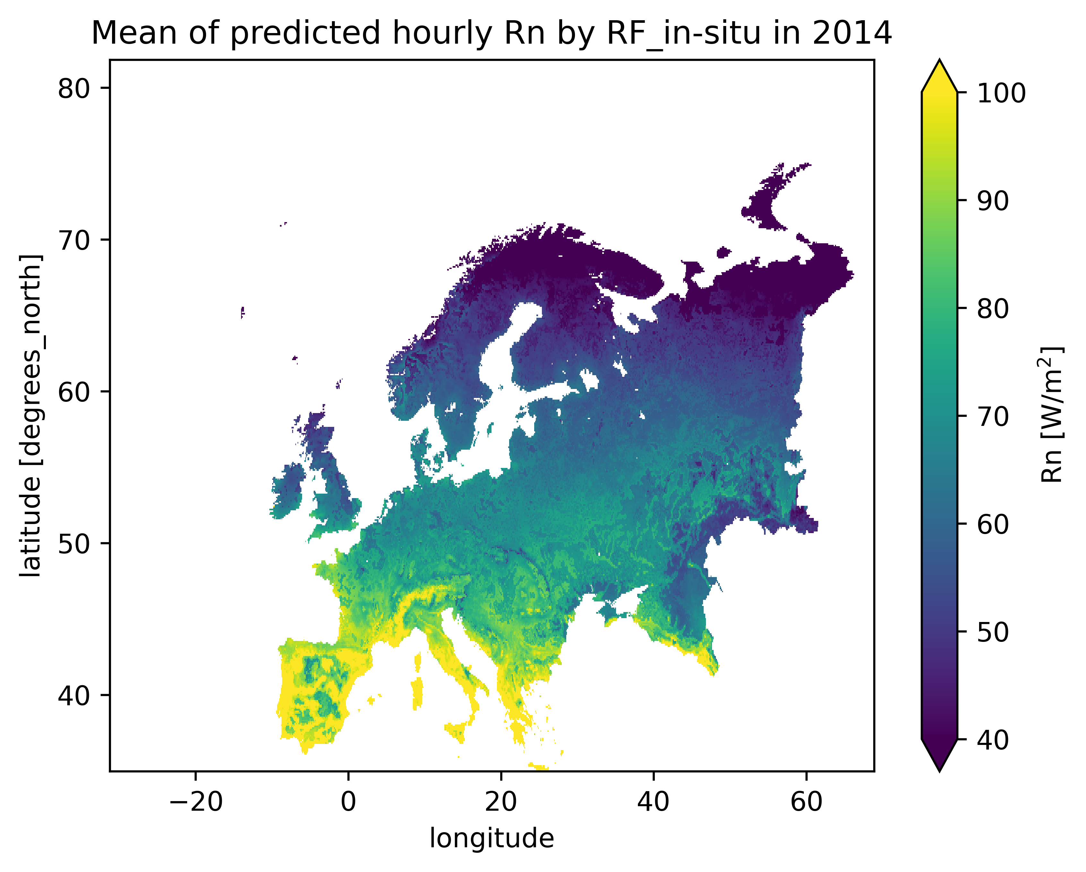
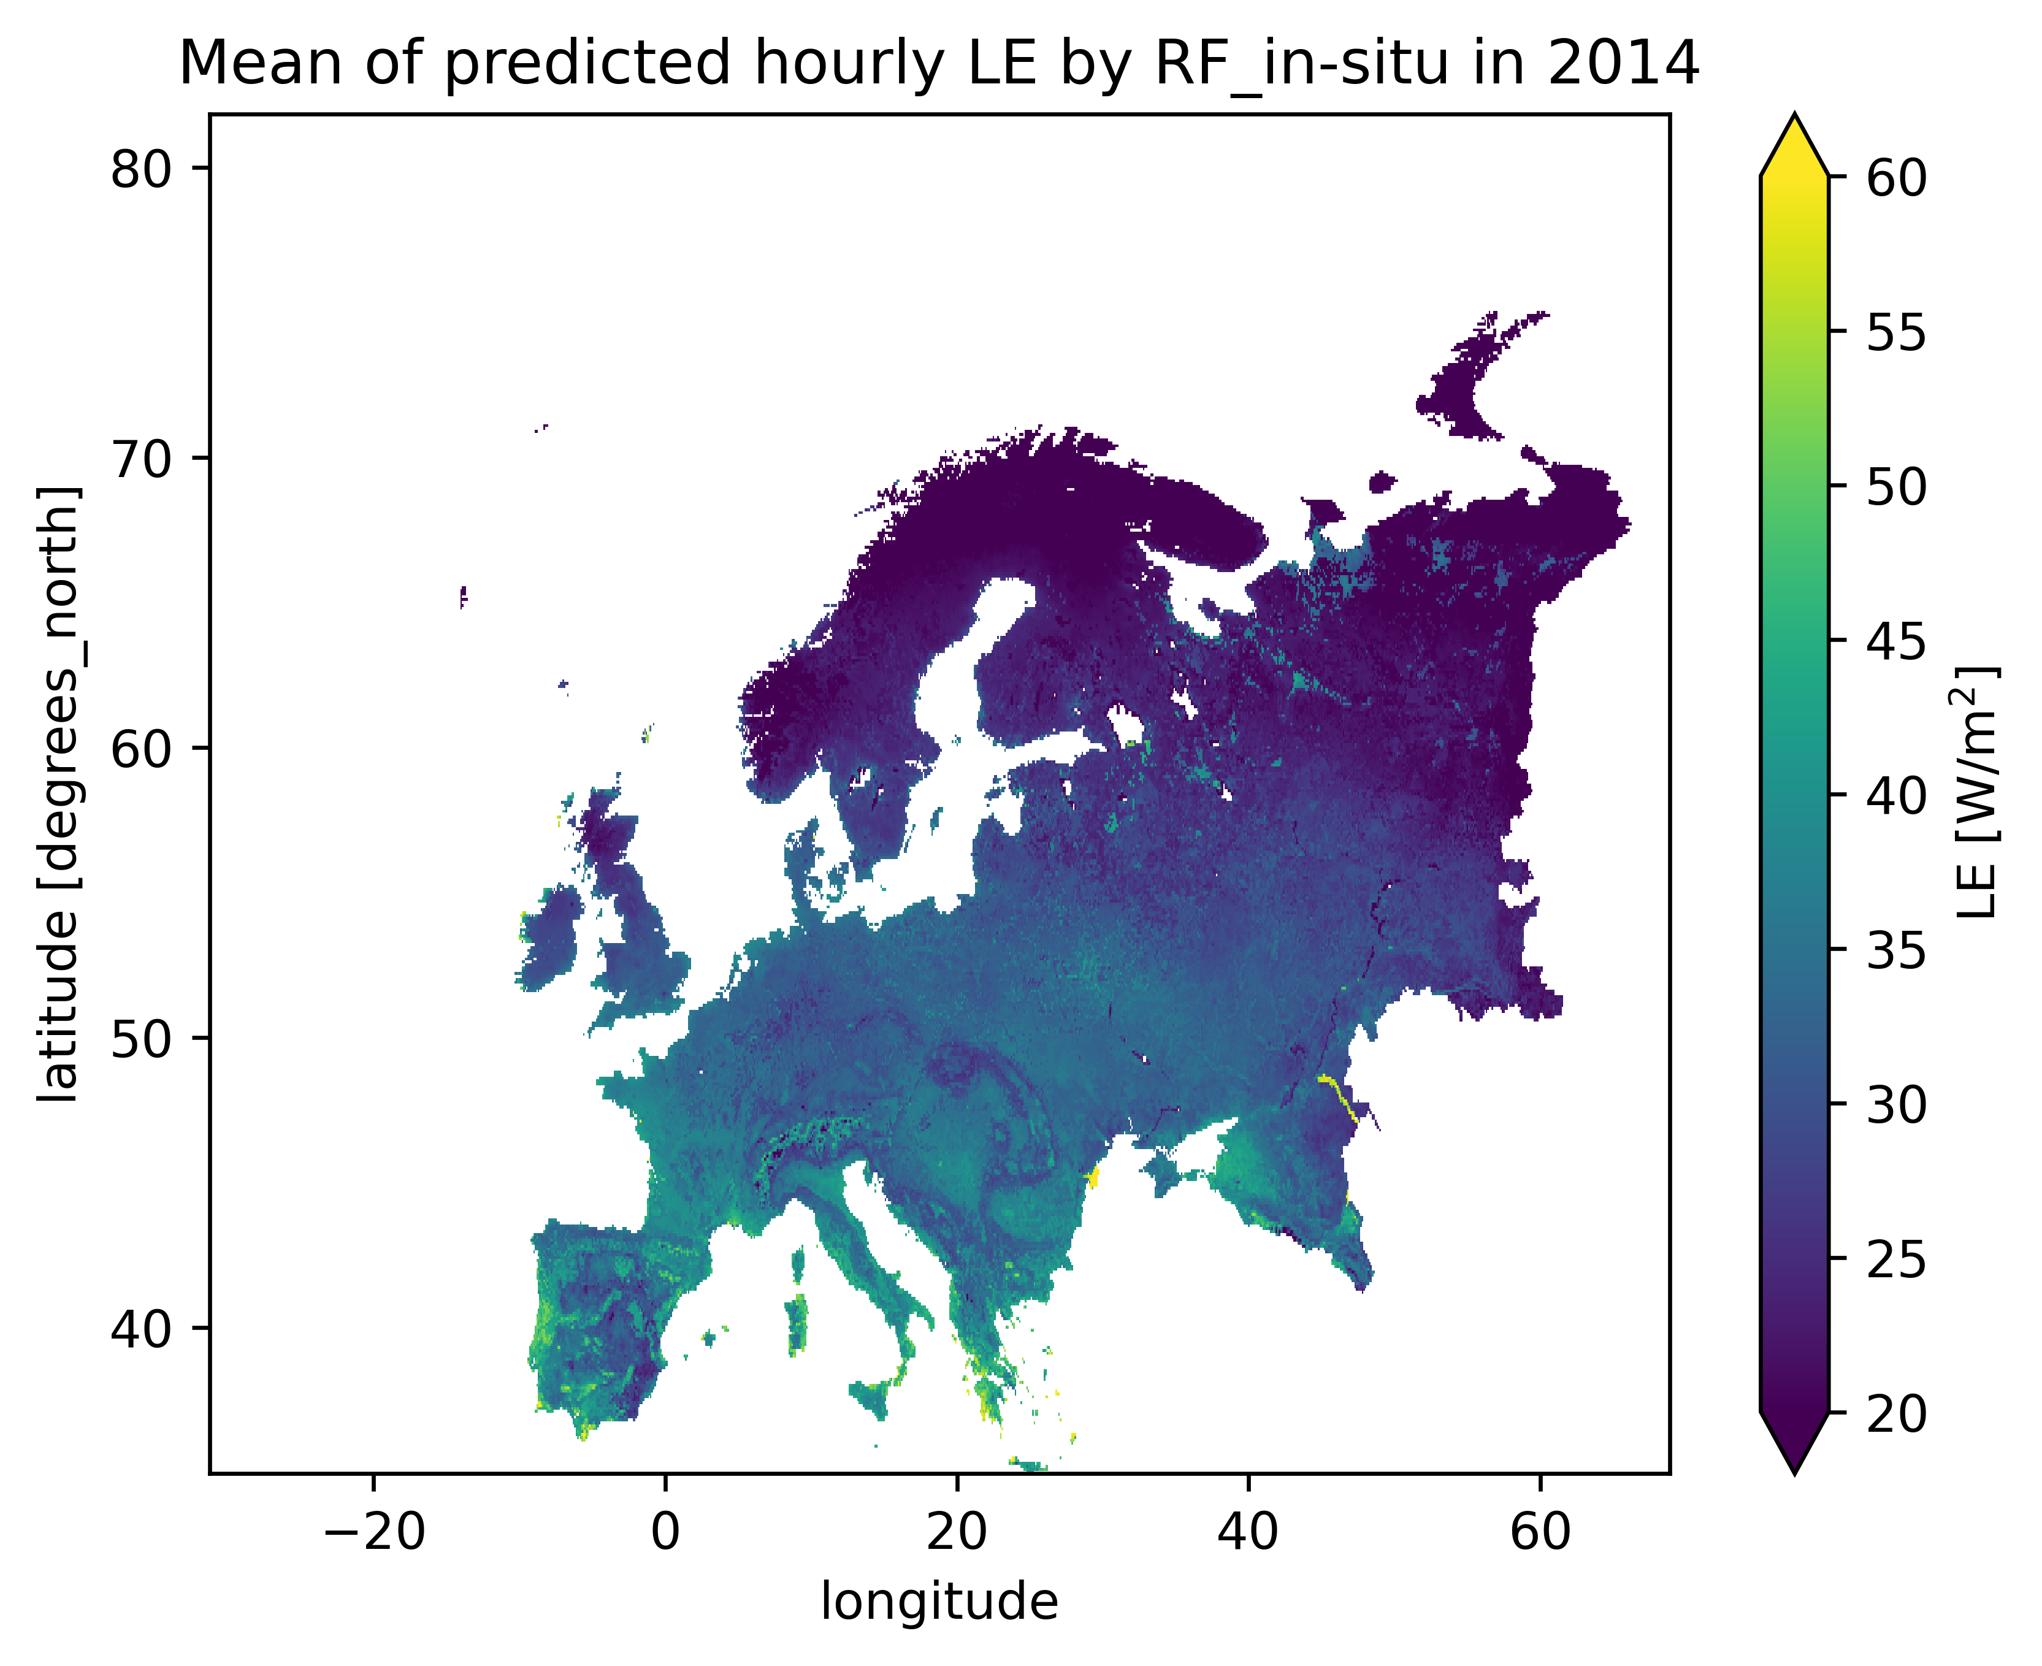
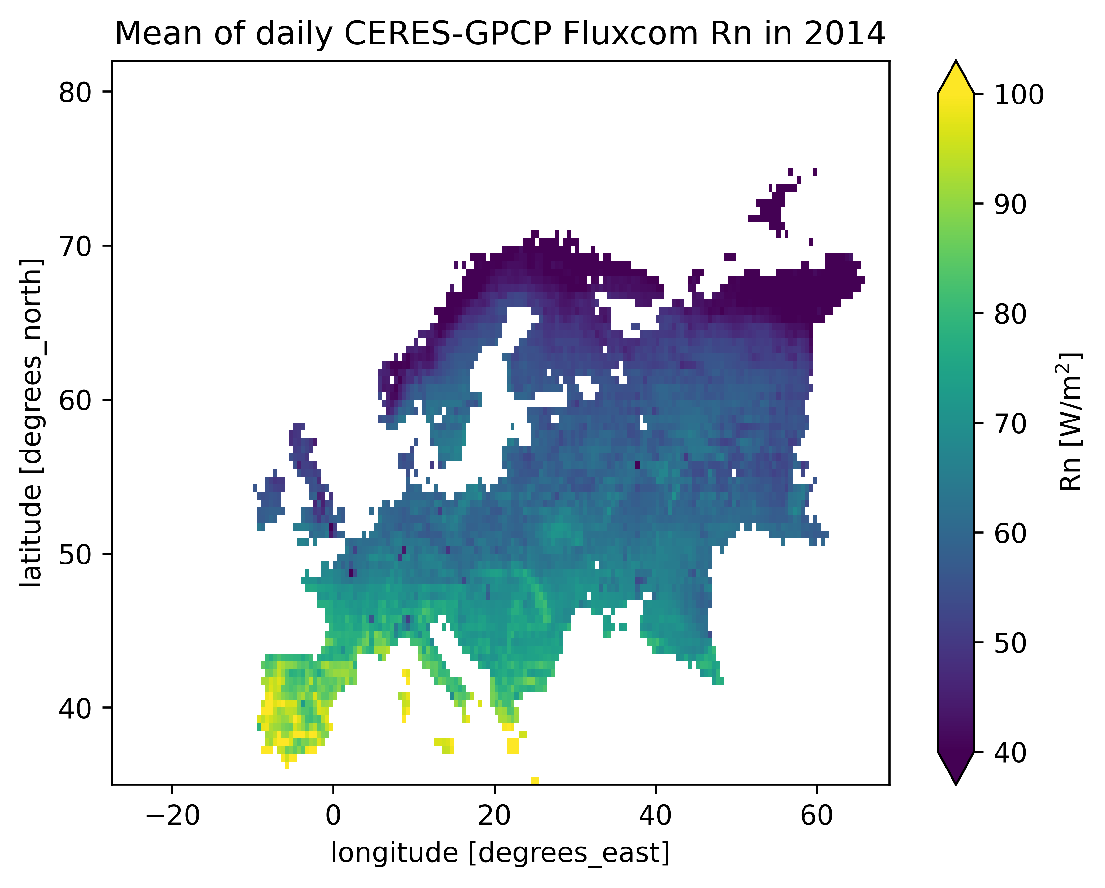
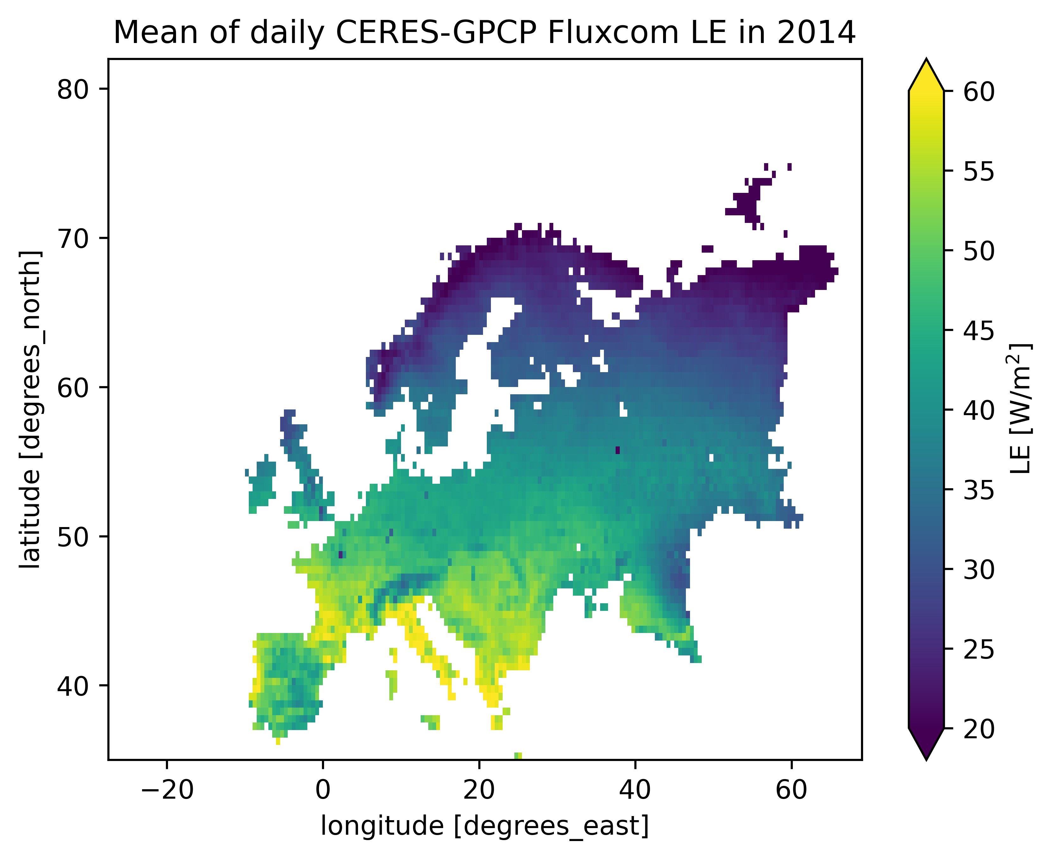
5 Fluxes map

Slide 16
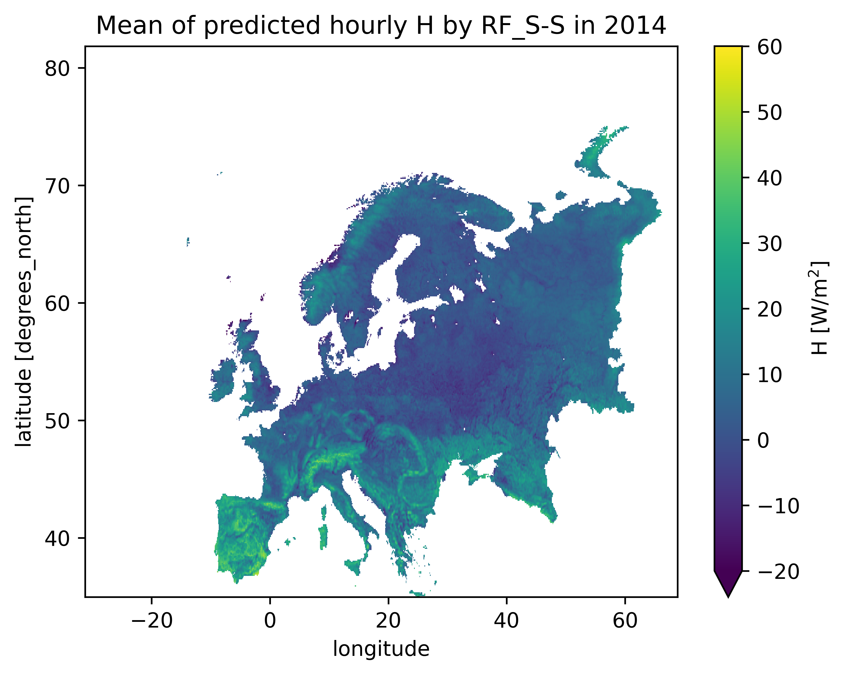
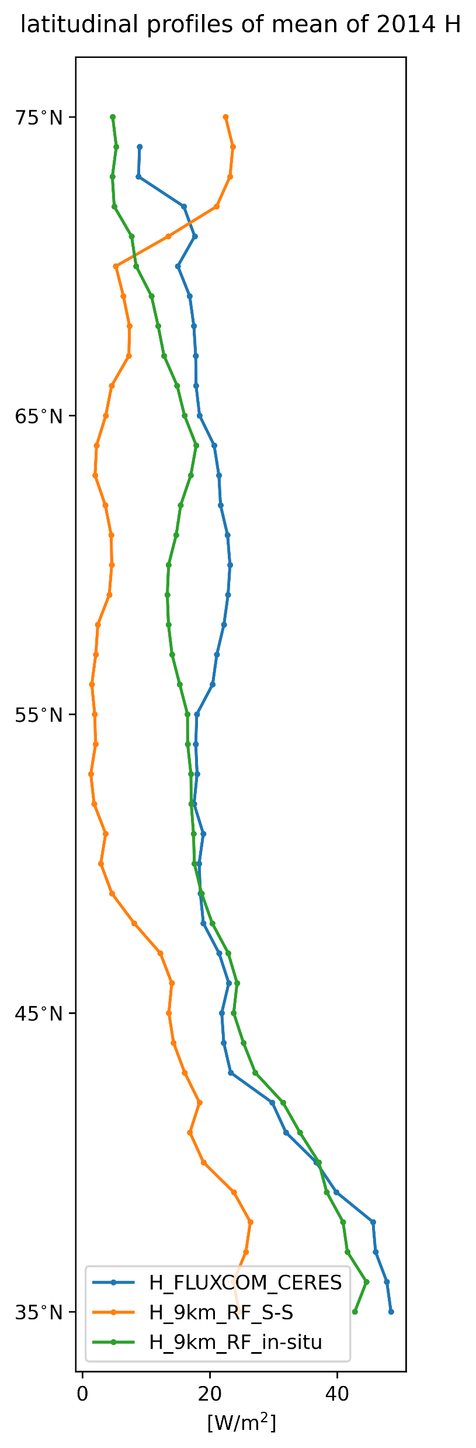
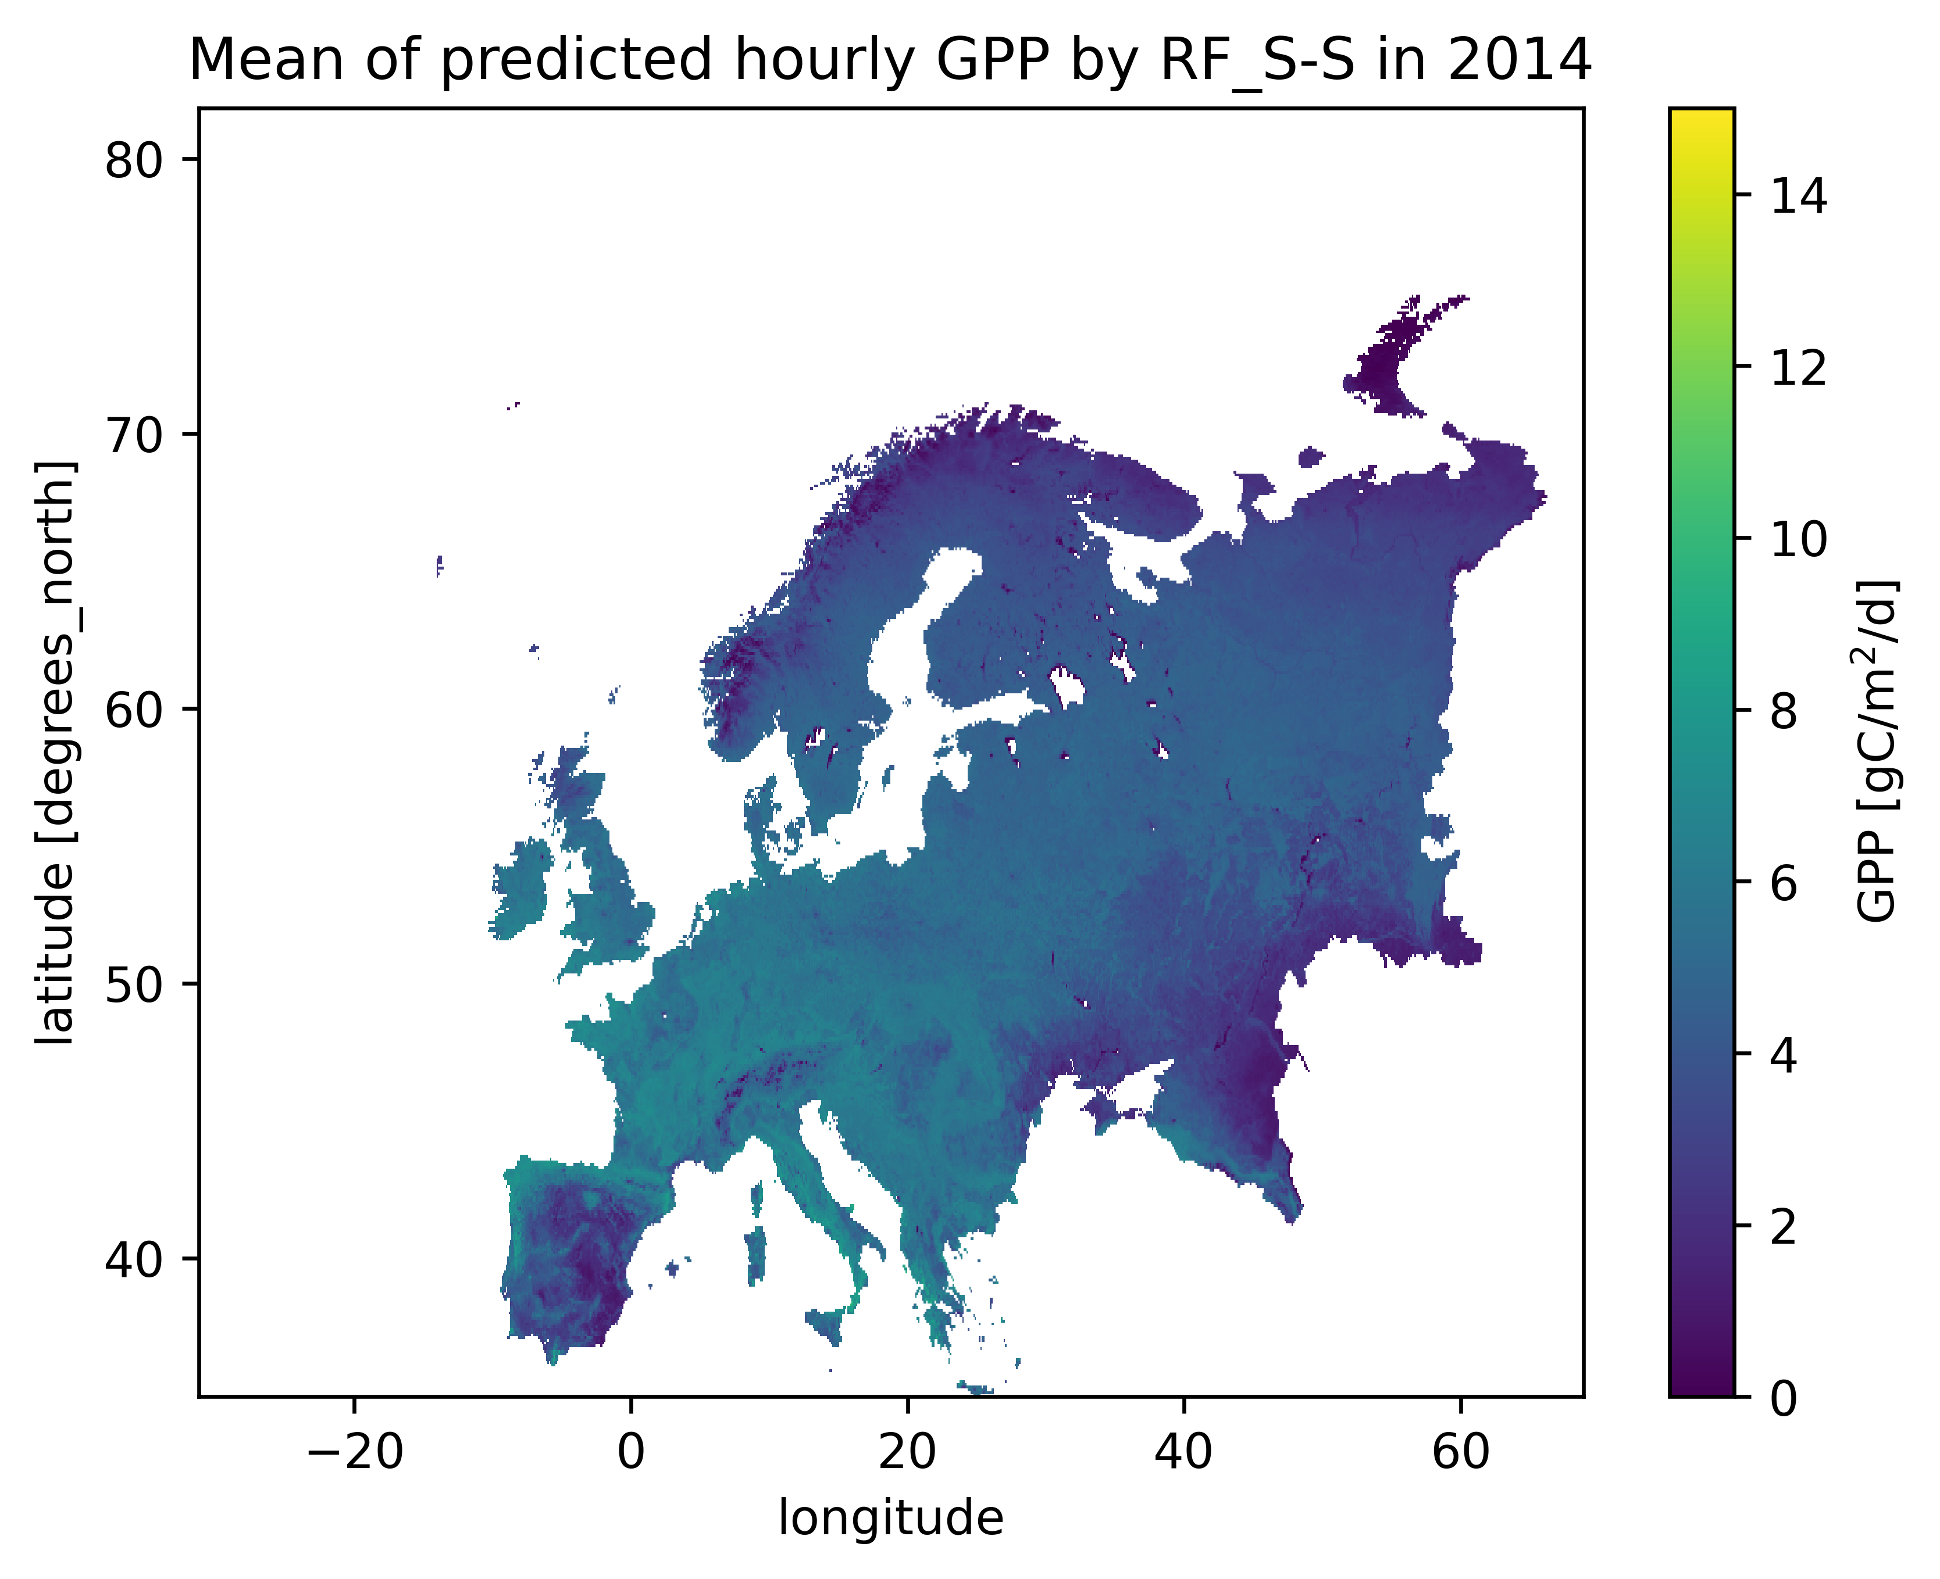
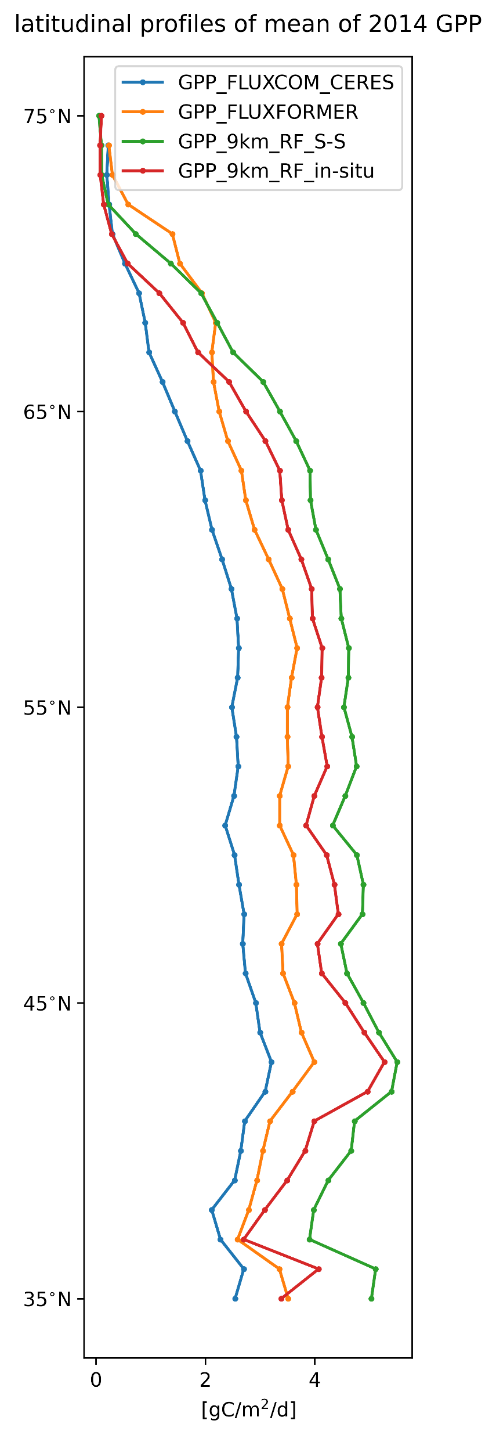

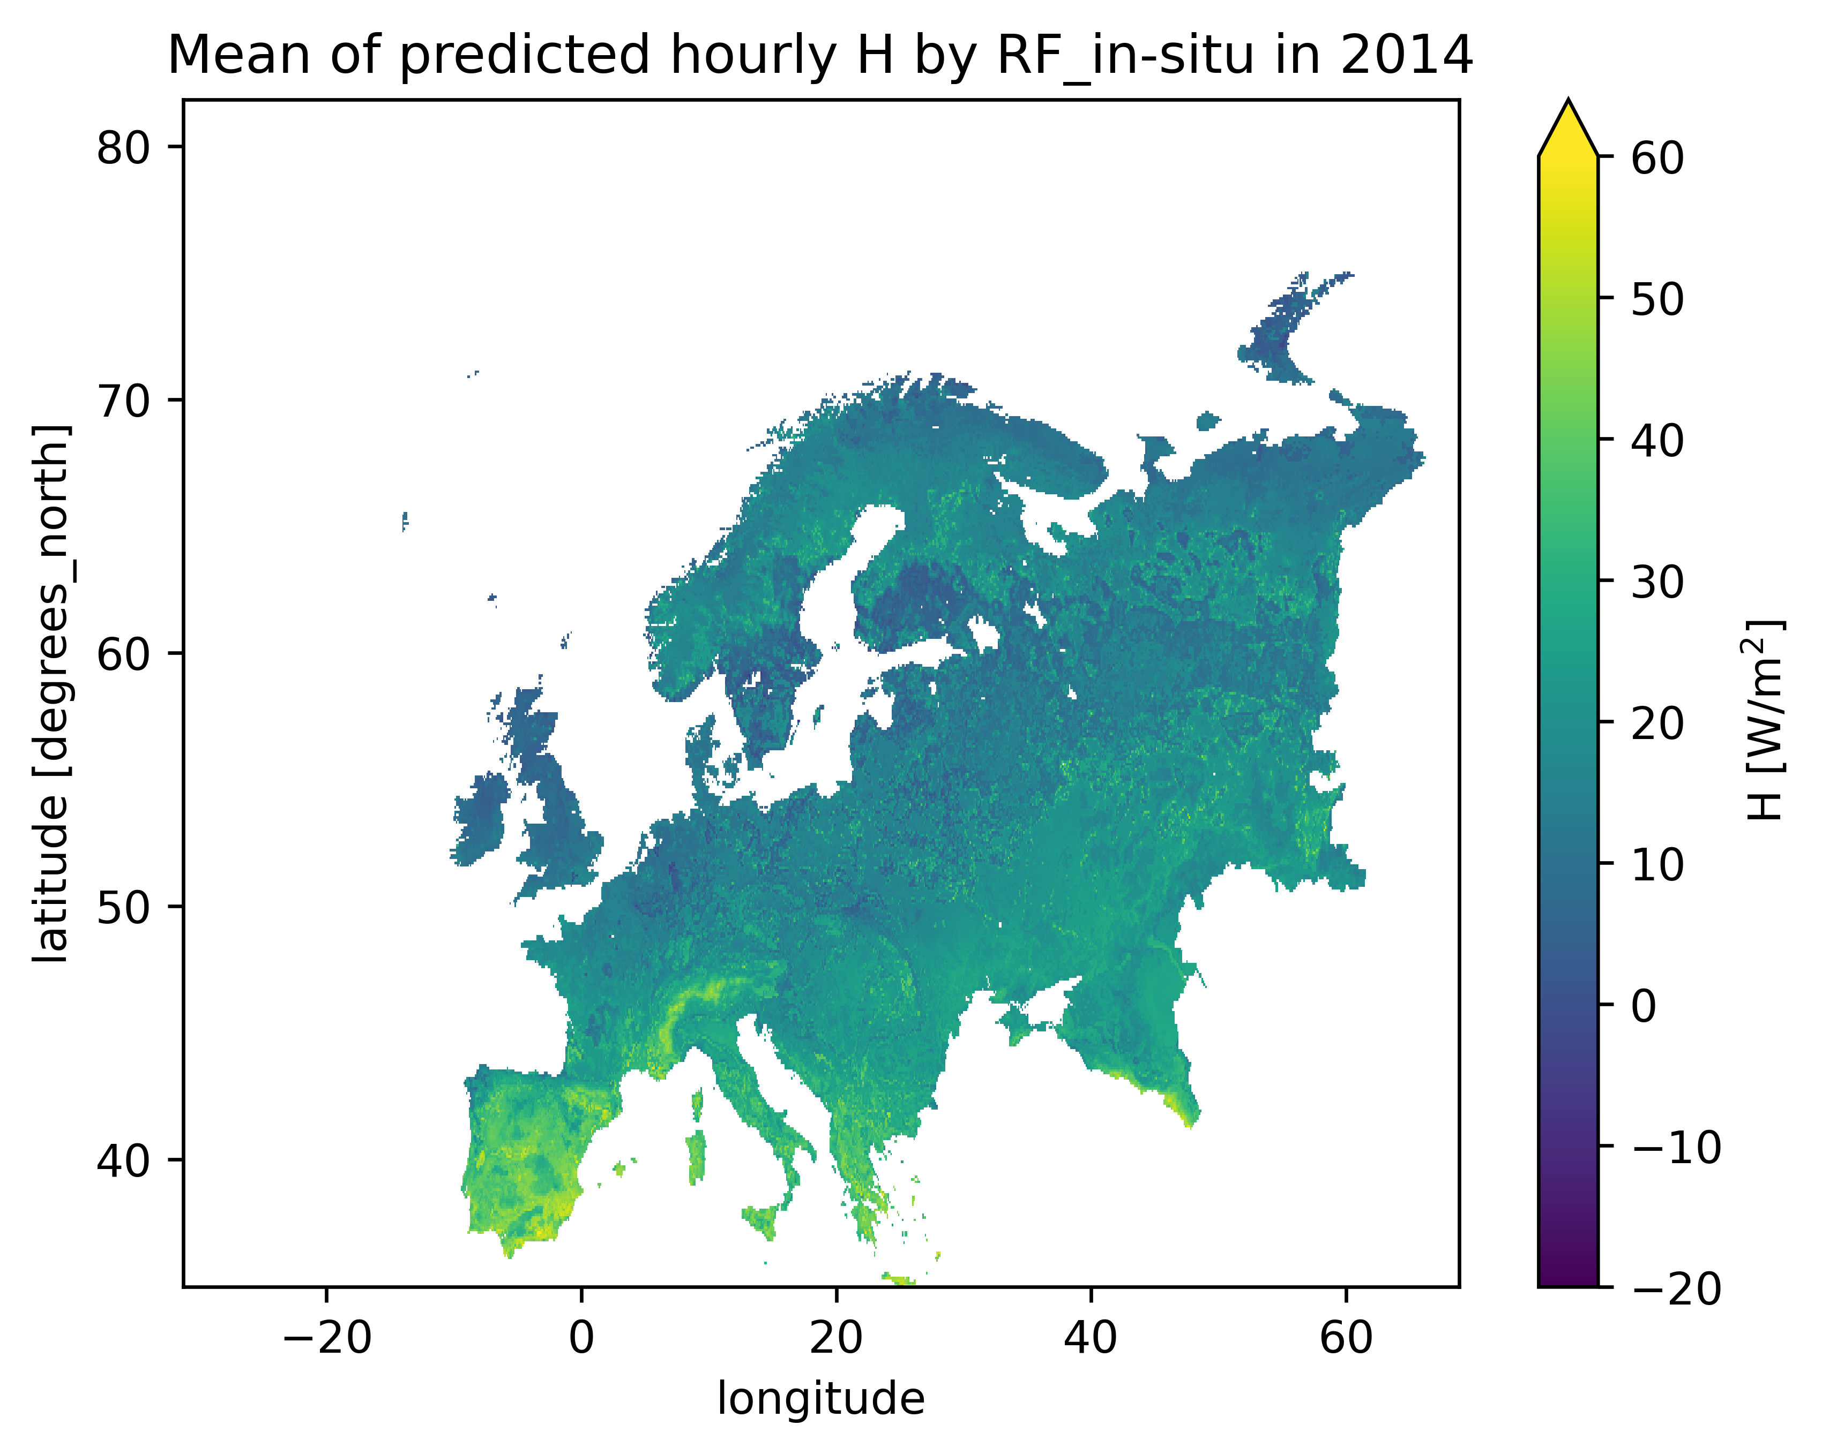
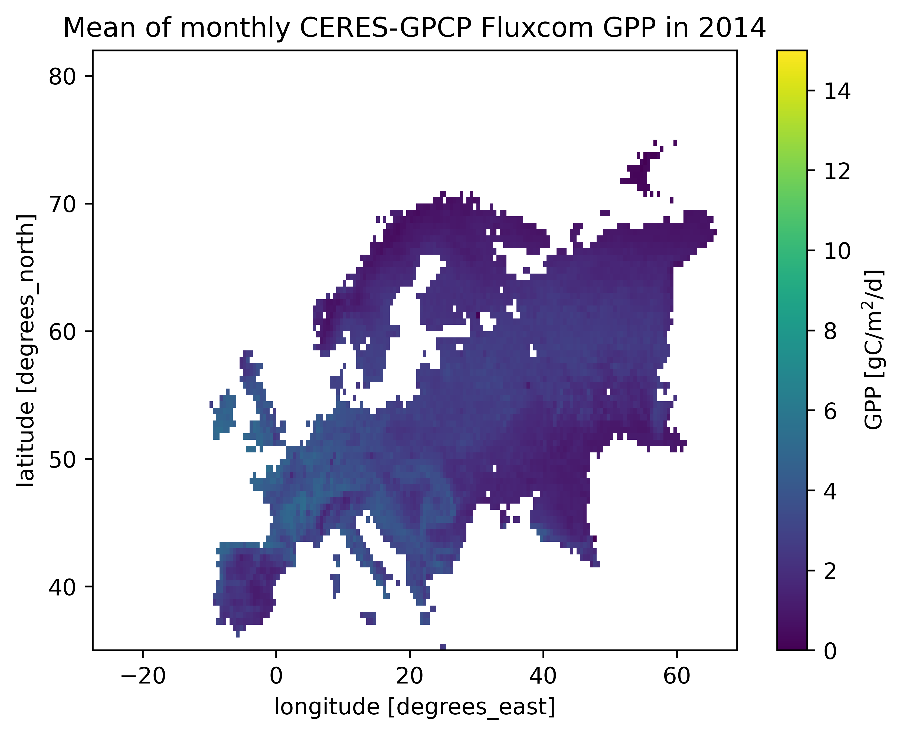
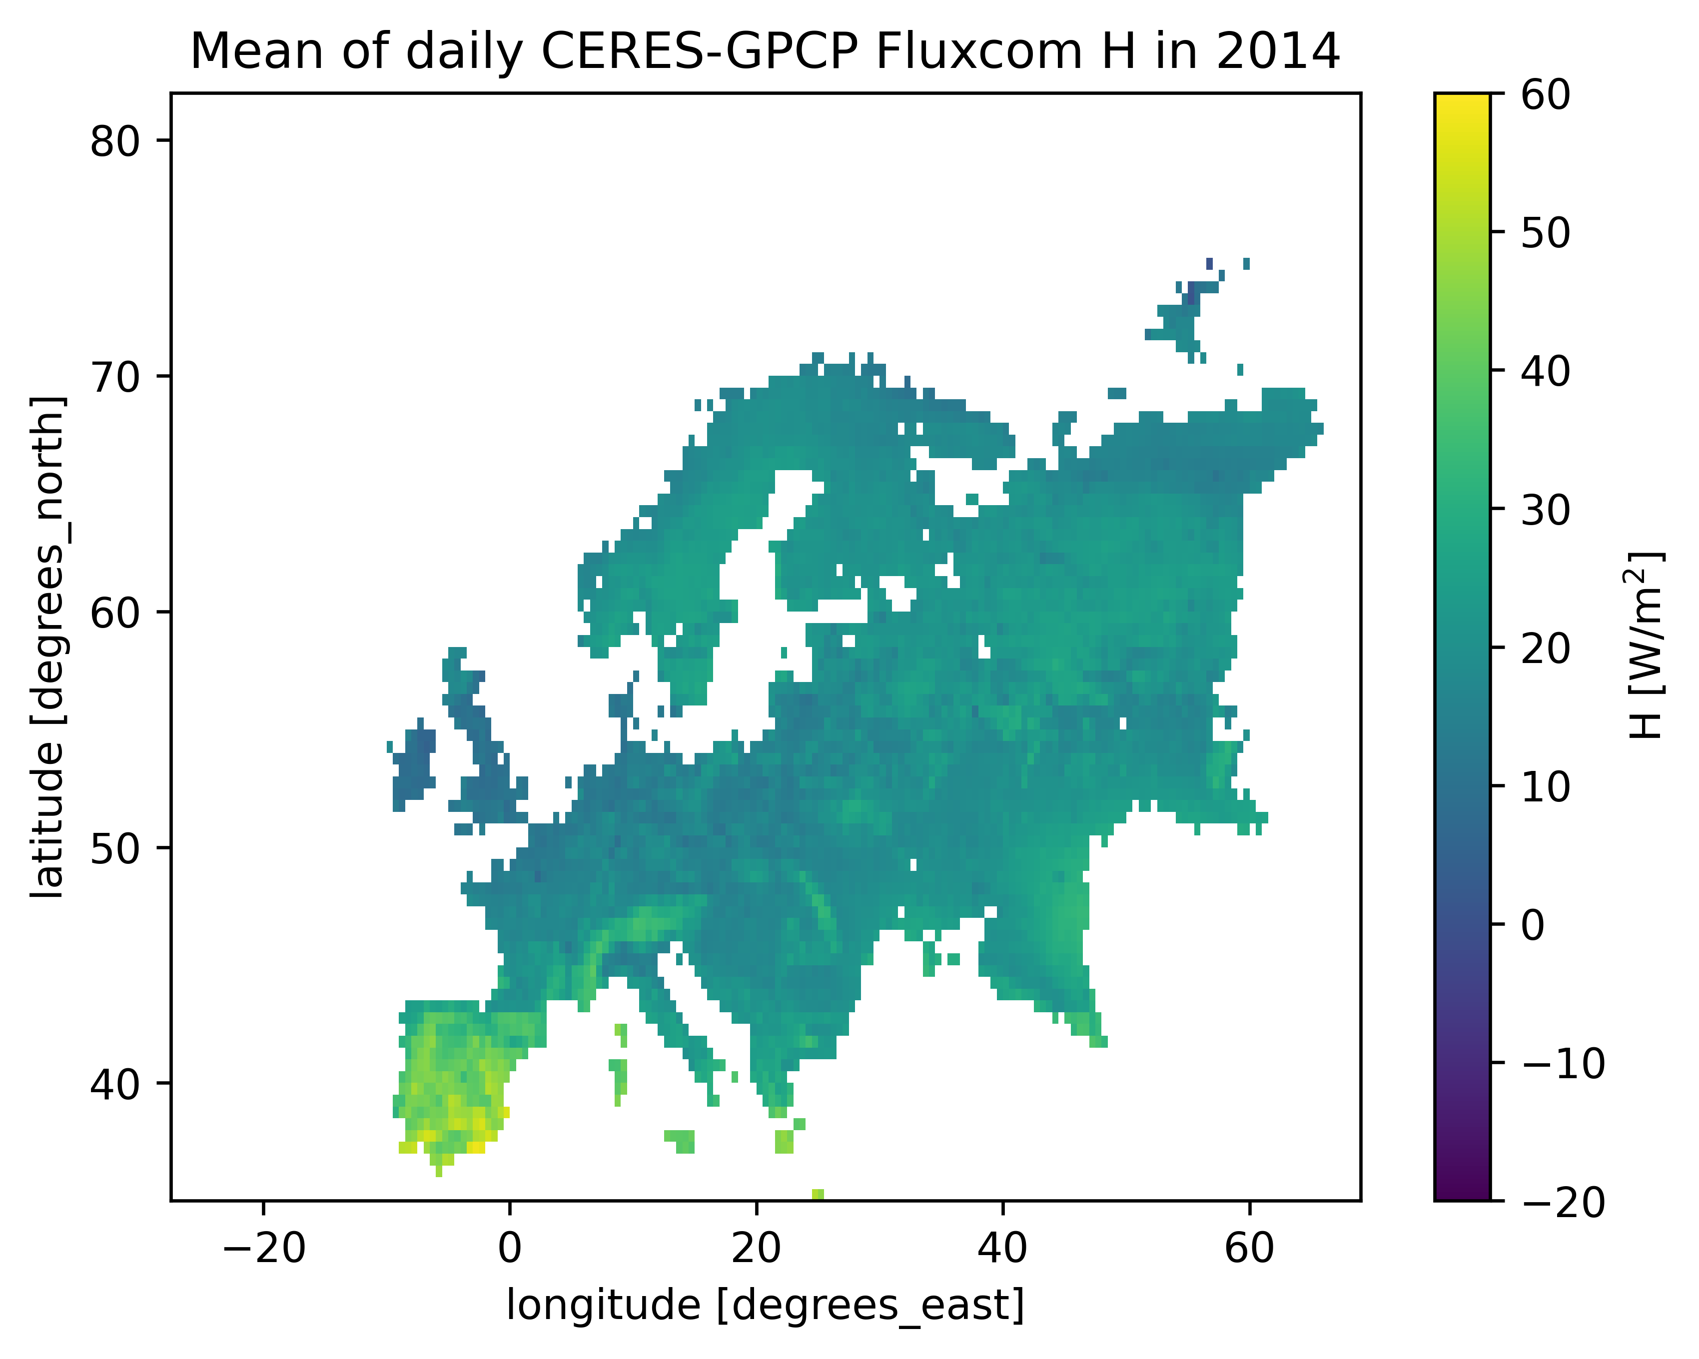
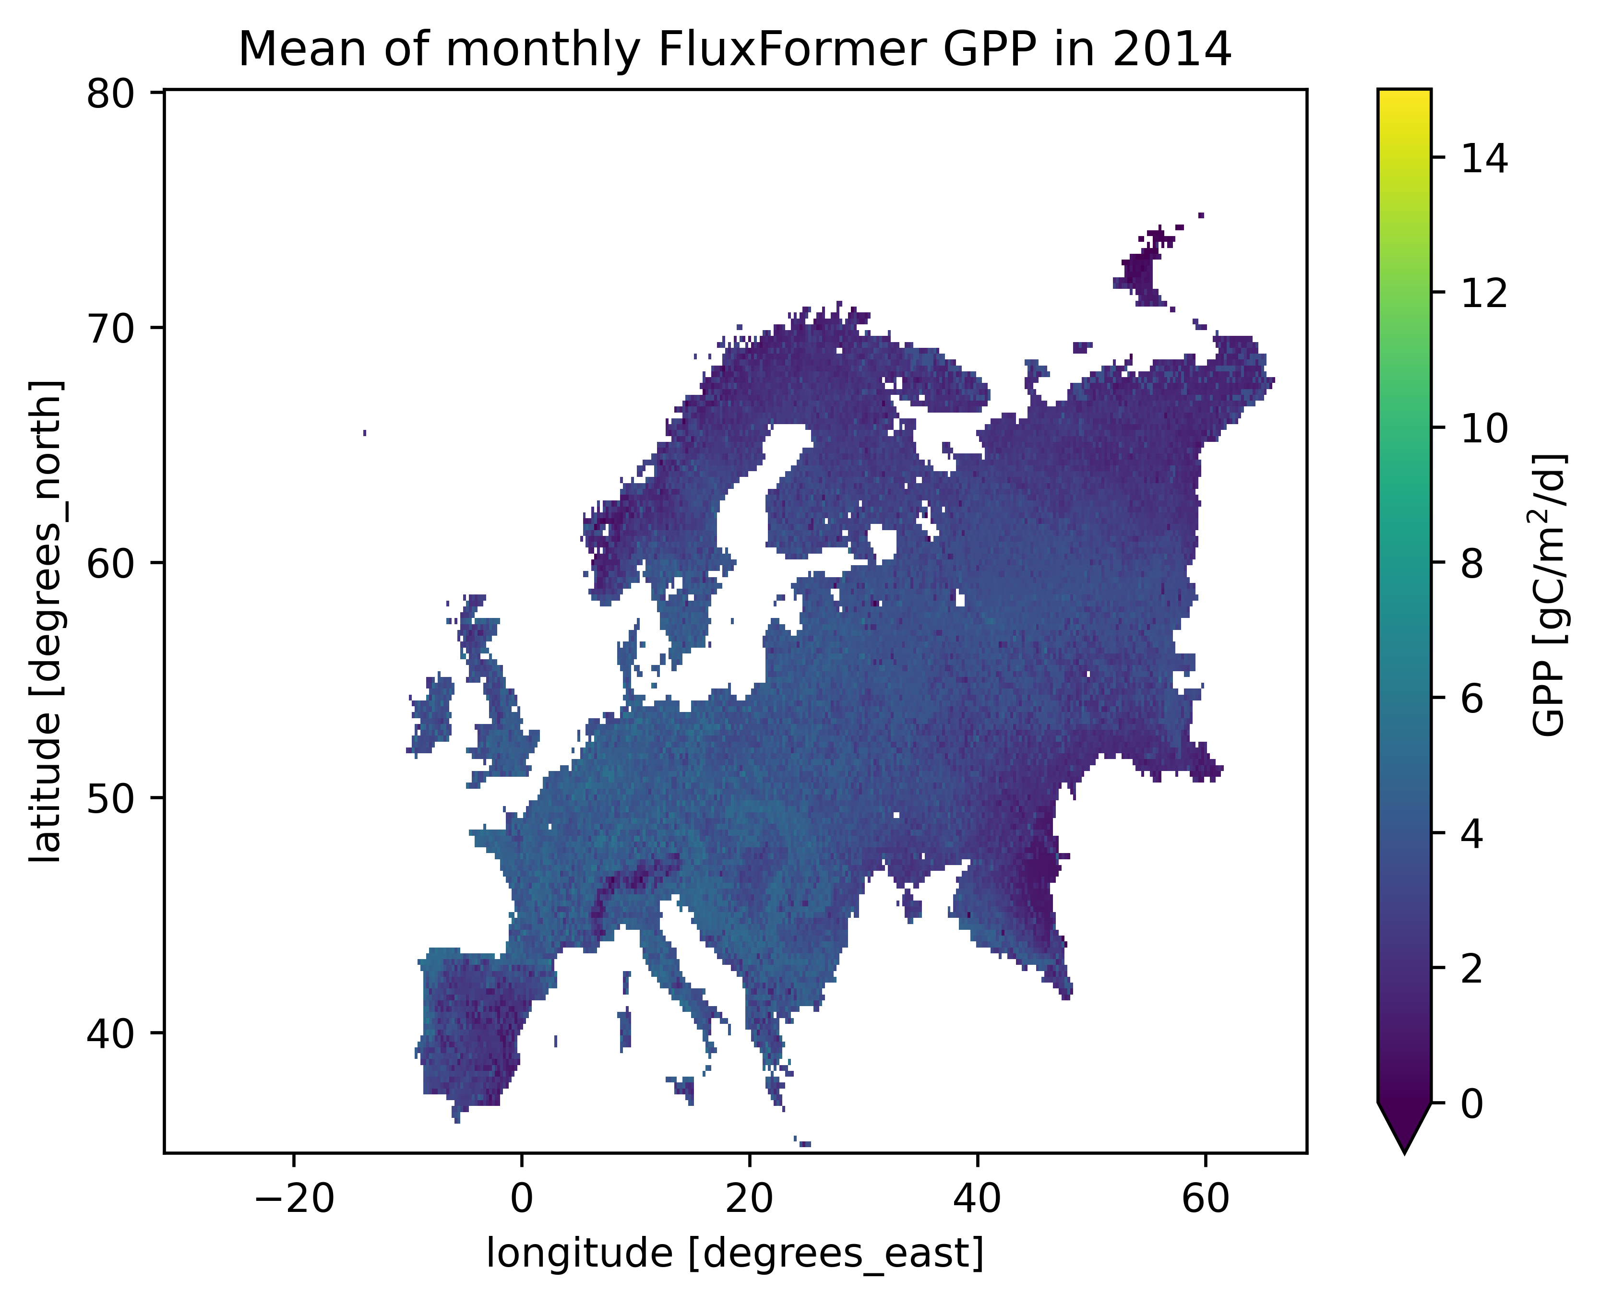
5 Fluxes map

Slide 17
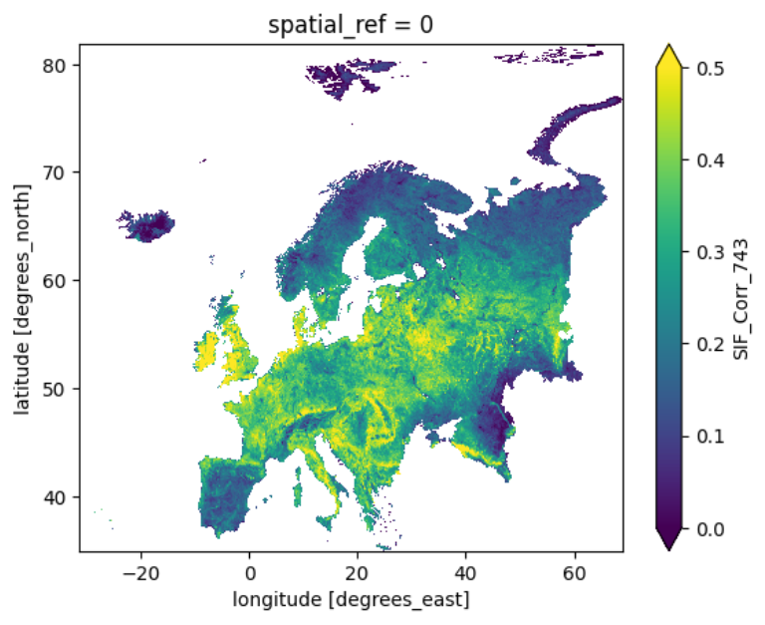
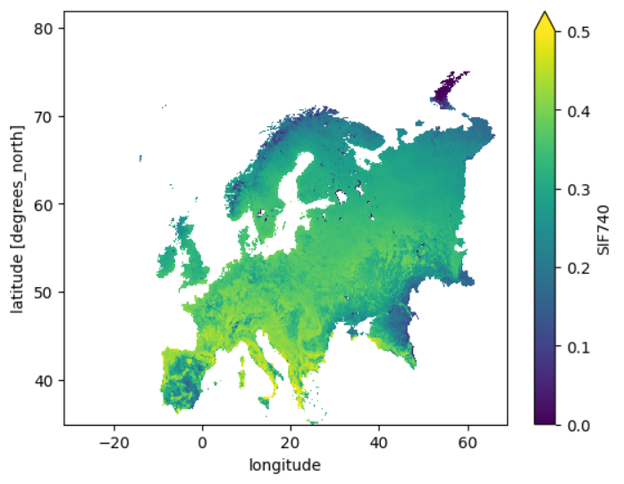
Mean of SIF 740 from RF_S-S in 2018
Mean of SIF 740 from TROPOMISIF in 2018

Slide 18


Thanks for listenting!
q.han@utwente.nl
More information

Slide 19
Input feature | Unit | source | Spatial-temporal resolution | Target spatial-temporal resolution | Interpolation method | Spatial resampling method
Rin | W m⁻² | ERA5-land | 11km, hourly | 11km, half-hourly | Do diff to convert cumulative data to half-hourly, and then divide 3600 seconds to get W m⁻² | -
Rli | W m⁻² | ERA5-land | 11km, hourly | 11km, half-hourly | Same as above | -
Precip_msr | mm | ERA5-land | 11km, hourly | 11km, half-hourly | do diff to convert cumulative data to half- hourly | -
p | hPa | ERA5-land: surface_pressure | 11km, hourly | 11km, half-hourly | Linear interpolation | -
Ta | ℃ | ERA5-land | 11km, hourly | 11km, half-hourly | Linear interpolation | -
ea | hPa | ERA5-land | 11km, hourly | 11km, half-hourly | Linear interpolation | -
u | m s⁻¹ | ERA5-land | 11km, hourly | 11km, half-hourly | Linear interpolation | -
CO2 | mg m⁻³ | https://ads.atmosphere.copernicus.eu/cdsapp#!/dataset/cams-global-ghg-reanalysis-egg4?tab=overview | 0.75°, 3-hourly | 11km, half-hourly | Nearest neighbor interpolation to hourly | Aggregate average
LAI | m² m⁻² | https://cds.climate.copernicus.eu/cdsapp#!/dataset/satellite-lai-fapar?tab=overview | 300m, 10 days | 11km, half-hourly | linear interpolation to daily, then nearest neighbor interpolation to hourly. | Aggregate average
SSM | cm³ cm⁻³ | GSSM1km | 1km, daily | 11km, half-hourly | Linear interpolation | Aggregate average
Vcmo | µmol m⁻² s⁻¹ | https://zenodo.org/record/6466968#.ZDkg0nbP2Uk | 0.5° | 11km | - | Aggregate average
Canopy height | m | https://share.phys.ethz.ch/~pf/nlangdata/ETH_GlobalCanopyHeight_10m_2020_version1/3deg_cogs/ | 10m | 11km | - | Aggregate average
IGBP | - | https://cds.climate.copernicus.eu/cdsapp#!/dataset/satellite-land-cover?tab=overview | 300m, yearly | 11km | - | Aggregate average
Data resource

