Slide 1
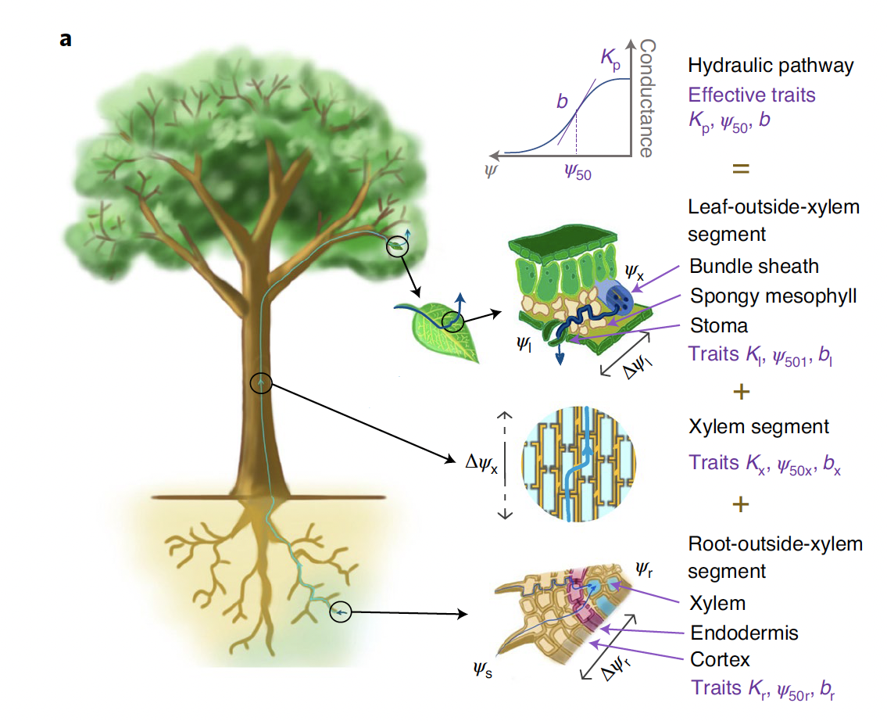
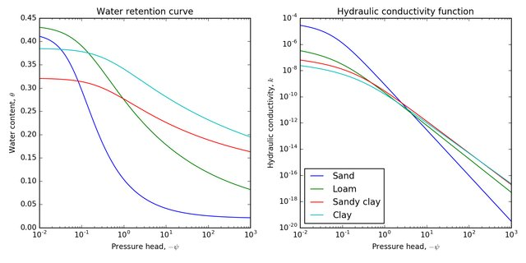
The soil-plant-hydraulic system and its properties
Joshi et al., (2022)
Plant part
Soil part
Ψ_{leaf}
Hydraulic conductivity, K
Ψ_{stem}
Affected by soil pore-size distribution !
Ψ_{soil}
Ψ_{root}
Both used in Richard’s equation
Ψ_{soil}
Soil water cotntent, θ
Drought stress: risk of ‘hydraulic failure’ increases when root water availability declines, or when vapour pressure deficit increases at the leaf surfaces.
Ψ_{soil}
Notes:
As a thermodynamic property of the water itself (i.e., its free energy), the
Ψ can be averaged at any scale and across media,

Slide 2
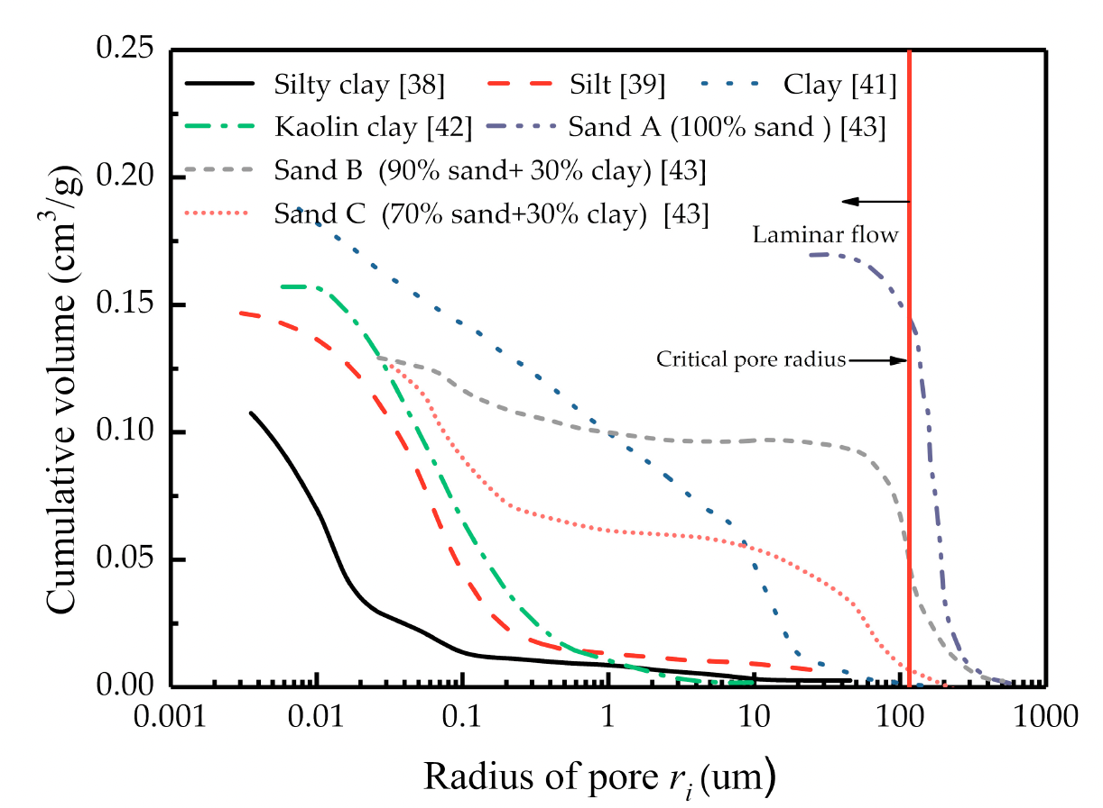
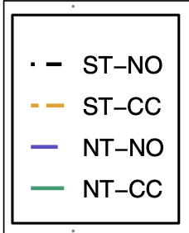

Use Ψ_{soil} to derive PSD and dynamic soil hydraulic curves
Central to this is a set of hydraulic equations in which pore-size distribution (PSD) directly affects the hydraulic functions: Kosugi model
Soil Texture
Land management effects
Chen et al., 2019
Local variability
Bulk densities
Araya et al., 2022
ST: standard till; NT: no-till; CC: cover cropping; NO: no cover-cropping
Schlüter &
Vogel, 2016

Slide 3
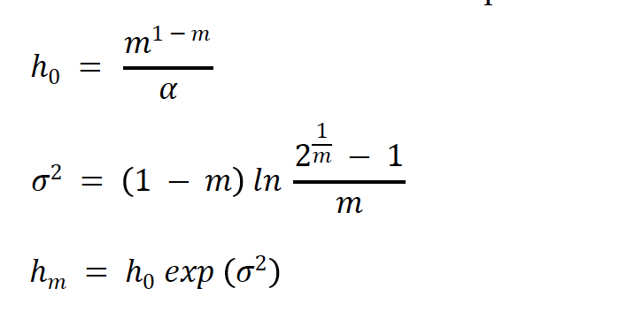
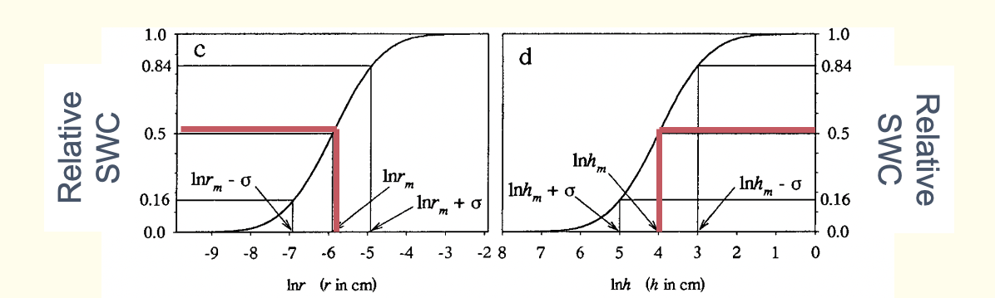
Kosugi model
Kosugi parameters =VG parameters

Slide 4
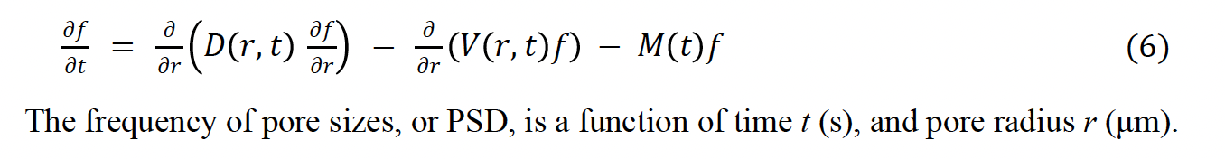
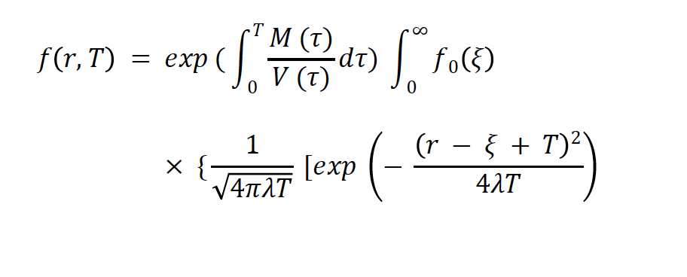
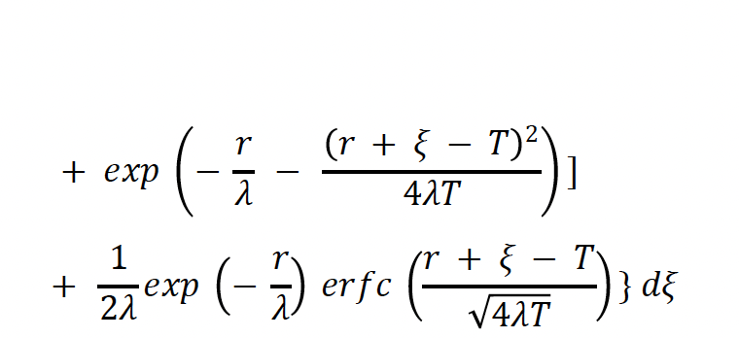
Use Fokker-Planck equation to simulate changes in PSD
The FPE calculates how the pore-size distribution (PSD) changes due to changes in management for example
The three coefficients of PSD are the dispersion term D (μm2 s-1), the
drift term V (μm s-1), and the degradation term M (s-1). E.g. D quantifies the changes in the variance of the PSD, playing a crucial role in determining the width of the probability function over time. Consequently, it is intimately associated with σ, the positive square root of the variance.

Slide 5
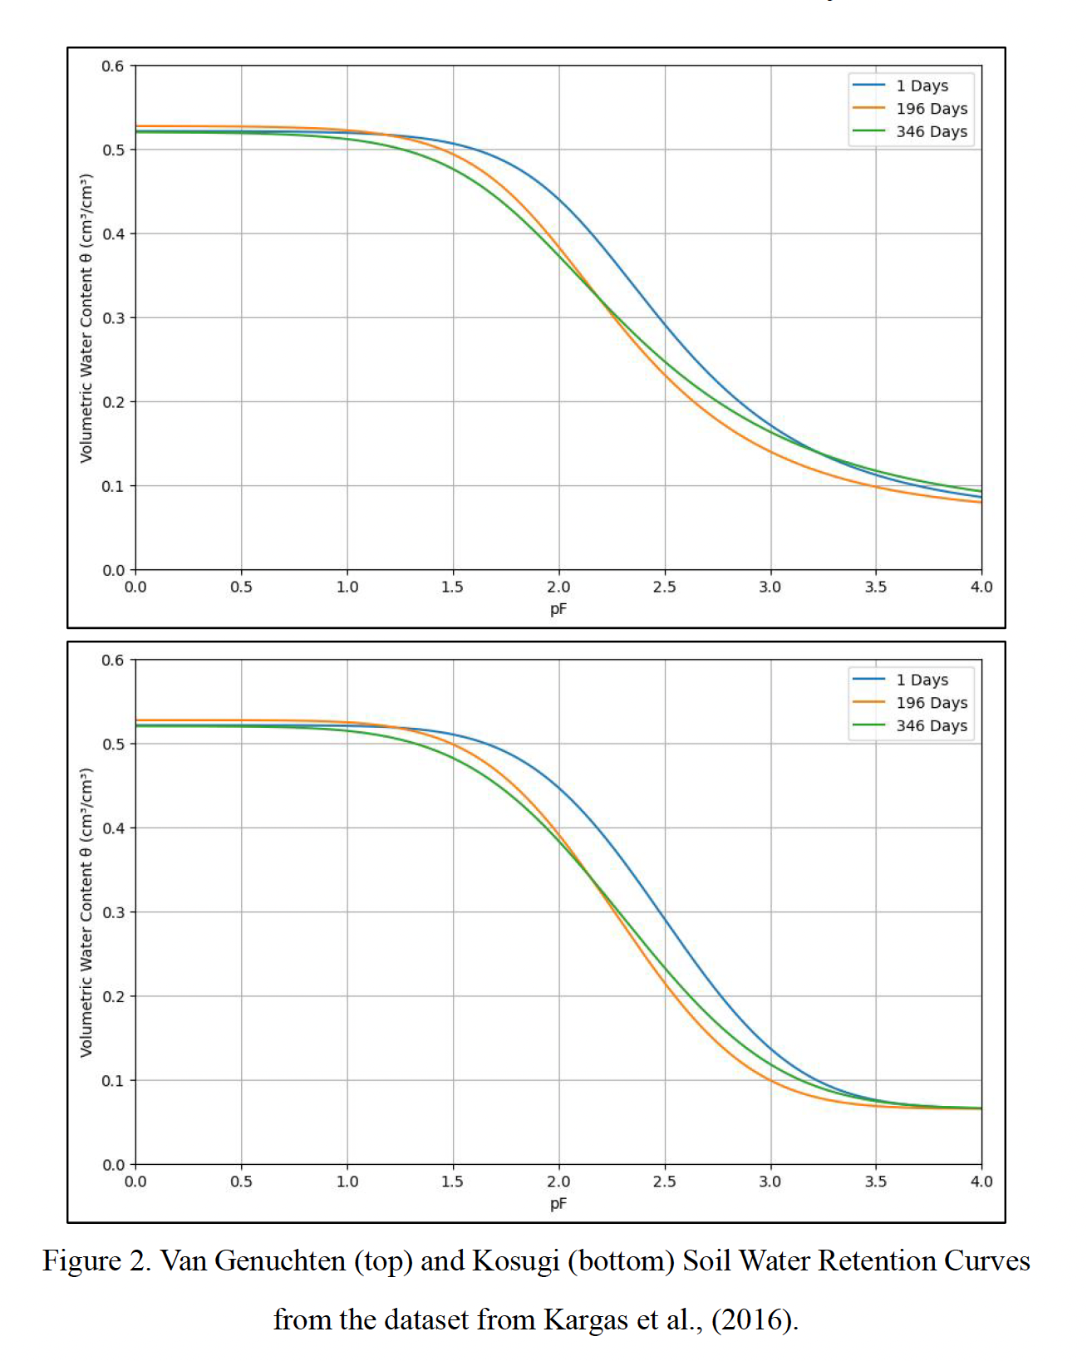
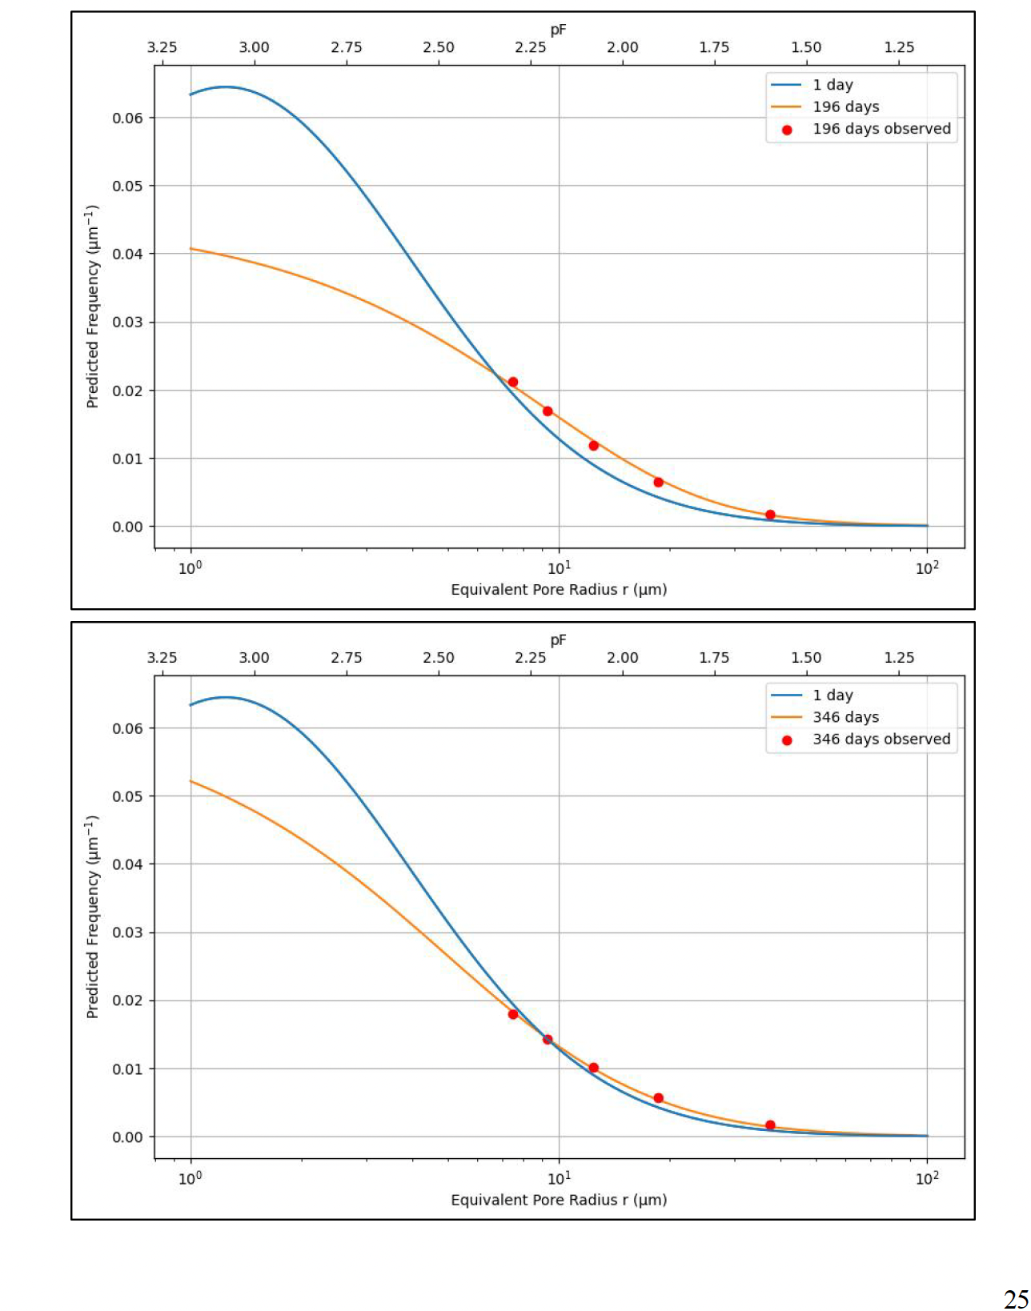
Use Fokker-Planck equation to simulate changes in PSD
Kargas et al. (2016) conducted a study on soil hydro-physical and functional
properties on days 196 and 346 after the introduction of rotary ploughing (RoT) on topsoil at a university in Attica, Greece, from October 2011 to September 2012
PSD function: VG
SWRC: VG
PSD function: Kosugi
SWRC: Kosugi

Slide 6
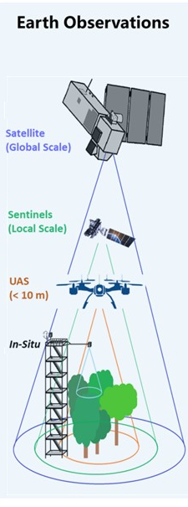
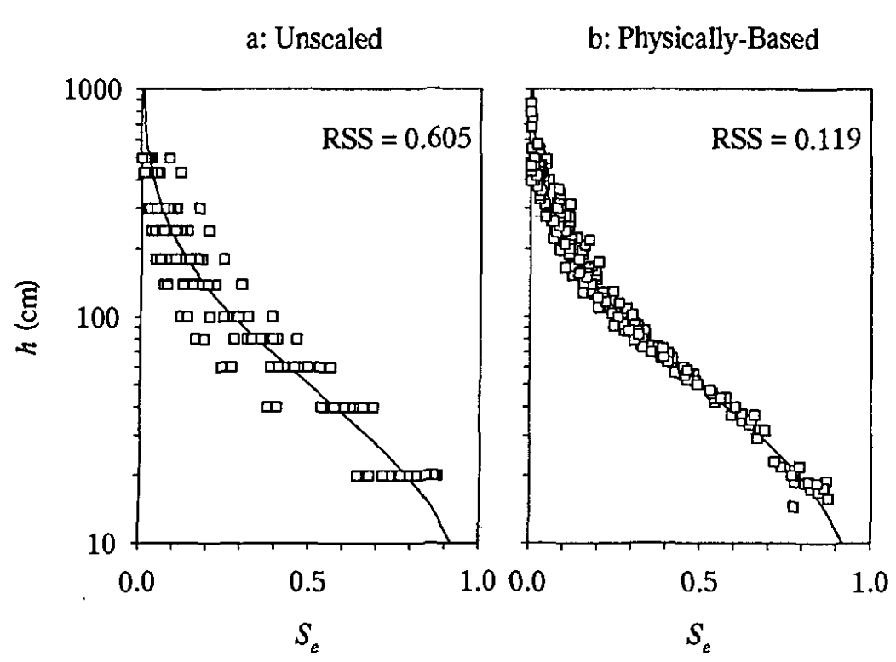
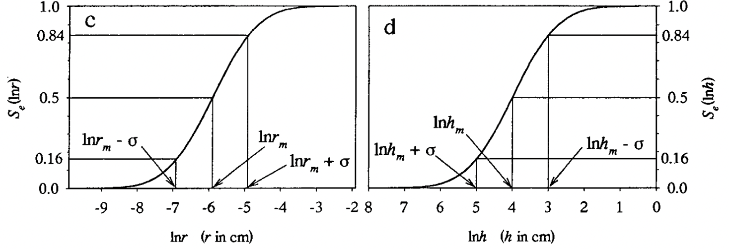
Seamless moving across spatiotemporal scales..
Earth observations at nested scales
→ area-representative soil parameters at a range of scales
Kosugi hydraulic functions (Zhang et al., 2018) also provide excellent scaling opportunities (Kosugi & Hopmans, 1998)
Hydraulic parameter sets will be accompanied with physically meaningful scaling parameters
information on sub-grid scaling variance is given for dynamical up-and downscaling, or to perturb hydraulic parameters for model ensemble output generation
h_{m} (median capillary pressure head = median Ψ_{s}), and standard deviation, σ, as Kosugi parameters
Un-scaled
Scaled
Relative SWC
Relative SWC
Relative SWC

Slide 7
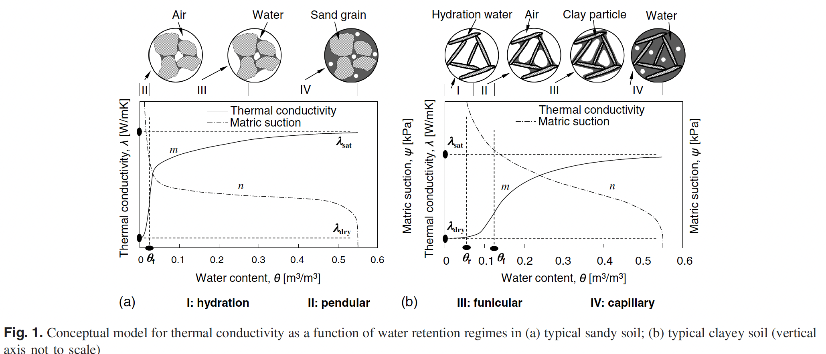
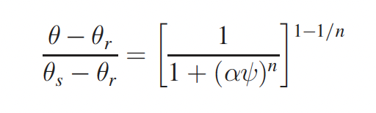
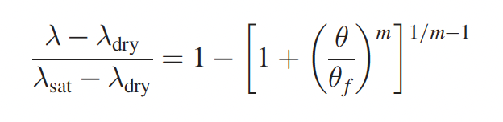
Implementing unifying soil hydro-thermal framework
Lu & Dong (2015)
Hydraulic and thermal theories are unified
UoR currently collating and working on improved unified theories that also take into account temperature effects on hydraulic functions

