Slide 1
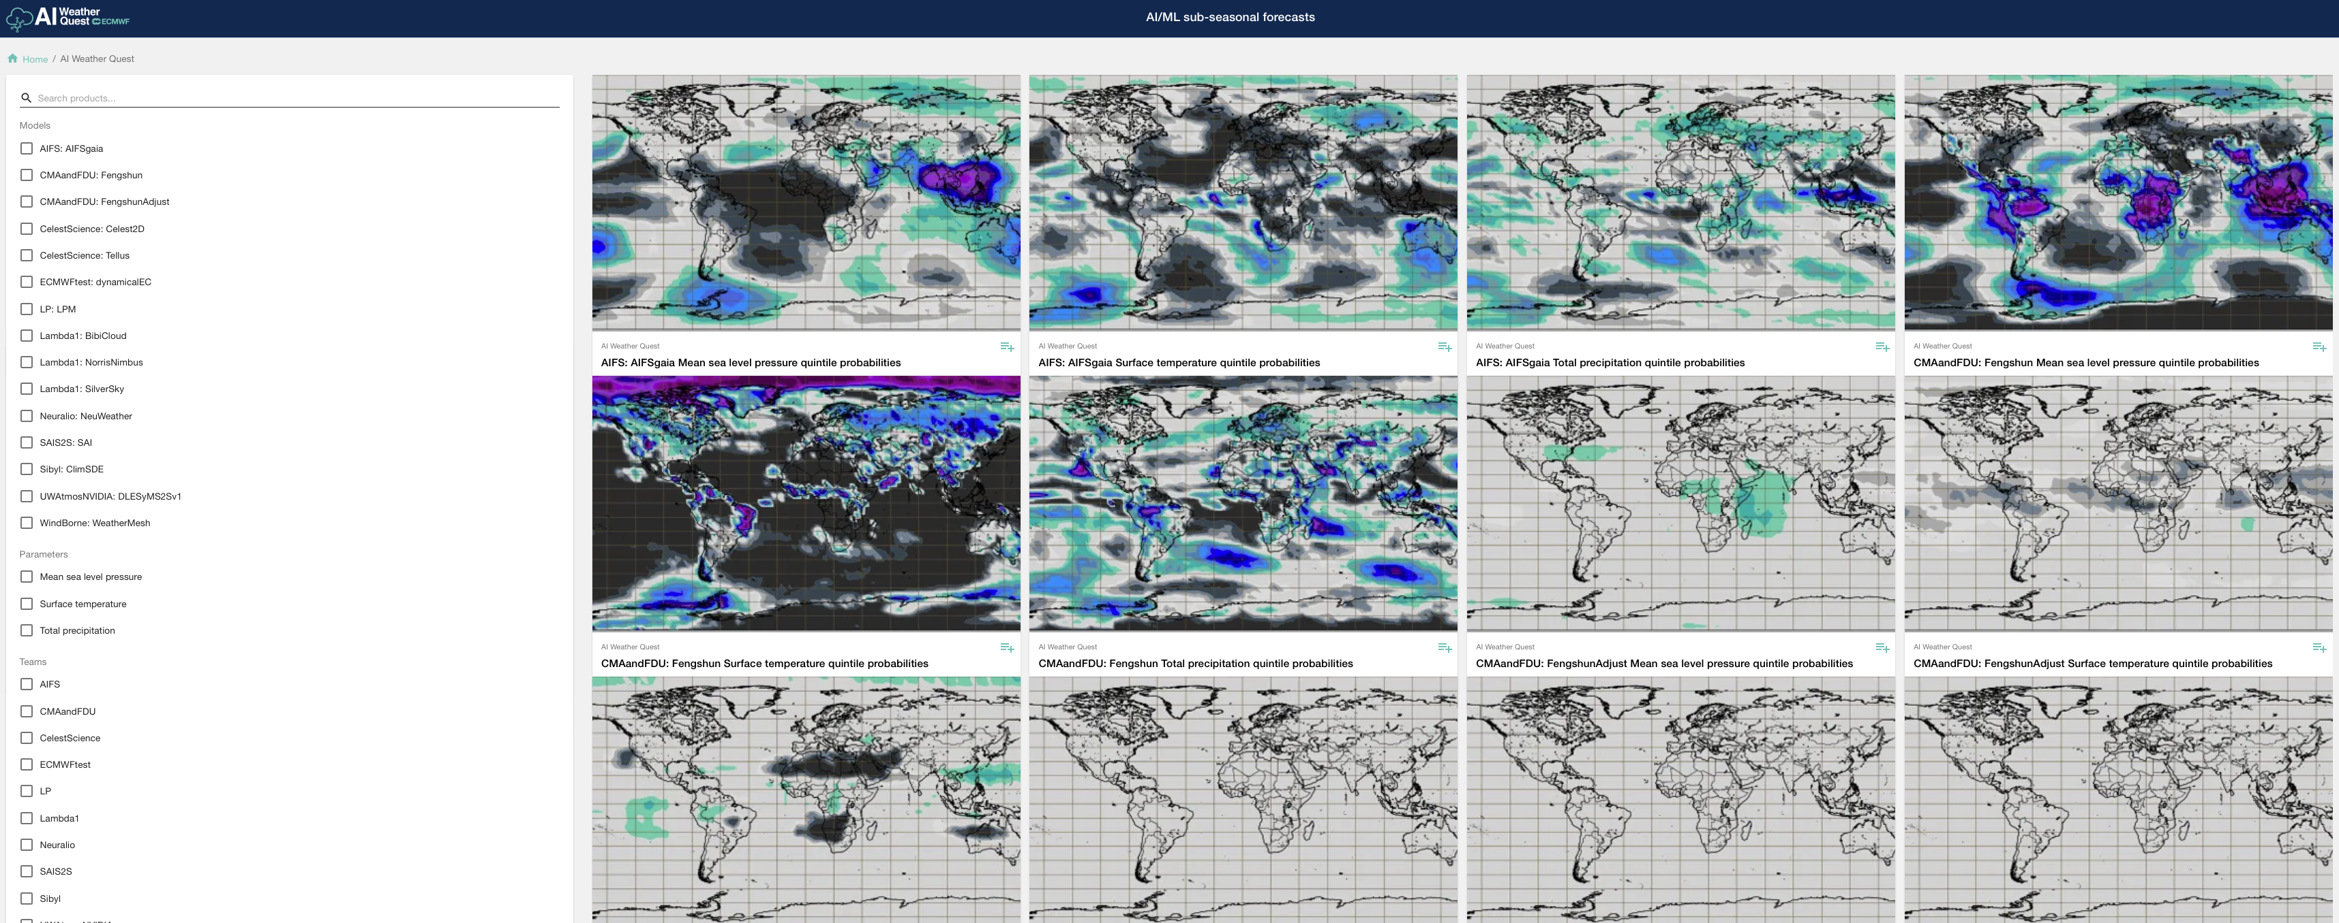
Selection panel
Individual forecast panels

