Slide 1
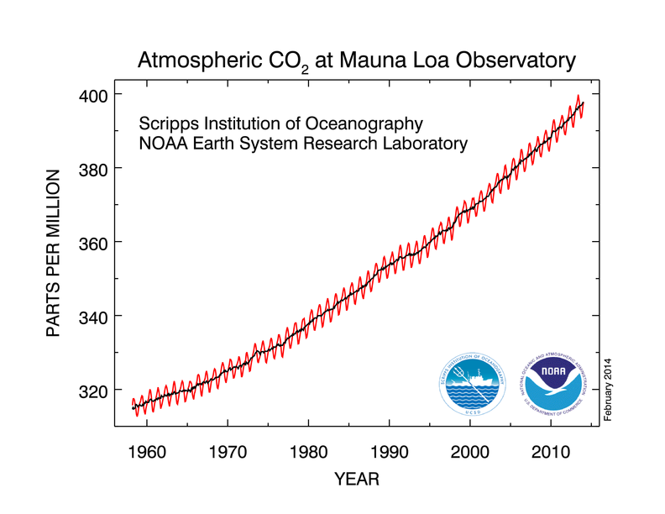
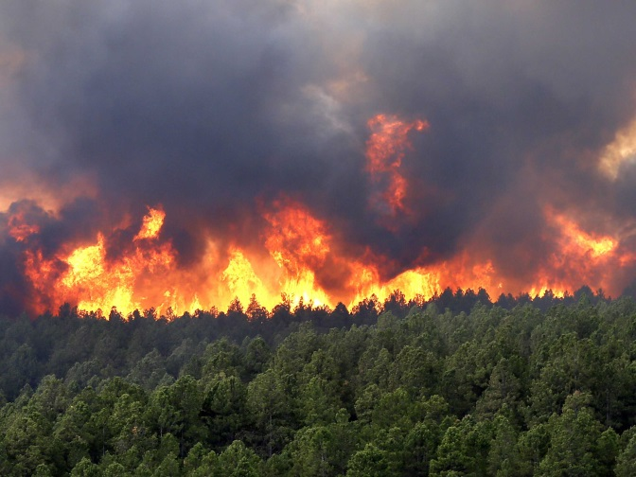
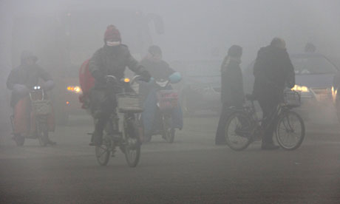
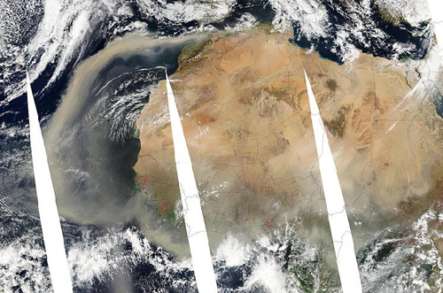
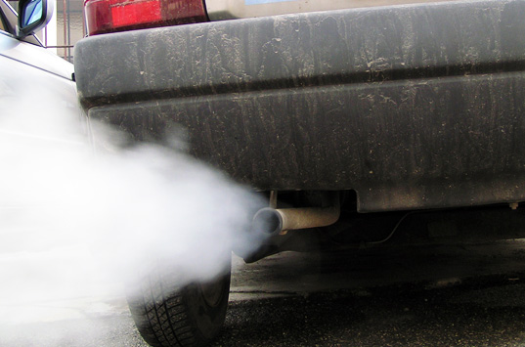

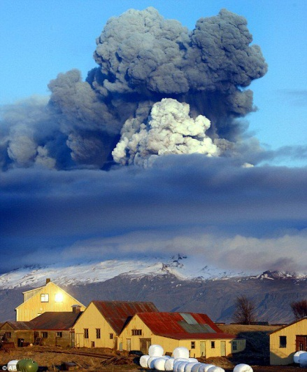
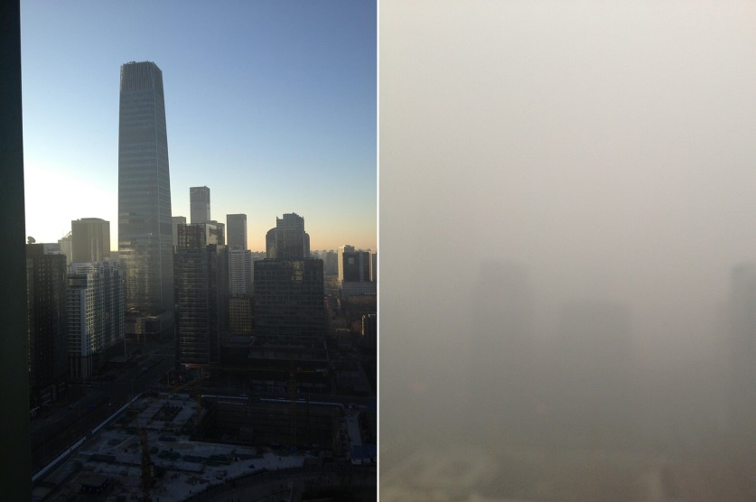
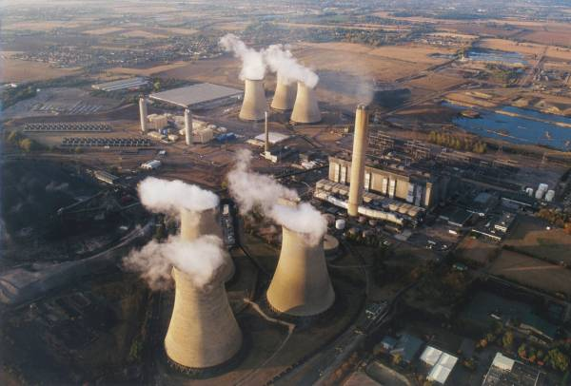
Atmospheric composition

Slide 2

Data Assimilation of Atmospheric Composition
Antje Inness
Contributions from: Angela Benedetti, Alessio Bozzo, Richard Engelen, Johannes Flemming, Sebastien Massart

Slide 3
Outline
Introduction
Potential benefit for NWP
Challenges for atmospheric composition DA
Observations of atmospheric composition
Aerosol assimilation
Concluding remarks

Slide 4
1. Introduction
Environmental and health concern (29,000 premature deaths in UK per year)
Important to provide air quality forecasts
Expertise in data assimilation and atmospheric modelling
Not principally different from meteorological DA but several new challenges
Interaction of atmospheric composition (AC) and NWP
  Feedback on dynamics via radiation scheme
  Precipitation and clouds
  Satellite data observations influenced by aerosols (and trace gases)
  Hydrocarbon (Methane) oxidation is water vapour source
  Assimilation of AC data can have impact on wind field
Notes:
WHO(2014): ~ 7 million deaths related to air pollution in 2012. Biggest environmental health risk.

Slide 5
Composition-IFS (C-IFS)
Over the last decade IFS has been extended with modules for atmospheric composition (aerosols, reactive gases, greenhouse gases)
GEMS -> MACC -> CAMS (Copernicus Atmosphere Monitoring Service) projects
At first a “Coupled System”, now composition fully integrated into IFS
Data assimilation of AC data to provide best possible IC for subsequent forecasts
AC benefits from online integration and high temporal availability of meteorological fields
C-IFS provides daily analyses and 5-day forecasts of atmospheric composition in NRT

Slide 6
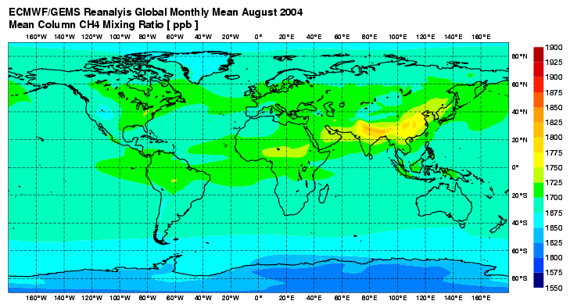
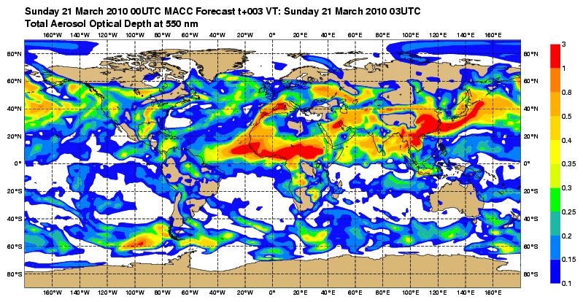

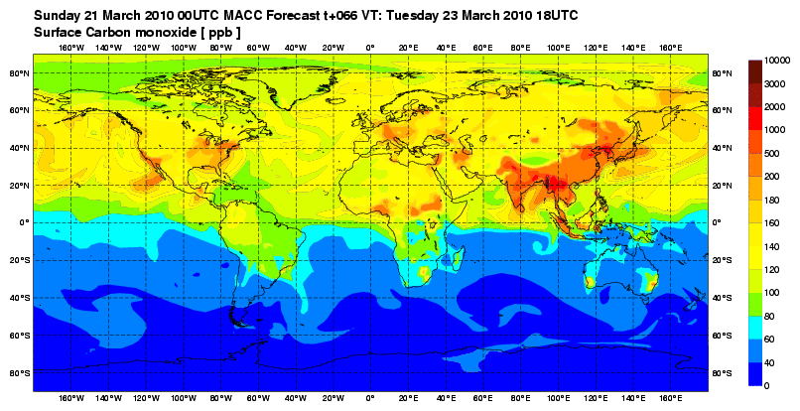
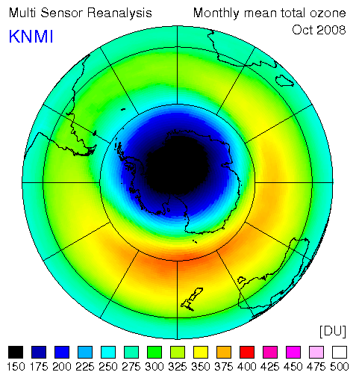
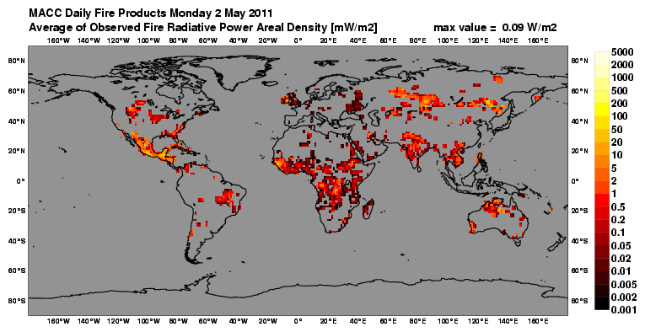
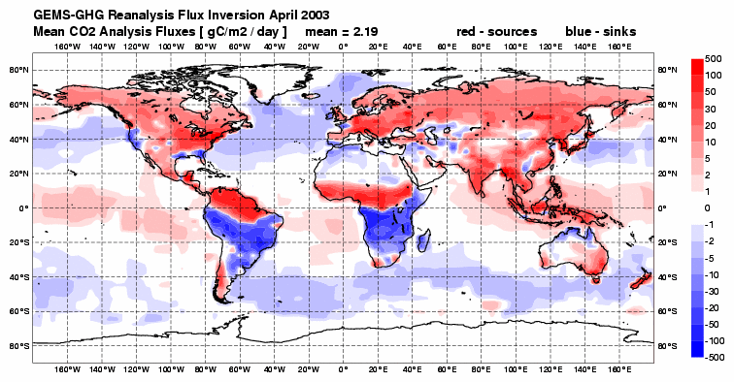
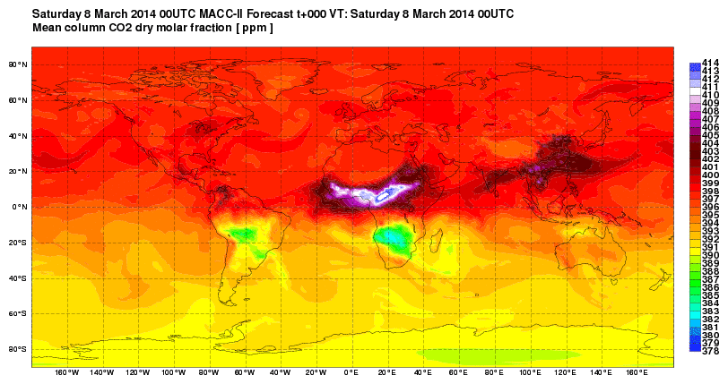
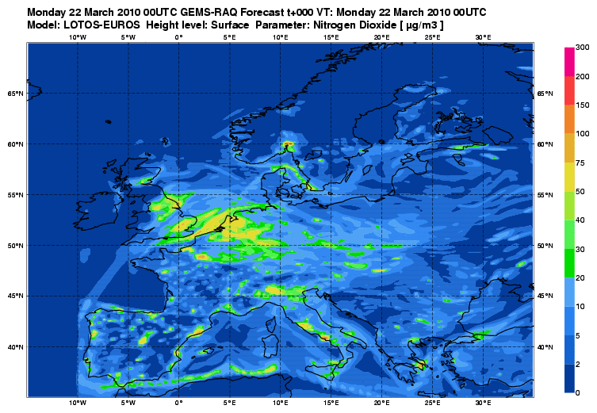
CAMS Service Provision
Retrospective
Daily (NRT)
Reanalysis
2003 onwards
Aerosols
Ozone records
Global Pollution
Fires
GHG forecast
Flux Inversions
Air quality
atmosphere.copernicus.eu

Slide 7
CAMS data assimilation system
Chemistry solvers included in IFS
e.g. TM5 (CB05)
54 species, 126 reactions
photolysis, dry and wet deposition
(no TL + AD of chemistry)
Extra information:
Emissions (e.g. GFAS)
Fluxes
IFS control variables
CHEM: O3, NO2, SO2, CO, HCHO
AER: single or dual control variables (total or fine & coarse mode aerosol mixing ratio)
GHG: CO2, CH4
Meteorological variables
Observations
Observation operators
Varbc
Background error statistics
Aerosol model with 12 bins (no TL or AD)
GHG fields

Slide 8
2. Potential benefit for NWP
Interactive aerosols: Feedback on dynamics via radiation scheme: Tegen AER climatology used in radiation scheme (MACC climatology will be used from CY43R3 onwards)
Use of O3 (& other fields) in the radiation scheme: MACC climatologies used
RTTOV observation operator: Use of O3, CO2 analysis fields to improve the use of radiances sensitive to O3, CO2: model O3 is used, but climatologies used for other tracers (e.g. fixed CO2 value)
Dynamical coupling with wind/ T through TL and AD: turned off
Multivariate JB: Correlations between tracers and dynamical variables, e.g. O3 and vorticity; correlations between chemical species: univariate

Slide 9
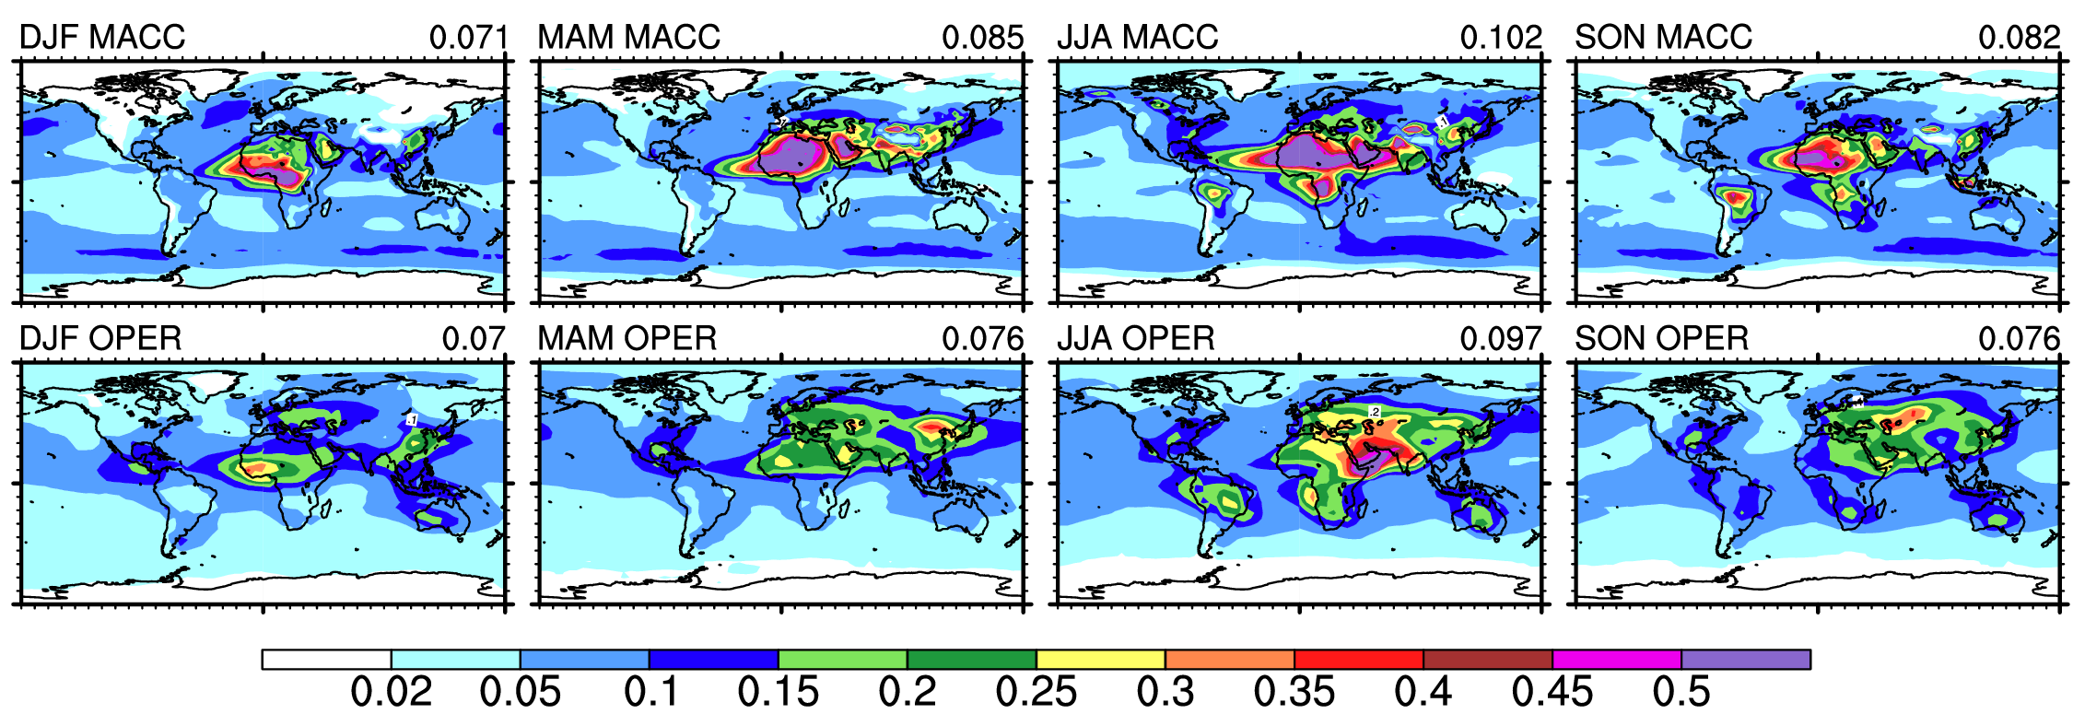
Climatological AOD 550nm distribution
MACC vs Tegen et al 1997 (OPER)
Credits: Alessio Bozzo
MACC reanalysis (2003-2012): sources of biomass burning from GFAS, sulphate aerosol precursor from EDGAR 4.1, prognostic for sea salt and dust, revised dust model
Optical properties recomputed for RRTM spectral bands and for each aerosol type/size bin. Mass mixing ratio as input to radiation
Vertical distribution following an exponential decay with scale height derived from the MACC model for each aerosol type. Monthly varying for dust.
Notes:
the Tegen climatology is currently the operational choice but from CY43R3 it will be substituted by the CAMS climatology

Slide 10
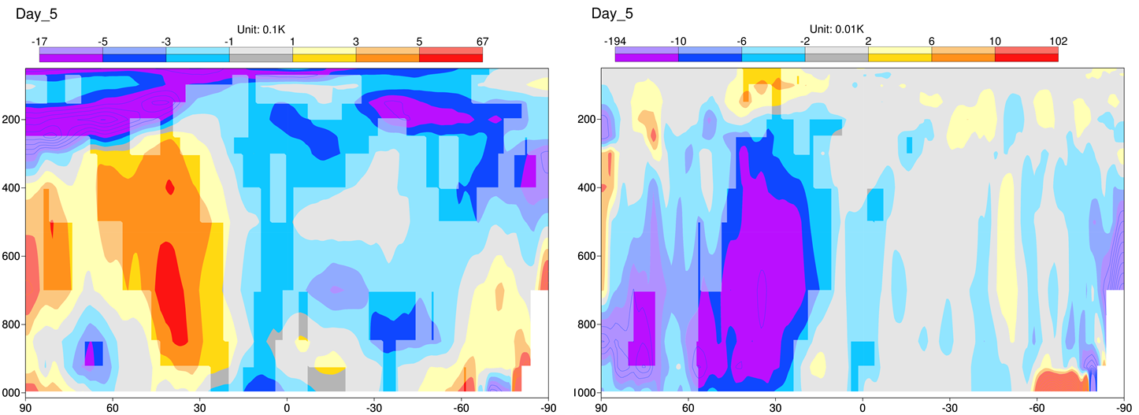
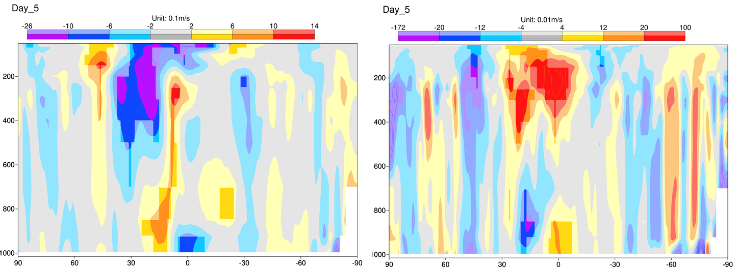
Impacts on forecast errors
Temp
Change in mass distribution and optical properties -> reduction in SW absorption -> reduction in temperature (positive)
This is of the order of 0.1K for a bias of the order of 0.3K – it explains at least ~30% of the temperature error.
Similar for winds at upper levels
U-wind
June-July
Model FC error d+5
June-July
Change in FC error d+5
Credits: Alessio Bozzo
Notes:
on the left it is shown the temperature and U wind mean error at d+5 with the Tegen climatology and on the right hand side the difference in mean error using the CAMS climatology. So when the difference is opposite in sign to the mean error, it is good (mean error decreases)

Slide 11
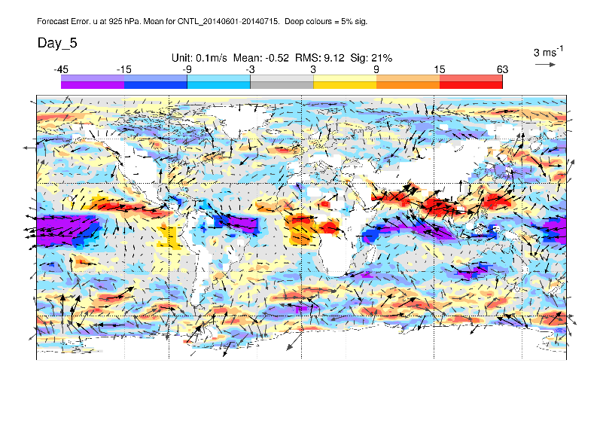
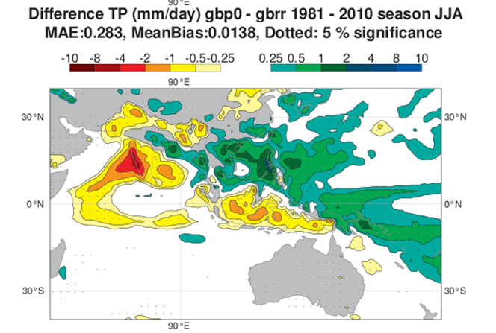
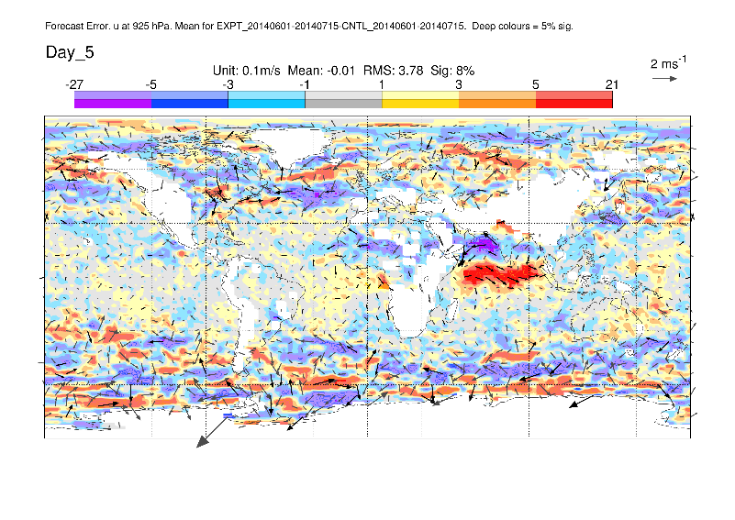
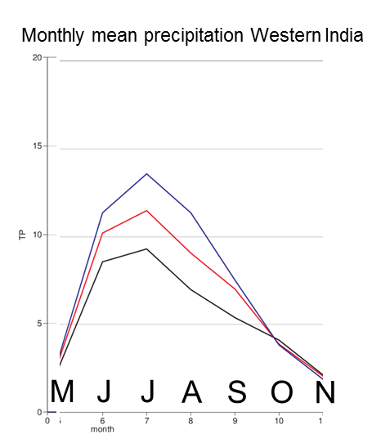
Impacts on FC errors
U 925 hPa – model bias at D+5
June-July
20 year run
U 925 hPa – change in model bias
OLD climatology
NEW climatology
GPCP (obs)
Credits: Alessio Bozzo, Linus Magnusson
Notes:
Mean error and change, as in previous slide. Here the main point is that there is a feedback between the change in aerosol radiative forcing (mainly less absorption by the mineral dust layer over the Arabian peninsula) and the local circulation in summer in the northern Indian ocean region. In particular, the model tends to have too strong lower level zonal wind associated to the summer Monsoon circulation and this contributes to an overestimation of precipitation in western India. The change in aerosol radiative forcing helps to slow down the circulation and reduces the precipitation bias. It is responsible for a reduction in the wind model bias of ~30% and the improvement in precipitation bias is confined to the western India coast only.

Slide 12
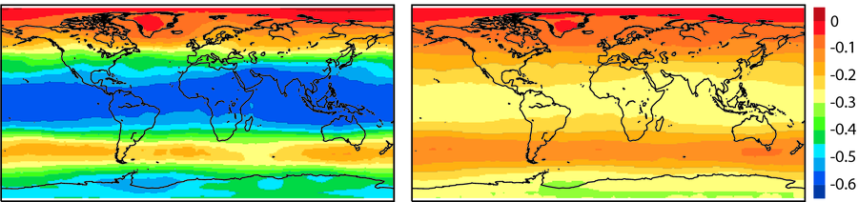
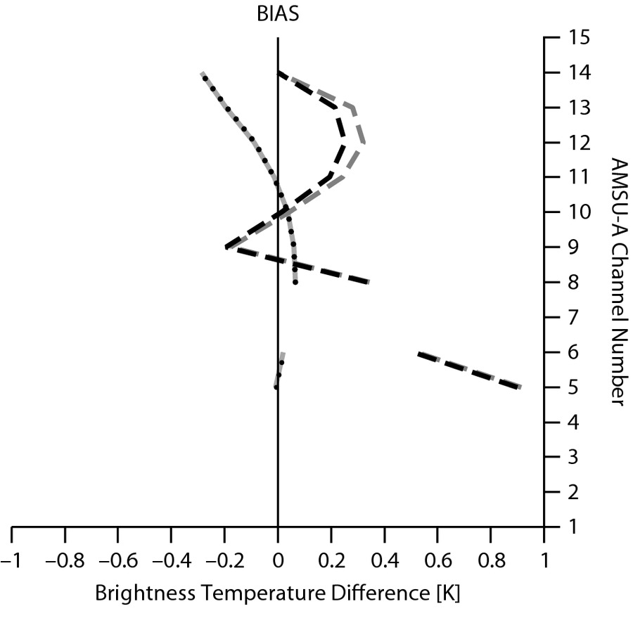
Benefit of trace gases for NWP:
Variable CO₂ in radiance assimilation
Engelen and Bauer, QJRMS, 2011
Reduced AIRS and IASI Bias Correction
Fixed CO2
Variable CO2
Mean bias correction (K) for August 2009 for AIRS channel 175 (699.7 cm⁻¹; maximum temperature sensitivity at ~ 200 hPa)
Using modelled CO₂ in AIRS/IASI radiance assimilation leads to significant reduction in needed bias correction.
Small positive effect on T analysis and neutral scores/ small positive impact at 200 hPa T in Tropics
Stratospheric T in variable CO2 exp more consistent with AMSU-A
It would be beneficial to replace the fixed value by more realistic values
stratosphere
Reduced
AMSU-A
Bias Correction

Slide 13
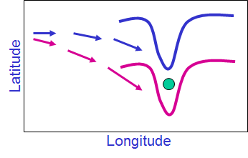
Wind information from tracers
Prospect to extract wind information from long lived tracers in stratosphere and upper troposphere, e.g. O3, H2O, N2O.
Similar to cloud track winds but data coverage worse
Potential to extract wind info indirectly through TL and AD of tracer advection
Potential was demonstrated in early studies for H2O (Thepaut 1992) and O3 (Daley 1995; Riishojgaard 1996; Holm 1999; Peuch et al. 2000).
Could compliment existing wind observations and help in areas where there is a lack of adequate global wind profile data
Notes:
Tracer observations not really available at spatial and temporal resolution needed to extract wind info directly
DA gives the potential to extract wind info indirectly through TL and AD of tracer advection
Variability of O3 in UTLS is dominated by transport process. Photochemical lifetime long (months) and O3 is good tracer for flow).
Similar to assimilation of IR and MW humidity channels have positive impact on tropospheric winds (Peuby and McNally, 2009)

Slide 14
Requirements to extract wind information from tracers
Complete data coverage (3D), frequent observations
Accurate observations
High quality background field
No bias between obs and background
Depends on accuracy of TL model compared to full model (better for passive tracers/ long chemical lifetime) => E.g. extracting wind information from O3 is more difficult in the tropics and summer hemisphere where photochemical lifetime is shorter
Studies have looked at this in idealized experiments (e.g. Daley 1995; Riishojgaard 1996; Peuch et al. 2000; Allen et al. 2013, 2014) focussing on long lived tracers O3, H2O, N2O and found positive impact for perfect observations.
Few studies used real data (e.g. MLS O3, Semane et al. 2009) and positive results are less clear
Notes:
Tracer observations not really available at spatial and temporal resolution needed to extract wind info directly
DA gives the potential to extract wind info indirectly through TL and AD of tracer advection
Variability of O3 in UTLS is dominated by transport process. Photochemical lifetime long (months) and O3 is good tracer for flow).
Similar to assimilation of IR and MW humidity channels have positive impact on tropospheric winds (Peuby and McNally, 2009)

Slide 15
Coupling between tracer and wind field in 4D-Var:
illustration using 1D advection model
Model equations
u = u(x,t) = wind over periodic domain [0,L]
q = q(x,t) = passive tracer
= diffusion coef.
= perturbations
= adjoint variables
Tangent linear equations:
Adjoint equations:

Slide 16
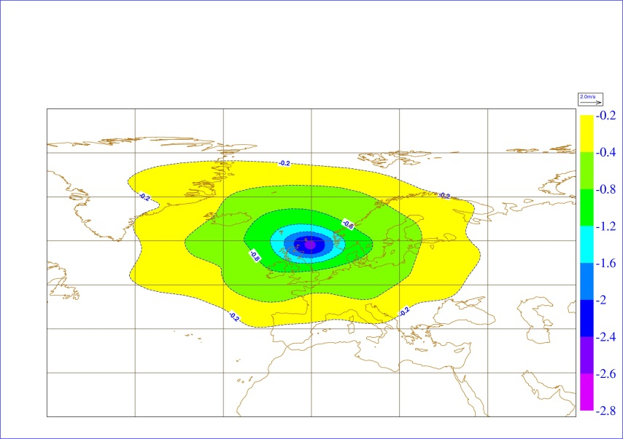
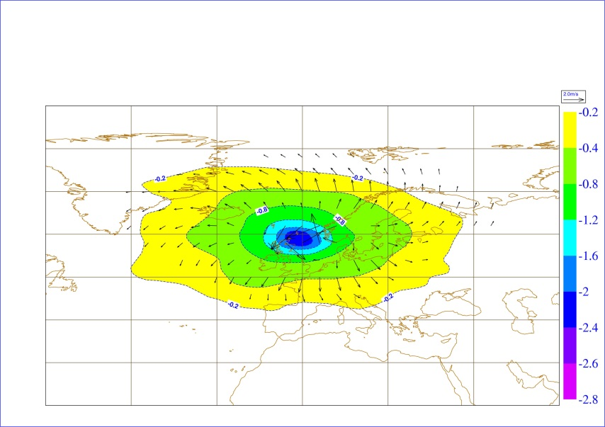

Single observation experiments -
Ozone and wind increments
3D-Var
4D-Var 9z
Level 20,
≈ 30 hPa
4D-Var 12z
4D-Var 15z
6h assimilation window
Notes:
Increments you get from observation placed at the beginning of the window (top right), in the middle of the window (bottom left) and the end of the window (bottom right). Observation at the beginning of the window is like 3D-var (Integration of the tangent linear model for no timesteps does nothing!, Mike’s old 4D-var lecture shows the maths)

Slide 17
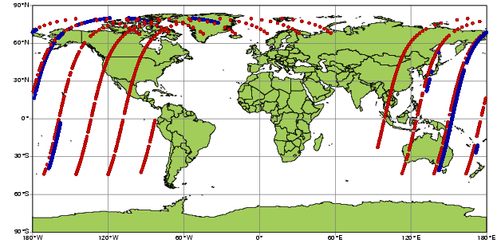
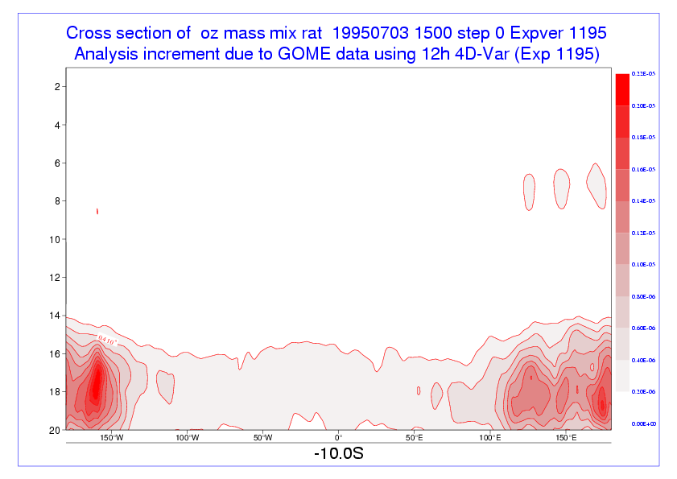
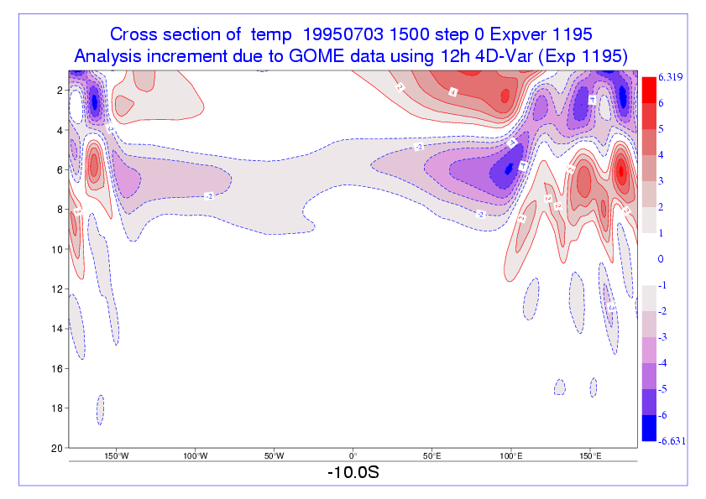
Ozone increments at 10S
Impact of ozone data in 4D-Var: Example from ERA-Interim
The stratosphere is not well constrained by observations:
Ozone profile data generate large temperature increments
4D-Var adjusts the flow where it is least constrained, to improve the fit to observations
=> IFS O3 analysis is completely uncoupled now
GOME 15-layer profiles (~15,000 per day)
SBUV 6-layer profiles ( ~1,000 per day)
Associated Temp increments
1 hPa
Large systematic O3 increments
20 hPa
D. Dee

Slide 18
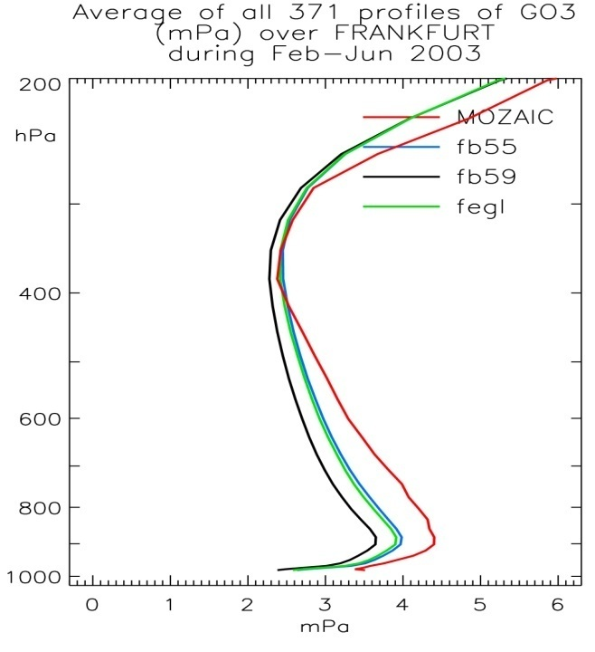
Benefit of chemical coupling
Background NOx levels determine O3 production/loss
Assimilation of NO2 has an impact on ozone field (through chemical feedbacks in the CTM)
Assimilation of NO2 can improve O3 field
Validation with MOZAIC ozone data
Control (no CO or NO2 assim, only O3 assim)
MOZAIC observation
CO & NO2 assim
NO2 assim

Slide 19
3. Challenges for atm. composition data assimilation

Slide 20
Challenges
Quality of NWP depends predominantly on initial state
AC modelling depends on initial state (lifetime) and surface fluxes
Large part of chemical system not sensitive to initial conditions because of chemical equilibrium, but dependent on model parameters (e.g. emissions, deposition, reaction rates,…)
Data assimilation is challenging for short lived species (e.g. NO2)
CTMs have larger biases than NWP models
Most processes take place in boundary layer, which is not well observed from space
Only a few species (out of 100+) can be observed
Data availability
More complex and expensive, e.g. atmospheric chemistry, aerosol physics
Concentrations vary over several orders of magnitude

Slide 21
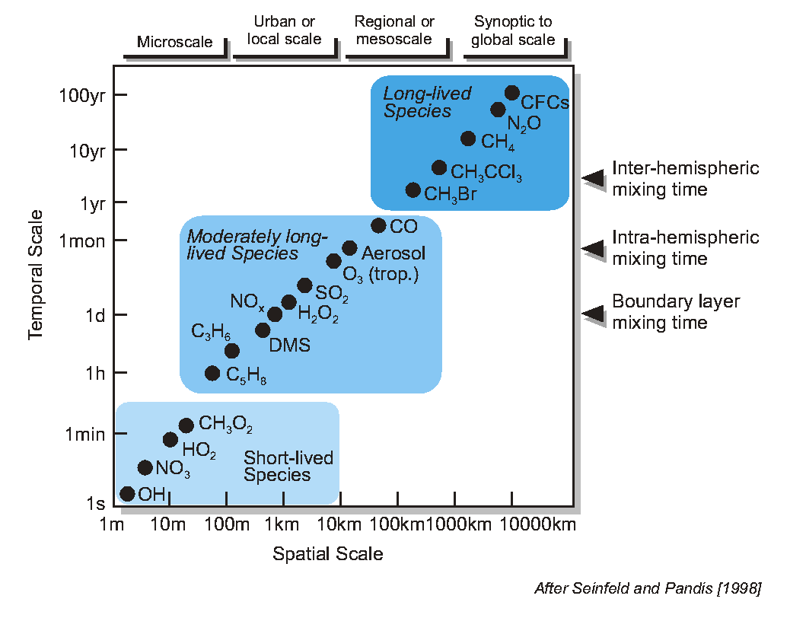
Chemical Lifetime vs. Spatial Scale
◄ into stratosphere
No transport modelled

Slide 22
Emission Estimates
Emissions are one of the major uncertainties in modeling (can not be measured directly)
The compilation of emissions inventories is a labour-intensive task based on a wide variety of socio-economic and land use data
Some emissions can be “modeled” based on wind (sea salt aerosol) or temperature (biogenic emissions)
Some emissions can be observed indirectly from satellites instruments (Fire radiative power, burnt area, volcanic plumes)
„Inverse“ methods can be used to correct emission estimates using observations and models – in particular for long lived gases such as CO2 (e.g. Chevallier et al. 2014) and Methane (Bergamaschi et al. 2009)
Emissions can be included in the control vector and adjusted together with concentrations (e.g. Hanea et al. 2004; Elbern et al. 2007; Miyazaki et al. 2012)

Slide 23
Emission Processes
Combustion related (CO, NO_{x}, SO₂, VOC, CO₂)
  fossil fuel combustion
  biofuel combustion
  vegetation fires (man-made and wild fires)
Fluxes from biogeochemical processes (VOC, CH4, CO₂, Pollen):
  biogenic emissions (plants, soils oceans)
  agricultural emissions (incl. fertilisation)
Fluxes from wind blown dust and sea salt (from spray)
Volcanic emissions (ash, SO₂, HBr …)
In MACC we use GFAS fire emissions (Kaiser et al. 2012) and MACCity anthropogenic emissions (Granier et al. 2011)
Biomass burning accounts for ~ 30% of total CO and NO_{x} emissions, ~10% CH4

Slide 24
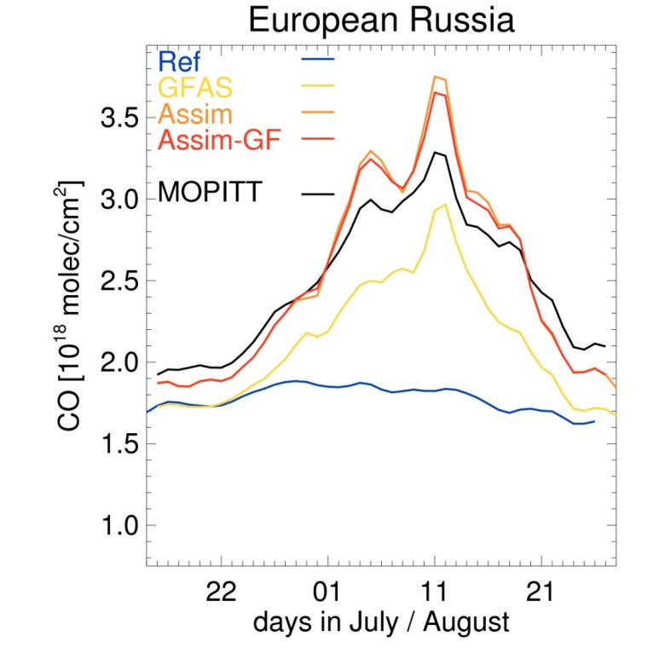
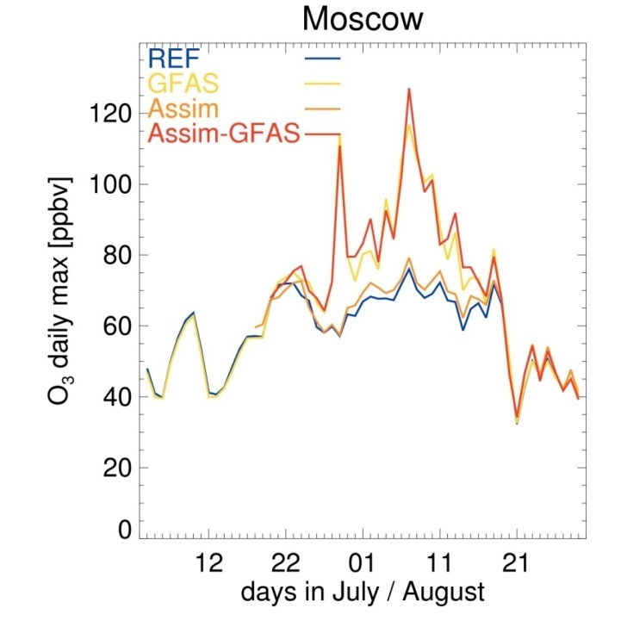
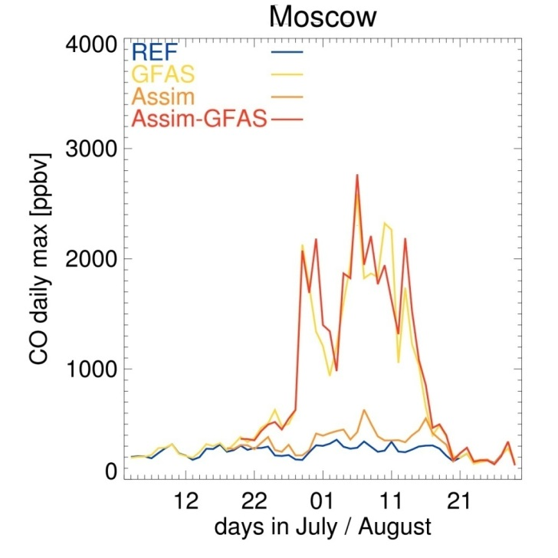
Importance of emissions (Russian fires 2010)
Huijnen et al. 2012 (ACP)
Total column CO
Assimilation of IASI TCCO leads to improved fit to MOPITT TCCO
TCCO from Assim and Assim-GFAS are very similar
Daily maximum surface O3 and CO
GFAS emissions are needed to get peak in surface concentrations in GFAS and Assim-GFAS

Slide 25
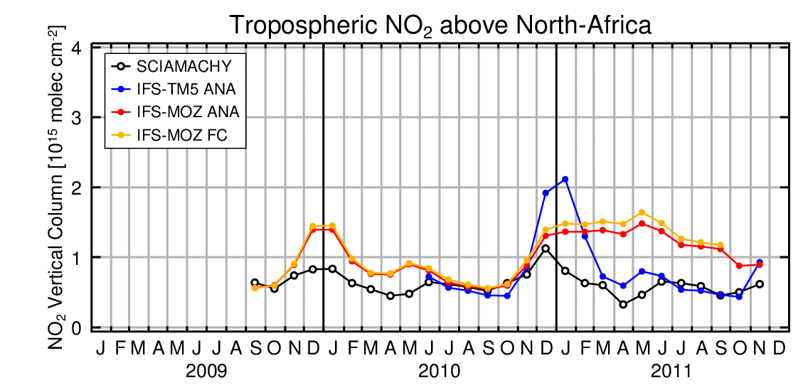
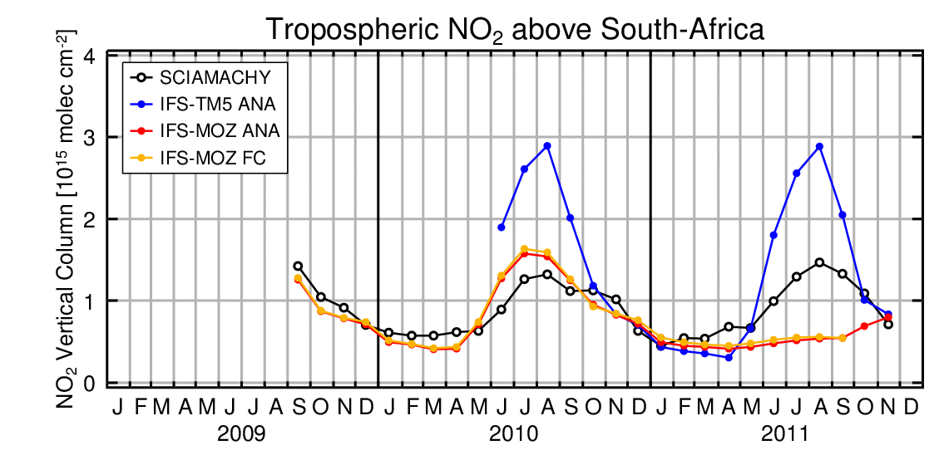
Importance of fire emissions on tropospheric NO2
GFAS emissions for January used by mistake in IFS-MOZ during 2011

Slide 26
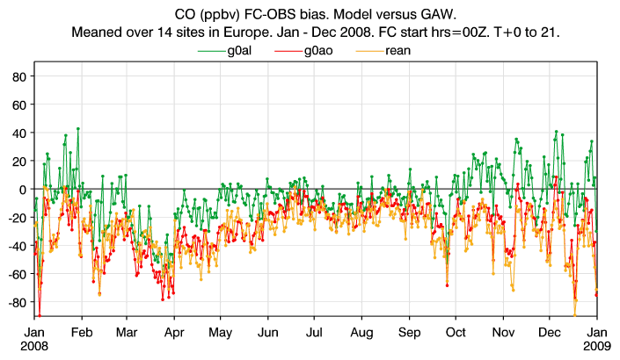
Impact of anthropogenic emissions:
CO Bias - GAW Europa timeseries
C-IFS runs:
HTAP emissions
MACCity emissions
Coupled system:
Reanalysis (MACCity)
(GFAS used in all runs)
Choice of emissions data set has large impact on surface concentrations
J. Flemming

Slide 27
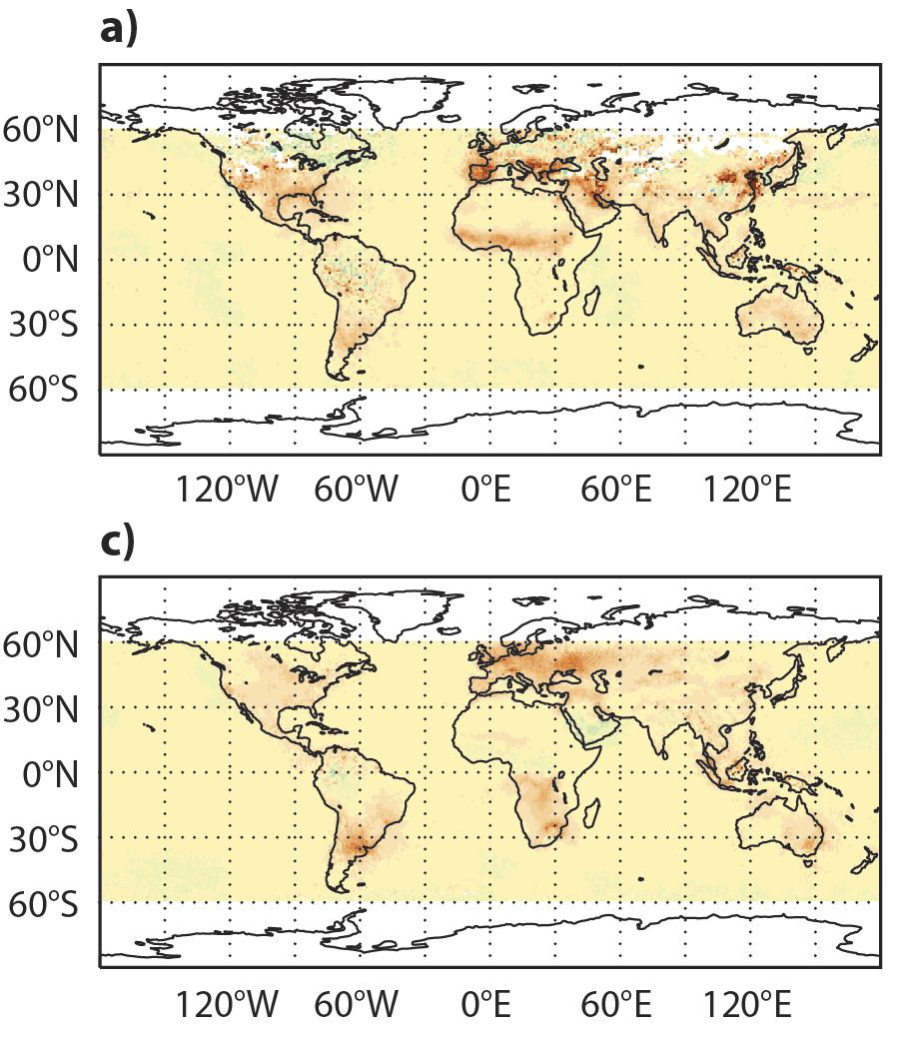
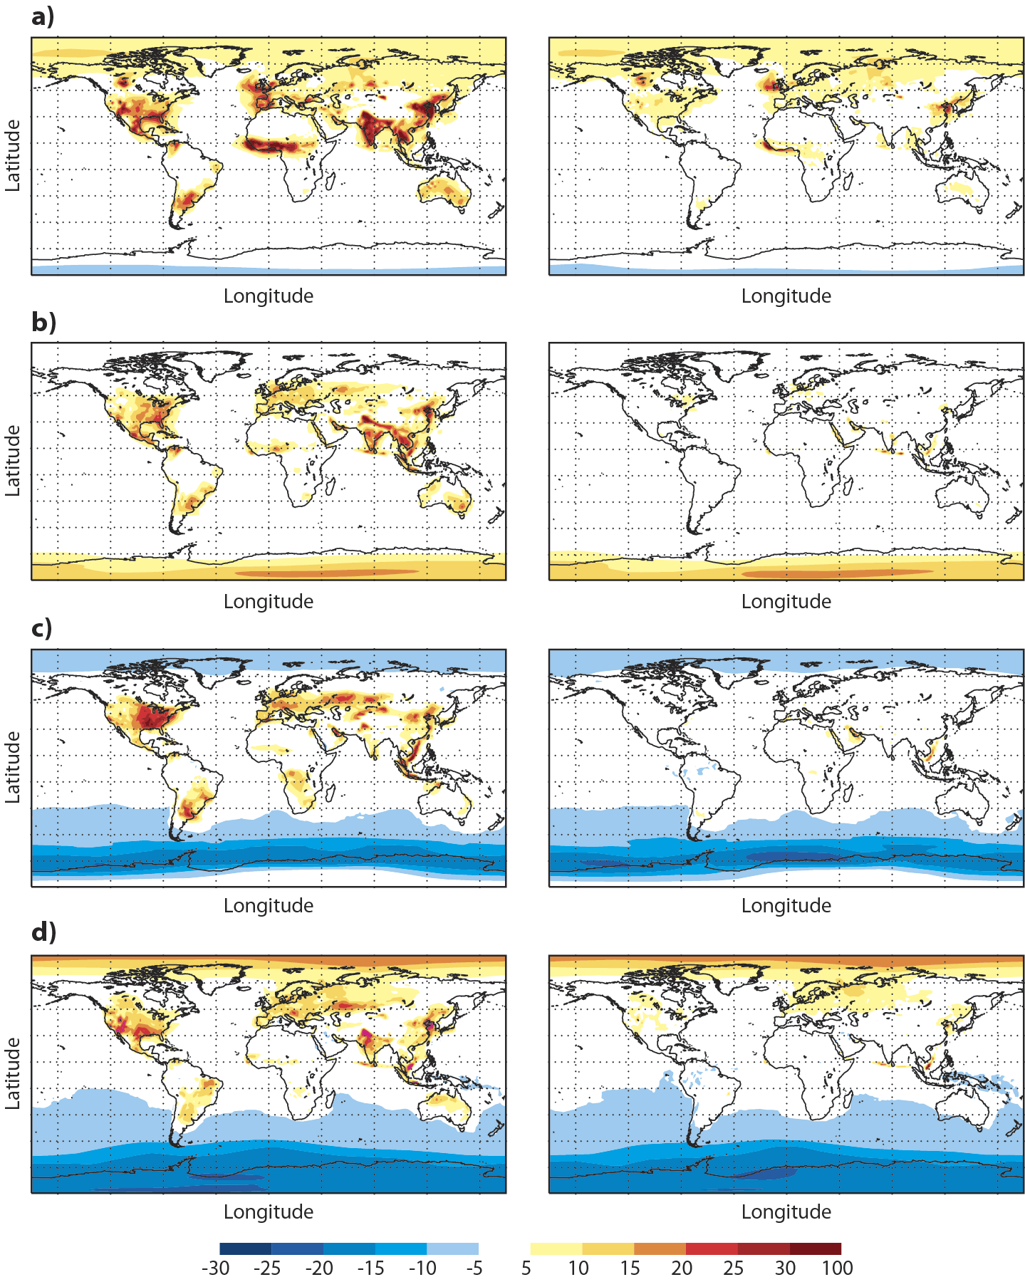

Short lived memory of NO2 assimilation
OMI NO2 analysis increment [%]
Differences between
Analysis and CTRL
12h fc from ASSIM and CTRL
JF 2008
JF 2008
JJA 2008
JJA 2008
[10¹⁵ molec/cm²]
Large positive increments from OMI NO2 assim
Large differences between analyses of ASSIM and CTRL
Impact is lost during subsequent 12h forecast
It might be more beneficial to adjust emissions (instead of IC)

Slide 28
4. Observations of atmospheric composition

Slide 29
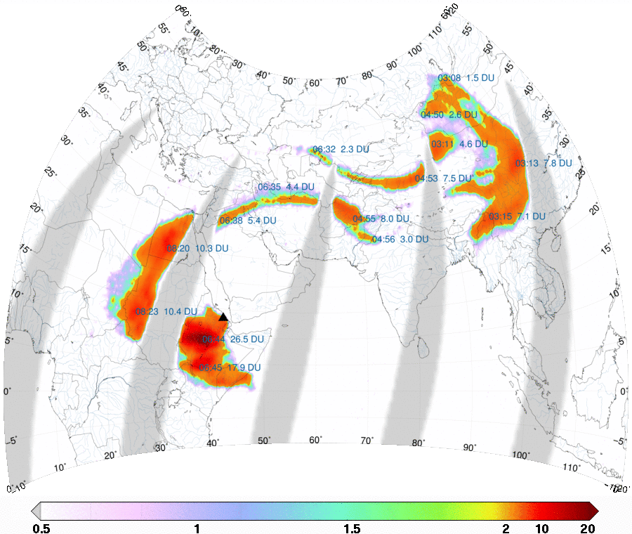
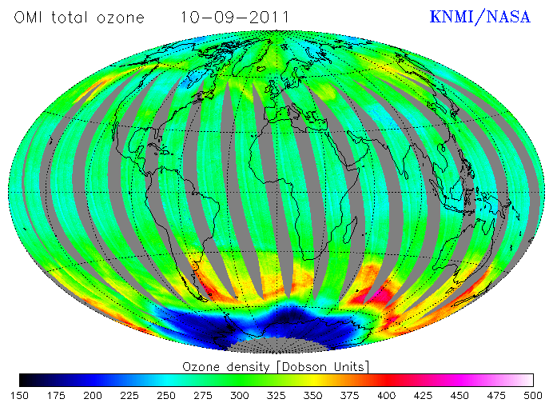
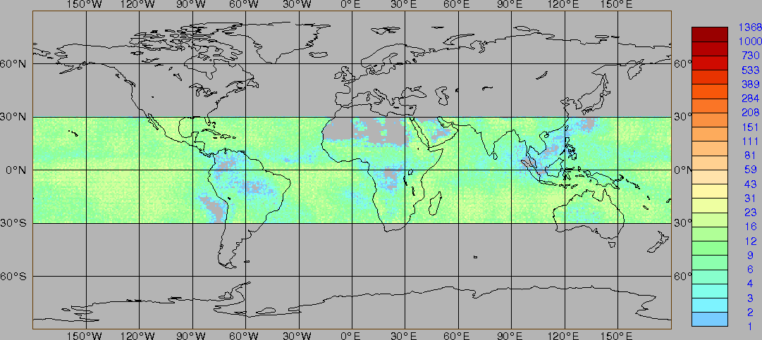
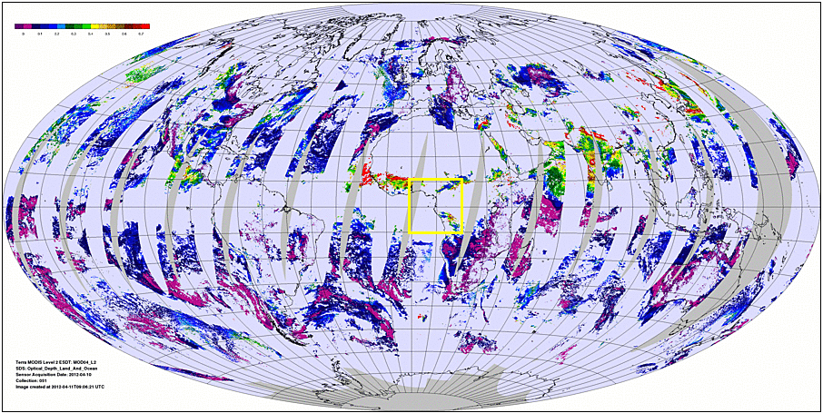
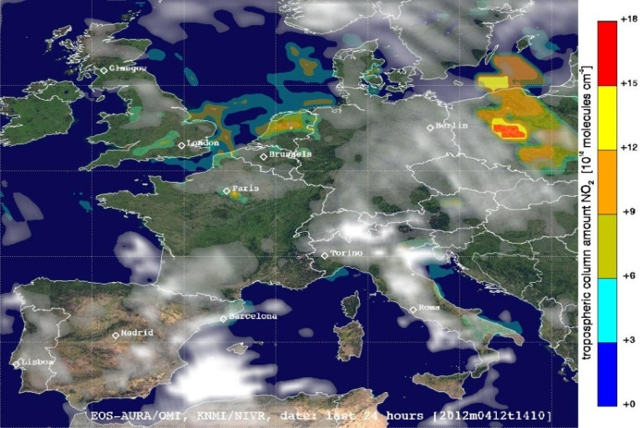
Satellite observations
O₃, OMI, KNMI/NASA
SO₂, GOME-2, SACS, BIRA/DLR/EUMETSAT
CH₄, IASI, LMD
Aerosol Optical Depth, MODIS, NASA
NO₂, OMI, KNMI/NASA
Atmospheric composition observations traditionally come from UV/VIS measurements. This limits the coverage to day-time only. Infrared/microwave are now adding more and more to this spectrum of observations (MOPITT, AIRS, IASI, MLS, MIPAS …)
Notes:
The last few decades satellites have provided many exciting observations of atmospheric composition. This has allowed us to view the ozone hole, pollution, dust plumes, and volcanic ash, among many other things.

Slide 30
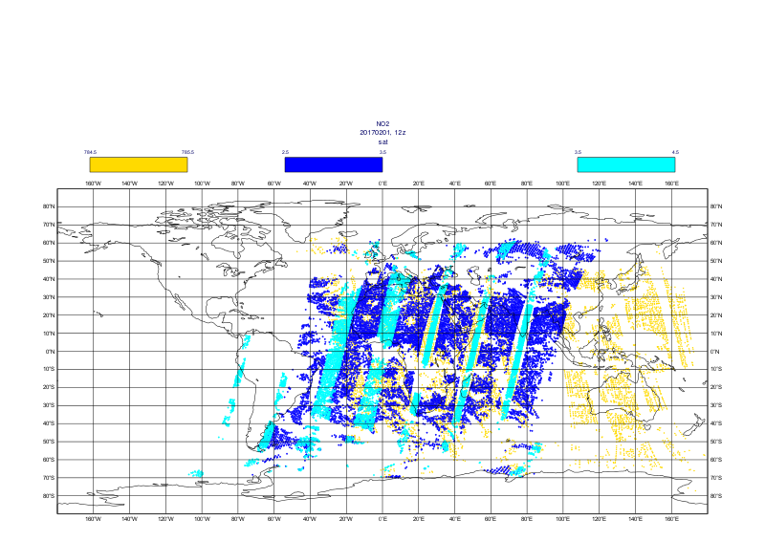
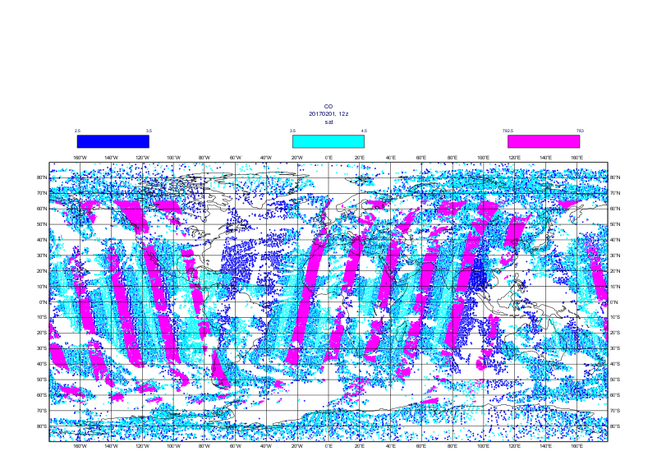
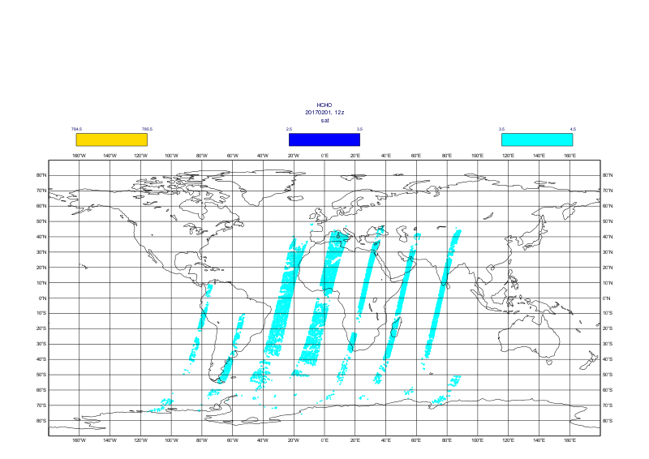
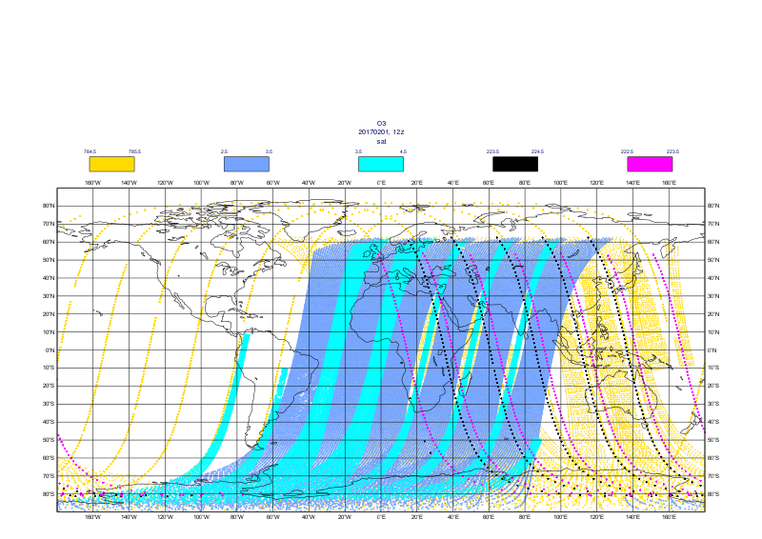

Reactive gases data availability in CAMS NRT system
20170201, 12z
CO
Tropospheric NO2
OMI
AURA
IASI Metop-A
GOME-2 Metop-A
IASI Metop-B
GOME-2 Metop-B
MOPITT TERRA
HCHO
O3
GOME-2 Metop-A
GOME-2 Metop-A
GOME-2 Metop-B
OMI
AURA
OMI, MLS
AURA
SO2
GOME-2 Metop-A
SBUV/2
NOAA-19
assimilated
OMPS
SNPP
GOME-2 Metop-B
monitored

Slide 31



Greenhouse gases data availability in CAMS ‘NRT’ GHG system: 20160224, 0z & 12z
Lower troposphere CH₄/CO₂
TANSO-FTS
GOSAT
OCO-2
20160224, 00Z+12z
XCO₂ in ppm
Nadir mode orbit
XCH₄ in ppb
Middle troposphere CH₄/CO₂
IASI
Metop-A Metop-B
XCH₄ in ppb
20160224, 00Z+12z
Notes:
GOSAT: Lower Troposphere (it’s what we want because the main variability is there) but not dense at all and only daytime data. Two measurement modes: nadir over land (even more sparse) and glint over ocean.
IASI: Middle Troposphere. Less interesting but better coverage, denser and daytime + nighttime measurements.
OCO-2: Similar to GOSAT but only “one line” (tiny swath). At the beginning of the mission, few orbits at nadir and then few orbits at glint.

Slide 32
Issues with Observations
AC Satellite retrievals
  Little or no vertical information from satellite observations. Total or partial columns retrieved from radiation measurements. Weak or no signal from boundary layer.
  Fixed overpass times and daylight conditions only (UV-VIS) -> no daily maximum/cycle
  Global coverage in a few days (LEO); often limited to cloud free conditions; fixed overpass time.
  Retrieval errors can be large; small scales not resolved
  We use retrievals for AC: Averaging kernels important
AC in-situ observations
  Sparse (in particular profiles)
  Limited or unknown spatial representativeness

Slide 33

Importance of height resolved observations
Impact of a single observation in 3D-Var
(for model variable at a gridpoint)
x_{a}: analysis value
x_{b}: background value
y: observation
σ_{o}²: observation variance
σ_{b}²: background covariance
B: column of background error covariance matrix
Analysis increment is proportional to a column of B-matrix
B-matrix determines how increment is spread out from a
single observation to neighbouring gridpoints/ levels

Slide 34


Increment from a single TCO3 observation
Ozone background errors
Vertical correlations
Increment created by a single O3 obs
Standard deviation
Horizontal correlations
Ozone observation of 247 DU, 66 DU lower than background
Maximum impact around L20 (~35 hPa)
Profile data are important to obtain a good vertical analysis profiles

Slide 35




Ozone hole in GEMS reanalysis: Cross section along 8E over South Pole, 4 Oct 2003
Oct 2004
ASSIM (MIPAS)
Assimilation (MIPAS)
Control
CTRL
70S
Assimilation with profile data
Assimilation with total column data

Slide 36
5. Aerosol DATA assimilation

Slide 37


4D-Var assimilation system for aerosols
Aerosol assimilation is difficult because:
There are numerous unknowns (depending on the aerosol model) and very little observations to constrain them
The concentrations vary hugely with for instance strong plumes of desert dust in areas with very little background aerosol, which makes it difficult to estimate the background error covariance matrix

Slide 38
Aerosols in the ECMWF IFS (C-IFS)
fine mode
coarse mode
12 aerosol-related prognostic variables:
* 3 bins of sea-salt (0.03 – 0.5 – 0.9 – 20 µm)
* 3 bins of dust (0.03 – 0.55 – 0.9 – 20 µm)
* Black carbon (hydrophilic and –phobic)
* Organic carbon (hydrophilic and –phobic)
* SO₂ -> SO₄
Physical processes include:
emission sources (some of which updated
in NRT, i.e.fires),
horizontal and vertical advection by dynamics
vertical advection by vertical diffusion and
convection
aerosol specific parameterizations for
dry deposition, sedimentation, wet deposition
by large-scale and convective precipitation, and
hygroscopicity (SS, OM, BC, SU)
Morcrette et al. 2009, JGR, 114, doi:10.1029/2008JD011235

Slide 39
The aerosol prediction system: Analysis
Assimilated observations are the 550nm MODIS (Aqua and Terra) Aerosol Optical Depths (AODs) over land and ocean and PMAp (Metop-A) AOD over ocean
Control variable is formulated in terms of the total aerosol mixing ratio.
To come: dual mode control variable. Aerosol control variables are the fine mode (<1 µm diameter) and coarse mode aerosol mixing ratio.
Improvements of dual mode control variable are especially seen in fine mode AOD
Analysis increments are repartitioned into the species according to their fractional contribution to the total or fine/coarse mode aerosol mixing ratio.
Background error statistics were computed using forecasts errors as in the NMC method (48h-24h forecast differences).
Observation errors are prescribed fixed values.
Variational bias correction is applied to AOD.
Notes:
Fine mode to come….

Slide 40

AOD data availability in CAMS NRT system,
20170201, 12z
MODIS Aqua
MODIS Terra
PMAp Metop-B
PMAp
Metop-A
assimilated
monitored

Slide 41
How does it work?
Nonlinear run:
All bins/species are initialized from a previous forecast; the total aerosol mixing ratio is initialized from sum of all bins/species.
All aerosol variables go through advection, vertical diffusion and convection.
Individual bins/species mixing ratio are used to compute optical depth according to the bin/species-specific optical properties.
Tangent linear/adjoint runs:
Perturbations of optical depth are started from zero perturbations on individual bin/species mixing ratios on the first call of the tangent linear.
These perturbations are then passed to the adjoint routine to compute the gradient wrt individual bin/species mixing ratios. The gradient in the total aerosol mixing is then obtained from
where f_{i} represents the fractional contribution of each bin/species to the total
mixing ratio.
3. The gradient wrt total aerosol mixing ratio is then used in the minimization and
the resulting increment in r_{t} is used in the tangent linear run to compute
updated perturbations on the individual bin/species mixing ratios as follows:
This last step is not fully justifiable unless at all times and at all locations.

Slide 42




Saharan dust outbreak: 6 March 2004
Model simulation
Assimilation
MODIS
Aerosol optical depth at 550nm (upper)
and 670/675nm (lower)
SEVIRI
Cape Verde
AERONET
Assimilation
Simulation
March
Angela Benedetti

Slide 43





Example for wrong aerosol attribution
Eruption of the Nabro volcano in June 2011 put a lot of fine ash into the stratosphere.
This was observed by AERONET stations and the MODIS instrument.
sulphate
biomass
ICIPE-Mbita - AERONET
dust
sea salt
The MACC aerosol model did not contain stratospheric aerosol at this time, so the observed AOD was wrongly attributed to the available aerosol types.
MACC AOD analysis
AERONET total AOD
AERONET fine mode AOD

Slide 44


Why we need profiling data for aerosol assimilation
MODIS Aerosol Optical Depth
CALIPSO feature mask
Aerosol & cloud amounts,
Forecast only
AOD is a column-integrated quantity
Assimilation of AOD does not modify the vertical profile
Profile data are needed (lidar)
Aerosol & clouds amounts,
AOD Assimilation
Graphics by Luke Jones
Notes:
What you’re presented with is a map of the world showing a section of the A-Train orbit, and some simple menus. You can choose a start year, month, day, hour and minute and that defines the orbit start time. And you can choose a period in hours which dictates the length of orbit you want to show. Then if you click any two points on the orbit you get a plot of…
… CloudSat reflectivity, CALIPSO feature classification flag (just as in the previous slide), and then the IFS forecast for the corresponding section. The IFS plots show cloud and aerosol optical thickness superimposed – aerosol is represented by the vertical colours, and cloud is represented by superimposed shades of grey. The experiments shown here are eybt and f026, which are forecast only and with data assimilation respectively.
As you can see, this only allows a qualitative comparison, not a quantative one, but you can see that there’s generally pretty good agreement between the observations and both IFS forecasts. Areas of cloud match well, as do aerosol in the boundary layer. The vertical structure of the forecast aerosols had never been looked at before though, and so one thing that this comparison has thrown up is these areas where aerosol appears to have been lifted up by convection, and this is not seen in the CALIPSO data. So this now raises the question of whether the model is not raining the aerosol out well enough in convective plumes, or the CALIPSO processing algorithm has problems seeing aerosol underneath cloud.
Apparent uplifting of aerosol by convection has lead to more thought being put into both model parameterisation and CALIPSO processing.
Parameterisation: should aerosol be lifted like this? Should it not be rained out instead? May trigger work to more closely integrate the wet deposition with the convection scheme to get more realistic behaviour.
CALIPSO processing: algorithm to detect aerosol is not used underneath cloud of more than a certain thickness, despite possibility that it could possibly still detect some aerosol. Might lead to CALIPSO missing aerosol that really is there. May trigger work on this processing.

Slide 45



Towards lidar assimilation: Impact of Calipso on vertical profiles
NRT CALIPSO level 1.5 product available since mid-2011
Mean Attenuated aerosol backscatter at 532 nm (cloud cleared)
Aimed at operational NWP centres (ECMWF, US Naval Research Lab, JMA,…)
Developed through close collaboration with NASA LaRC CALIPSOTeam
Lidar observation operator in place and performing well
Calipso data have positive impact on the aerosol extinction profile (in initial tests)
Observations
Observations-Model extinction (km-1)
Lidar and MODIS
Lidar and MODIS
MODIS only
Observations-Model extinction (km-1)
MODIS only
Monthly averaged extinction (km⁻¹)
at 532nm at Sede Boker (453 profiles)
(*) Lidar data are courtesy of Arnon Karnieli. Special thanks to
Simone Lolli, Judd Welton and the MPLNET team.

Slide 46
6. Concluding remarks
Atmospheric composition (AC) and weather interact
IFS has been extended to include fields of atmospheric composition: Reactive gases, greenhouse gases, aerosols => Composition-IFS (C-IFS)
Modelling of AC needs to include many species with concentrations varying over several orders of magnitude
AC forecasts benefit from realistic initial conditions (data assimilation) but likewise from improved emissions
Extra challenges for DA of atmospheric composition compared to NWP - but also potential benefits through chemical coupling and impact on NWP
CAMS system produces useful AC forecast and analyses, freely available from atmosphere.copernicus.eu

Slide 47


atmosphere.copernicus.eu
More information about the environmental monitoring activities at ECMWF and how to access the data can be found on:

Slide 48
References: Reactive Gases
N. Elguindi, H. Clark, C. Ordóñez, V. Thouret, J. Flemming, O. Stein, V. Huijnen, P. Moinat, A. Inness, V.-H. Peuch, A. Stohl, S. Turquety, G. Athier, J.-P. Cammas, and M. Schultz (2010): Current status of the ability of the GEMS/MACC models to reproduce the tropospheric CO vertical distribution as measured by MOZAIC. Geosci. Model Dev., 3, 501-518, 2010
Flemming, J., Benedetti, A., Inness, A., Engelen, R. J., Jones, L., Huijnen, V., Remy, S., Parrington, M., Suttie, M., Bozzo, A., Peuch, V.-H., Akritidis, D., and Katragkou, E.: The CAMS interim Reanalysis of Carbon Monoxide, Ozone and Aerosol for 2003–2015, Atmos. Chem. Phys., 17, 1945-1983, doi:10.5194/acp-17-1945-2017, 2017.
Flemming, J. and Inness, A. (2016): Carbon Monoxide [in "State of the Climate in 2015"]. Bull. Amer. Meteor. Soc., 97 (8), S55-S58.
Flemming, J. and Inness, A. (2015): Carbon Monoxide [in "State of the Climate in 2014"]. Bull. Amer. Meteor. Soc., 96 (7), S49-S52.
Flemming, J., Huijnen, V., Arteta, J., Bechtold, P., Beljaars, A., Blechschmidt, A.-M., Josse, B., Diamantakis, M., Engelen, R. J., Gaudel, A., Inness, A., Jones, L., Katragkou, E., Marecal, V., Peuch, V.-H., Richter, A., Schultz, M. G., Stein, O., and Tsikerdekis, A.: Tropospheric chemistry in the integrated forecasting system of ECMWF, Geosci. Model Dev. Discuss., 7, 7733-7803, doi:10.5194/gmdd-7-7733-2014, 2014.
Flemming, J., and A. Inness (2013), Volcanic sulfur dioxide plume forecasts based on UV satellite retrievals for the 2011 Grímsvötn and the 2010 Eyjafjallajökull eruption, J. Geophys. Res. Atmos., 118, doi:10.1002/jgrd.50753.

Slide 49
References: Reactive Gases
Flemming, J., Inness, A., Jones, L., Eskes, H. J., Huijnen, V., Schultz, M. G., Stein, O., Cariolle, D., Kinnison, D., and Brasseur, G. (2011): Forecasts and assimilation experiments of the Antarctic ozone hole 2008, Atmos. Chem. Phys., 11, 1961-1977, doi:10.5194/acp-11-1961-2011
J. Flemming, Inness, A., Flentje, H., Huijen, V., Moinat, P., Schultz, M.G. and Stein O. (2009): Coupling global chemistry transport models to ECMWF's integrated forecast system. Geosci. Model Dev., 2, 253-265, 2009. www.geosci-model-dev.net/2/253/2009/
Huijnen, V., M. J. Wooster, J. W. Kaiser, D. L. A. Gaveau, J. Flemming, M. Parrington, A. Inness, D. Murdiyarso, B. Main and M. van Weele. Fire carbon emissions over maritime southeast Asia in 2015 largest since 1997. Sci. Rep. 6, 26886; doi: 10.1038/srep26886 (2016).
Huijnen, V., Flemming, J., Kaiser, J. W., Inness, A., Leitao, J., Heil, A., Eskes, H. J., Schultz, M. G., Benedetti, A., Hadji-Lazaro, J., Dufour, G., and Eremenko, M. (2012). Hindcast experiments of tropospheric composition during the summer 2010 fires over western Russia. Atmos. Chem. Phys., 12:4341–4364.
Zerefos, C. S., Eleftheratos, K., Kapsomenakis, J., Solomos, S., Inness, A., Balis, D., Redondas, A., Eskes, H., Allaart, M., Amiridis, V., Dahlback, A., De Bock, V., Diémoz, H., Engelmann, R., Eriksen, P., Fioletov, V., Gröbner, J., Heikkilä, A., Petropavlovskikh, I., Jarosławski, J., Josefsson, W., Karppinen, T., Köhler, U., Meleti, C., Repapis, C., Rimmer, J., Savinykh, V., Shirotov, V., Siani, A. M., Smedley, A. R. D., Stanek, M., and Stübi, R.: Detecting volcanic sulfur dioxide plumes in the Northern Hemisphere using the Brewer spectrophotometers, other networks, and satellite observations, Atmos. Chem. Phys., 17, 551-574, doi:10.5194/acp-17-551-2017, 2017.

Slide 50
References: Reactive Gases
Inness, A., Blechschmidt, A.-M., Bouarar, I., Chabrillat, S., Crepulja, M., Engelen, R. J., Eskes, H., Flemming, J., Gaudel, A., Hendrick, F., Huijnen, V., Jones, L., Kapsomenakis, J., Katragkou, E., Keppens, A., Langerock, B., de Mazière, M., Melas, D., Parrington, M., Peuch, V. H., Razinger, M., Richter, A., Schultz, M. G., Suttie, M., Thouret, V., Vrekoussis, M., Wagner, A., and Zerefos, C.: Data assimilation of satellite retrieved ozone, carbon monoxide and nitrogen dioxide with ECMWF's Composition-IFS, Atmos. Chem. Phys., 15, 5275-5303, doi:10.5194/acp-15-5275-2015, 2015.
Inness, A., Baier, F., Benedetti, A., Bouarar, I., Chabrillat, S., Clark, H., Clerbaux, C., Coheur, P., Engelen, R. J., Errera, Q., Flemming, J., George, M., Granier, C., Hadji-Lazaro, J., Huijnen, V., Hurtmans, D., Jones, L., Kaiser, J. W., Kapsomenakis, J., Lefever, K., Leita ̃o, J., Razinger,M., Richter, A., Schultz, M. G., Simmons, A. J., Suttie, M., Stein, O., Th ́epaut, J.-N., Thouret, V., Vrekoussis, M., Zerefos, C., and the MACC team (2013). The MACC reanalysis: an 8 yr data set of atmospheric composition. Atmos. Chem. Phys., 13(8):4073–4109.
Inness, A., Benedetti, A., Flemming, J., Huijnen, V., Kaiser, J. W., Parrington, M., and Remy, S.: The ENSO signal in atmospheric composition fields: emission-driven versus dynamically induced changes, Atmos. Chem. Phys., 15, 9083-9097, doi:10.5194/acp-15-9083-2015, 2015.
Inness, A., Flemming, J., Suttie, M. and Jones, L., 2009: GEMS data assimilation system for chemically reactive gases. ECMWF RD Tech Memo 587. Available from http://www.ecmwf.int.
C. Ordonez, N. Elguindi, O. Stein, V. Huijnen, J. Flemming, A. Inness, H. Flentje, E. Katragkou, P. Moinat, V-H. Peuch, A. Segers, V. Thouret, G. Athier, M. van Weele, C. S. Zerefos, J-P. Cammas, and M. G. Schultz (2009): Global model simulations of air pollution during the 2003 European heat wave. Atmos. Chem. Phys., 10, 789-815, 2010. www.atmos-chem-phys.net/10/789/2010/
Stein, O., Flemming, J., Inness, A., Kaiser, J. W., and Schultz, M. G. (2012). Global re- active gases forecasts and reanalysis in the MACC project. Journal of Integrative Environmental Sciences, 1:1–14

Slide 51
References: Areosols
Bellouin, N., J. Quaas, J.-J. Morcrette, and O. Boucher, 2013: Estimates of radiative forcing from the MACC re-analysis. Atmos. Chem. Phys., 13, 2045-2062.
Benedetti, A. et al, 2014: Operational dust prediction. Chapter 10 in: Knippertz, P.; Stuut, J.-B. (eds.), Mineral Dust – A Key Player in the Earth System, Springer Netherlands, 223–265, ISBN 978-94-017-8977-6. doi:10.1007/978-94-017-8978-3_10
Benedetti, A., Morcrette, J.-J., Boucher, O., Dethof, A., Engelen, R. J., Fisher, M., Flentje, H., Huneeus, N., Jones, L., Kaiser, J. W., Kinne, S., Manglold, A., Razinger, M., Simmons, A. J., and Suttie, M. (2009). Aerosol analysis and forecast in the European Centre for Medium-Range Weather Forecasts Integrated Forecast System: 2. Data assimilation. J. Geophys. Res., 114(D13):D13205
Benedetti, A., Kaiser, J. W., and Morcrette, J.-J. (2012). Global aerosols [in “State of the climate in 2011”]. Bull. Amer. Meteor. Soc., 93(7):S44–S46. (Also for subsequent years)
Huneeus, N., M. Schulz, Y. Balkanski, J. Griesfeller, S. Kinne, J. Prospero, S. Bauer, O. Boucher, M. Chin, F. Dentener, T. Diehl, R. Easter, D. Fillmore, S. Ghan, P. Ginoux, A. Grini, L. Horowitz, D. Koch, M.C. Krol, W. Landing, X. Liu, N. Mahowald, R. Miller, J.-J. Morcrette, G. Myhre, J. Penner, J. Perlwitz, P. Stier, T. Takemura, and C. Zender, 2011: Global dust model intercomparison in AEROCOM phase I. Atmos. Chem. Phys., 11, 7781-7816, doi:10.5194/acp-11-7781-2011.
Mangold, A., H. De Backer, B. De Paepe, S. Dewitte, I. Chiapello, Y. Derimian, M. Kacenelenbogen, J.-F. Léon, N. Huneeus, M. Schulz, D. Ceburnis, C. O'Dowd, H. Flentje, S. Kinne, A. Benedetti, J.-J. Morcrette, and O. Boucher, 2011: Aerosol analysis and forecast in the European Centre for Medium-Range Weather Forecasts Integrated Forecast System: 3. Evaluation by means of case studies, J. Geophys. Res.,116, D03302, doi: 10.1029 /2010JD014864.

Slide 52
References: Areosols
Morcrette, J.-J., Boucher, O., Jones, L., Salmond, D., Bechtold, P., Beljaars, A., Benedetti, A., Bonet, A., Kaiser, J. W., Razinger, M., Schulz, M., Serrar, S., Simmons, A. J., Sofiev, M., Suttie, M., Tompkins, A. M., and Untch, A. (2009). Aerosol analysis and forecast in the European Centre for Medium-Range Weather Forecasts Integrated Forecast System: Forward modeling. J. Geophys. Res., 114(D6):D06206.
Morcrette, J.-J., O. Boucher, L. Jones, D. Salmond, P. Bechtold, A. Beljaars, A. Benedetti, A. Bonet, J.W. Kaiser, M. Razinger, M. Schulz, S. Serrar, A.J. Simmons, M. Sofiev, M. Suttie, A.M. Tompkins, A. Untch, and the GEMS-AER team, 2009: Aerosol analysis and forecast in the ECMWF Integrated Forecast System: Forward modelling. J. Geophys. Res., 114, D06206, doi: 10.1029 /2008JD011235.
Morcrette, J.-J., A. Beljaars, A. Benedetti, L. Jones, and O. Boucher, 2008: Sea-salt and dust aerosols in the ECMWF IFS. Geophys. Res. Lett., 35, L24813, doi:10.1029/2008GL036041.
Morcrette, J.-J., A. Benedetti, L. Jones, J.W. Kaiser, M. Razinger, and M. Suttie, 2011: Prognostic aerosols in the ECMWF IFS: MACC vs. GEMS aerosols. ECMWF Technical Memorandum, 659, 32 pp.
Morcrette, J.-J., A. Benedetti, A. Ghelli, J.W. Kaiser, and A.P. Tompkins, 2011: Aerosol-cloud-radiation interactions and their impact on ECMWF/MACC forecasts. ECMWF Technical Memorandum, 660, 35 pp.
Nabat, P., S. Somot, M. Mallet, I. Chiapello, J.-J. Morcrette, F. Solmon, S. Szopa, and F. Dulac, 2013: A 4-D climatology (1979-2009) of the monthly aerosol optical depth distribution over the Mediterranean and surrounding regions from a comparative evaluation and blending of remote sensing and model products. Atmos. Meas. Tech., 6, 1287-1314, doi:10.5194/amt-6-1287-2013.
Peubey, C., A. Benedetti, L. Jones, and J.-J. Morcrette, 2009: GEMS-Aerosol: Comparison and analysis with GlobAEROSOL data. In GlobAEROSOL User Report, October 2009, 11-20.

Slide 53
References: Greenhouse Gases
Agusti-Panareda, A., Diamantakis, M., Bayona, V., Klappenbach, F., and Butz, A.: Improving the inter-hemispheric gradient of total column atmospheric CO2 and CH4 in simulations with the ECMWF semi-Lagrangian atmospheric global model, Geosci. Model Dev., 10, 1-18, doi:10.5194/gmd-10-1-2017, 2017.
A. Agusti-Panareda; S. Massart; F. Chevallier; G. Balsamo; S. Boussetta; E. Dutra; A. Beljaars
A biogenic C02 flux adjustment scheme for the mitigation of large-scale biases in global atmospheric CO2 analyses and forecasts. ECMWF Technical Memorandum, no 773, 2015
http://www.ecmwf.int/en/elibrary/technical-memoranda
Agusti-Panareda, A., S.Massart, F.Chevallier,S.Boussetta, G.Balsamo, A.Beljaars, P.Ciais, N.M.Deutscher, R.Engelen, L.Jones and R.Kivi, J.-D.~Paris, V.-H. Peuch, V.Sherlock, A.T.Vermeulen, P.O.Wennberg, D.Wunch, 2014: Forecasting global atmospheric CO2, Atmospheric Chemistry and Physics ,14, 11959-11983, doi:10.5194/acp-14-11959-2014
Chevallier, F., R. J. Engelen, C. Carouge, T. J. Conway, P. Peylin, C. Pickett-Heaps, M. Ramonet, P. J. Rayner, and I. Xueref-Remy, 2009. AIRS-based vs. flask-based estimation of carbon surface fluxes. J. Geophys. Res., 114, D20303, doi:10.1029/2009JD012311.
Chevallier, F., R. J. Engelen, and P. Peylin, 2005. The contribution of AIRS data to the estimation of CO2 sources and sinks. Geophys. Res. Lett., 32, L23801, doi:10.1029/2005GL024229.

Slide 54
References: Greenhouse Gases
Engelen, R.J., S. Serrar, and F. Chevallier, 2009. Four-dimensional data assimilation of atmospheric CO2 using AIRS observations. J. Geophys. Res., 114, D03303, doi:10.1029/2008JD010739.
Engelen, R.J. and A. P. McNally, 2005. Estimating atmospheric CO2 from advanced infrared satellite radiances within an operational four-dimensional variational (4D-Var) data assimilation system: Results and validation. J. Geophys. Res., 110, D18305, doi:10.1029/2005JD005982
Massart et al. (2016)
Ability of the 4-D-Var analysis of the GOSAT BESD XCO2 retrievals to characterize atmospheric CO2 at large and synoptic scales. Atmos. Chem. Phys., 16, 1653–1671, www.atmos-chem-phys.net/16/1653/2016/
doi:10.5194/acp-16-1653-2016. http://www.atmos-chem-phys.net/16/1653/2016/acp-16-1653-2016.pdf
Massart, S. and Agusti-Panareda, A. and Aben, I. and Butz, A. and Chevallier, F. and Crevoisier, C. and Engelen, R. and Frankenberg, C. and Hasekamp, O., 2014: Assimilation of atmospheric methane products in the MACC-II system: from SCIAMACHY to TANSO and IASI0, Atmospheric Chemistry and Physics, 14, 6139–6158,10.5194/acp-14-6139-2014.
Verma, S., Marshall, J., Parrington, M., Agusti-Panareda, A., Massart, S., Chipperfield, M. P., Wilson, C., and Gerbig, C.: Extending methane profiles from aircraft into the stratosphere for satellite total column validation: A comparative analysis of different data sources, Atmos. Chem. Phys. Discuss., doi:10.5194/acp-2016-704, in review, 2016.

Slide 55
References: General
References: Fires
Kaiser, J. W., Heil, A., Andreae, M. O., Benedetti, A., Chubarova, N., Jones, L., Morcrette, J.-J., Razinger, M., Schultz, M. G., Suttie, M., and van der Werf, G. R. (2012). Biomass burning emissions estimated with a global fire assimilation system based on observed fire radiative power. Biogeosciences, 9:527–554.
Kaiser, J. W. and van der Werf, G. R. (2012). Global Biomass Burning [in ”State of the Climate in 2011”]. Bull. Amer. Meteor. Soc., 93(7):S54–S55. (also for other years)
Kaiser, J.W., M. Suttie, J. Flemming, J.-J. Morcrette, O. Boucher, and M.G. Schultz, 2009: Global real-time fire emission estimates based on space-borne fire radiative power observations. AIP Conf. Proc., 1100, 645-648.
Rémy, S., Veira, A., Paugam, R., Sofiev, M., Kaiser, J. W., Marenco, F., Burton, S. P., Benedetti, A., Engelen, R. J., Ferrare, R., and Hair, J. W.: Two global data sets of daily fire emission injection heights since 2003, Atmos. Chem. Phys., 17, 2921-2942, doi:10.5194/acp-17-2921-2017, 2017.
Granier, C., Bessagnet, B., Bond, T., D’Angiola, A., Dernier van der Gon, H., Frost, G., Heil, A., Kaiser, J., Kinne, S., Klimont, G., Kloster, S., Lamarque, J.-F., Liousse, C., Masui, T., Meleux, F., Mieville, A., Ohara, T., Raut, J.-C., Riahi, K., Schultz, M., Smith, S., Thompson, A., van Aardenne, J., van der Werf, G., and van Vuuren, D. (2011). Evolution of anthropogenic and biomass burning emissions of air pollutants at global and regional scales during the 1980–2010 period. Climatic Change, 109(1-2):163–190.
Hollingsworth, A., Engelen, R. J., Textor, C., Benedetti, A., Boucher, O., Chevallier, F., Dethof, A., Elbern, H., Eskes, H., Flemming, J., Granier, C., Kaiser, J. W., Morcrette, J.-J., Rayner, P., Peuch, V.-H., Rouil, L., Schultz, M. G., and Simmons, A. J. (2008). Toward a monitor- ing and forecasting system for atmospheric composition: The GEMS project. Bull. Amer. Meteor. Soc., 89(8):1147–1164.

