Slide 1

Numerical Weather Prediction
Parametrization of Subgrid Physical Processes
Clouds (2)
Ice and Mixed-Phase Microphysics
Richard Forbes
(with thanks to Adrian Tompkins and Christian Jakob)
forbes@ecmwf.int

Slide 2
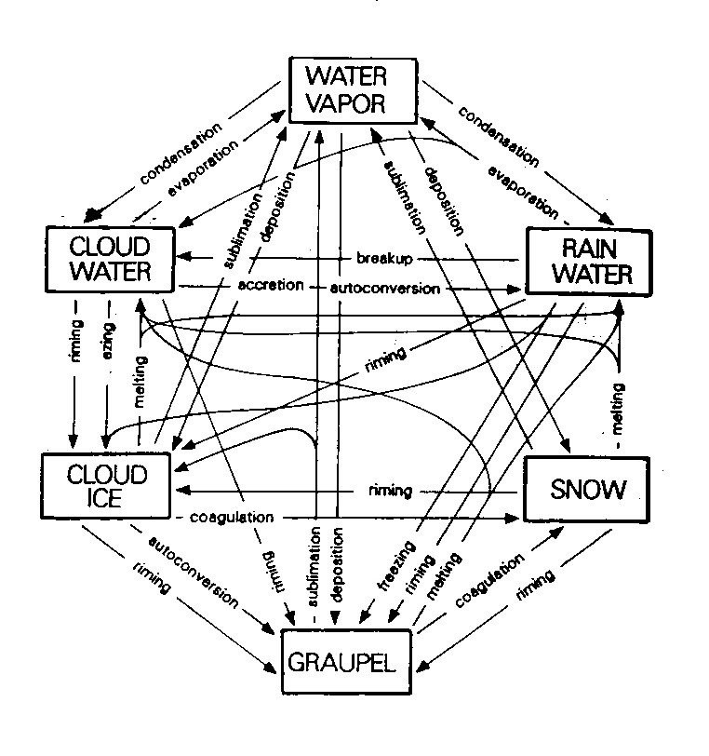
Cloud Parametrization Issues:
Which quantities to represent ?
Water vapour
Cloud water droplets
Rain drops
Pristine ice crystals
Aggregate snow flakes
Graupel pellets
Hailstones
Note for ice phase particles:
  Additional latent heat.
  Terminal fall speed of ice hydrometeors significantly less.
  Optical properties are different (important for radiation).
Notes:
Real world a continuum of different particles, but can be simplified into discrete categories.

Slide 3
Ice and mixed-phase microphysical processes
To describe ice-phase cloud and precipitation processes in our models we need to represent:
  Nucleation of ice crystals
  Diffusional growth of ice crystals (deposition) and sublimation
  Collection processes for ice crystals (aggregation), for ice and liquid droplets (riming)
  The advection and sedimentation (falling) of particles
  Melting and freezing processes

Slide 4

First recorded mention of the “six-cornered snowflake” - Kepler (1611)
Notes:
1601 became Imperial mathematician to Emperor Rudolf II

Slide 5
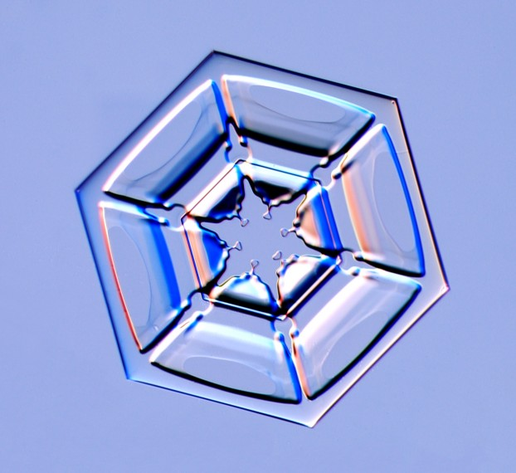
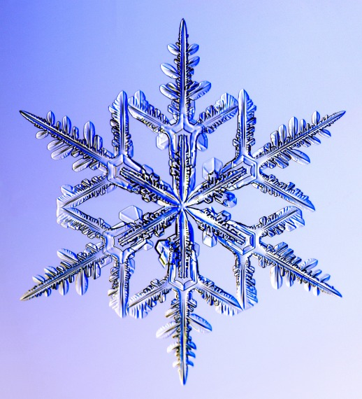
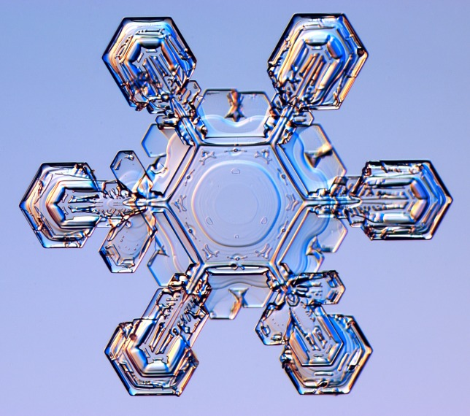
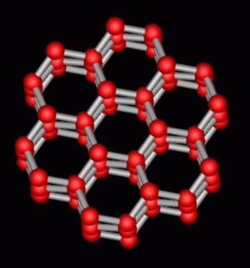
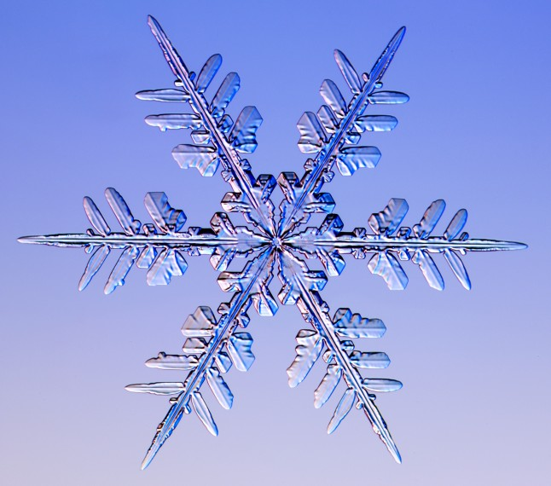
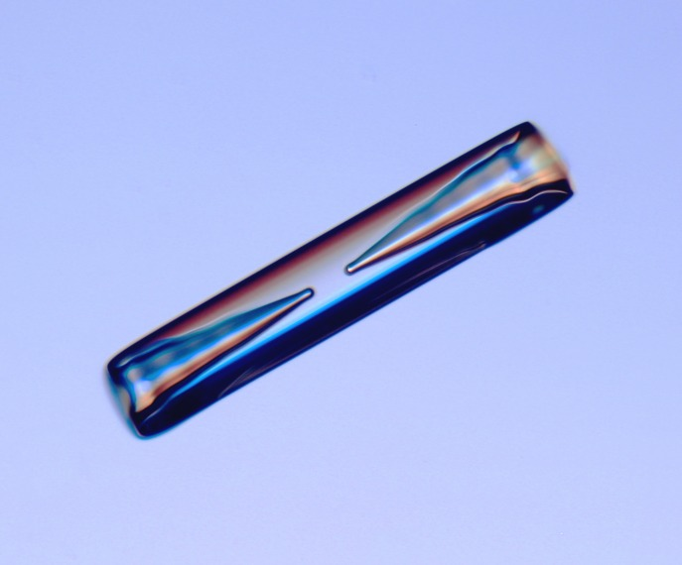
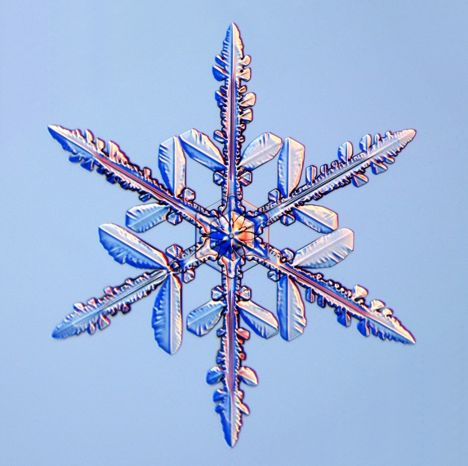
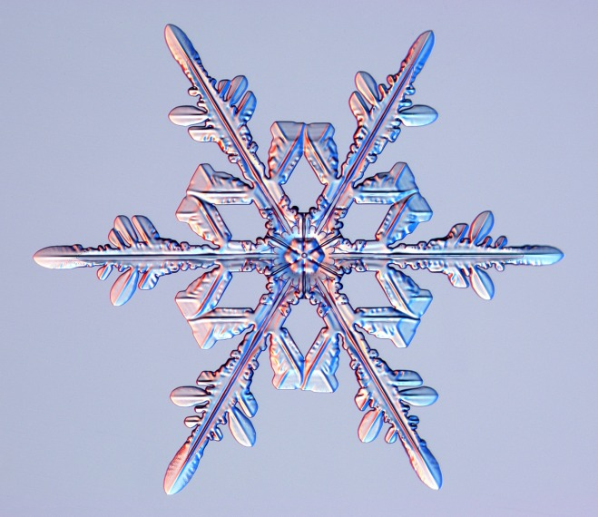
“The Six-Cornered Snowflake”
www.snowcrystals.com
Ken Libbricht

Slide 6
Ice Microphysical Processes
Ice nucleation
Depositional Growth (and sublimation)
Collection (aggregation/riming)
Splintering
Melting

Slide 7
Ice Nucleation
Droplets do not freeze at 0ºC !
Ice nucleation processes can be split into homogeneous and heterogeneous processes
Homogeneous nucleation
No preferential nucleation sites (i.e. pure water or solution drop)
Homogeneous freezing of cloud water droplets occurs below about -38ºC, so all ice below this temperature (e.g. water droplets carried upward by convective updraughts).
Homogeneous nucleation of ice crystals from small aqueous solution drops (haze particles), which have a lower freezing temperature, is dependent on a critical relative humidity above saturation (function of temperature). So new ice cloud formation needs high supersaturations.
Observations of clear air supersaturation are common…

Slide 8
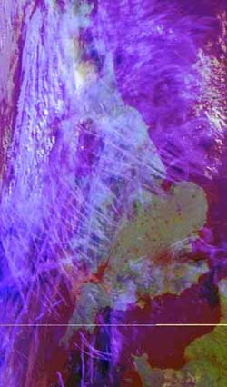
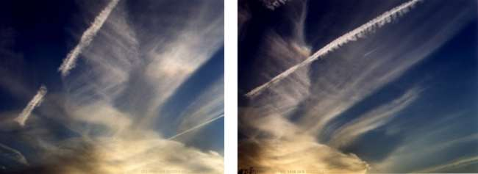
Ice Nucleation:
Homogeneous Nucleation
At cold temperatures (e.g. upper troposphere) ratio between liquid and ice saturation vapour pressures is large (can support large ice supersaturations).
If air mass is lifted, and does not contain significant liquid particles or ice nuclei, high supersaturations with respect to ice can occur, reaching 160%.
Long lasting contrails are a signature of supersaturation.
Institute of Geography, University of Copenhagen

Slide 9
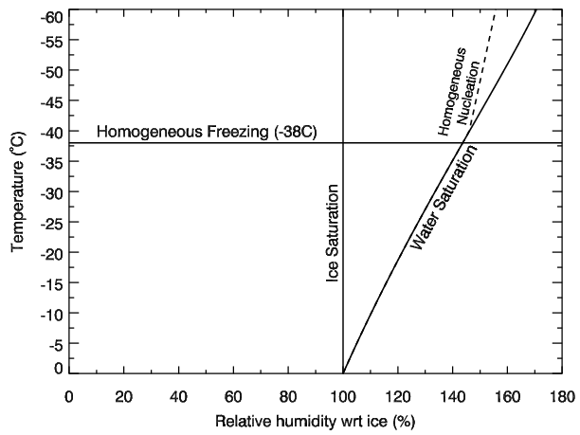
Ice supersaturation and homogeneous nucleation
What is the maximum ice supersaturation?
Classical theory and laboratory experiments document the critical vapour saturation mixing ratio with respect to ice at which homogeneous nucleation initiates from aqueous solution drops (Pruppacher and Klett, 1997; Koop et al., 2000).
Leads to supersaturated RH threshold S_{crit} as a function of temperature (Koop et al., 2000, Kärcher and Lohmann, 2002).

Slide 10
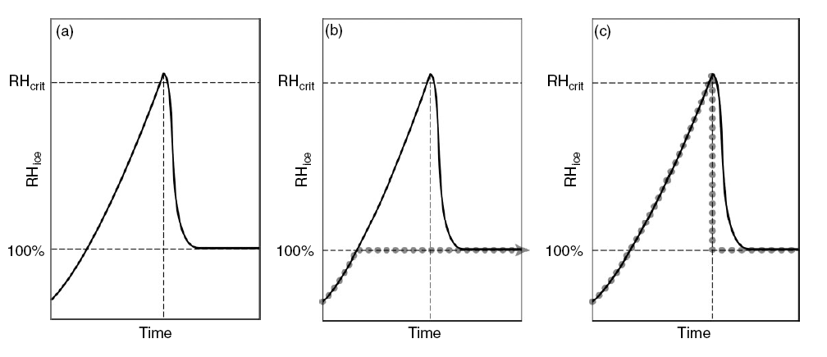
Parametrizing ice supersaturation and homogeneous nucleation
Evolution of an air parcel subjected to adiabatic cooling at low temperatures
S_{crit}
Evolution of an air parcel subjected to adiabatic cooling at low temperatures
Dotted line: Evolution if no ice supersaturation allowed
(many models)
Dotted line: Evolution if ice supersaturation is allowed until reaches S_{crit} then all supersaturation converted to ice (ECMWF model)
From Tompkins et al. (2007) adapted from Kärcher and Lohmann (2002)

Slide 11
RH wrt ice PDF at 250hPa one month average
Supersaturation
Aircraft obs and ECMWF model
B
Clip to RHi = S_{crit}
ECMWF model
Aircraft observations
Clip to RHi = 1
C
A
A: Numerics and interpolation for default model
B: The RH=1 microphysics mode
C: Drop due to GCM assumption of subgrid fluctuations in total water

Slide 12
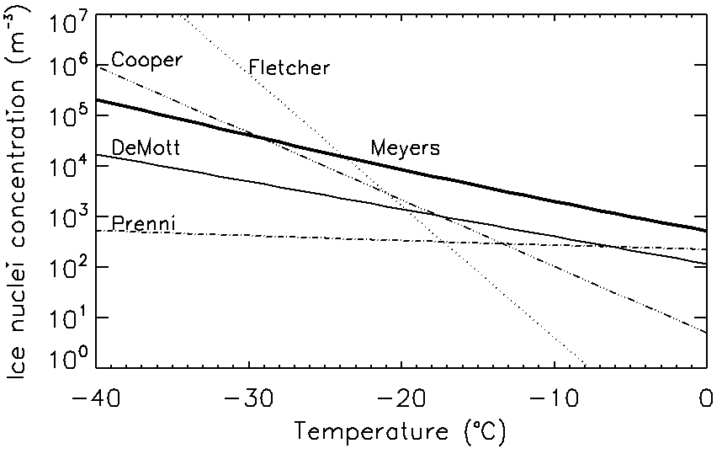
Ice Nucleation
Heterogeneous nucleation
Preferential sites for nucleation (interaction with solid aerosol particles – ice nuclei)
Frequent observation of ice between 0ºC and colder temperatures indicates heterogeneous processes are active.
Number of activated ice nuclei increases with decreasing temperature so heterogeneous nucleation more likely with increasing altitude, e.g. Fletcher (1962); Cooper (1986), Meyers (1991); Prenni et al. (2007) DeMott et al (2010).
Lots of uncertainty!

Slide 13
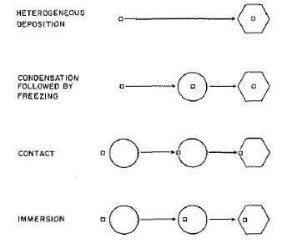
Ice Nucleation:
Heterogeneous nucleation
Heterogeneous deposition
Condensation followed by freezing
Still many uncertainties in heterogeneous ice nucleation processes in the atmosphere and their impacts!
aerosol
Contact
supercooled drop
ice crystal
Immersion
Schematic of heterogeneous ice nucleation mechanisms
(from Rogers and Yau, 1996)

Slide 14
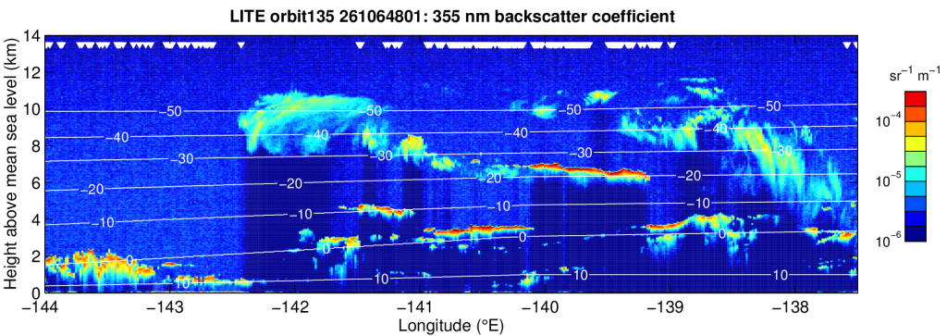
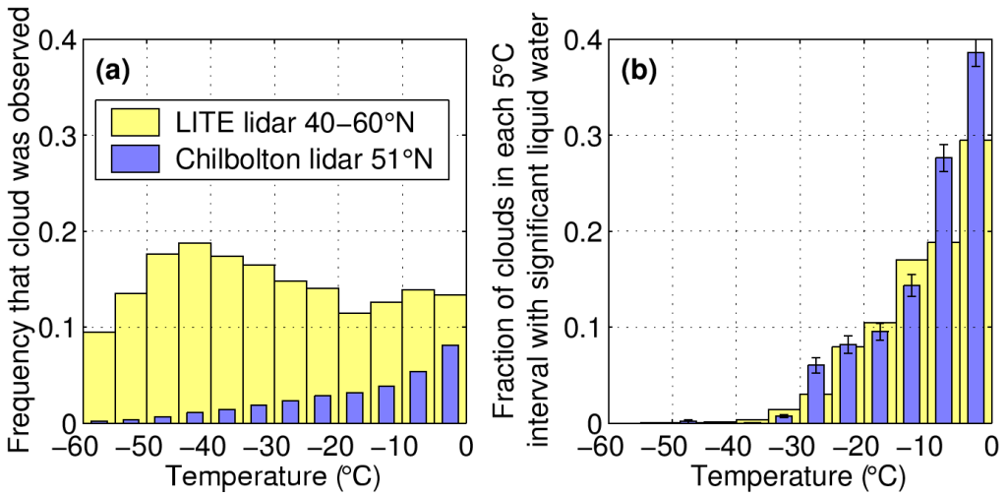
Mixed-phase cloudsion:
Observed supercooled liquid water occurrence
Lidar in space
Lidar: lower backscatter from ice cloud
Lidar: high backscatter from liquid water layers
Observations:
Colder than -38ºC, no supercooled liquid water.
Supercooled liquid water increasingly common as approach 0ºC.
Often in shallow layers at cloud top, or in strong updraughts associated with convection
Often mixed-phase cloud – liquid and ice present
Convective clouds with tops warmer than -5ºC rarely have ice.
(Hogan et al., GRL, 2004)

Slide 15
Diffusional growth of ice crystals
Deposition
Equation for the rate of change of mass for an ice particle of diameter D due to deposition (diffusional growth), or sublimation if subsaturated air:
s C F
Integrate over assumed particle size spectrum to get total ice mass growth
Deposition rate depends primarily on
  the supersaturation (or subsaturation), s
  the particle shape (habit), C (plate, column, aggregate)
  the ventilation factor, F (particle falling through air)
The particular mode of growth (edge growth vs corner growth) is sensitive to the temperature and supersaturation

Slide 16

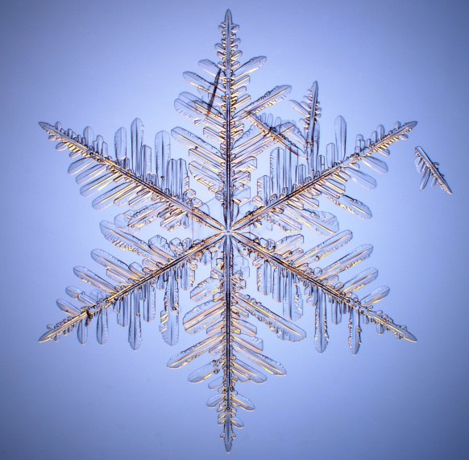
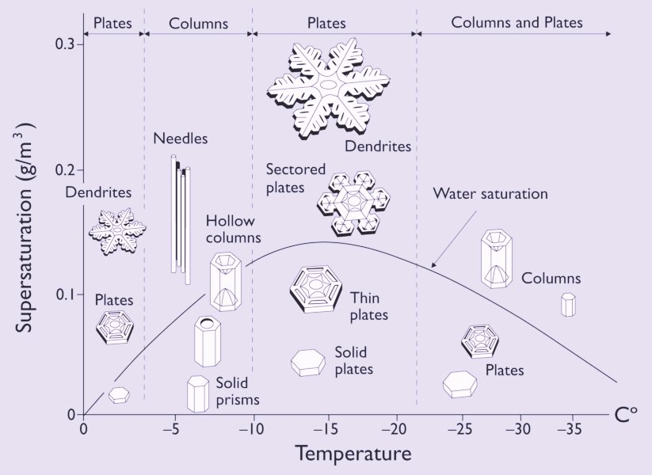
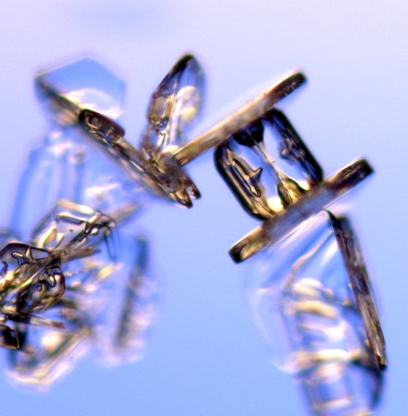

Diffusional growth of ice crystals
Ice Habits
Ice habits can be complex, depend on temperature: influences fall speeds and radiative properties
http://www.its.caltech.edu/~atomic/snowcrystals/
Notes:
Could mention molecules moving on surface depending whether diffusion limited. Max SVP diff at -15

Slide 17
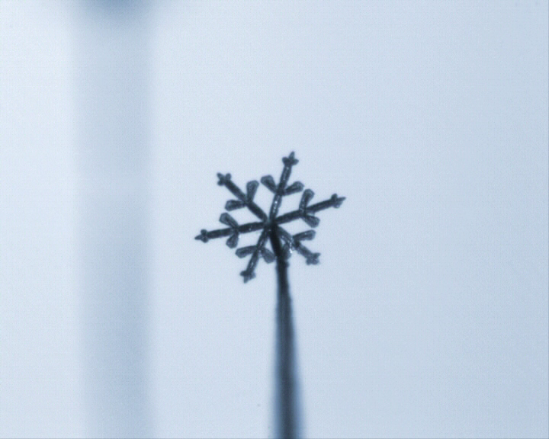
Diffusional growth of ice crystals
Animation of crystal growth

Slide 18
Diffusional growth of ice crystals
Mixed Phase Clouds: Bergeron Process (I)
The saturation vapour pressure with respect to ice is smaller than with respect to water.
A cloud which is saturated with respect to water is supersaturated with respect to ice.
A cloud which is sub-saturated with respect to water can be supersaturated with respect to ice.

Slide 19
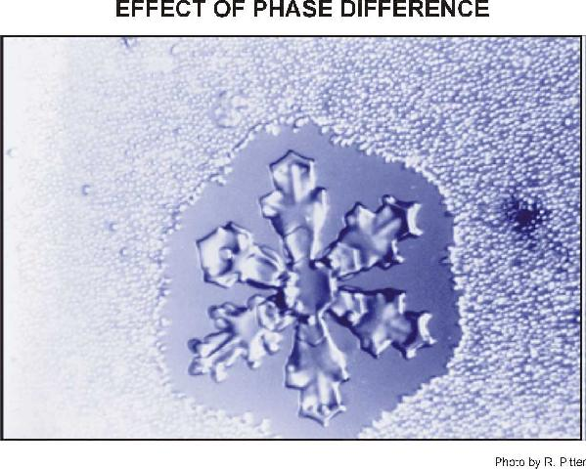
Diffusional growth of ice crystals
Mixed phase cloud Bergeron process (II)
Ice particles grow at the expense of water droplets
(Bergeron-Findeisen-Wegener process)
Ice particle enters water cloud
Cloud is supersaturated with respect to ice
Diffusion of water vapour onto ice particle
Cloud will become sub-saturated with respect to water
Water droplets evaporate to increase water vapour

Slide 20
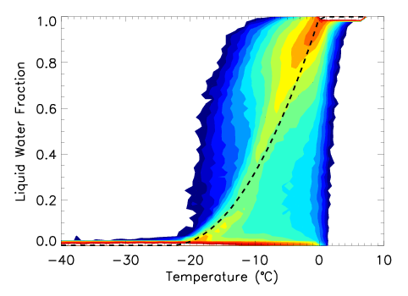
Parametrizing cloud phase
Diagnostic vs prognostic
Many (global) models with a single condensate prognostic parametrize ice/liquid phase as a diagnostic function of temperature (see dashed line for ECMWF model pre-2010 below).
Models with separate prognostic variables for liquid water and ice, parametrize deposition allowing a wide range of supercooled liquid water/ice fraction for a given temperature (see shading in example below).
PDF of liquid water fraction of cloud for a diagnostic mixed phase scheme (dashed line) and prognostic ice/liquid scheme (shading)
Notes:
ECMWF Training Course
02 May 2000
Moist Processes

Slide 21
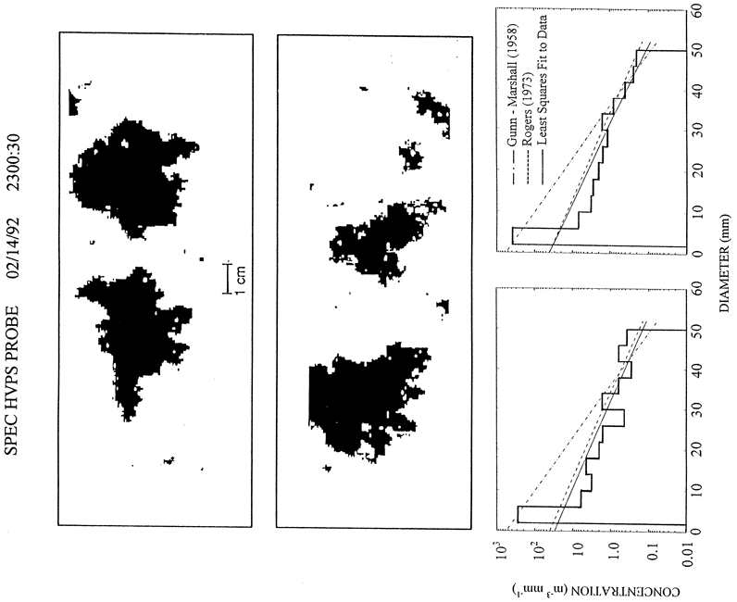
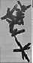
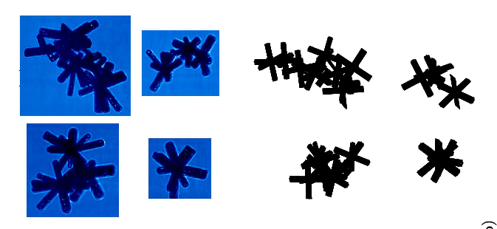
Collection processes:
Ice Crystal Aggregation
Ice crystals can aggregate together to form “snow”
“Sticking” efficiency increases as temperature exceeds –5ºC
Irregular crystals are most commonly observed in the atmosphere (e.g. Korolev et al. 1999, Heymsfield 2003)
CPI
Model
500 μm
Westbrook et al. (2008)
Field & Heymsfield ‘03
T=-46ºC
Lawson, JAS’99

Slide 22
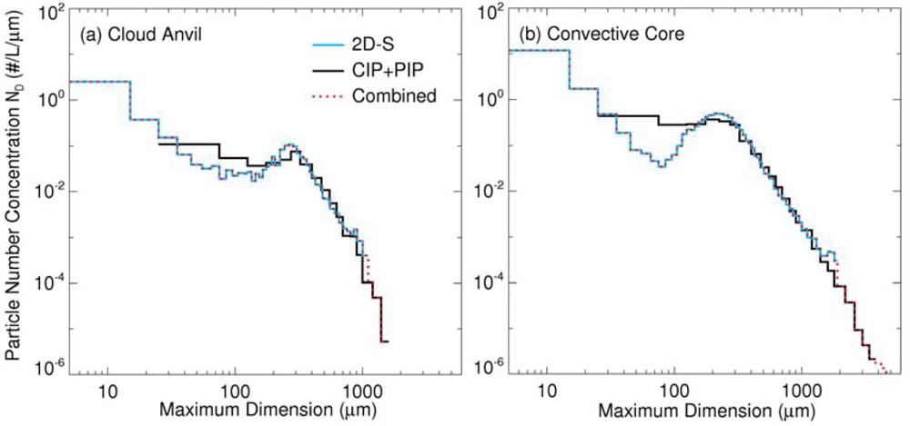
Parametrization of aggregation
Many models still have separate variables for ice and snow with a parametrization for aggregation, represented as an autoconversion.
But any separation in the particle size spectra between ice and snow is much less clear than for cloud droplets and e.g. Minnis et al. 2012
Some schemes represent aggregation as an evolving particle size distribution, either prognostic number concentration (i.e. q_{i}, N_{i}) or as a diagnostic function (e.g. fn(q_{i},T)).
22

Slide 23
Precipitation generation
Ice clouds
Representing aggregation in the ice phase with separate ice and snow variables (conversion ice-to-snow) analogous to warm-phase autoconversion, e.g. in ECMWF model:
G_{p}
q_{l}^{crit}
q_{l}
c₀=10⁻³ e^{0.025(T - 273.15)} s⁻¹
Rate of conversion of ice (small particles) to snow (large particles) increases as the temperature increases.
qi_{crit}=3.10⁻⁵ kg kg⁻¹

Slide 24
Microphysics Parametrization:
The “category” view: Ice and Snow (ECMWF scheme)
Water vapour
q_{v}
Condensation Evaporation
Deposition Sublimation
Condensation Evaporation
Cloud water
q_{l}
Cloud ice
q_{i}
Deposition Sublimation
Freezing – Melting - Bergeron
Autoconversion Collection
Collection
Autoconversion Collection
Rain
q_{r}
Snow
q_{s}
Freezing - Melting
Sedimentation

Slide 25
Microphysics Parametrization:
The “category” view: Ice particle mass and number conc.
Water vapour
q_{v}
Condensation Evaporation
Deposition Sublimation
Condensation Evaporation
Cloud water
q_{l}
Ice particles
q_{i} + N_{i}
Deposition Sublimation
Freezing – Melting - Bergeron
Autoconversion Collection
Collection
Rain
q_{r}
Freezing - Melting
Sedimentation

Slide 26
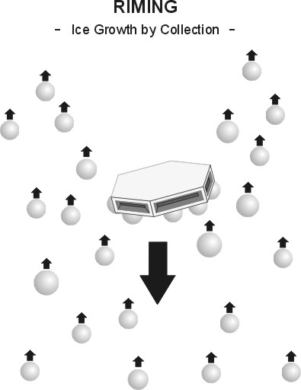
Collection processes:
Riming – capture of water drops by ice
Graupel formed by collecting liquid water drops in mixed phased clouds (“riming”), particulaly when at water saturation in strong updraughts (convection). Round ice crystals with higher densities and fall speeds than snow dendrites.
Hail forms if particle temperature close to 273K, since the liquid water “spreads out” before freezing. Generally referred to as “Hail” – The higher fall speed (up to 40 m/s) imply hail only forms in convection with strong updraughts able to support the particle long enough for growth.

Slide 27
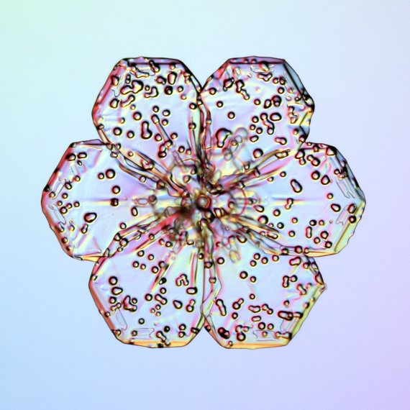
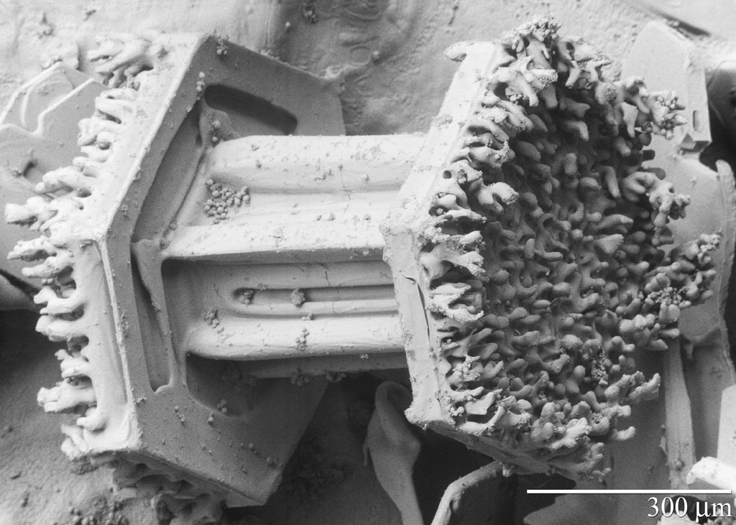
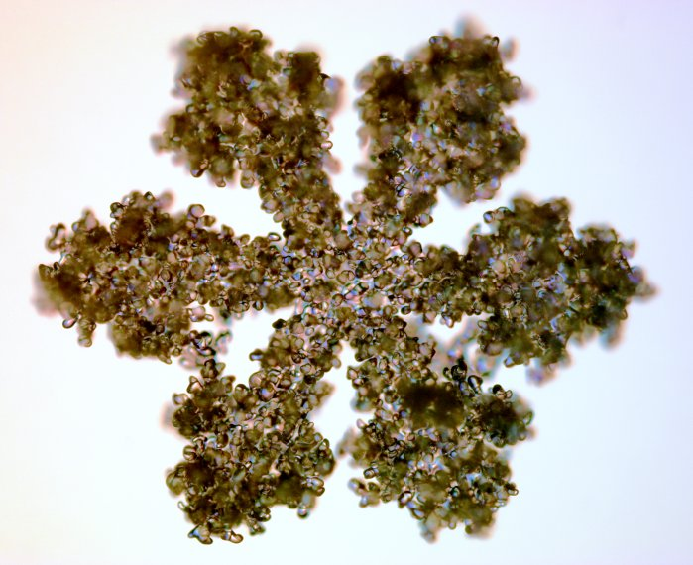
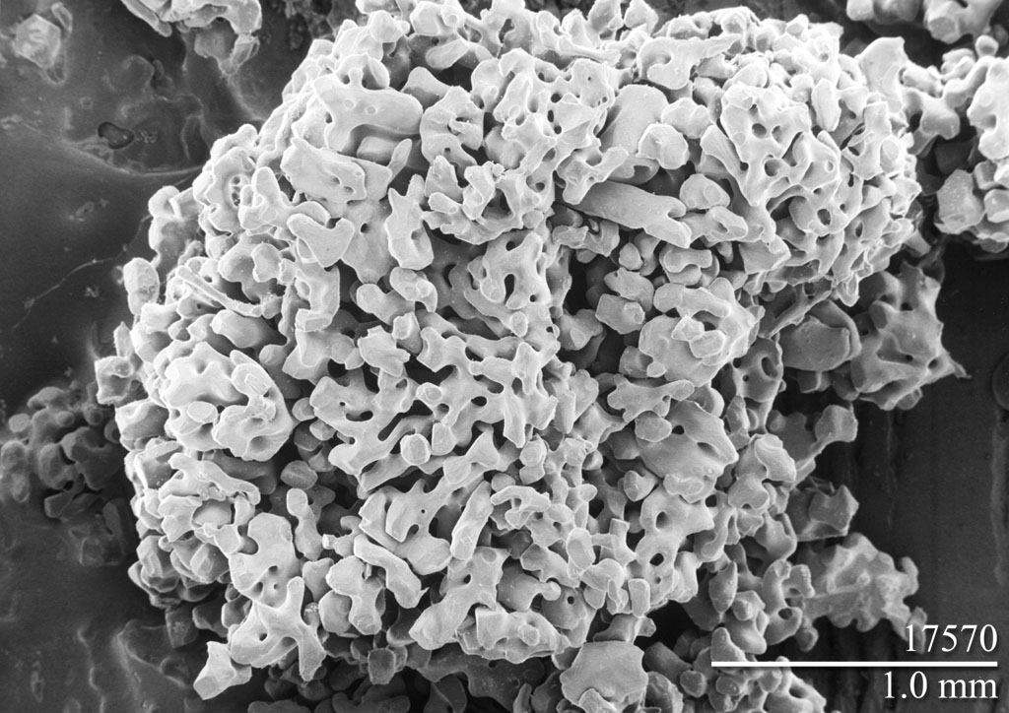
Rimed Ice Crystals
http://www.its.caltech.edu/~atomic/snowcrystals
Electron micrographs (emu.arsusda.gov)

Slide 28
Parametrization of rimed ice particles
Most GCMs with parametrized convection don’t explicitly represent graupel or hail (too small scale)
In cloud resolving models, traditional split between ice, snow and graupel and hail as prognostic variables, but this split is rather artificial.
Degree of riming can be light or heavy, particle density can vary smoothly.
Alternative approach is to have ice particle properties as the prognostic variables, e.g.
  Morrison and Grabowski (2008) have 3 ice variables: deposition mass, rime mass and number.
  Morrison and Milbrandt (2015) have 4 ice variables to also represent hail-type particles: total ice mass, rime mass, rime volume and number.
  Avoids artificial thresholds between different categories.
28

Slide 29
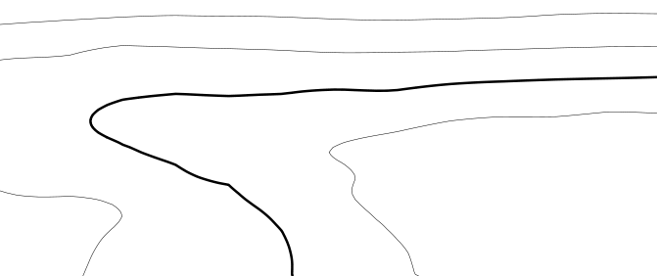
Freezing rain and ice pellets
Schematic cross-section (warm front)
Elevated warm layer, snow melts
Where layer is shallow, partially melted particles refreeze to ice pellets
Where layer is deeper, completely melted particles (rain drops) don’t refreeze at typical temperatures of few degrees below zero, but freeze on surface impact.
Freezing rain is a major hazard when it occurs.
3 km
Cold
Snow
0ºC
2 km
Wet Snow (melting)
Rain/Snow mix (melting)
Warm
Snow
Rain
1 km
Cold
Snow
Ice Pellets
Freezing Rain
Rain
Notes:
ECMWF Training Course
02 May 2000
Moist Processes

Slide 30
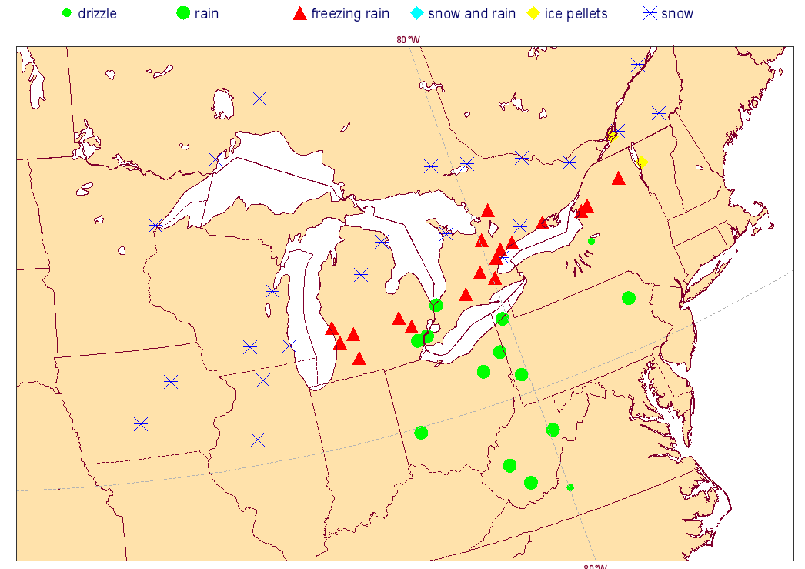
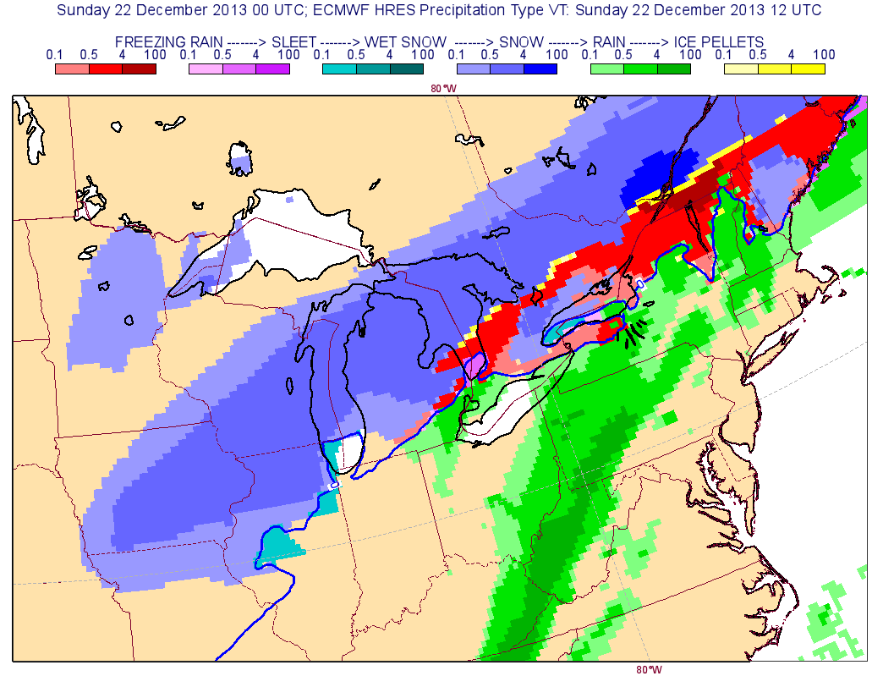
Prediction of Severe Weather: Freezing Rain
Case study: Toronto 22 Dec 2013
Observed precipitation type 11-12UTC
12 UTC
“Freezing rain” is supercooled rain that freezes on impact with the surface – can be a major hazard!
ECMWF model (since CY41r1) prediction of “freezing” rain and precipitation type (freezing rain/sleet/wet snow/snow/rain/ice pellets)

Slide 31
Other ice-phase microphysical processes
Splintering of ice crystals, Hallet-Mossop splintering through riming around -5ºC. Leads to increased numbers of smaller crystals.
Sedimentation due to gravity. Fall speed depends on particle size (and habit/density for ice).

Slide 32
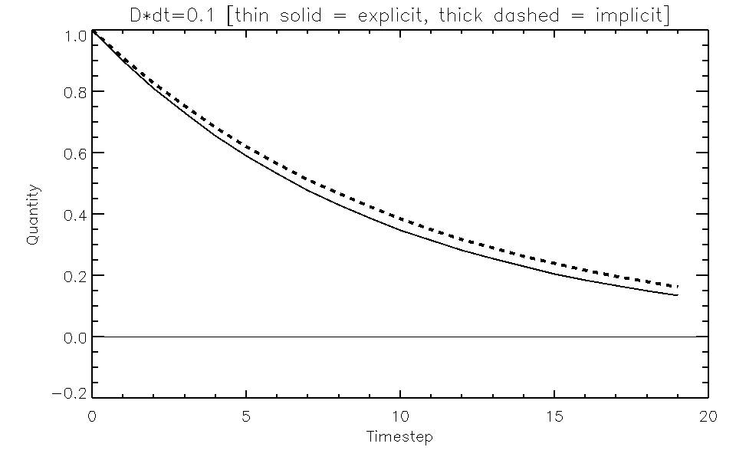
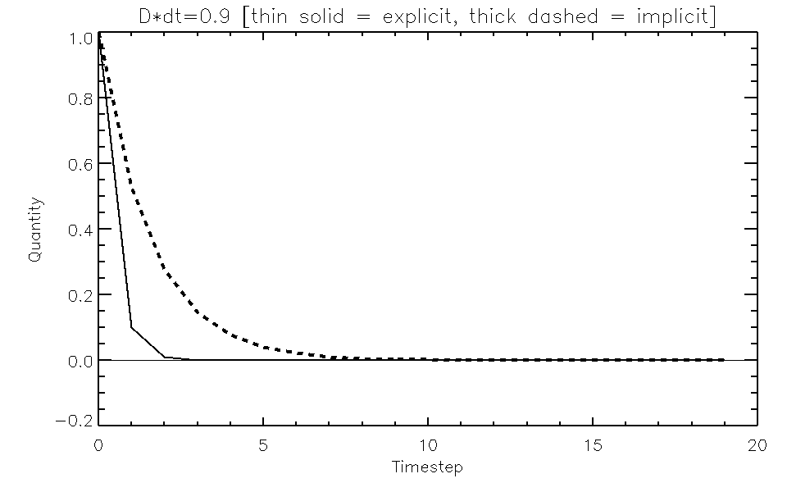
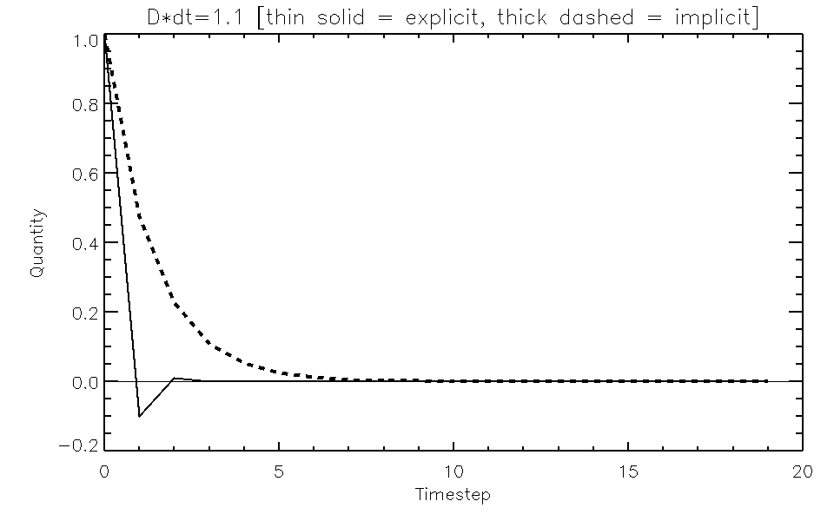
Numerics: Explicit vs Implicit
= e.g. cloud water/ice
Process = e.g. autoconversion, sedimentation
Upstream forward in time solution (n = current time level, n+1 = next time level)
Explicit solution
Rearrange
For long timesteps D∆t maybe >1 so explicit Φ^{n+1} becomes negative!
Implicit solution
Rearrange
D∆t = 0.1
D∆t = 0.9
D∆t = 1.1

Slide 33
Numerics and sedimentation
Advected quantity (e.g. ice)
Sedimentation term
Options for sedimentation
  (1) semi-Lagrangian
  (2) time splitting
  (3) implicit numerics
Constant
Explicit Source/Sink
Implicit Source/Sink
(not required for short timesteps)
what is short?
Implicit:
Upstream forward in time,
k = vertical level
n = time level
φ = cloud water (q_{x})
Solution

Slide 34
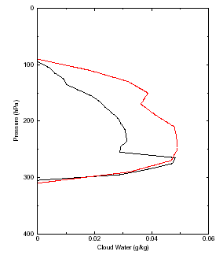
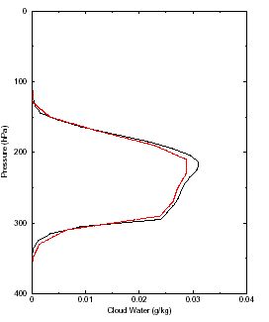
Ice Sedimentation:
Improved numerics in SCM cirrus case
Important to have a sedimentation scheme that is not sensitive to vertical resolution and timestep.
Vertical profile of ice water content
Old numerics before CY29R1
Sensitive to vertical resolution
Implicit forward-in-time upstream
Not sensitive to vertical resolution
100 vertical levels (black) versus
50 vertical levels (red)

Slide 35
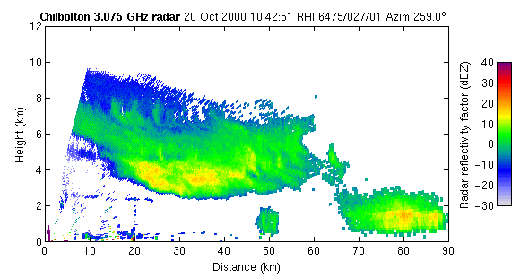
Falling Precipitation
Ice
Snow
Melting layer
Rain
Courtesy R Hogan, University of Reading, www.met.rdg.ac.uk/radar

Slide 36
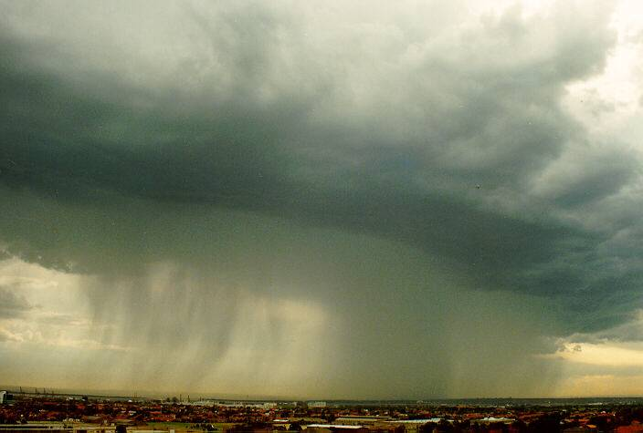
Microphysics - Summary

Slide 37
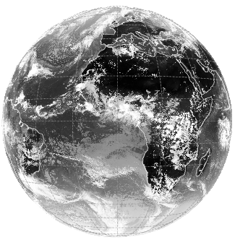

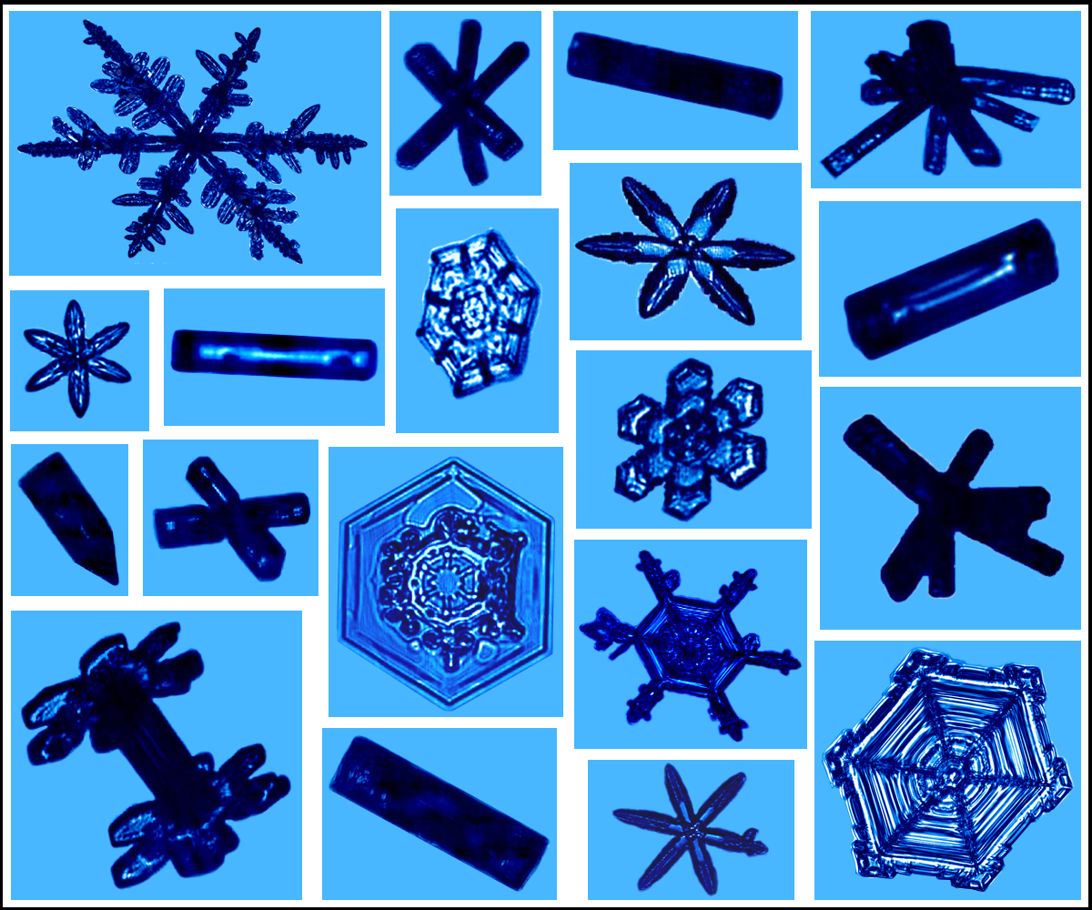
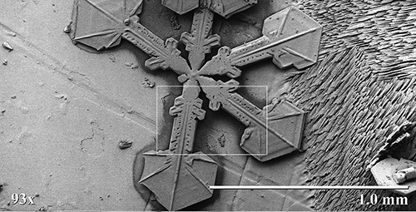
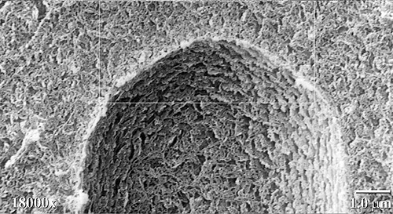
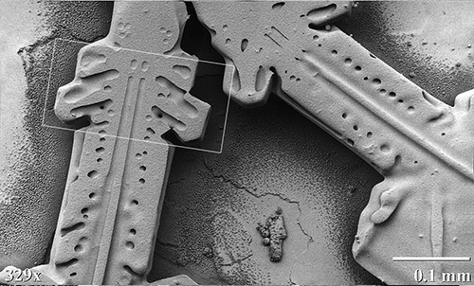
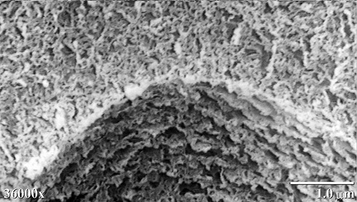
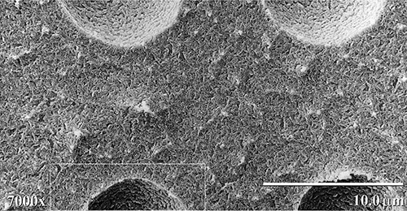
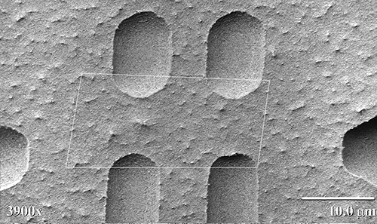



From global to micro-scales
Hugely complex system. Need to simplify!
emu.arsusda.gov
Notes:
Huge complexity and uncertainty in atmospheric motions and physical processes right from the global scale to the micro-scale. It’s amazing that we get anything right, but we do. And that’s because there are some basic physical principles that allow us to approximate the real world in a relatively simple way.
As we go to smaller scales, the timescales for processes also become shorter, but what scales are important for predictability?

Slide 38
Summary
Parametrization of cloud and precipitation microphysical processes:
  Need to simplify a complex system
  Accuracy vs. complexity vs. computational efficiency trade off
  Appropriate for the application and no more complexity than can be constrained and understood
  Dynamical interactions (latent heating), radiative interactions
  Still many uncertainties (particularly ice phase)
  Particular active area of research is aerosol-microphysics interactions.
  Microphysics often driven by small scale dynamics – how do we represent this in models…..
Next lecture: Cloud Cover
  Sub-grid scale heterogeneity
  Linking the micro-scale to the macro-scale

Slide 39
References
Reference books for cloud and precipitation microphysics:
Pruppacher. H. R. and J. D. Klett (1998). Microphysics of Clouds and Precipitation (2nd Ed). Kluwer Academic Publishers.
Rogers, R. R. and M. K. Yau, (1989). A Short Course in Cloud Physics (3rd Ed.) Butterworth-Heinemann Publications.
Mason, B. J., (1971). The Physics of Clouds. Oxford University Press.
Hobbs, P. V., (1993). Aerosol-Cloud-Climate Interactions. Academic Press.
Houze, Jr., R. A., (1994). Cloud Dynamics. Academic Press.
Straka, J., (2009). Cloud and Precipitation Microphysics: Principles and Parameterizations. Cambridge University Press.

