Slide 1
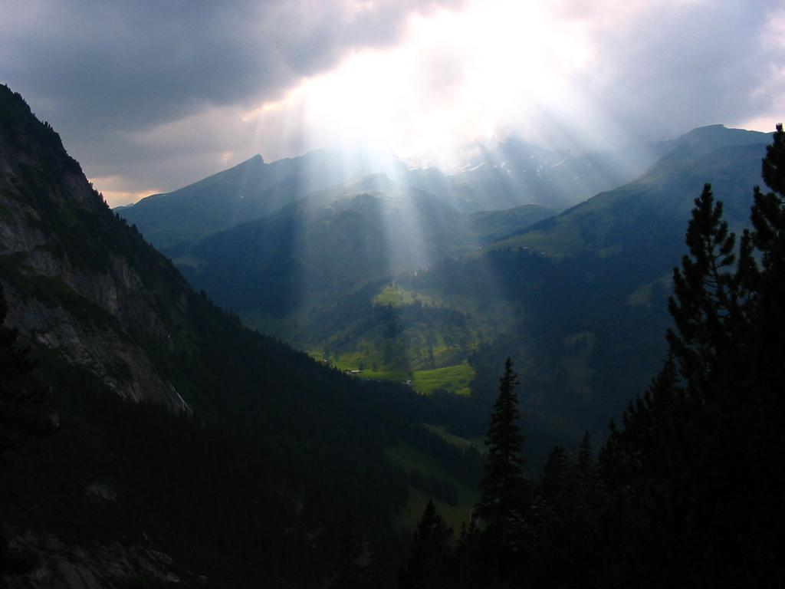
Radiative transfer in numerical models of the atmosphere
Robin Hogan
Slides contain contributions from Jean-Jacques Morcrette, Alessio Bozzo,Tony Slingo and Piers Forster

Slide 2

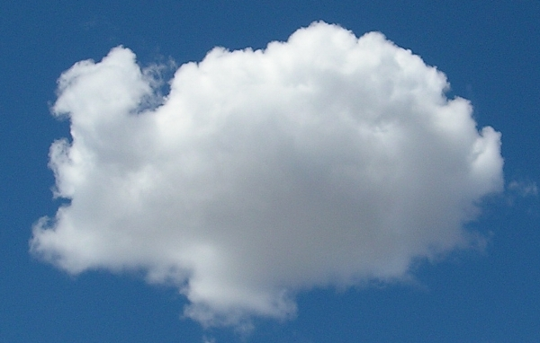
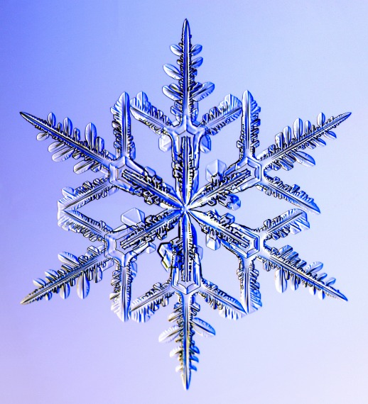
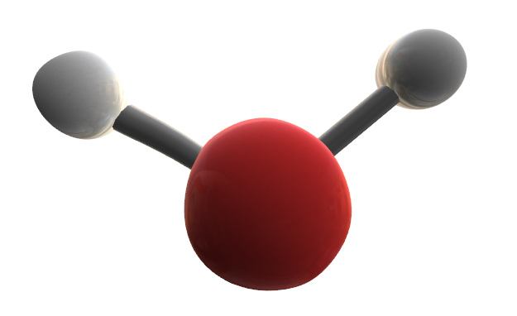
Outline
Lecture 1
  Global context
  From Maxwell to the two-stream equations
Lecture 2
  Gaseous absorption and emission
  Representing cloud structure
  Some remaining challenges
Lecture 3 (Alessio Bozzo)
  The ECMWF radiation scheme

Slide 3
Further reading
Petty, G., 2006: A first course on atmospheric radiation
Liou, K.-N., 1992: Radiation and Cloud Processes in the Atmosphere. Oxford University Press, 487 pp.
Morcrette, J-J., H. W. Barker, J. N. S. Cole, M. J. Iacono, R. Pincus, 2008: Impact of a New Radiation Package, McRad, in the ECMWF Integrated Forecasting System. Mon. Wea. Rev., 136, 4773–4798.
Randall, D. A., 2000: General circulation model development
Hogan, R. J., and J. K. P. Shonk, 2009: Radiation parametrization and clouds. Proc. ECMWF Seminar 1-4 Sept 2008.
Scattering animations http://www.met.rdg.ac.uk/clouds/maxwell

Slide 4
Part 1: Global context
What does a radiation scheme do?
How does radiation determine global temperature?
What is the role of radiation in the global circulation?
How do we evaluate radiation schemes globally?

Slide 5
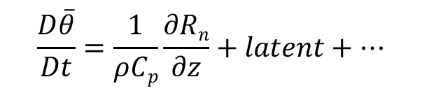
What does a radiation scheme do?
Prognostic variables: temperature, humidity, cloud fraction, liquid and ice mixing ratios, surface temperature
Diagnostic variables: sun angle, surface albedo, pressure, O₃, aerosol; well-mixed gases: CO₂, O₂, CH₄, N₂O, CFC-11 and CFC-12
CAMS project can provide prognostic aerosols, CO₂ and CH₄
Radiation scheme
Fluxes / irradiances between model levels in W m⁻²
Net flux R_{n} = S – – S⁺ + L – – L⁺
S –, S⁺
L–, L⁺
Thermodynamic equation:
Radiation terms in surface energy balance: soil & sea temperatures

Slide 6
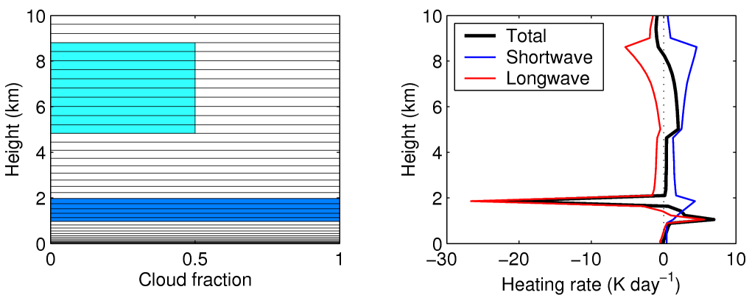
Heating rate profiles
Radiation scheme
  Radiation in the presence of clouds tends to destabilize the atmosphere
S_{n}
L_{n}

Slide 7
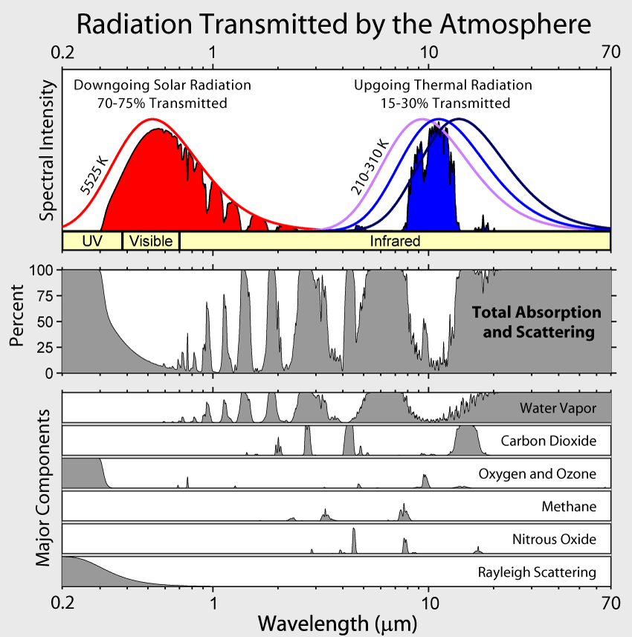
Spectral distribution of radiation
Shortwave: atmosphere is mostly transparent
Longwave: atmosphere is mostly opaque

Slide 9
If the Earth was black (α=0), T_{eff} = 278 K, still lower than observed 288 K

Slide 12
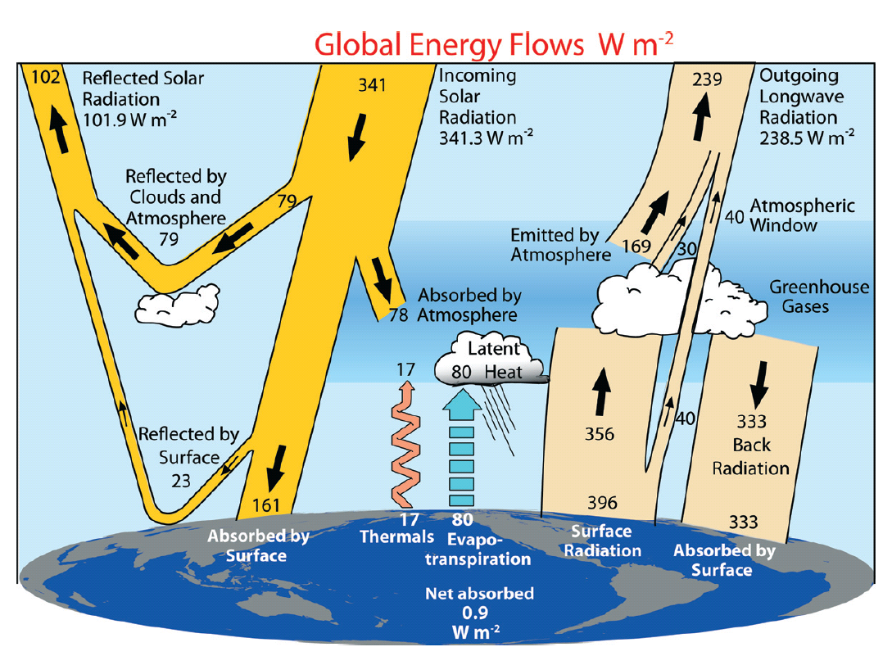
Global energy flows
Trenberth et al. (2009); modification of Kiehl & Trenberth (1997)

Slide 13
Global circulation
Warmer tropics means same pressure layers are thicker at equator
By thermal wind balance there must be westerlies
Excess heat transported polewards by
  Disturbances in these westerlies
  Oceanic transport

Slide 14
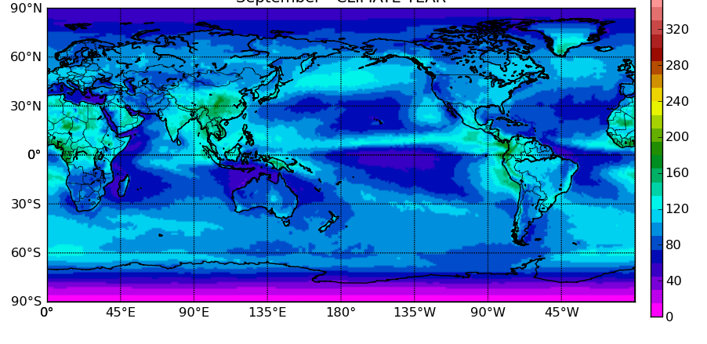
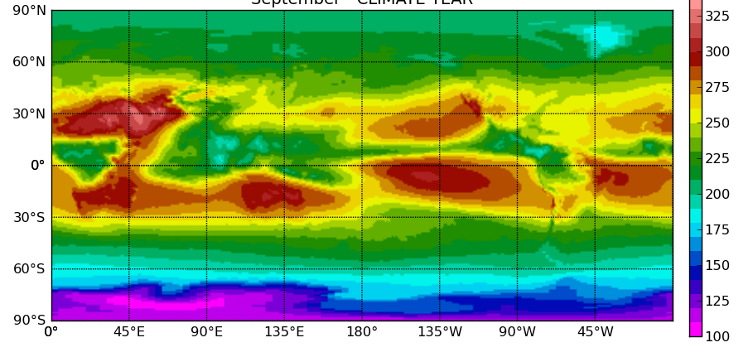
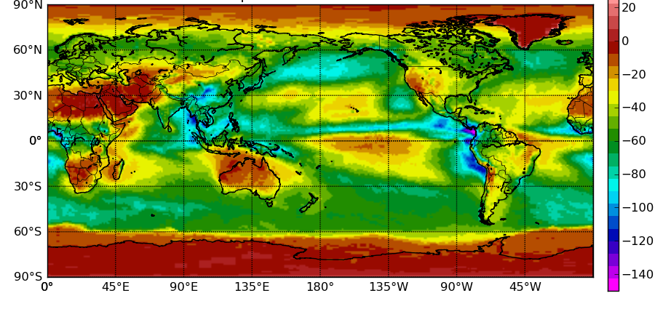
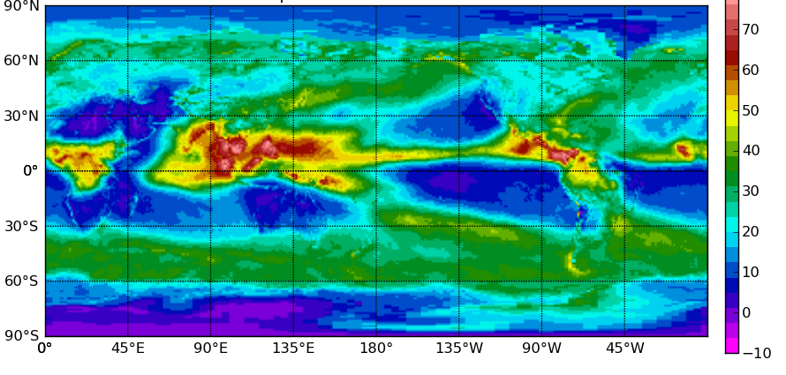
CERES radiometer (Sept)
TOA total upwelling irradiance
  Shortwave – Longwave
TOA cloud radiative effect (or “forcing”): F_{n}^{cloud} – F_{n}^{clear}
  Shortwave – Longwave

Slide 15
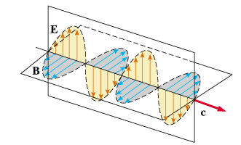
Part 2: Maxwell’s equations to the two-stream equations
How do Maxwell’s equations explain optical phenomena?
How do we describe scattering by cloud particles, aerosols and molecules?
How is radiative transfer implemented in models?

Slide 16
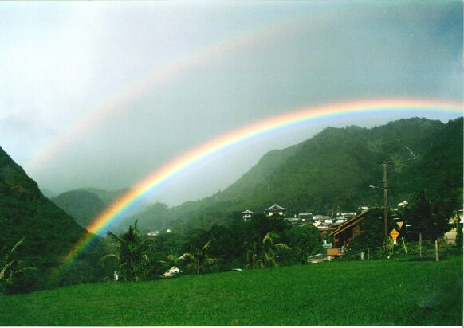
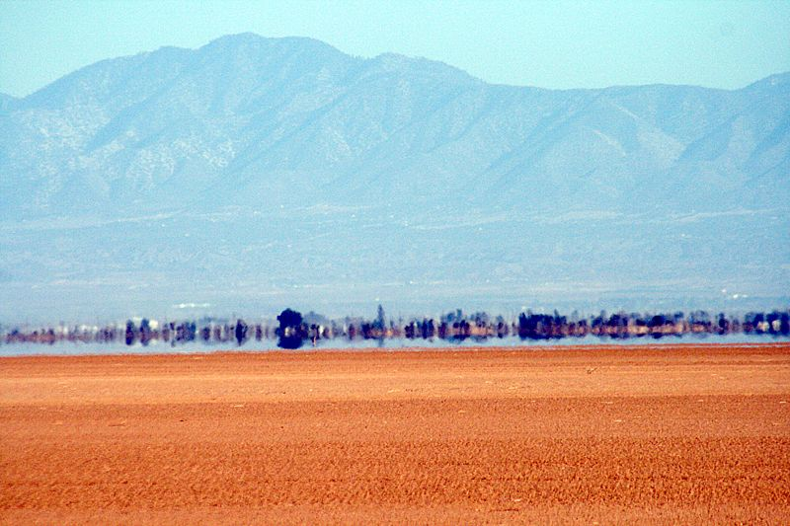

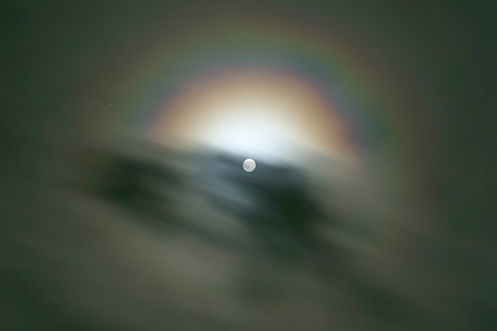

Slide 17
Building blocks of atmospheric radiation
Emission and absorption of quanta of radiative energy
  Governed by quantum mechanics: the Planck function and the internal energy levels of the material
  Responsible for complex gaseous absorption spectra
Electromagnetic waves interacting with a dielectric material
  An oscillating dipole is excited, which then re-radiates
  Governed by Maxwell’s equations + Newton’s 2nd law for bound charges
  Responsible for scattering, reflection and refraction
p
E
+
−
Oscillating dipole p is induced, which is typically in phase with the incident electric field E
Dipole radiates in all directions (except directly parallel to its axis)

Slide 18
Maxwell’s equations
Almost all atmospheric radiative phenomena are due to this effect, described by the Maxwell curl equations:
  where c is the speed of light in vacuum, n is the complex refractive index (which varies with position), and E and B are the electric and magnetic fields (both functions of time and position);
It is illuminating to discretize these equations directly
  This is known as the Finite-Difference Time-Domain (FDTD) method
  Use a staggered grid in time and space (Yee 1966)
  Consider two dimensions only for simplicity
  Need gridsize of ~0.02 μm and timestep of ~50 ps for atmospheric problems
B_{y}
E_{z}
E_{z}
B_{x}
B_{x}
B_{y}
E_{z}
E_{z}

Slide 19
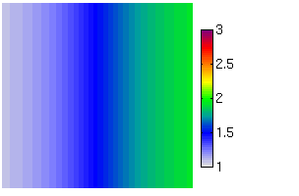

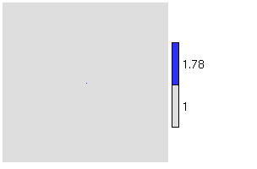

Simple examples
Refraction (a mirage)
Rayleigh scattering (blue sky)
n gradient
Single dipole
Refractive index Total E_{z} field
Scattered field
(total − incident)

Slide 20
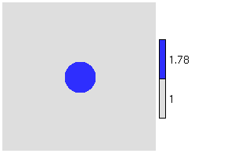

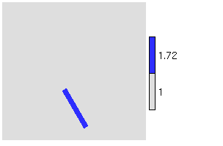

More complex examples
A sphere (or circle in 2D)
An ice column
Refractive index Total E_{z} field
Scattered field
(total − incident)

Slide 21
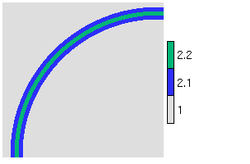

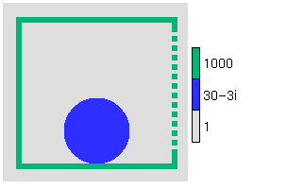
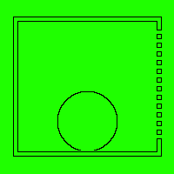
Non-atmospheric examples
Single-mode optic fibre
Potato in a microwave oven
Refractive index Total E_{z} field
Many more animations at www.met.rdg.ac.uk/clouds/maxwell
(interferometer, diffraction grating, dish antenna, clear-air radar, laser…)

Slide 22
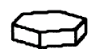
Particle scattering
Maxwell’s equations used to obtain scattering properties
Suppose we illuminate a single particle with monochromatic radiation of flux density P (in W/m²)
  Scattering cross-section σ_{s} (in m²) is defined such that the total scattered power (in W) is Pσ_{s}
  Absorption cross-section σ_{a} is the same but for absorbed power
  Extinction cross-section σ_{e} = σ_{s}+σ_{a} is the sum of the two
  Single scattering albedo ω₀ = σ_{s}/σ_{e}
Directional scattering described by the phase function p(Ω)
  Ω is the angle between incident and scattered directions
  Phase function normalized such that
P

Slide 23
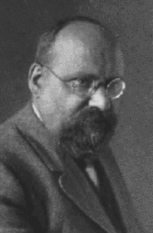
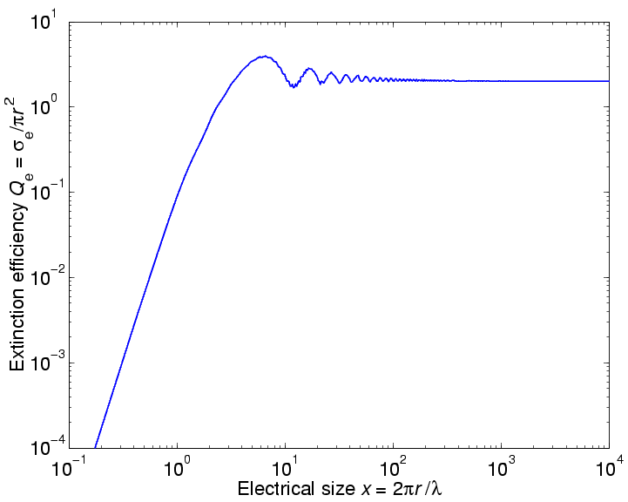
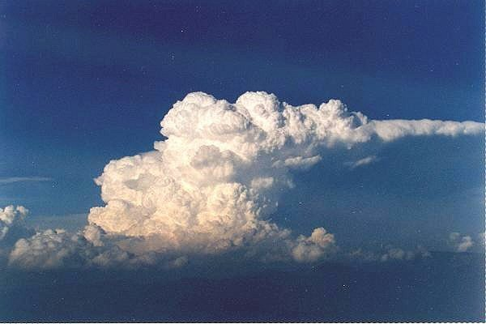
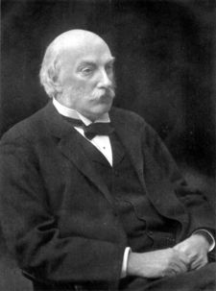
The limits of Mie theory
Gustav Mie
Geometric optics region (r>>λ):
Q_{e} = 2; σ_{e}= 2πr ²
…clouds are white
Rayleigh region (r<<λ):
Lord Rayleigh
…the sky is blue

Slide 24
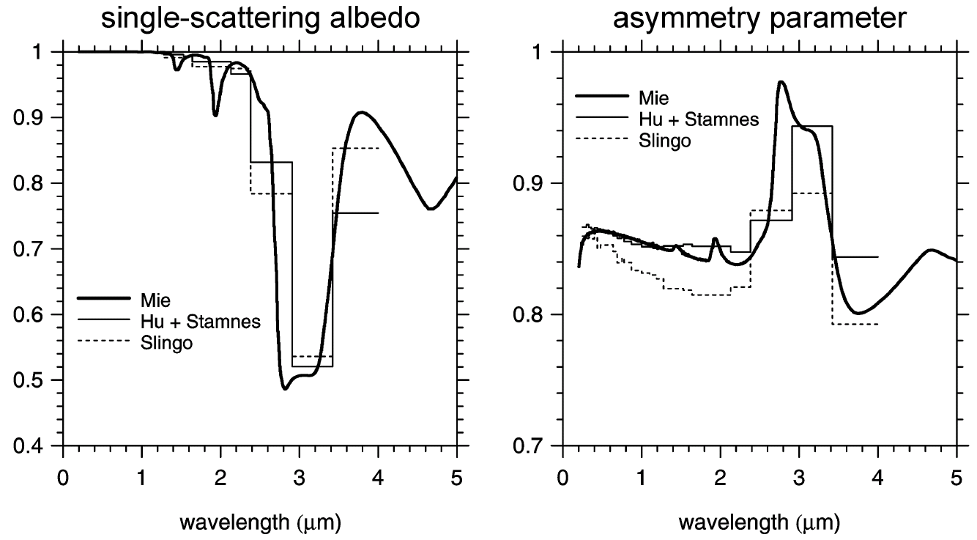
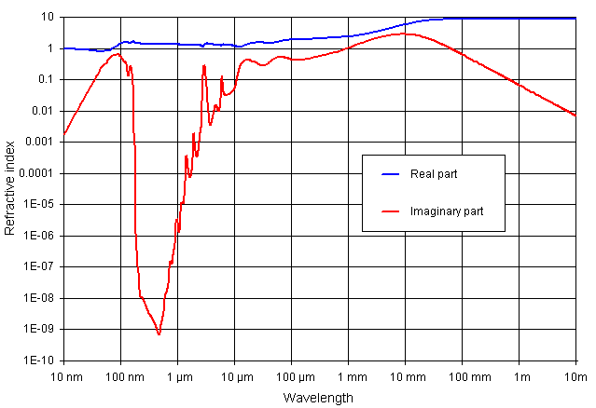
Single scattering albedo ω=σ_{s}/σ_{e}
Absorption related to imaginary part of refractive index m_{i}
For liquid and ice
  Visible: m_{i} is very small so ω is close to one (0.999…)
  Longwave: m_{i} higher so ω ∼ 0.5
Aerosols in the shortwave
  Water soluble: 0.9-0.95; Black carbon ~ 0.3
Refractive index of liquid water
Real part
Imaginary part

Slide 25
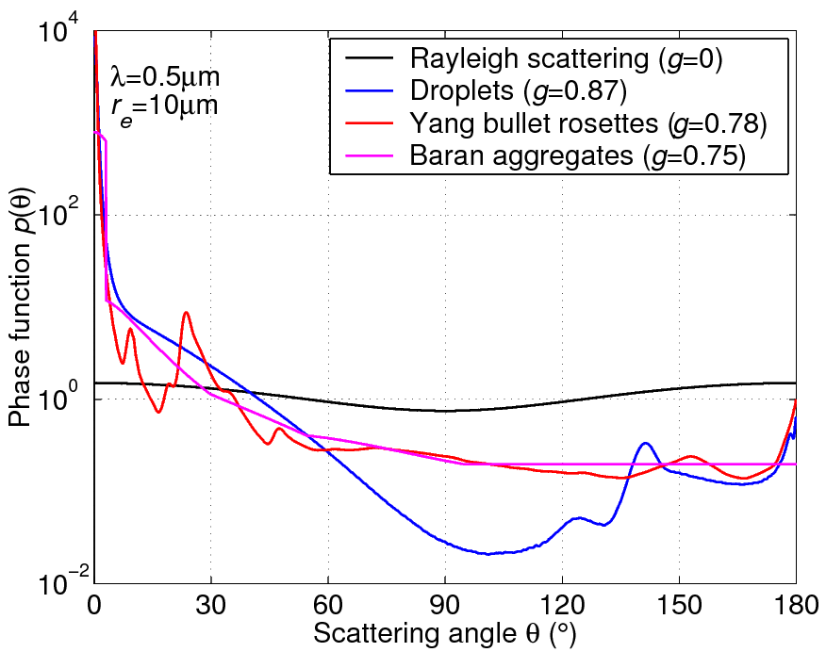
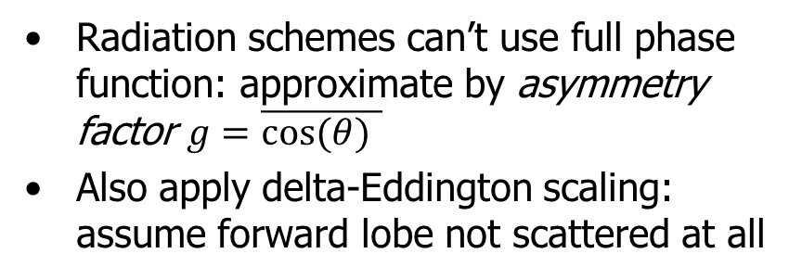
The scattering phase function
θ
The distribution of scattered energy is known as the “scattering phase function”
Different methods are suitable for different types of scatterer
Radiation schemes can’t use full phase function: approximate by asymmetry factor $g=\overline{cos⁡(θ) }$
Also apply delta-Eddington scaling: assume forward lobe not scattered at all

Slide 26


Size distributions
We want volume integral of scattering properties
Describe size distribution by n(r) [m⁻⁴], where n(r)dr is number conc of particles with radius between r and r +dr
  Extinction coefficient [m⁻¹] is integral of particle extinction cross-section [m²] per unit vol: $βe=\int{n(r)σ_{e}(r)dr}$
In geometric optics region (r $≫$λ) $σ_{e}\left(r\right)=2πr^{2}$, so it is appropriate to characterize average particle size by
  Effective radius $re=\frac{\int{r3n(r)dr}}{\int{r2n(r)dr}}=\frac{3LWC}{2ρlβe,go}$
Can convert model’s prognostic water content to extinction
In each part of the spectrum, ω and g parameterized as a function of r_{e}

Slide 27
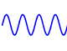
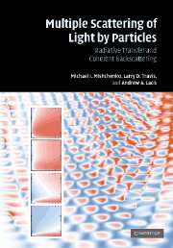
From Maxwell to radiative transfer
Maxwell’s equations in terms of fields E(x,t), B(x,t)
Mishchenko et al. (2007)
Reasonable assumptions:
Ignore polarization
Ignore time-dependence (sun is a continuous source)
Particles are randomly separated so intensities add incoherently and phase is ignored
Random orientation of particles so phase function doesn’t depend on absolute orientation
No diffraction around features larger than individual particles
3D radiative transfer in terms of monochromatic radiances I (x,Ω,ν) in W m⁻² sr⁻¹ Hz⁻¹

Slide 28

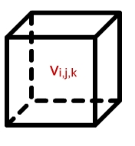


The 3D radiative transfer equation
This describes the radiance I in direction Ω (where the x and ν dependence of all variables is implicit):
Loss by absorption or scattering
Source
Such as thermal emission
Gain by scattering Radiation scattered from all other directions
Spatial derivative representing how much radiation is upstream
Direction Ω
Direction Ω’

Slide 29
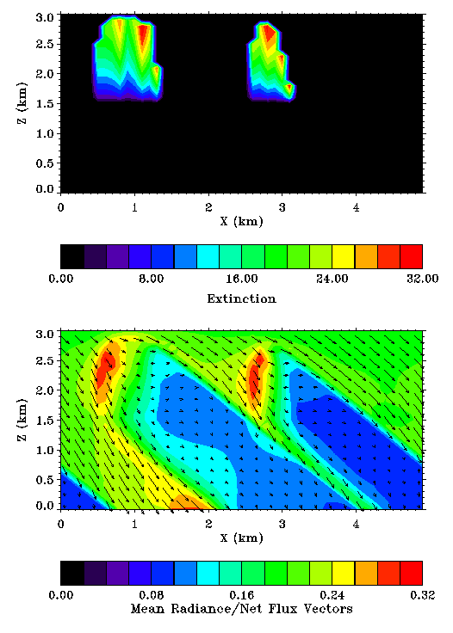
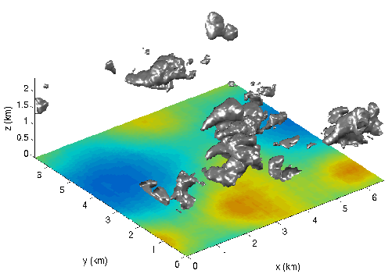
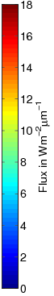
Explicit 3D radiation calculations
Freely available Monte Carlo and SHDOM codes can compute radiance fields everywhere
Very slow: 5D problem
Need to approximate for GCMs
SW: Franklin Evans, University of Colorado
LW: Sophia Schafer, University of Reading

Slide 30
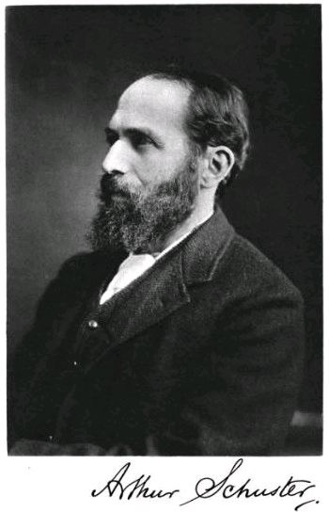
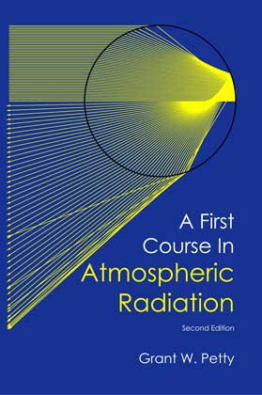
Two-stream approximation
3D radiative transfer in terms of monochromatic radiances I (x,Ω,ν)
Unreasonable assumptions:
Radiances in all directions represented by only 2 (or sometimes 4) discrete directions
Atmosphere within a model gridbox is horizontally infinite and homogeneous
Details of the phase functions represented by one number, the asymmetry factor
1D radiative transfer in terms of two monochromatic fluxes F ±(z,ν) in W m⁻² Hz⁻¹

Slide 31
Direct solar flux
θ₀
TOA flux:
  F_{0.5}^{d} = S₀cos(θ₀)
Zenith optical depth in layer i is δ_{i}, calculated simply as the vertical integral of extinction coefficient β_{e} across the layer
Fluxes at layer interfaces are
  F_{i+0.5}^{d} = F_{i-0.5}^{d}exp(-δ_{i}/cos θ₀)
F_{0.5}^{d}
Layer 1
δ₁
F_{1.5}^{d}
Layer 2
δ₂
F_{2.5}^{d}
For the moment we assume the model layers to be horizontally homogeneous and infinite: no representation of radiation transport between adjacent model columns

Slide 32
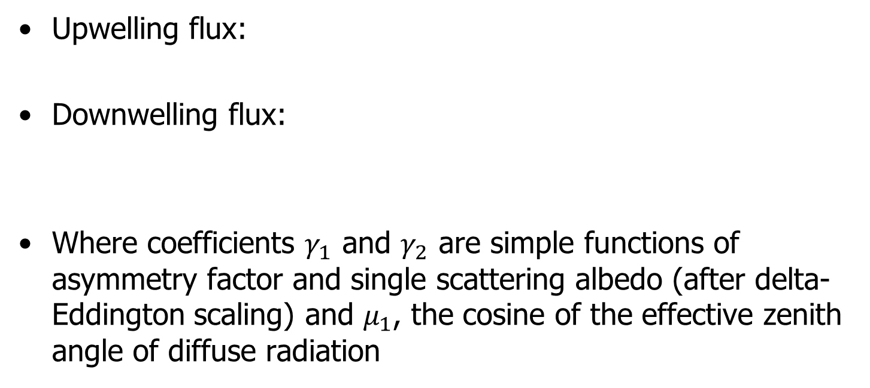
Two-stream equations for diffuse flux
Gradient of flux with height
Loss of flux by scattering or absorption
Gain in flux by scattering from other direction
Source from scattering of the direct solar beam (shortwave) or emission (longwave)
Upwelling flux:
Downwelling flux:
Where coefficients $γ_{1}$ and $γ_{2}$ are simple functions of asymmetry factor and single scattering albedo (after delta-Eddington scaling) and $μ_{1}$, the cosine of the effective zenith angle of diffuse radiation

Slide 33

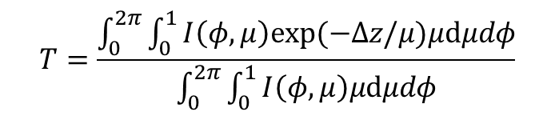
Two-stream angle / diffusivity factor
μ₁=cos(θ₁) is the effective zenith angle that diffuse radiation travels at to get the right transmittance T
Most longwave schemes use Elsasser (1942) diffusivity factor of 1/μ₁=1.66, equivalent to θ₁=53°
Flux F_{i-1/2}⁺=TF_{i-1/2}⁺
θ₁
Radiances I(φ,μ)
Δz
Flux F_{i+1/2}⁺
Two stream approximation

Slide 34
Discretized two-stream scheme
Diffuse TOA source S₀⁻
F_{0.5}⁺
F_{0.5}⁻
Source terms S⁺, S⁻
Reflection R, Transmission T
Layer 1
F_{1.5}⁺
F_{1.5}⁻
Layer 2
F_{2.5}⁺
F_{2.5}⁻
Surface source S_{s}⁺, albedo α_{s}
Shortwave: scattering of direct solar beam
Longwave: thermal emission
Equations relating diffuse fluxes between levels take the form:
Terms T, R and S found by solving two-stream equations for single homogeneous layers: solutions given by Meador and Weaver (1980)

Slide 35
Solution for two-level atmosphere
Solve the following tri-diagonal system of equations
Efficient to solve and simple to extend to more layers
Typical schemes also include separate regions at each height for cloud and clear-sky

Slide 36
Summary so far
Radiation is the fundamental driver of the climate system
  While a full radiative transfer model is quite complex, phenomenal such as anthropogenic climate change can be explained mathematically with very simple physical concepts
The radiative transfer aspects of a radiation scheme can be traced back to Maxwell’s equations, including
  Particle scattering
  The two-stream equations
Next lecture: gas absorption spectra and clouds

