Slide 1
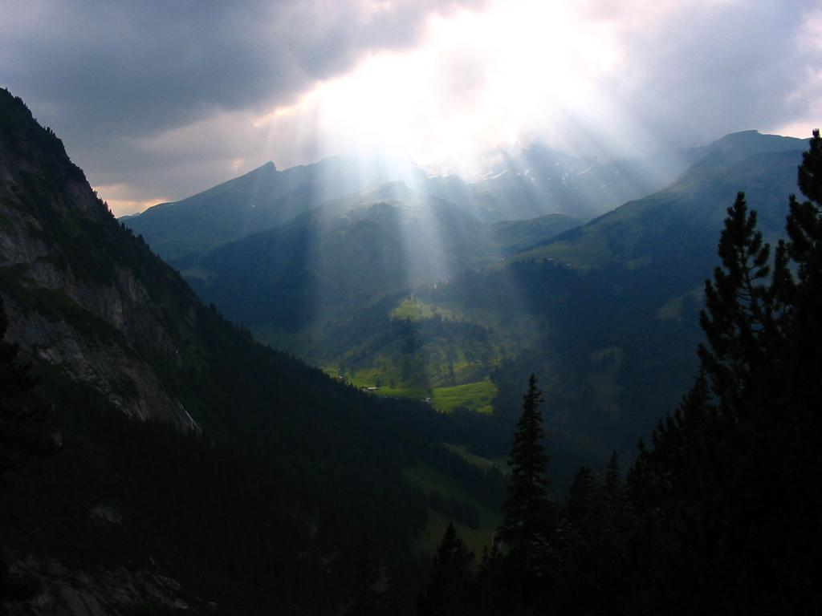
Radiative transfer in numerical models of the atmosphere
Robin Hogan
Slides contain contributions from Jean-Jacques Morcrette, Alessio Bozzo,Tony Slingo, Piers Forster and Sophia Schaefer

Slide 2

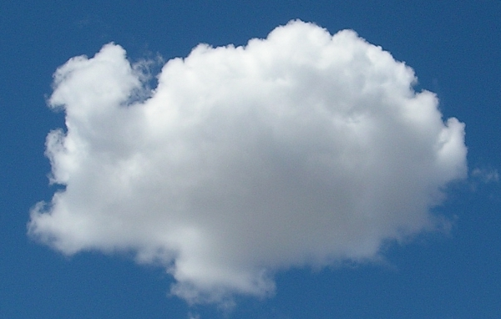
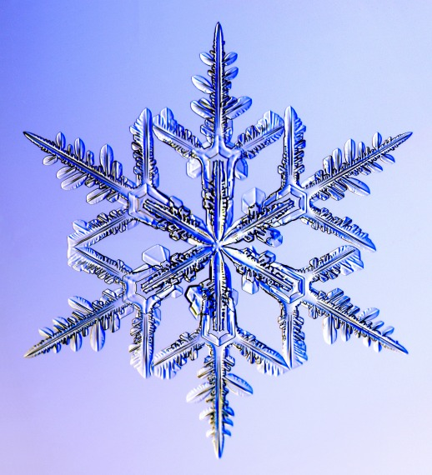
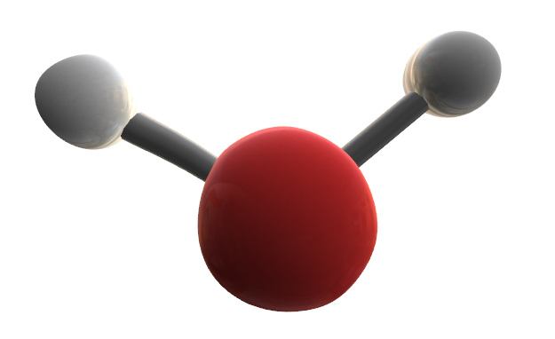
Outline
Lecture 1
  Global context
  From Maxwell to the two-stream equations
Lecture 2
  Gaseous absorption and emission
  Representing cloud structure
  Some remaining challenges
Lecture 3 (Alessio Bozzo)
  The ECMWF radiation scheme

Slide 3
Part 3: Gaseous absorption and emission
Part 2 considered monochromatic radiative transfer only
What causes complex emission/absorption spectra of gases?
Lecture 3 will outline how we represent this efficiently in models

Slide 4
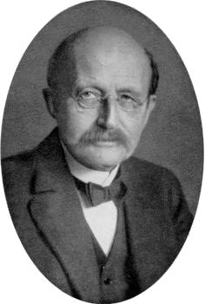
Planck’s law
Max Planck
Spectral radiance [W m⁻² sr⁻¹ Hz⁻¹] emitted by a black body at temperature T is
Can change to per-unit-wavelength via B_{ν}dν=B_{λ}dλ:
h = Planck’s constant 6.626x10⁻³⁴ J s
k = Boltzmann’s const 1.381x10⁻²³ J K⁻¹
c = speed of light 299792458 m s⁻¹

Slide 5
Emission by gases
Planck function has a continuous spectrum at all temperatures: maximum possible emission by medium in thermal equilibrium
Absorption by gases is an interaction between molecules and photons and obeys quantum mechanics
  Not quantized: kinetic energy ~ kT/2
  Quantized: changes in levels of energy occur by ΔE=h Δν steps
    rotational energy: lines in the far infrared λ > 20μm
    vibrational energy (+rotational): lines in the 1 - 20 μm
    electronic energy (+vibr.+rot.): lines in the visible and UV
Radiation schemes are benchmarked to spectroscopic databases from laboratory measurements
  For example, HITRAN database (Rothman et al. JQSRT 2009)

Slide 6
Composition of the Earth’s atmosphere
Gas | Parts by volume | Interaction
Nitrogen (N₂) | 780,840 ppmv (78.084%) | SW (Rayleigh)
Oxygen (O₂) | 209,460 ppmv (20.946%) | SW (Ray+abs)
Water vapour (H₂O) | ~0.40% full atmosphere, surface ~1%-4% | LW, SW (abs)
Argon (Ar) | 9,340 ppmv (0.9340%)
Carbon dioxide (CO₂) | 390 ppmv (0.039%) rising | LW, SW (abs)
Neon (Ne) | 18.18 ppmv (0.001818%)
Helium (He) | 5.24 ppmv (0.000524%)
Methane (CH₄) | 1.79 ppmv (0.000179%) rising | LW
Krypton (Kr) | 1.14 ppmv (0.000114%)
Hydrogen (H₂) | 0.55 ppmv (0.000055%)
Nitrous oxide (N₂O) | 0.319 ppmv (0.00003%) rising | LW
Carbon monoxide (CO) | 0.1 ppmv (0.00001%)
Xenon (Xe) | 0.09 ppmv (9×10⁻⁶%) (0.000009%)
Ozone (O₃) | 0.0 to 0.07 ppmv (0 to 7×10⁻⁶%) | LW, SW (abs)
SW “shortwave” solar radiation: Rayleigh scattering (blue sky) or absorption
LW “longwave” terrestrial infrared radiation: absorbing greenhouse gases

Slide 7
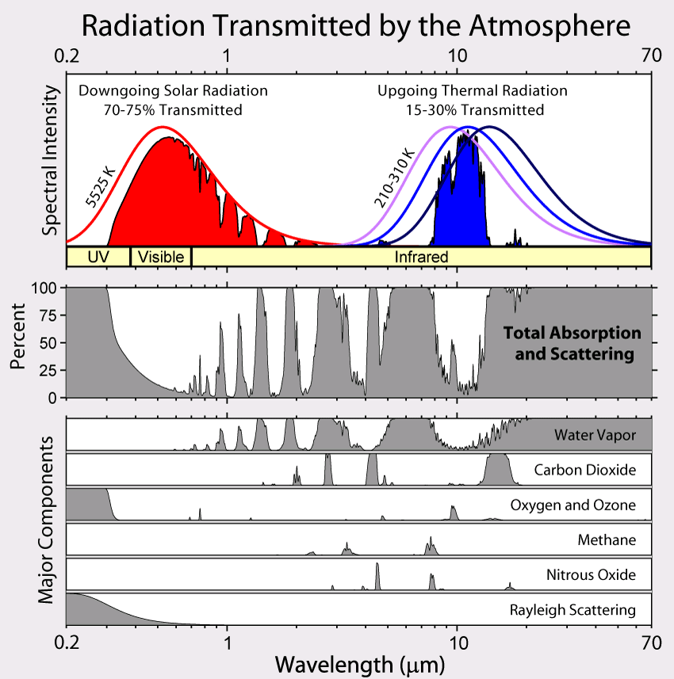
H₂O
CH₄
CO₂
CO₂
H₂O
O₃
Rayleigh scattering
H₂O
O₂
O₃
H₂O,
CO₂

Slide 8
Spectral lines
Spectral lines are of frequency ν=ΔE/h
Absorption cross-section per molecule: σ_{ν}=S f (ν−ν₀)
  S = line strength
  ν₀ = centre frequency
  f (ν−ν₀) = line shape (normalized to unit area)
Natural broadening
  Due to Heisenburg’s principle (negligible)
Pressure broadening
  Molecular collisions disrupt energy levels (troposphere and stratosphere)
Doppler broadening
  Due to random motion of molecules, absorption/emission is Doppler-shifted from natural line position (mesosphere)

Slide 9
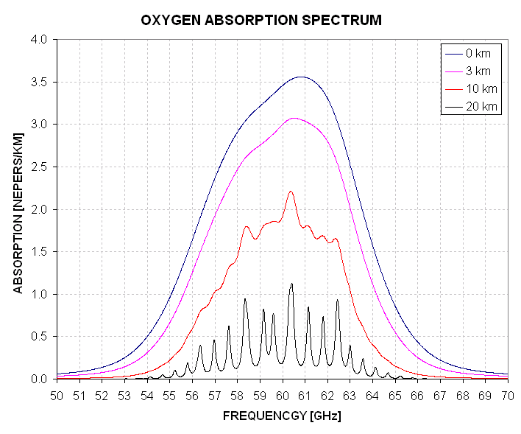
Pressure broadening
Theory is rather heuristic; usually described adequately but not perfectly by the Lorenz line shape:
With the half-width at half the maximum roughly proportional to the frequency of collisions, modelled by:

Slide 10
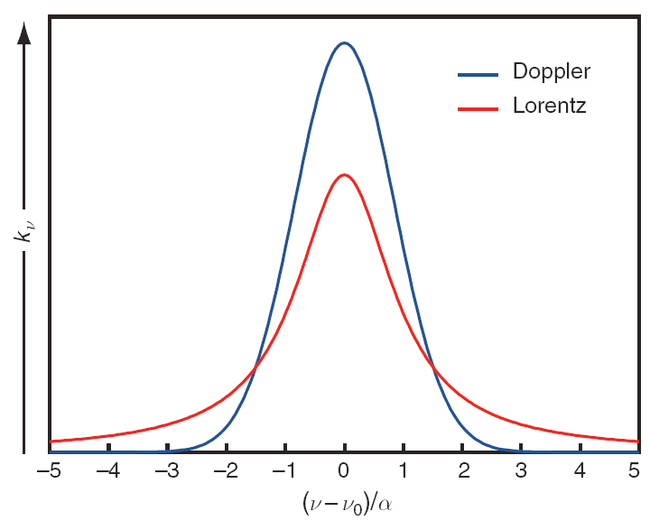
Doppler broadening
Molecular velocity distribution is Gaussian:
Doppler shift ν’= ν (1 – v/c) so line shape is Gaussian
where

Slide 11
Continuum absorption
In addition to spectral lines, some absorption does not exhibit line structure – this is due to:
Photoionization
  High energy photons (X/γ-rays) strip electrons from atoms
  Kinetic energy of resulting ion and electron not quantized, so will be continuum absorption above ionization energy
Photodissociation
  Ultraviolet light can break molecules (e.g. O_{2,} O₃) into constituent atoms: protects us from hard UV at surface
Water vapour continuum uncertain: mechanism is either
  Far wings of lines (due to underestimate by Lorenz shape)
  Temporary water vapour clusters (dimers, trimers etc.)

Slide 12
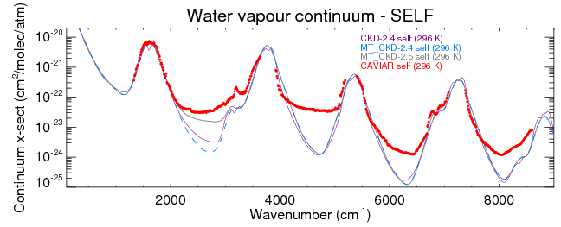
Water vapour continuum
Shine et al. in CAVIAR project have found that current water vapour continuum models can significantly underestimate absorption in windows between bands, particularly in the near infrared
5 μm
1.25 μm

Slide 13
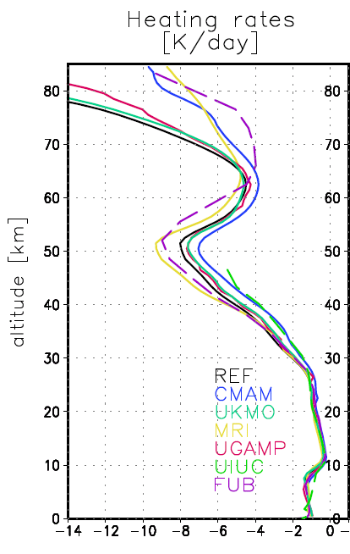
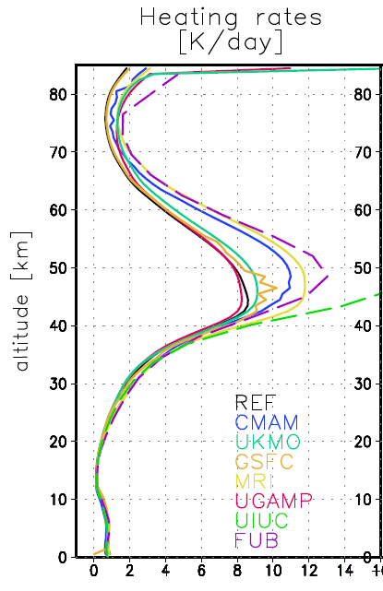
GRIPS intercomparison
Large discrepancies in ozone layer and mesosphere
Longwave
Shortwave

Slide 14
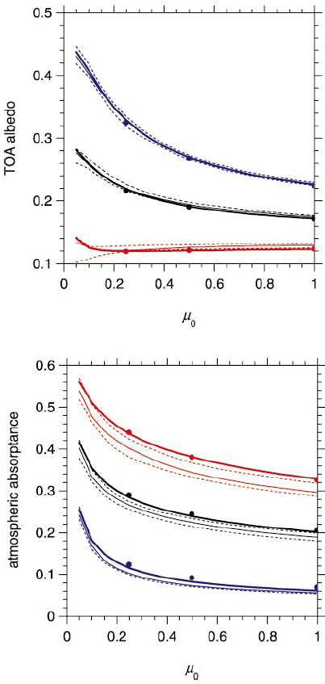
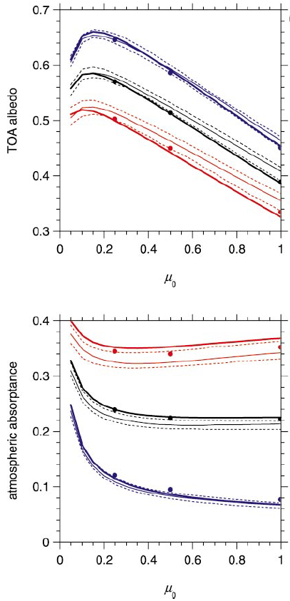
Shortwave comparison
Clear tropical profile Liquid cloud (plane parallel)
UV and visible
Barker et al. (JClim 2003)
Most models underestimate clear-sky near-IR absorption
  Poor continuum
Most models underestimate liquid cloud near-IR absorption
Full shortwave
Near infrared
LBL benchmark
Model range
Dusk
Overhead sun
Dusk
Overhead sun
Notes:
14

Slide 15
Part 4: Representing cloud structure
Representing cloud fraction, overlap and inhomogeneity
What is the impact of overlap and inhomogeneity on the radiation budget?

Slide 16
Cloud fraction parametrization
If cloud is diagnosed only when gridbox-mean q_{t} > q_{s} then resulting cloud fraction can only be 0 or 1
Cloud fraction can be diagnosed from prognostic or diagnostic sub-grid distribution of humidity and cloud
ECMWF uses a prognostic equation for cloud fraction
Sub-grid PDF of q_{t} (implicit or explicit)
q_{s}(T)
q_{t} = q + q_{l}
1
Cloud fraction
  Cloud can form when gridbox RH < 100%
0

Slide 17
Multi-region two stream
a
b
E.g. Met Office Edwards-Slingo scheme
Solve for two fluxes in clear and cloudy regions
  Matrix is now denser (pentadiagonal rather than tridiagonal)
Layer 1
a
b
Layer 2
  Note that coefficients describing the overlap between layers have been omitted

Slide 18
Are we using computer time wisely?
Radiation is an integral:
Dimension | Typical number of quadrature points | How well is this dimension known? | Consequence of poor resolution
Time | 1/3 (every 3 h) | At the timestep of the model | Changed climate sensitivity (Morcrette 2000); diurnal cycle (Yang & Slingo 2001)
Angle | 2 (sometimes 4) | Well (some uncertainty on ice phase functions) | ±6 W m⁻² (Stephens et al. 2001)
Space | 2 (clear+cloudy) | Poorly (clouds!) | Up to a 20 W m⁻² long-term bias (Shonk and Hogan 2009)
Spectrum | 100-250 | Very well (HITRAN database) | Incorrect climate response to trace gases?

Slide 19
Three further issues for clouds
Clouds in older GCMs used a simple cloud fraction scheme with clouds in adjacent layers being maximally overlapped
  Observations show that vertical overlap of clouds in two layers tends towards random as their separation increases
  Real clouds are horizontally inhomogeneous, leading to albedo and emissivity biases in GCMs (Cahalan et al 1994, Pomroy and Illingworth 2000)
  Radiation can pass through cloud sides, but these 3D effects are negelcted in all current GCMs

Slide 20
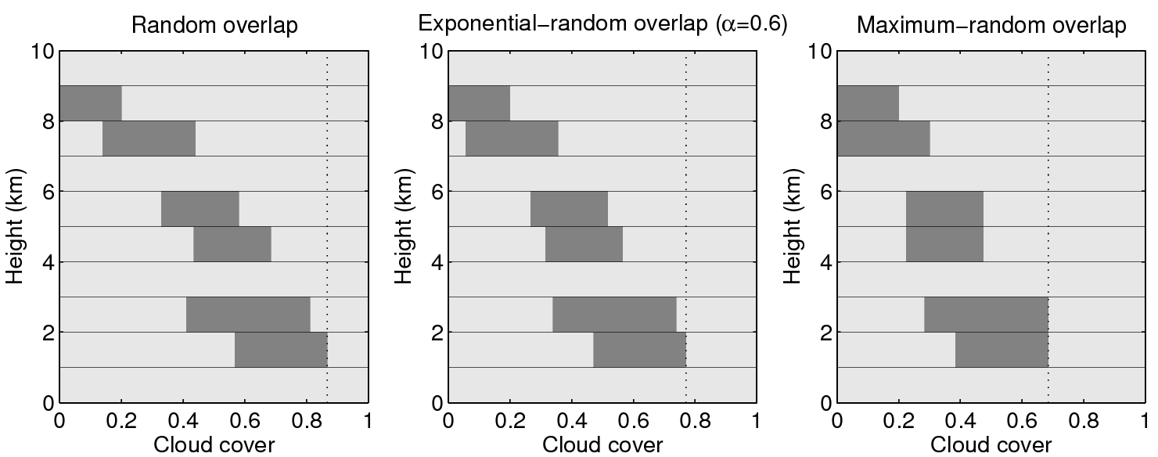
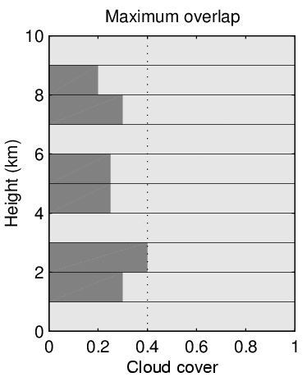
Cloud overlap parametrization
Even if can predict cloud fraction versus height, cloud cover (and hence radiation) depends on cloud overlap
  sdfsdfs
Observations (Hogan and Illingworth 2000) support “exponential-random overlap”:
  Non-adjacent clouds are randomly overlapped
  Adjacent clouds correlated with decorrelation length ~2km
  Many models still use “maximum-random overlap”

Slide 21
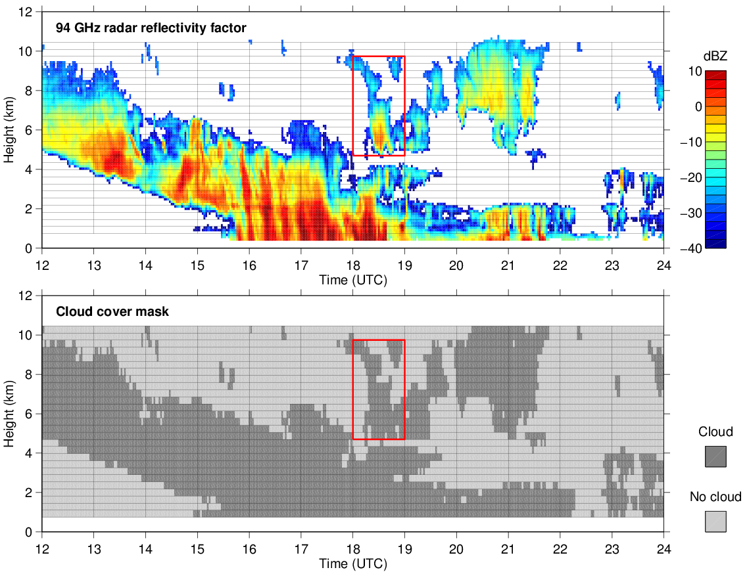
Cloud overlap from radar: example
Radar can observe the actual overlap of clouds

Slide 22
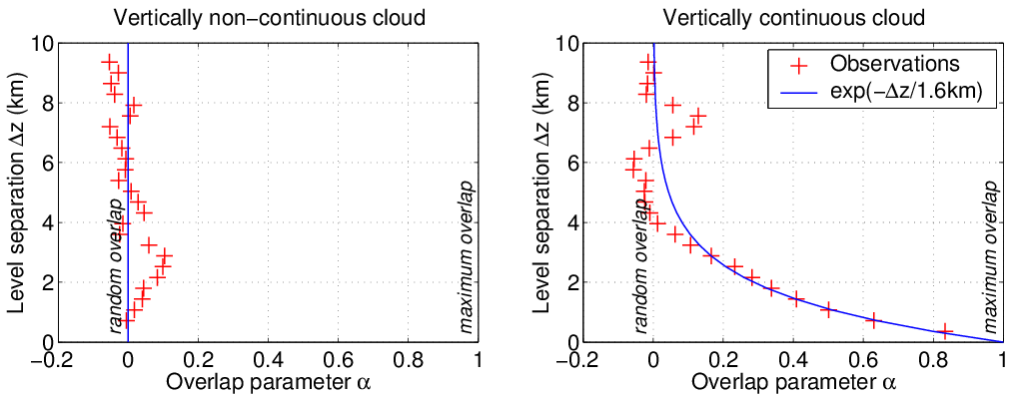
Cloud overlap: results
Vertically isolated clouds are randomly overlapped
Overlap of vertically continuous clouds becomes rapidly more random with increasing thickness, characterized by an overlap decorrelation length z₀ ~ 2 km
Hogan and Illingworth (QJ 2000)

Slide 23
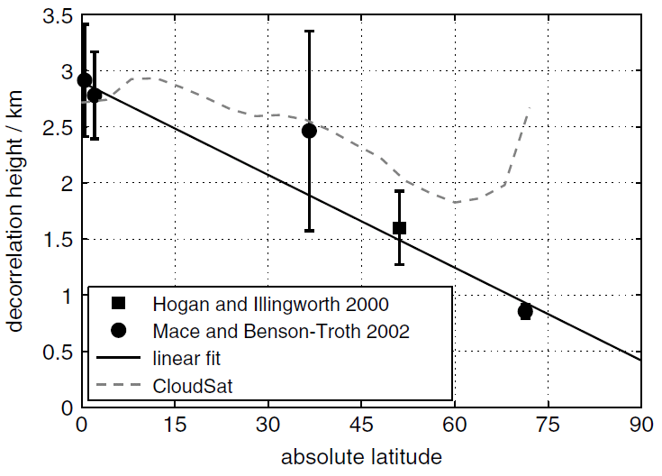
Cloud overlap globally
Latitudinal dependence of decorrelation length from Chilbolton and the worldwide ARM sites
  More convection and less shear in the tropics so more maximally overlapped
Maximum overlap
TWP (Mace & Benson 2002)
SGP (Mace & Benson 2002)
Latitudinal dependence available as an option in the ECMWF model
Chilbolton (Hogan & Illingworth 2000)
NSA (Mace & Benson 2002)
Random overlap
Shonk et al. (QJ 2010)

Slide 24
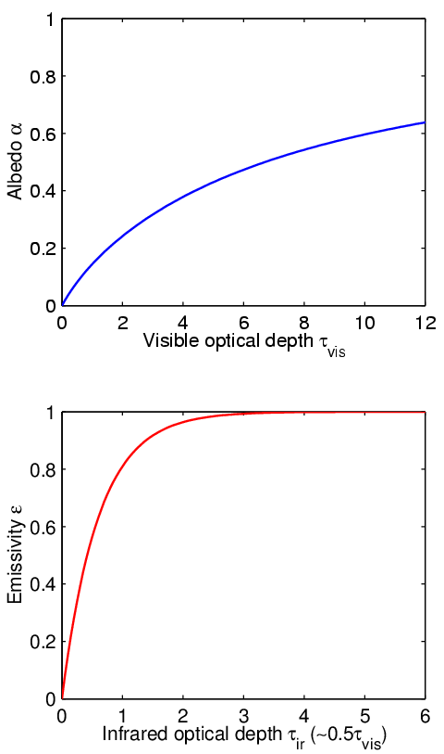
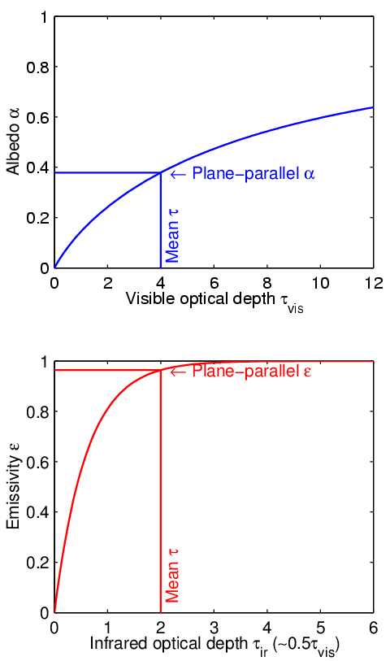
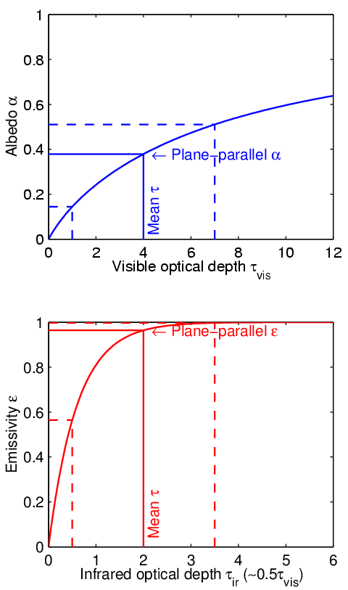
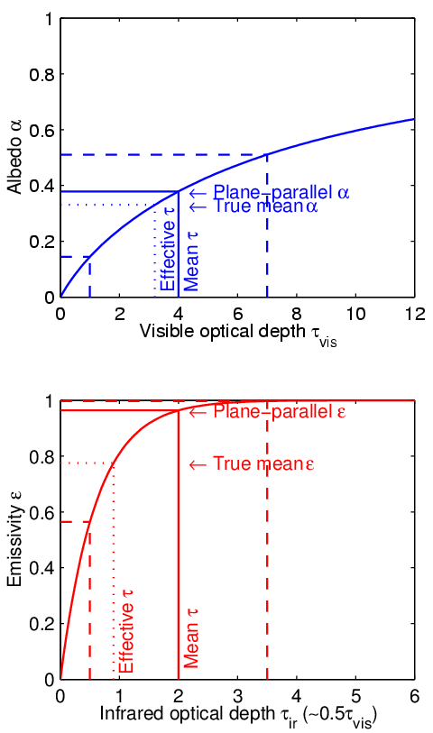
Why is cloud structure important?
An example of non-linear averaging
Clear air Cloud
Inhomogeneous cloud
Non-uniform clouds have lower mean emissivity & albedo for same mean optical depth due to curvature in the relationships
Infrared absorption optical depth

Slide 25
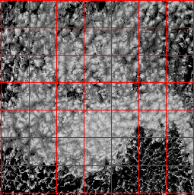
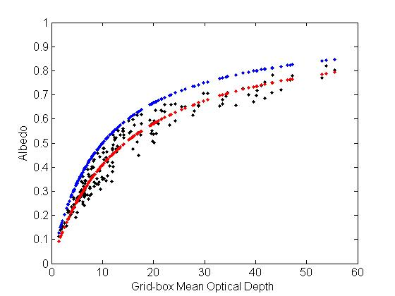
Example from MODIS
MODIS Stratocumulus
100-km boxes
Plane-parallel albedo
True mean albedo
PP albedo for scaled optical depth
By scaling the optical depth it appears we can get an unbiased fit to the true top-of-atmosphere albedo
  Until McRad (2007), ECMWF used a constant factor of 0.7
  Now a more sophisticated scheme is used

Slide 26
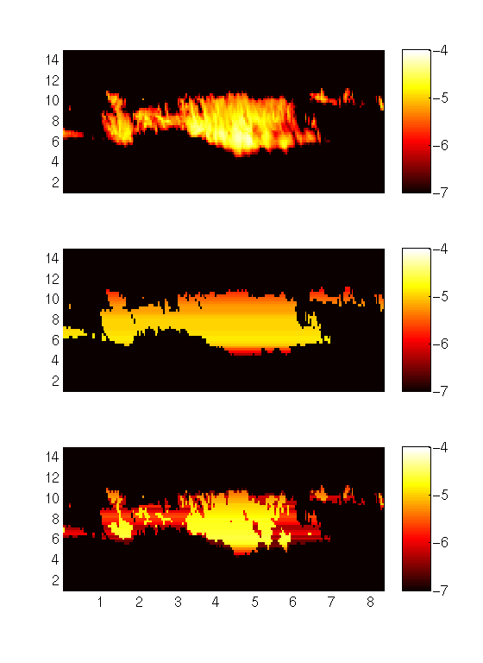
Representing cloud structure: Tripleclouds
Ice water content from Chilbolton radar, log₁₀(kg m^{–3})
Plane-parallel approx:
  2 regions in each layer, one clear and one cloudy
“Tripleclouds”:
  3 regions in each layer
  Alternative to McICA
  Uses Edwards-Slingo capability for stratiform/convective regions for another purpose
Height (km)
Height (km)
Height (km)
Time (hours)
Shonk and Hogan (JClim 2008)

Slide 27
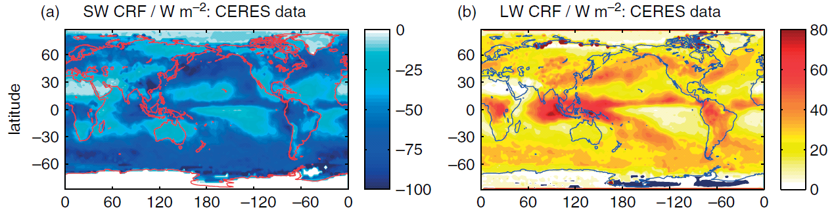
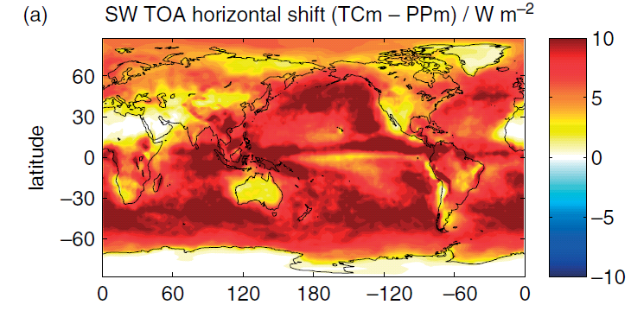
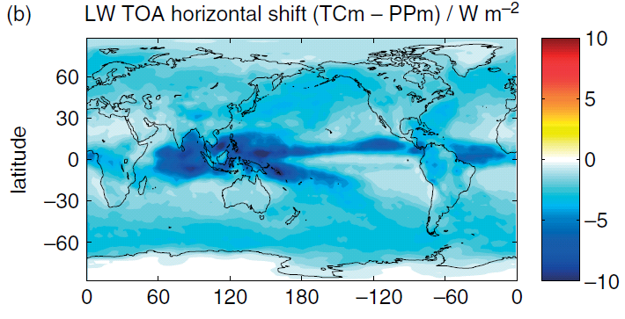
Global impact of cloud structure
Shonk and Hogan (2010)
Cloud radiative forcing (CRF) is change to top-of-atmosphere net flux due to clouds
Clouds cool the earth in the shortwave and warm it in the longwave:
Representing horizontal cloud structure reduces absolute CRF by around 12%:

Slide 28
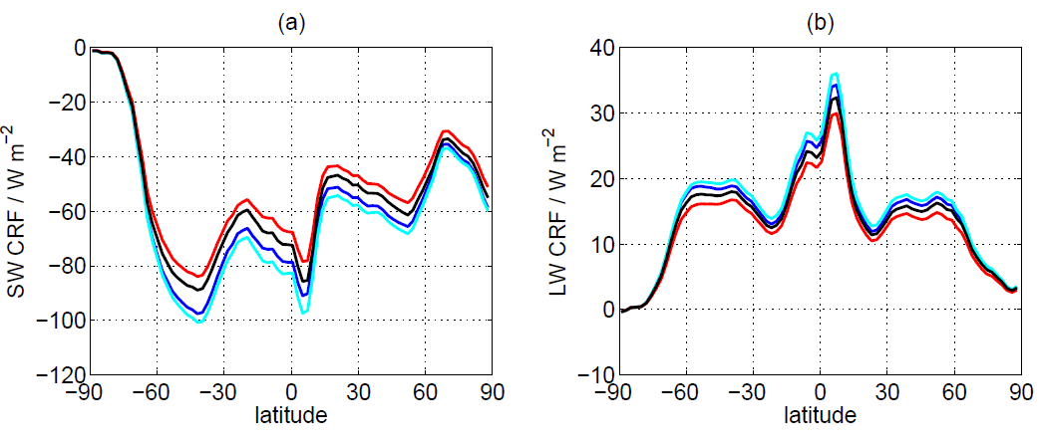
Horizontal versus vertical structure
Horizontal structure, maximum overlap
Horizontal structure, realistic overlap
Horizontally homogeneous, max overlap
Horizontally homogeneous, realistic overlap
Correcting cloud structure changes cloud radiative effect by around 10%
Impact of adding horizontal structure about twice that of improving vertical overlap
Note that uncertainties in the horizontal structure effect are much larger than in the vertical overlap effect

Slide 29
Part 5: Remaining challenges
Improve efficiency
  Radiation schemes often the slowest part of the model, so may called infrequently and not in every model column
Improve accuracy
  Better spectroscopic data, particularly the continuum
  Better treatment of upper stratosphere/mesosphere to enable satellite observations here to be assimilated
  Evaluate against new observations
Add new processes
  Radiative properties of prognostic aerosols
  Non-local-thermodynamic equilibrium for high-top models
  Cloud inhomogeneity information from cloud scheme
  Three dimensional radiative transfer in presence of clouds

Slide 30
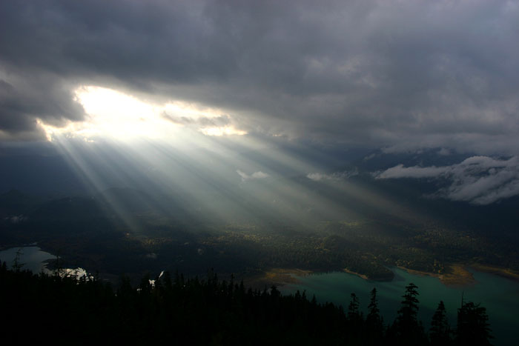
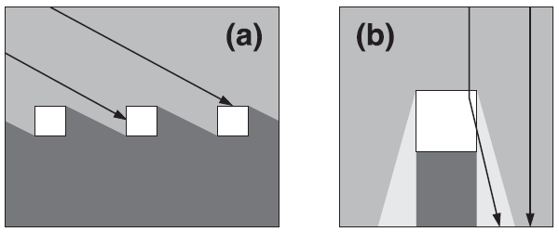
Errors due to neglecting 3D effects
Shortwave side illumination
  Strongest when sun near horizon
  Increases chance of sunlight intercepting cloud
Shortwave side escape
  Strongest when sun near zenith
  Forward scattering leads to more sunlight reaching the ground
Longwave effect
  Radiation can now be emitted from the side of a cloud
  3D effects can increase surface cloud forcing by a factor of 3 (for an isolated, optically thick, cubic cloud in vacuum!)

Slide 31
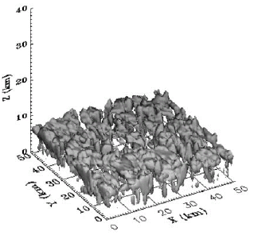
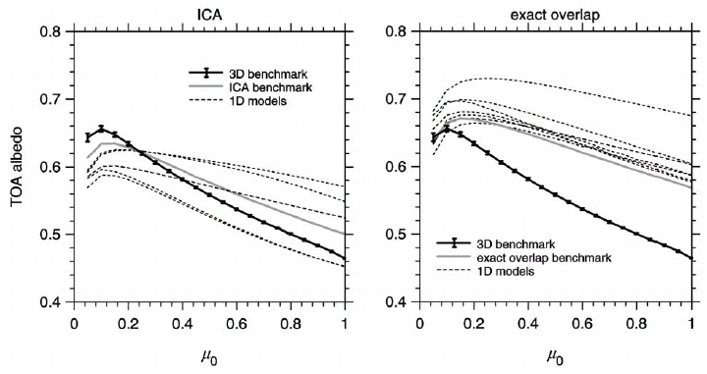
3D cloud benchmark
Large spread in 1D models, whether used in ICA mode or with cloud-fraction scheme Barker et al. (JClim 2003)
How can we represent this effect in GCM radiation schemes?

Slide 32
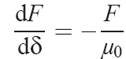
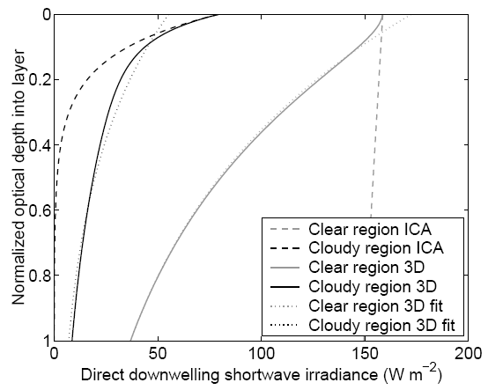

Direct shortwave calculation
ICA
First part of a shortwave calculation is to determine how far direct (unscattered) beam penetrates
  Solve this equation independently in the clear and cloudy regions (δ is optical depth):
Cloudy region
Clear region
  The solution is Beer’s law:

Slide 33
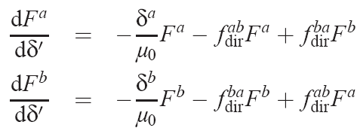
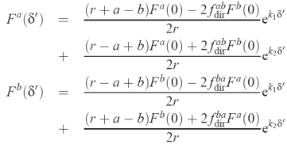
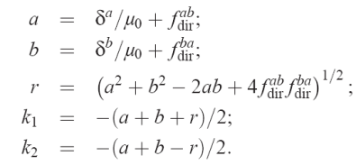
Direct shortwave calculation
3D radiation
Alternative: add terms expressing exchange between regions a & b:
  New terms depend on geometric constants f ^{ab} and f ^{ba}
  Solution of pair of coupled ODEs:
  Result: much less radiation gets through to next atmospheric layer!
a b
Cloudy region
Clear region

Slide 34
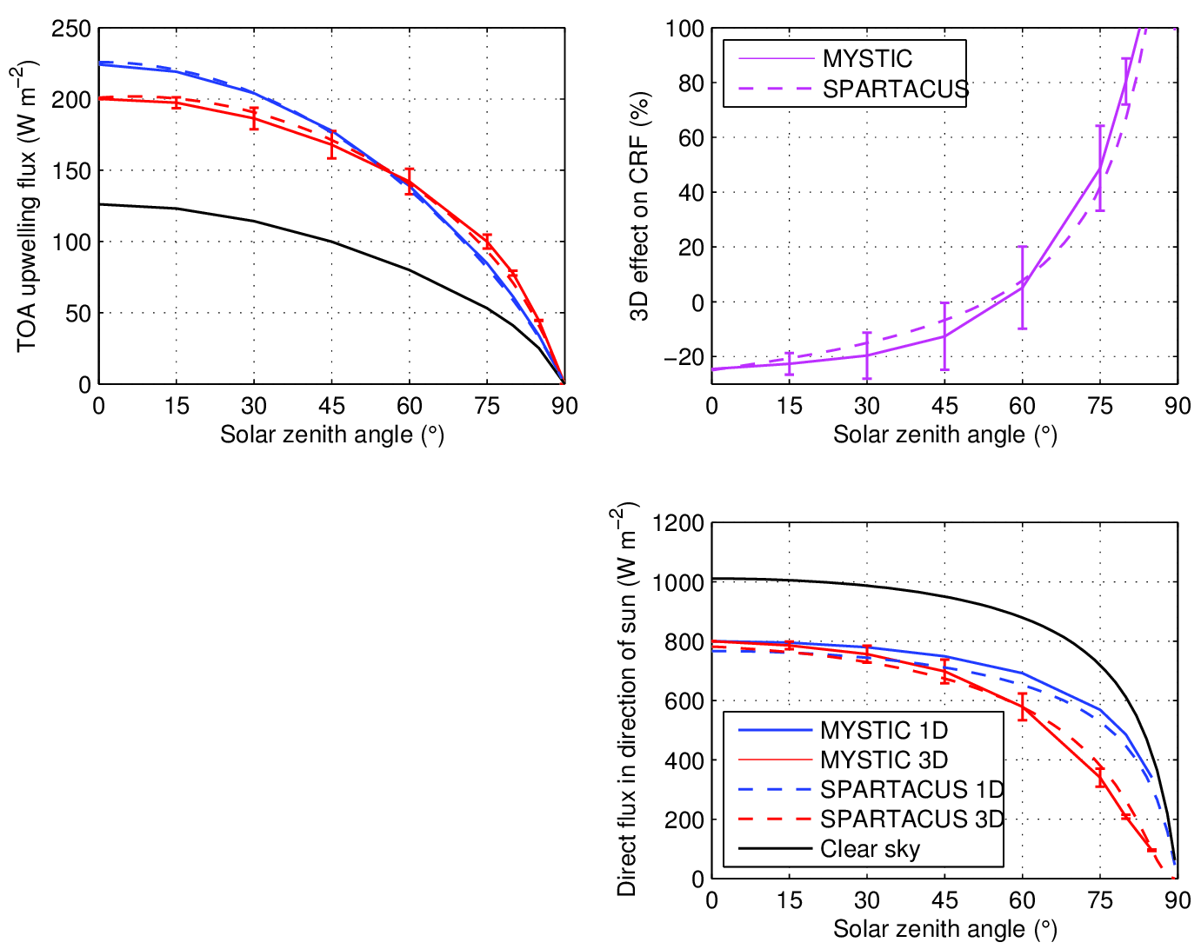
Evaluation of fast 3D scheme
New solver implementing these ideas: SPARTACUS (Speedy algorithm for radiative transfer through cloud sides)
Compare to full 3D Monte Carlo calculation in cumulus
  Mean of 4 solar azimuths, error bar indicates standard deviation due to sun orientation
Good match!
3D effect up to 20 W m⁻², similar to inhomogeneity effect
Hogan et al. (JGR 2016)

Slide 35
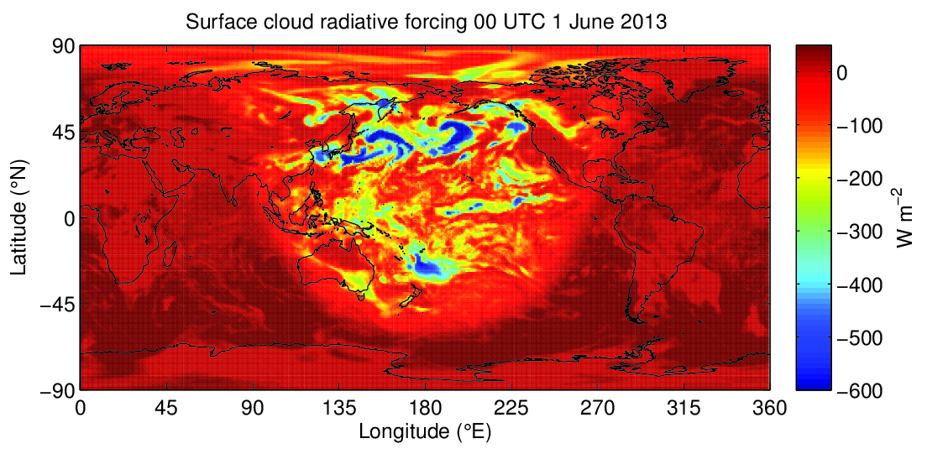
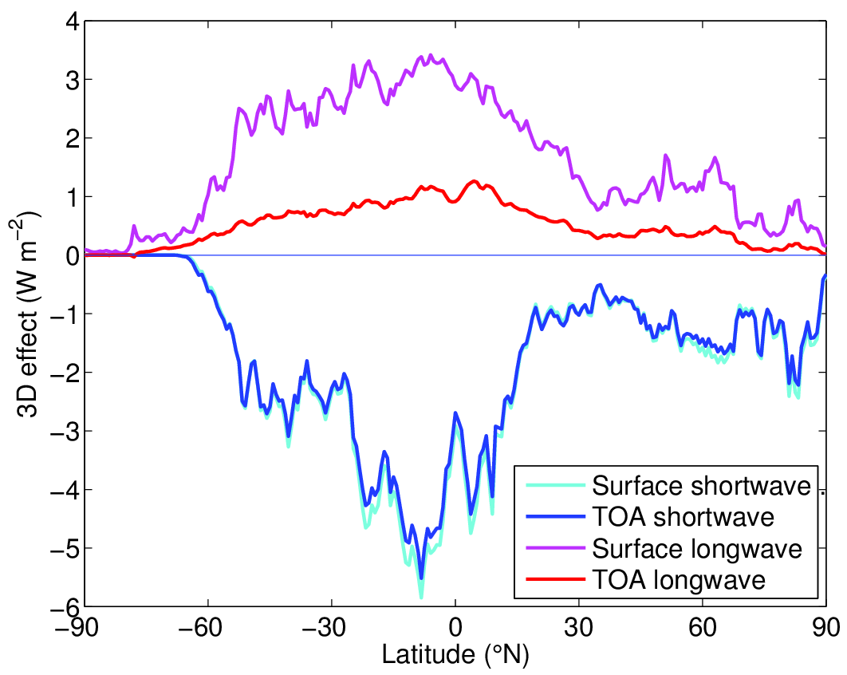
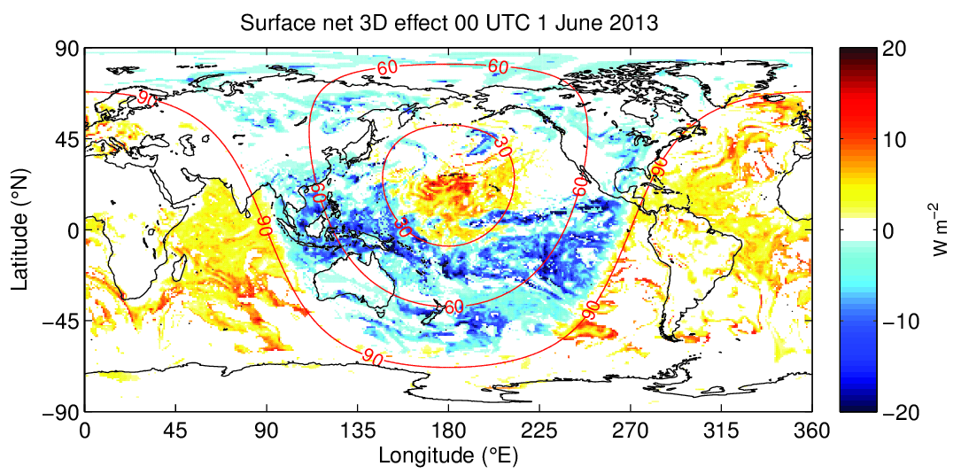
Towards a global estimate of the impact of 3D effects
Instantaneous cloud radiative forcing calculated by applying SPARTACUS to one ERA-Interim cloud field
3D effect is appreciable!
Next step: annual mean
Solar zenith angle
Night-time: positive LW effect
Low sun:
negative SW effect
High sun:
positive SW effect

Slide 36
Summary so far
Complex absorption spectra arise due to quantum mechanics
  Discrepancies remain between models, especially in representing the water vapour continuum and stratosphere/mesosphere infrared cooling rates
  The correlated-k-distribution is the state-of-the-art for representing gaseous absorption spectra in models
Observations of clouds from cloud radar have had a significant impact on the way they are represented in radiation schemes
  Significant errors still remain, e.g. representation of 3D effects
  Challenge to know whether we are allocating our computational resources wisely
Next lecture: what we currently implement in the ECMWF radiation scheme

